Slide 1
MIPS Control Panel Timing Generator
Overview
December 3, 2018
Revised May 19, 2019
Revised October 20, 2019
Revised March 30, 2020

Slide 2
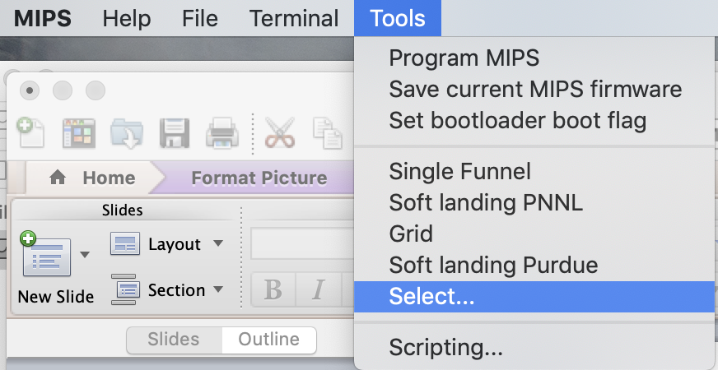
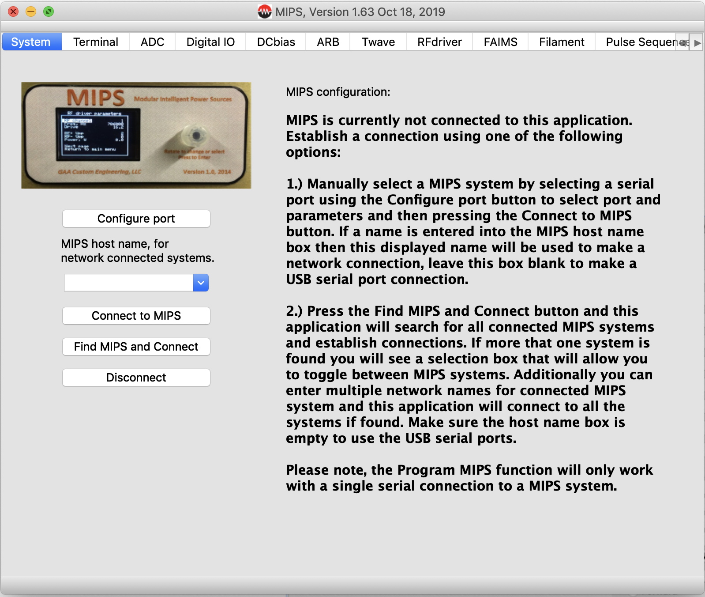
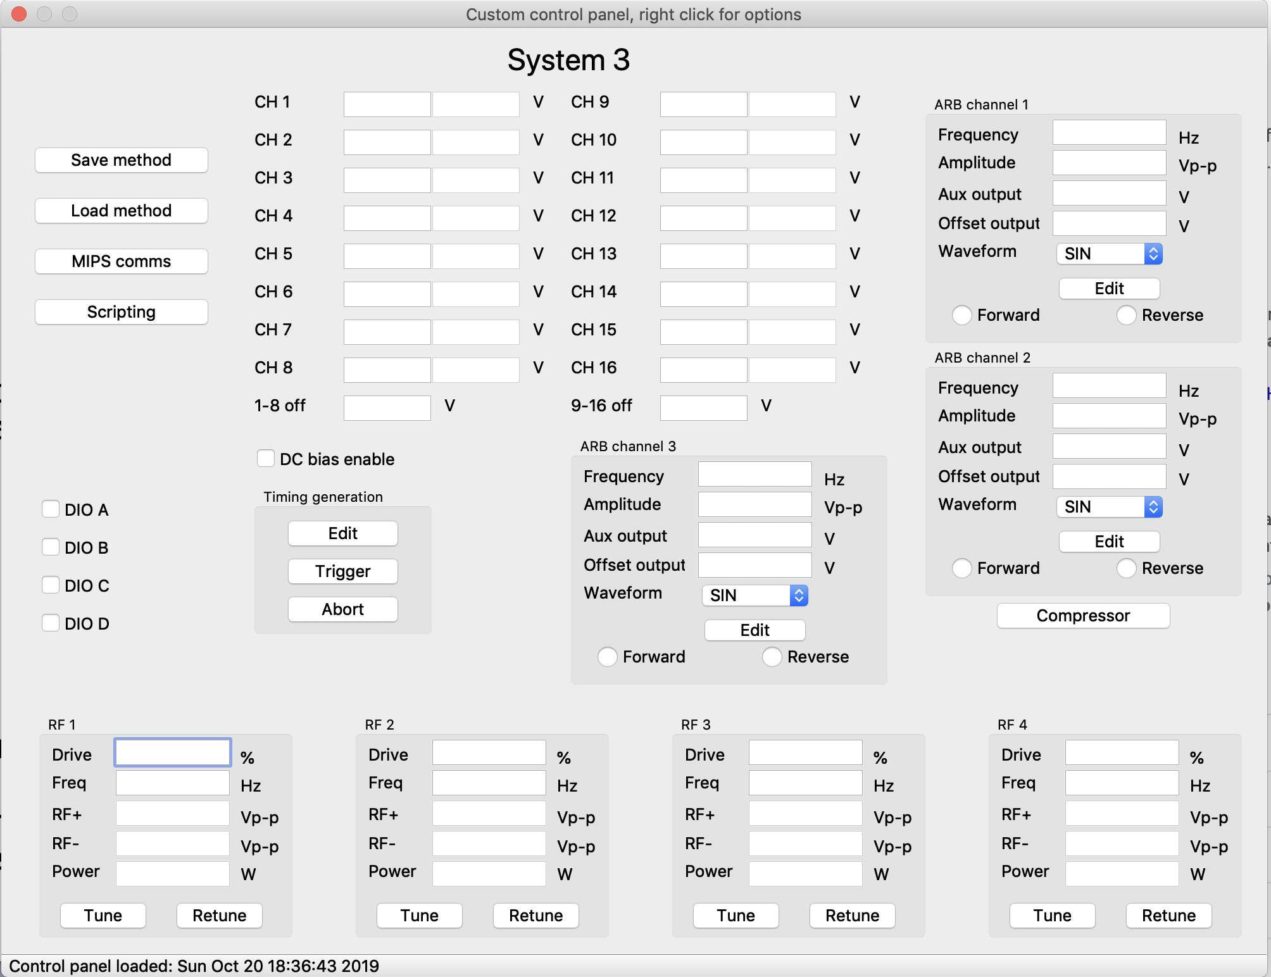
Loading MIPS Control Panels
MIPS main startup dialog
MIPS menu
Select this option to select a .cfg file that will load a control panel
MIPS host application, supports PC, MAC and Linux
Example control panel, these are easy to customize based on your system. When the control panel loads the MIPS main dialog will minimize.

Slide 3
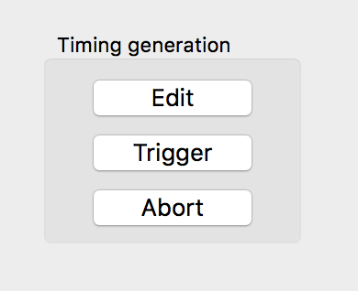
Control panel Interface
Adding the following command to the control panel configuration file will enable the timing generation function discussed in this document:
TIMING,Timing generation,MIPSname,X, Y
MIPSname is the name of the MIPS system where this timing control will be applied. X and Y define the location of the control.
Press this button to popup a dialog box to allow editing the pulse sequence
This is the dialog you will see on your control panel.
Press this button to trigger the pulse sequence and start a data acquisition
Press this button to stop an acquisition that is in progress

Slide 4
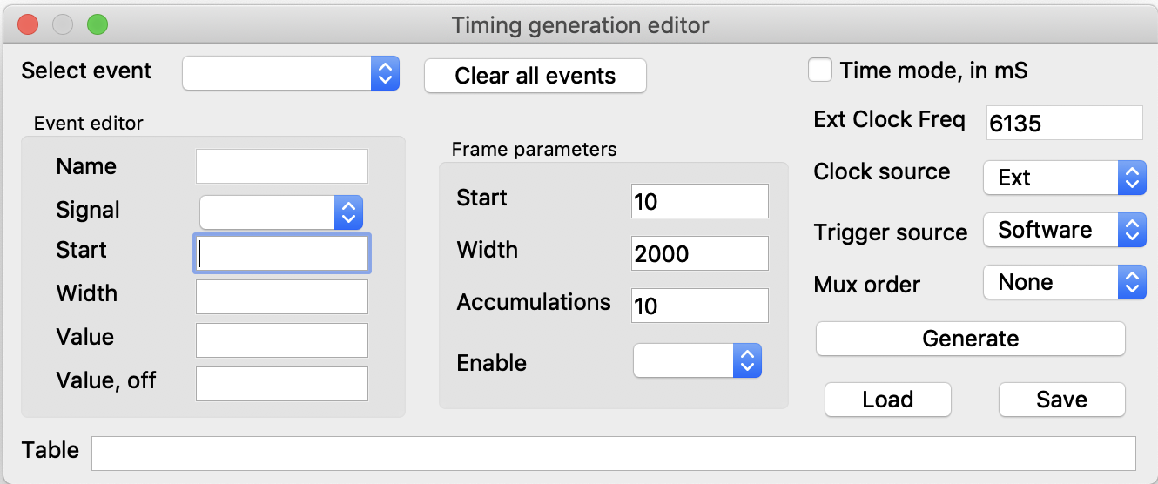
Pulse sequence editor
This section allows you to define an event in the pulse sequence. You can have as many events as needed in a pulse sequence.
This button will clear all events and allow you to start a new sequence.
This section defines clock and triggering options.
This button will use the current settings to generate a pulse sequence and display it in the table box.
This section defines the data collection frame, the number of accumulations and allows defining an Enable output signal if needed.
These buttons allow you to load and save pulse sequences to a data file.

Slide 5
Pulse sequence editor Event definition
Name of the selected event.
Allows you to define a new event, select an existing event, or delete an existing event
This is the signal this event defines. This list is automatically populated from the available options.
Starting point (in clock cycles) for this event in the pulse sequence.
Width (in clock cycles) of this event.
Define as many events as needed. You can have multiple events with the same start and width values. The event name must be unique.
Output value for this event when its active
Output value for this event when its inactive

Slide 6
Pulse sequence editor Frame parameters
The Frame parameters define the total length to the frame and the number of cycles the pulse sequence will repeat.
Defines the start point (in clock cycles) of the data acquisition frame in the pulse sequence.
Data acquisition frame width (in clock cycles).
This option allows you to define an output logic signal that will signal the acquisition interval.
This is the number of accumulations or cycles for this pulse sequence.

Slide 7
Pulse sequence editor Clock and trigger options
If you have selected time mode and your using an external clock then this box allows you to define the external clock frequency in Hz. This is needed to calculate the time in mS.
Pulse sequences can be defined in clock cycles or time in mS. Check this box if you wish to enter the parameters in mS.
Defines the clock used by the pulse sequence generator:
Ext uses the Clk input.
ExtN used the negative edge of the Clk input.
ExtS uses the S input.
There are also a number of internal clock frequency options.
Define the trigger option used to start a pulse sequence. Options include: Software External Trg input on the Pos edge, Neg edge, or Edge for any edge.
Note: The count values in the start and width boxes of the events and frame parameters can contain fixed numbers representing total counts or time and can also contain references to other event start and width values. For example if you define an event named ACC and it has a start count of 100 you can then define another event or frame parameter start or width as 25 + ACC.Start. You can use both + and – operators. This allows you to link events in a logical way so changing one event’s value will redefine other event in a logical way for your application.
The pulse sequence generator supports generation of Hadamard multiplexing bit sequences. Use this option to select the desired option.

Slide 8
Example pulse sequence
In this example we generate a generic pulse sequence. This sequence consists of four main events:
Fill time
Trap time
Release time
Inject time
For each of these events we define a start and width time and well as a signal to control. The signal is optional and it can be left blank. If the signal is selected then its active and off values need to be defined.
In this example we will focus on the event’s start and width values. This sequence is defined in a way that the user only need to edit the Inject time to define where in the sequence the injection occurs, all the events are linked. Below is a table of event start and width values to illustrate the capability:
Event name Start Width
Fill time Trap time.Start-Fill time.Width 100
Trap time Inject time.Start-Trap time.Width 10
Release time Inject time.Start 20
Inject time 200 9
In this example the user only needs to adjust the width values for the first three events and the Inject time Start. I have not shown the signals that are controlled, this will depend of your system, also Trap time does not control a signal, it represents a delay while the ions are held in the trapping region.

Slide 9
Hadamard multiplexing
Generation of a Hadamard multiplexing pulse sequence requires first the generation of the injection event. The following events must be defined as outlined in the example pulse sequence:
Fill time
Trap time
Release time
Inject time
When the pulse sequence is generated all the injection times are calculated based on the bit order, then the above four events are used to calculate each injection event.
Events defined in the pulse sequence with any other event names are used as defined and can control other aspects of the experiment.
Please note, the Injection time event’s start time must be set to zero

