Slide 1
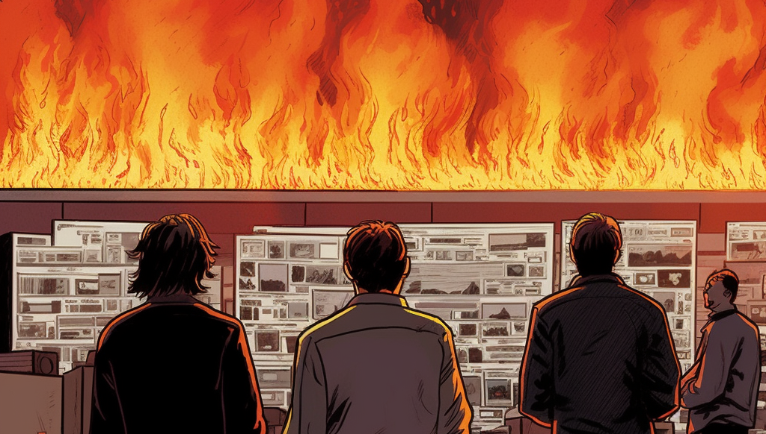

Git Tips Making Structural and Content changes in the same pull request

