Slide 1

Manipulating the Fabric of Time

Slide 2
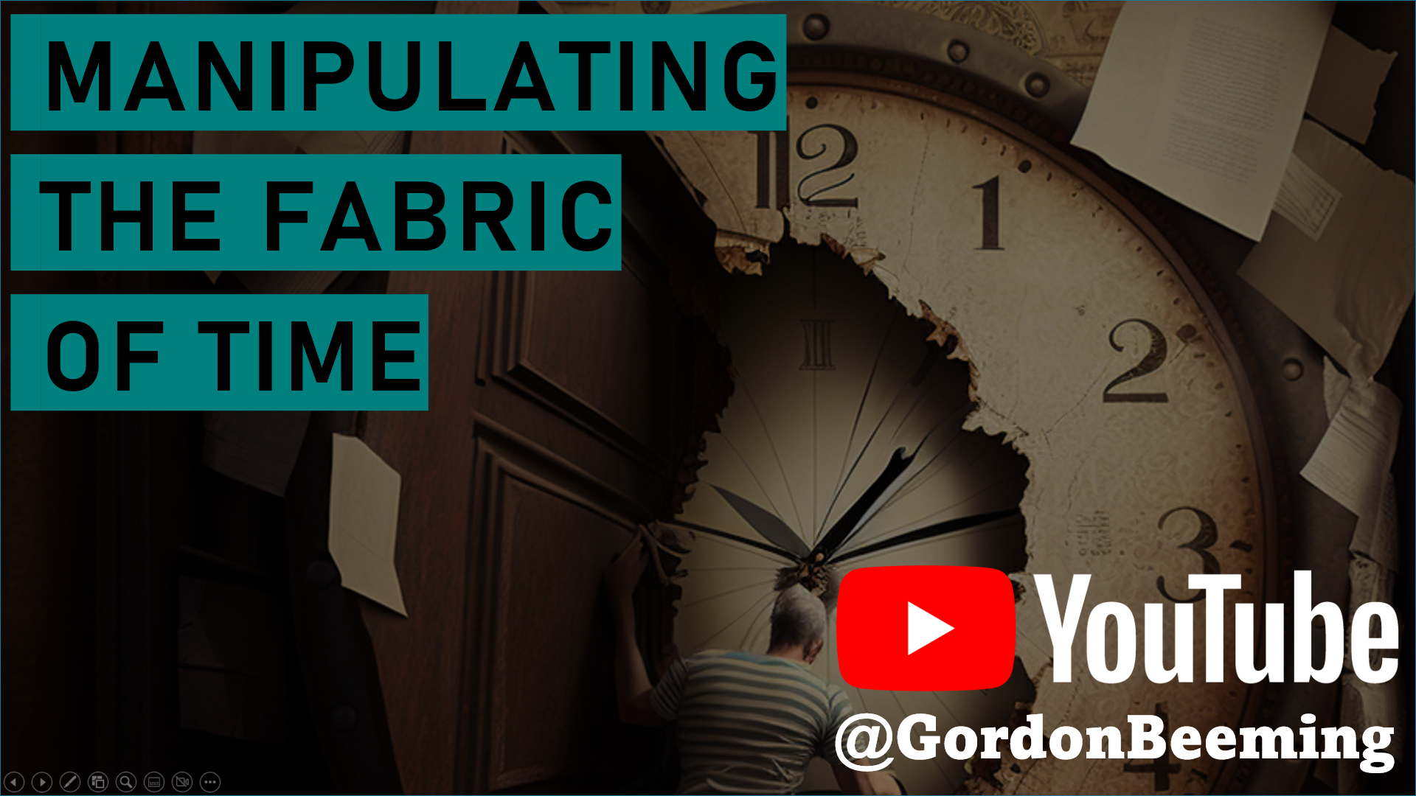
Manipulating the Fabric of Time

Slide 3
Manipulating the Fabric of Time

