Slide 1
Arixtra
Gordon Chalmers, CCRC, Dept of Computer Science

Slide 2
Introduction
Two papers
First paper about hydrogen bonding – experimental
Second paper about NMR measurements and comparison with experiment
Hydroxyl-proton hydrogen bonding in the heparin oligosaccharide arixtra in aqueous solution, Larive, … 2013
Solution structure of heparin pentasaccharide: NMR and DFT analysis, Hricovini, 2015
outline

Slide 3
Pentasaccharide
Is anticoagulant if attached to the antithrombin-III protease
Inhibitor.
First synthesized in 1990
Arixtra

Slide 4
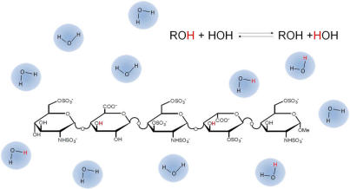
GlcNS6S, GlcA, GlcNS3S6S, IdoA2S, GlcNS6S
Picture

Slide 5
5 molecular dynamics trajectories
5, 6, 75, 9.3, 9.3 nanosecond trajectories
X-ray crystal structure Antithrombin-S195A factor Xa was used
Tip3p
Molecular dynamics

Slide 6
I have 1 microsecond trajectories – 2SO, 1C4, 4C1 of IdoA2s
I have trajectories with the 3OH charge eliminated in the GlcNS6S or IdoA2S
Trajectories

Slide 7
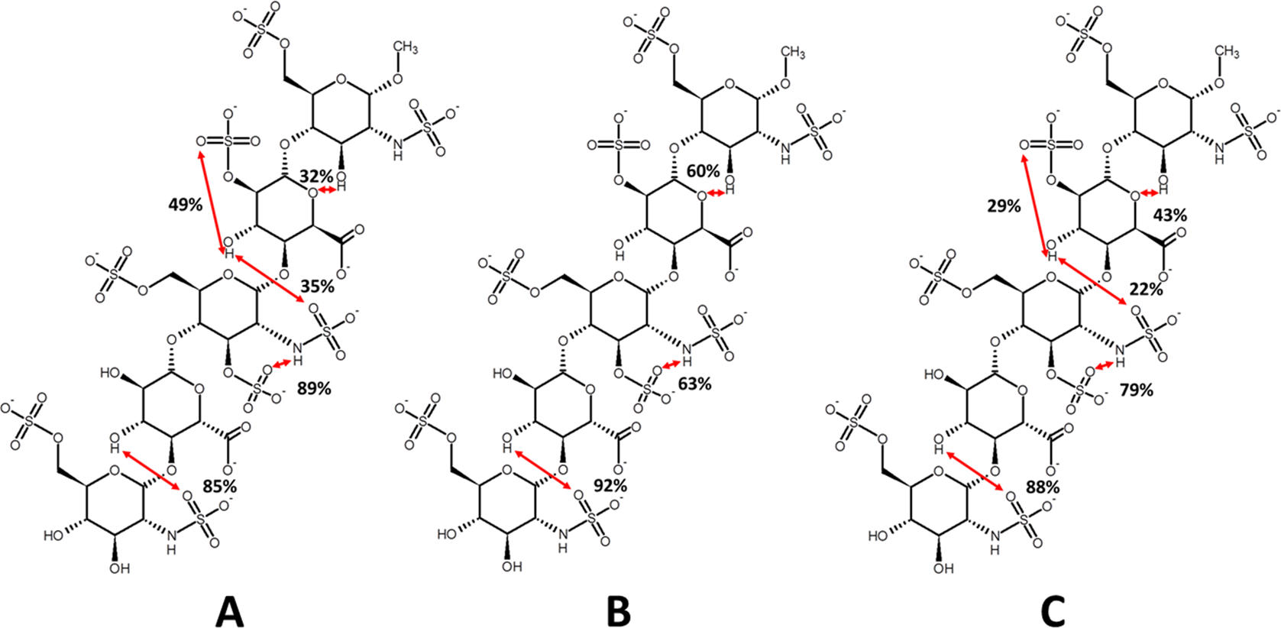
Hydrogen bonds

Slide 8
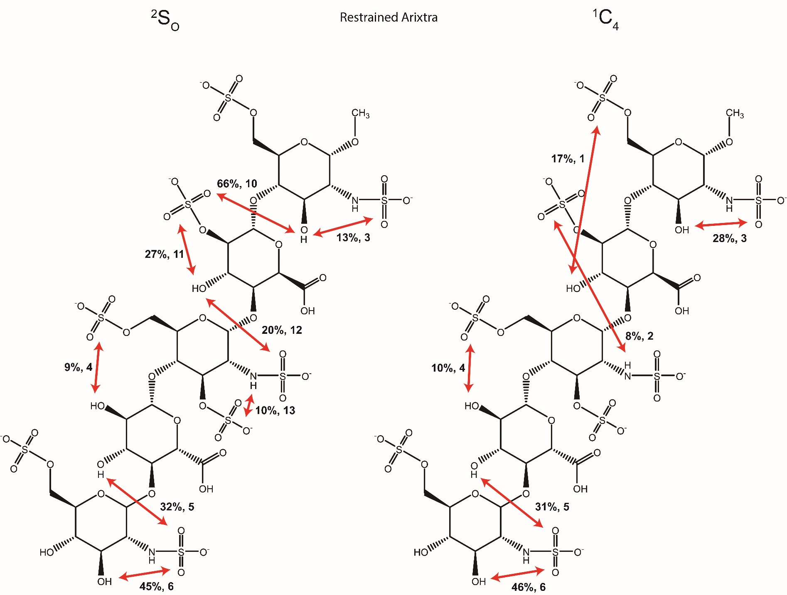

Slide 9
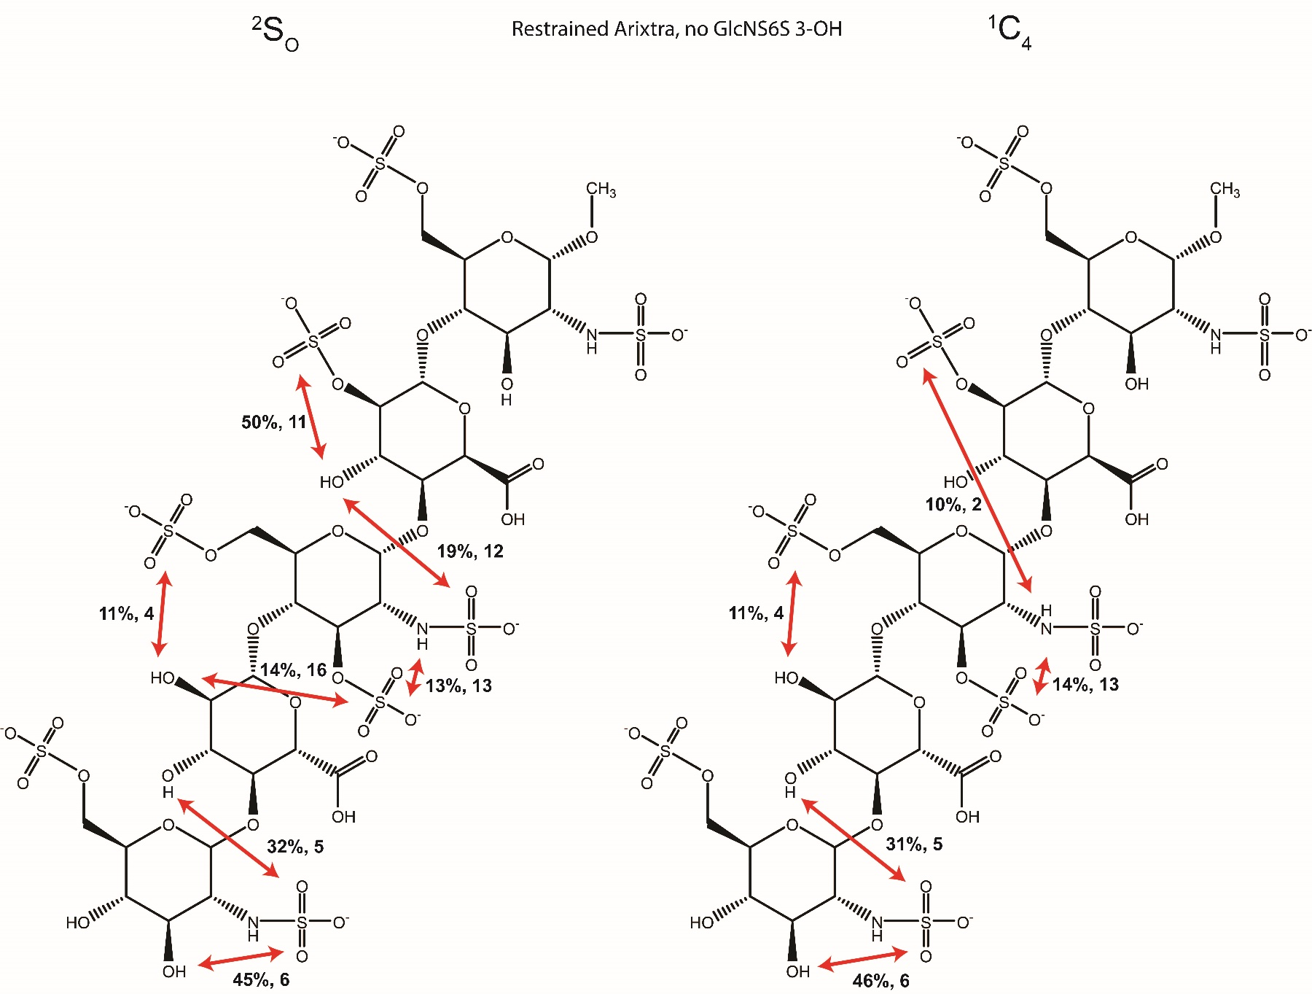

Slide 10
Chemical shift changes as a function of temperature
Chemical shift differences between residue and the monosaccharide – negative indicates hydroxyl close to an electronegative atom
Exsy proton exchange – lower rate shows the relaxation is protected, e.g. a hydrogen bond
Experiments

Slide 11
GlcA 3OH GlcNS6S 2-N-sulfo 85 92 consistent
GlcNS6S 2NH GlcNS3S6S 3-O-sulfo 89 63
IdoA 3OH GlcNS3S6S N-sulfo 35 2 consistent
IdoA 3OH idoA2S 2-O-sulfo 49 0 consistent
GlcNS6S 3OH IdoA O5 32 60
Hydrogen bonds

Slide 12
Chemical exchange of hydroxyl and water
Radiation damping and T1 relaxation
Two functions and two additional term
Depends upon the rate constants and radiation-damping parameters
Small rate constant could be due to hydrogen bond of the OH which is slowing the interaction with the H20s
Exsy curve

Slide 13
Temperature coefficient ppb/K, ppm
Negative shift indicates the possibility of hydrogen bond – negative due to proximity of electronegative atom
GlcNS6S OH3 11.2 -.008 13;8
GlcNS6S OH4 10.5 -.160 14.2
GlcA OH2 9.9 -.006 22.6
GlcA OH3 6.4 -.278 4.72 possible hydrogen bond
IdoA2S OH3 11.4 N/A 5.73 possible hydrogen bond
GlcNS6S OH3 9.1 -.199 25.9
Chemical shifts, Temperature Dependent

Slide 14
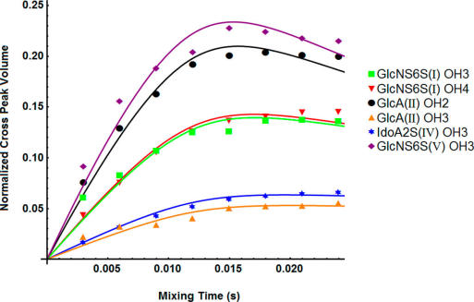
Lower rate – hydroxyl is protected from exchange with water – indicative of a hydrogen bond
These two suggest hydrogen bonds
Both measurements agrees with Larive calculation
Both measurements agree with my calculations
ProtOn water chemical exchange

Slide 15
H-C-C-H couplings
H4-C4-O4-C’, C4-O4-C1'-H1‘
Angle distributions
Did not use trajectories, density functional theory
Also calculated bond lengths and angles
2nd paper

Slide 16
H-C-C-H 1-2 2-3 3-4 4-5
2 |  | 3.6 |  |  | 10.4 |  |  | 8.5 |  |  | 10
3 |  | 3.8 |  |  | 7.2 |  |  | 2.4 |  |  | 3.1
4 |  | 3.5 |  |  | 10.7 |  |  | 9.3 |  |  | 9.9
5 |  | 7.5 |  |  | 9.9
6 |  | 3.8 |  |  | 10.3 |  |  | 9.6 |  |  | 10.1
1 | 2 | 3 | 4
4.5 | - | 4.8 | -
2.9 | - | 3.9 | 4.0
H4-C4-O4-C1’
C4-O4-C1'-H1‘
couplings

Slide 17
Larive 60 % 2SO, 40 % 1C4
Hricovini 85 % 2SO, 15 % `1C4
My trajectories 55 % 2SO 45 % 1C4
Also have a 10 microsecond of the Ido
Distribution of Ido conformations

Slide 18
3J couplings
Noe’s
Population calculation of arixtra trajectories with and without 3OH charge
Ring population of Ido
Comparison with experiments
\
My calculations

Slide 19
10 microseconds
1C4 2SO 4C1
GlcNS6S
GlcA
GlcNS3S6S
IdoA2S
GlcNS6S
0 | 91 | 0
51 | 33 | 1
15 | 74 | 0
76 | 1 | 0.1
0 | 92 | 0
population

Slide 20
Discussion

