Slide 1
AssignSLPMD – genetic algorithm assignment of spectra
Spectral assignment of noe strips is crucial to using experimental information to identify various molecular aspects
Assigning spectral intensities with a genetic algorithm and Amber trajectory
http://tesla.ccrc.uga.edu/software/

Slide 2
Assign SLP MD and light version
Gordon Chalmers
Complex Carbohydrate Research Center
Department of Computer Science
9/30/2019

Slide 3
Outline
Brief description of MD2NOE_Protein output – trajectory calcs
Improved spectral package – ‘light’ version of Assign_SLP_MD. This is the genetic algorithm part
Description of inputs and GUI; inputs follow standard spectrometer output
Demonstration and showing of example file input
Background and how the programs work
‘Light’ version is meant to make the use simple; there are further uses such as finding the population of protein conformations which require the full package

Slide 4
2 types of average coordinates – N H corrected, usual
MD2NOE_Protein flow
Spectral peak list is primary output – can be used to
calculate noe strips of a 3D HSQC NOESY spectrum
Calculate order parameters
Order parameters, tensor
noe strips in excel sheet and csv format
Calculate spectrum
Calculate internal correlation functions
Calculate relaxation rate matrix
Correct for Amber nomenclature
Peak list
Calculate nmr observables – noe buildup curves
Calculate predicted chemical shifts

Slide 5
New features of software
A ‘light’ version has been made. Fewer inputs, and defaults are used.
Example - population size, max generations, to a non-knowing person are now defaults.
The number of inputs is 1 – the excel input workbook. Defaults can be changed if necessary, in the GUI.
Designed to be user friendly and easy to use.

Slide 6
The output of the noe-protein programs from MD trajectories give predicted noe information.
Assign_SLP_MD uses predicted noe’s, rdc’s, chemical shifts and compares with experimental info to find best peak to residue match, i.e. assignment
The genetic algorithm has been used to sparsely label small and large proteins, including HtpG and rST6Gal1.
rST6Gal1 is a prototype protein used with recent software
Assigning using genetic algorithm

Slide 7
Input is an excel workbook
Different pages have output from the spectrometer, e.g. peak lists from the HSQC and 3D HSQC NOESY experiments
Also predictions output from MD2NOE_Protein, from the trajectory calculations
Will show. The use of these packages is being made very simple.

Slide 8
Sparky peak lists from MD2NOE_Protein
SPARKY is standard format for peak intensities
Demonstrate : MD2NOE_Protein calculates this with chemical shift prediction software; same format as from experiment
http://www.nmr2.buffalo.edu/nesg.wiki/Resonance_Assignment/Sparky

Slide 9
Excel input workbooks
Data and predictions – could be a single workbook
Mostly this is automated
Organized into simple format
Predictions are found from software and use minimal set of parameters and files – output of MD2NOE_Protein

Slide 10
Graphical User Interface (GUI)
Demonstrate – still in development
Our grant was awarded also for a friendly user interface

Slide 11
Genetic algorithms
Uses evolution to model a population of possible solutions to the problem
As the iterations continue, the population ‘flows’ to the hopefully optimal solution.
Local minima in the fitness function could trap the solution, but there are ways to deal with this.
This is one of the best approaches to finding approximate solutions to NP Hard or complete problems.

Slide 12
All of these use measurements and predictions are from the entire trajectory
ingredients
Noe’s at mixing time
Rdc’s
Predicted noe vectors (1-d spectra)
Chemical shifts
also >1 media (e.g. phage, peg for alignment),
Additional work to be added, e.g. methyl noe’s

Slide 13
Assign_SLP_MD Assignment flow
Order parameter files, predicted chsmical shift files, noe file
Noesy spectrum
Rdc’s, chemical shifts, weights
Make input files
Experimental measurements
Now automated
Confidence heatmap, i.e. statistics figure of assignment
Run genetic algorithm
Text file with possible solutions
Run output analysis program
Optional - Run statistics program
Confidence level program

Slide 14
This version generalizes the earlier Assign_SLP package
All aspects of the calculation use a trajectory – noe vectors, chemical shift predictions, rdc back calculation
May seem complicated but there are example scripts in the download at http://tesla.ccrc.uga.edu/software/
One line essentially required from the user
Am working on a GUI now
Also refining the software with fewer user inputs and more NMR friendly variable names
The usage is made to be very user friendly.
Instructions to use

Slide 15
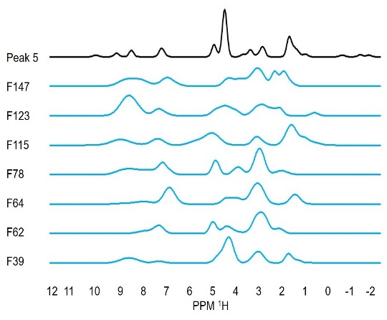
Experimental and predicted noe vectors
Example of matching – noe vectors

Slide 16
States of proteins
Proteins have ‘conformations’
Noe’s and genetic algorithm can be used to identify and calculate populations using trajectories
Still not good enough sampling
Rdc’s and chemical shifts also are used

Slide 17
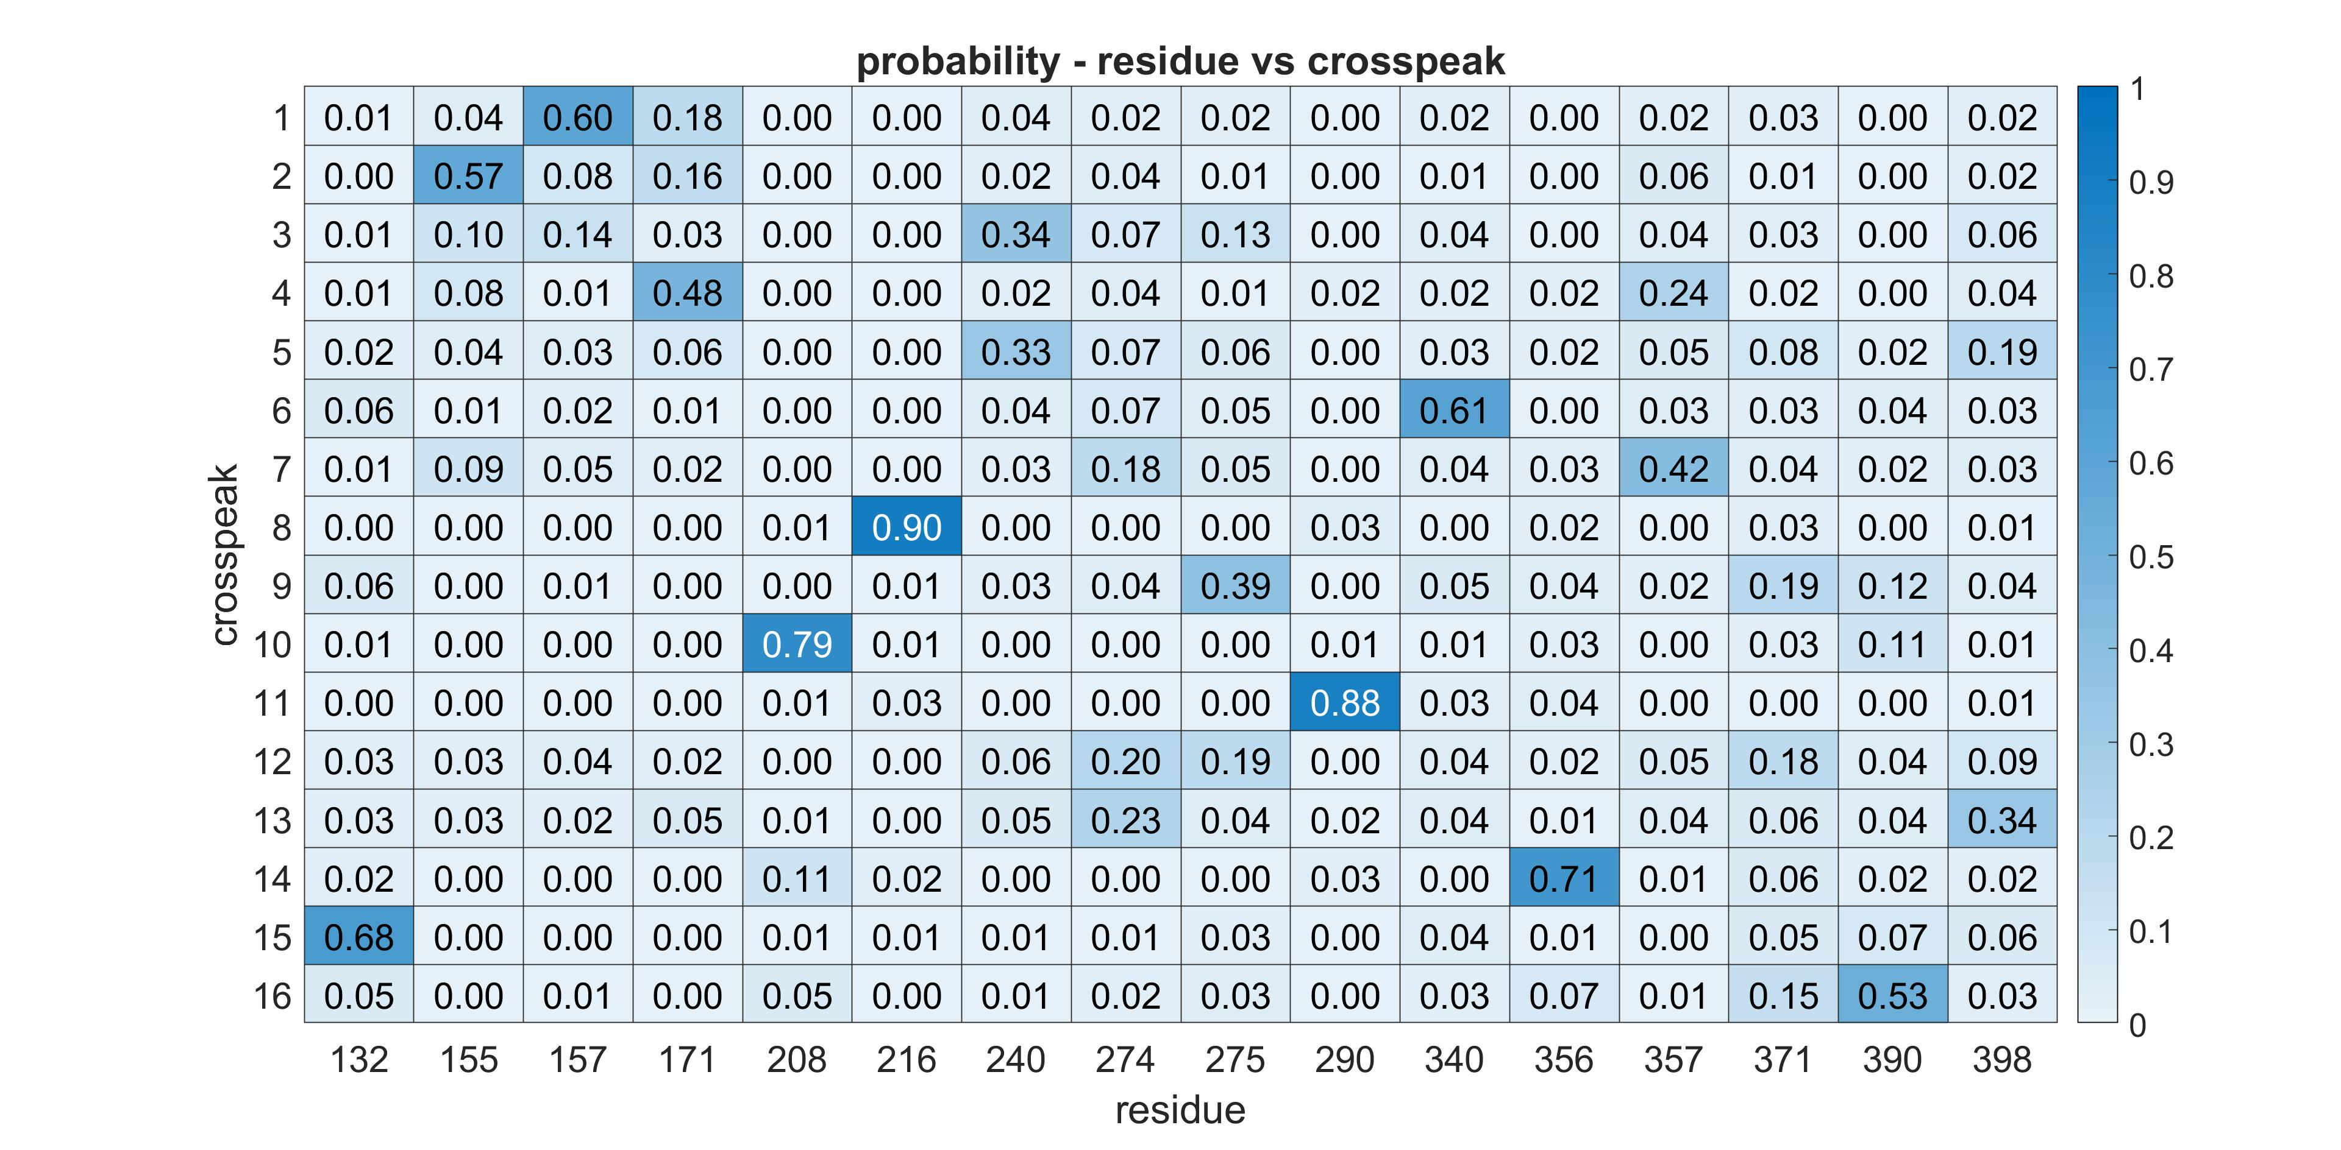
Statistics part of package. experimental data. Weights are used in estimating likeliness of correctness.

Slide 18
rST6Gal1
Mutagenesis was used as a check in 4 of the residues Assign_SLP_MD got all correct with high Probability

Slide 19
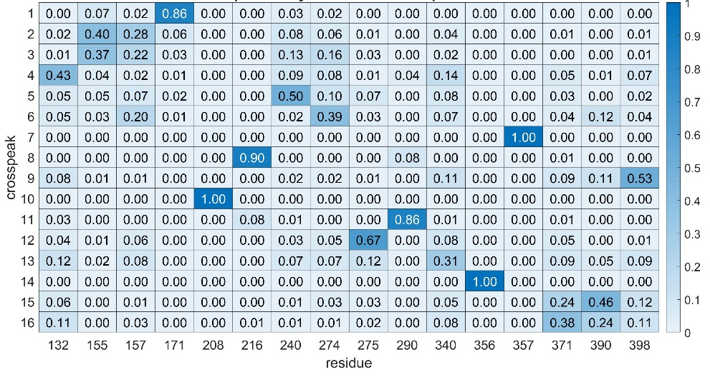
Program also can take in constraints – this is the assignment with the mutational constraints

Slide 20
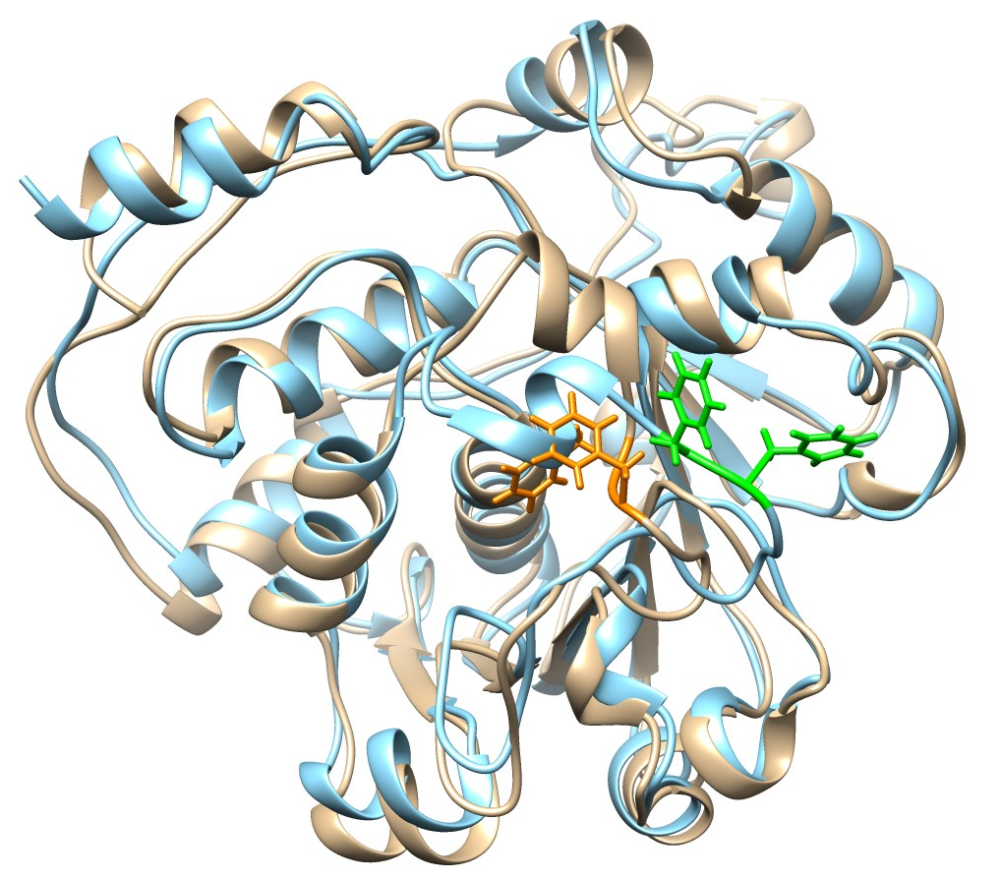
rST6Gal1 1μs MD Final Structure
Note that Phe 264 in the final structure (orange) is buried
Good hydrophobic contacts – Asp 255 also has new H-bonds
Transition between 2 distinct states, about residues 263/264
Genetic algorithm used to identify population
3 different trajectories were used finding states and comparing assignments

Slide 21
MD2NOE_Protein, Assign_SLP_MD
Has been used in assigning sparsely labeled rST6GAl1, 5 smaller proteins, …
Software will be further developed by others
Programs were used in a successful NIH grant application
Collaborators:
Professors Prestegard, Woods, Moreman
Alex Eletsky, Qi Gao, Rob Williams, Kari Pederson, Laura Morris
Graduate this semester.
conclusion

