Slide 1
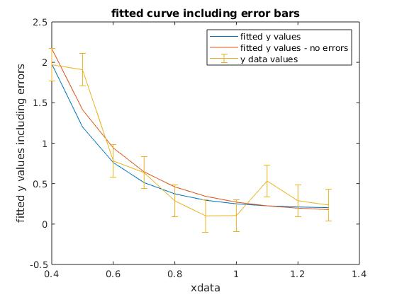
Fitting a function with uncertainties
fit: a*exp(-b*xdata)+c to ydata
No error fits: no measurement uncertainties
Fitted y values: emphasizes measurement uncertainty via normal probability function
Note that the 2nd method has better fit with the std bars

Slide 2
Probability
Assume that measurement is Gaussian distributed about mean
P(event)=1/σ/√2π exp(-(ydata(event)-yfit(event))²/2/σ²), 1-d fit
Would like maximal intersection of fitted function, e.g. curve, with this function
Takes into account measurement uncertainty with σ
More general functions and distributions can be used

Slide 3
Maximize P
Sum of data point probabilities
Fitting function is defined and dependent on several variables, e.g. a*exp(-b*xdata)+y
Maximize total probability (or minimize -P)
Avoid local minima by many trials

Slide 4
Minimization (maximization)
Many techniques in optimization
fminunc, fminsearch in Matlab
initialization of search is important, use naive function fit
genetic algorithms appropriate if there are many of function parameters, or discrete fit parameters
With GA’s, search space can be quite large, 10¹⁰⁰⁰

