Slide 1
Cyana on PSAS
Demos
Theory of Calculation
GmR137 2K5P
Advantages/Disadvantages
Gordon Chalmers
CBIS, RPI, Montelione Lab

Slide 2
Protein structure analysis software (PSAS)
Virtual box machine with software
Cyana, PSVS, DisMeta, Sparky, NMRPipe, and other software
Runs on personal laptops
Careful about sharing directories between host and VM
PSAS – VM - 1.0

Slide 3
Demos
Directory cyana/demo
basic, rdc, homodimer
Documentation: http://www.cyana.org/wiki/index.php/Main_Page
Could be more documentation, esp in RDCs, but software is proprietary
.upl, upper limits on distance restraints
.aco, rotatable angular constraints,
.rdc, residual dipolar couplings
Demonstrate

Slide 4
Theory of Cyana
Entirely based on torsion angles (e.g. dihedral angles), not Cartesian coordinates, constants such as rotation, Coulomb, etc…, N/A
Uses basic ‘force field’ parameters, quadratic in potential
Amber force field more appropriate, and ring conformations would be more explored in using this, rings of aromatic amino acids are fixed in Cyana
Simulated annealing in initial minimization, high temp -> low temp
Cyana is restraint based with data
Very fast, typical of optimization algorithms

Slide 5
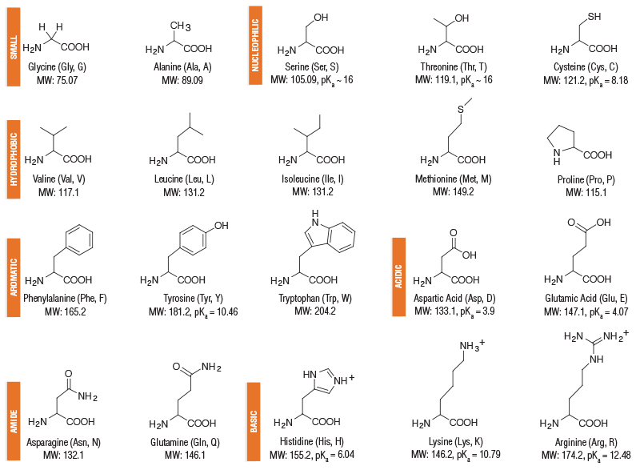
Rotatable Torsion angles

Slide 6
Sparsely populated with data
.str files contain information in BMRB, where there is
Automating data parsing is possible
http://www.bmrb.wisc.edu/
BMRB Likes pdb names, and sometimes not NESG names
BMRB and Protein Data Bank data

Slide 7
Some interest when first arrived
RDCs are generally available, but not in BMRB or PDB
In SPINE database
Tried different weightings of RDCs and tolerances of restraint violations
Better agreement of back calculation and exp with the data in the BMRB
No information in the PDB, just angular restraint violations
GmR137 2K5P

Slide 8
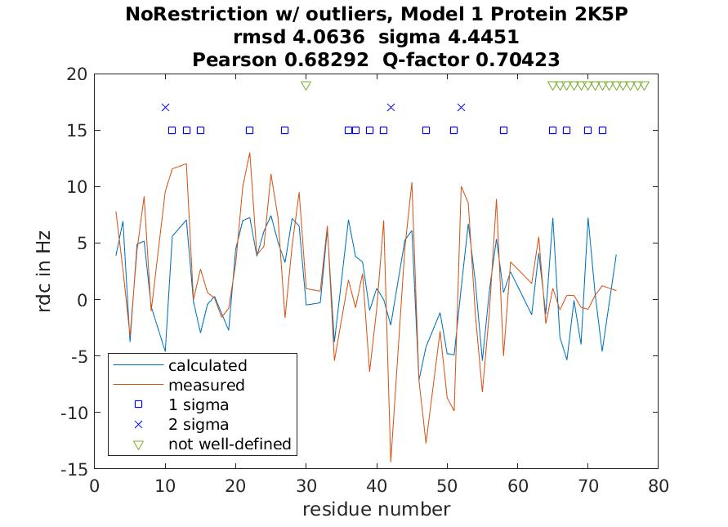
Weight .02, tolerance .25 Hz

Slide 9
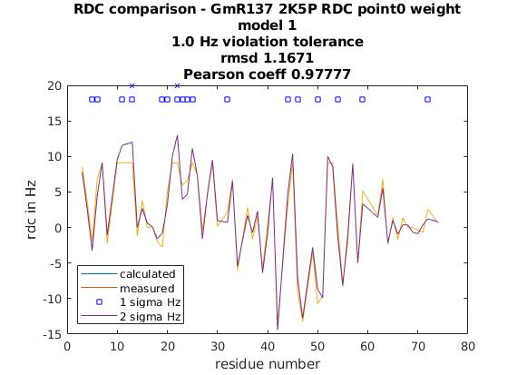
Weight 0.0, tolerance 1.0 Hz

Slide 10
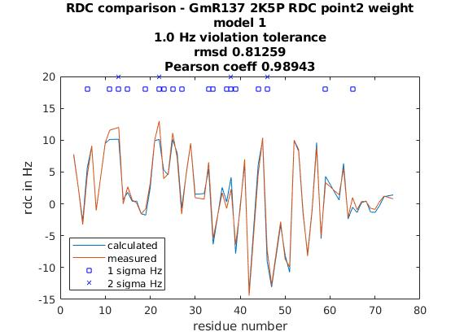
RDC weight 1/5, tolerance 1.0 Hz

Slide 11
Cyana is good, more suitable for MD than static structural work
Very fast and could use a more realistic force field
No ring flexibility
No bond ‘bending’, although realistic, for a degree or two
Discussion

Slide 12
Discussed Cyana in PSAS-VM
Theory is rotatable torsion angle based
Discussed BMRB and PDB data
Demos
Example of GmR137 2K5P
Conclusions

