Slide 1
“The first-in-class peptide binder to the SARS-CoV-2 spike protein”, G. Zhang, S. Pomplun, A.R. Loftis, A. Loas, B.L. Pentelute, not published yet
“Repurposing Therapeutics for COID-19: Supercomputer-Based Docking to the SARS-CoV-2 Viral Spike Protein and Viral Spike Protein-Human ACE2 Interface”, M.D. Smith and J.C. Smith, not published yet
Gordon Chalmers, RPI CBIS
Presentation 4/10/2020

Slide 2
Comparison of papers
Smith and Smith used small molecules, thorough MD, 1.6 microseconds for each in replica exchange modeling using GROMACS not Amber – with restraints-
Zhang et. al. studied peptides and used short MD simulations
Experimental work done to test the binding disruption in Zhang et. al.
CoVs are a large family of enveloped, positive-sense, single-stranded RNA viruses that infect a broad range of vertebrates.
Severe acute respiratory syndrome coronavirus

Slide 3
Comment about SARS-Cov-2
Number of cases still appear to be exponentially growing according to Johns Hopkins University.
There is a need for blocking the entry of the Spike S protein in its receptor binding domain (RBD) to its binding with the ACE2 enzyme in the respiratory tract
To be explained from these papers
Smith and Smith used MD and binding estimates from Vina, kCa of small molecules
Zhang et. al. used experiment from BLI, nM with peptides
Both claim the binding is sufficient to suppress typical binding of Spike S to ACE2

Slide 4
Binding of the Spike S protein
Prefers to attach to the Angiotensin-converting enzyme 2 (ACE2) receptor in the host cell
Goal of these studies is to find a mechanism to disrupt the binding, hence, weaken the intrusion of the virus
Recent structural models of the SARS-CoV-2 S-protein have been made (comment: MD is much better now than SARS-Cov 2002)
Claim is that small molecules are less inhibiting, hence Zhang et. al. used peptides

Slide 5
Related SARS viruses
“Characterization of viral proteins encoded by the SARS-coronavirus genome”, Y.J. Tan, S.G. Lim, and W. Hong, 2005
Studies on the structural proteins, spike, nucleocapsid, membrane and envelope, have shown homologues in all coronaviruses, and are important for viral assembly and expression and functional studies of the "accessory" proteins that are specifically encoded by SARS-CoV.
S, N, M, E proteins
This talk is about the Spike S protein and inhibiting its interaction with the ACE2 receptor site.
A lot of history of coronaviruses. There is similarity with how SARS-Cov-2 infects the cells with this earlier known SARS-Cov virus. This information is being used in the current work.

Slide 6
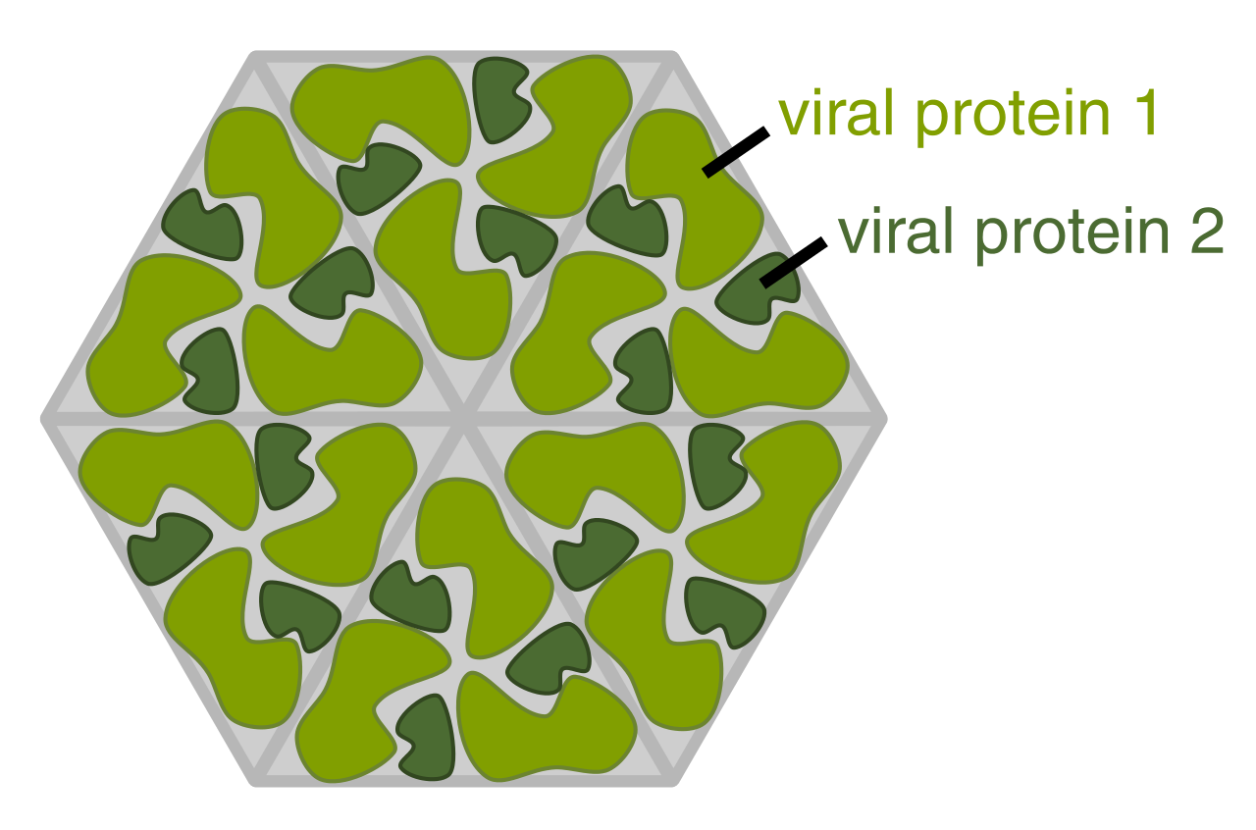
Structure of the viral capsid
Rather complicated, and different proteins are in this.
Also the RNA.
Spike S structural protein is in this and it interacts with the ACE2 part of the host cell on the membrane to bind and then infect with other molecules.
Then the RNA uses the host cell to disrupt its function.
The goal of these papers is to understand the blocking of the Spike S protein binding with the ACE2 receptor so as to restrict the delivery of the capsid proteins and RNA.

Slide 7
Inhibitors of binding
Smith and Smith: used the Oak Ridge Lab SUMMIT supercomputer and the SWEETLEAD database of ~8000 small molecules (ligands) to find those that bind to the S-protein ACE2 interface, with MD and docking
Zhang et. al. has found 23 mer peptide sequences that bind, derived from the ACE2 alpha 1 helix; these are not glycans or carbohydrates; one with very good binding, about 4 times as that of Spike S to ACE2
These molecules potentially block the S-protein interaction with ACE2 by interfering : One possible way of blocking the virus into respiratory cell intrusion (ACE2 is also important for heart function ...)
In order to be viable, the binders have to reduce the affinity of Spike S to ACE2

Slide 8
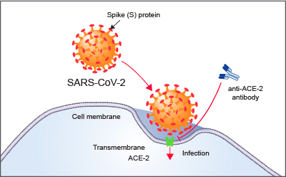
ACE2 Receptor Site
ACE-2 is the host cell receptor responsible for mediating infection by SARS-CoV-2, the novel coronavirus responsible for the coronavirus disease 2019 (COVID-19). Treatment with anti-ACE-2 antibodies disrupts the interaction between virus and receptor.
The mechanism is similar to the known SARS-Cov.
There is a lot of stuff on the outside of the cell membrane extending for 10’s of Angstroms.

Slide 9
SARS-Cov-2 Spike S protein images
Recently several models of this protein have been developed and with full glycosylation
Good websites for information about the modeling, European Bioinformatics Institute
www.ebi.ac.uk Cryo-EM structure
Woods group has developed a model of the glycoprotein
http://glycam.org/ glycosylated from PDB 6VSB, 24% of mass is from glycans

Slide 10
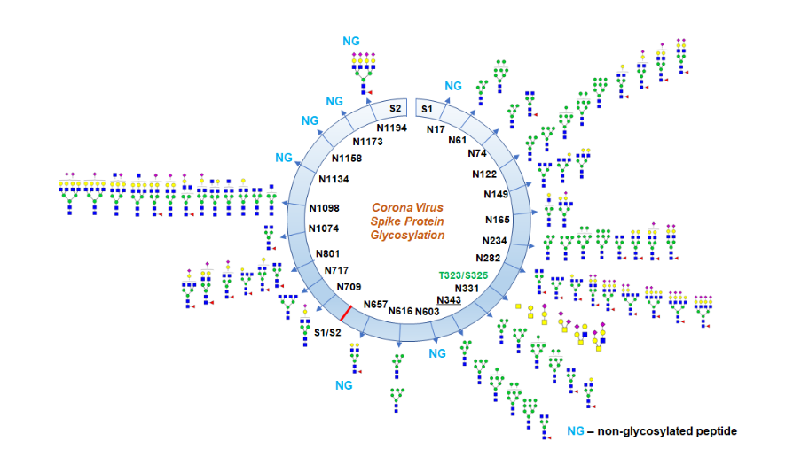
Glycosylation comment
Glycosylation profile on coronavirus SARS-CoV-2 characterized by high-resolution LC-MS/MS. About 17N-glycosylation sites were found occupied out of 22 potential sites along with two O-glycosylation sites bearing core-1 type O-glycans.Some N-glycosylation sites were partially glycosylated.

Slide 11
Use of SUMMIT
Smith and Smith screened the SWEETLEAD library to find potential binding molecules in the interface
200 peta flop supercomputer, 1.8 exaops genomic calculations in 2018
>8000 molecules in this library
20 found with regulatory data, additional 27 also found, all with Vina scores between -7.0 and -7.4 kCa in the binding to the Spike S ACE2 interface
Next, examples

Slide 12
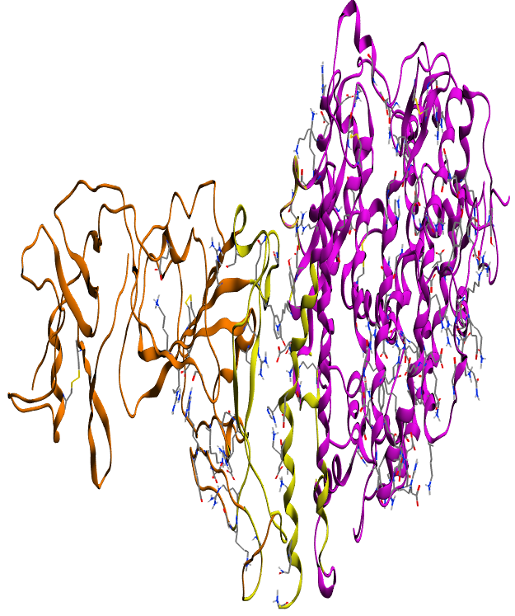
Binding of Spike S to ACE2
Binding
Rendering of nCoV-2019 S-protein and ACE2 receptor complex. Orange ribbons represent the S-protein, purple corresponds to ACE2, and yellow is a highlight of the interface targeted for docking. PDB: 2AJF from Spike S and ACE2 improved from SARS-Cov template
This is one image (i.e. pdb or frame), not the dynamical treatment.

Slide 13
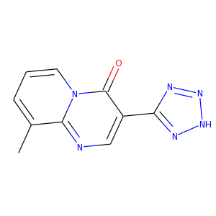
Example ligand to obstruct binding, Pemirolast
Used for treating chronic asthma
Some of the small molecules in this study with moderate to high binding are already used for treatment of different diseases; ~half of what the authors found are not
Binds in the ACE-2 Spike S interface. Vina score of -7.4 kCa. Smith and Smith give 47 examples in their paper.
MD simulations were done to support the binding analysis of the molecules and to score.

Slide 14
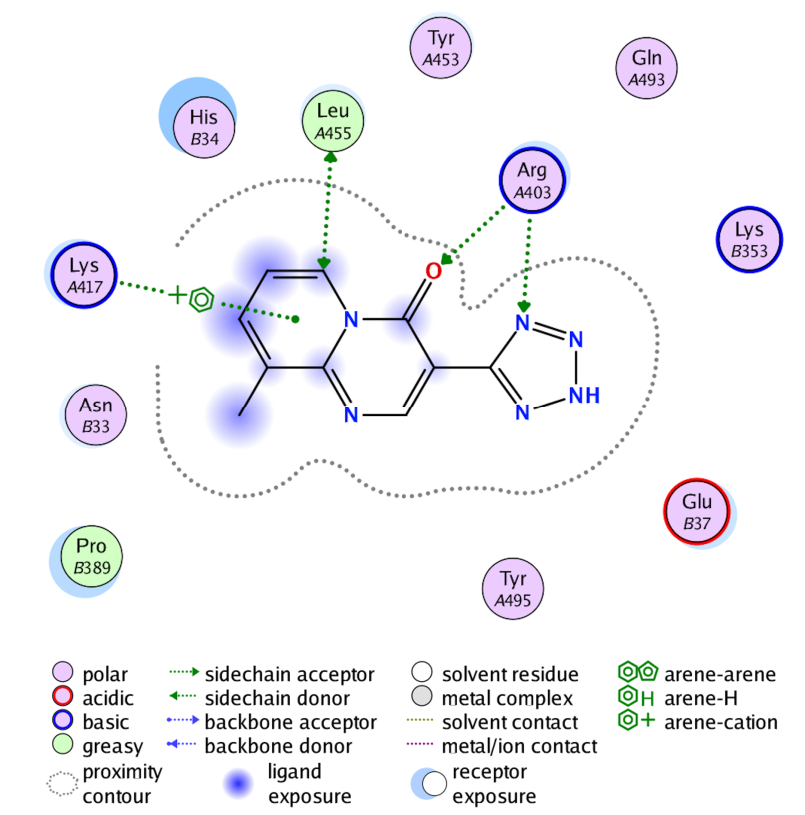
Interaction of Pemirolast
permirolast-protein interface interaction diagram (generated from MOE2016).
Residues with (A)
correspond to the S-protein, while those with (B) correspond with the ACE2 receptor.

Slide 15
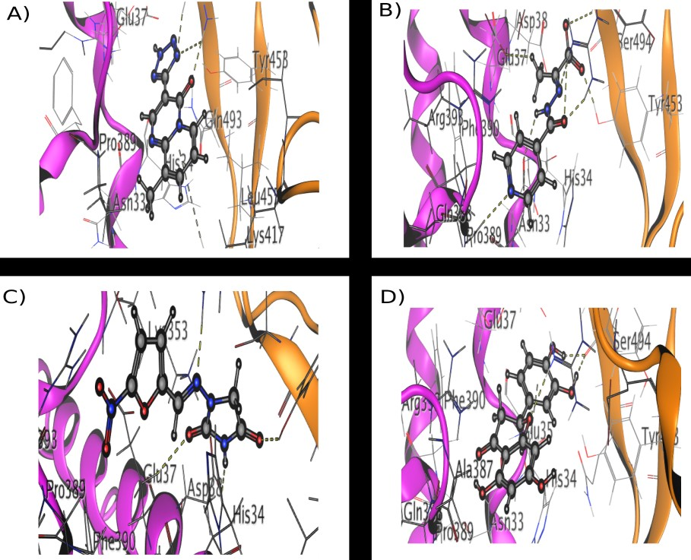
Ligand binding disrupts interface, Smith and Smith
Small molecules
This study does not take into account of the effects of a large binding region.
However, good MD was done on a large set of possible inhibitors using SUMMIT.
Renderings of four of the top scoring previously regulator approved small-molecules binding within the S-protein-ACE2 interface. A) pemirolast (ZincID: 5783214). B) isoniazid pyruvate (ZincID: 4974291). C) Nitrofurantoin (Zinc ID: 3875368). D) Eriodictyol (ZincID: 58117). Orange ribbons represent the S-protein and purple ribbons correspond to the ACE2 receptor

Slide 16
Optional – larger picture
Note: residues different on Spike S side
purple

Slide 17
Zhang et. al. and peptides
The interaction region at the interface is lengthy, and peptides were chosen for analysis, not small molecules
MD simulations are 200 ns – short for analysis of a protein, but it isn’t clear if the protein dynamics was used. 200 ns is appropriate for a less than 10 kDa molecule
Info was saved every 10 ps, not 2, which is typical, which would prohibit analysis of internal motion
Equilibration was done for only 2 ns – very short
Peptide sequence from ACE2, spike binding peptide 1 (SBP1), was found to bind however, experimentally
Binding with bio-layer interferometry showed affinity of 47 nM, compared with 14.4 nM for ACE2 – Spike S. Possible obstruction of the ACE2 Spike S binding with larger affinity.

Slide 18
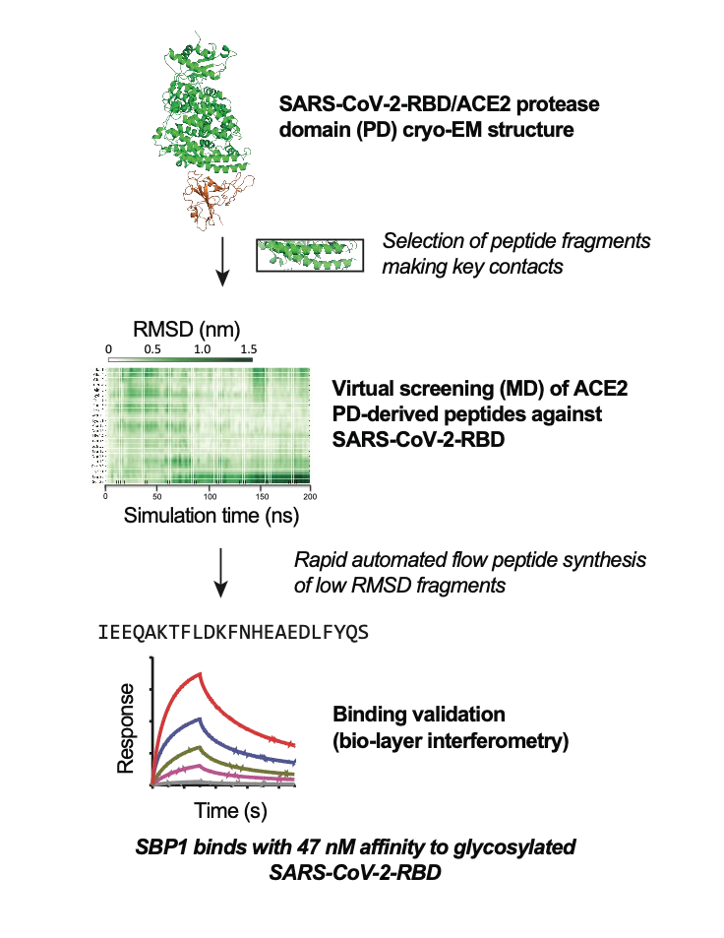
Sequence :IEEQAKTFLDKFNHEAEDLFYQS – 23 amino residues

Slide 19
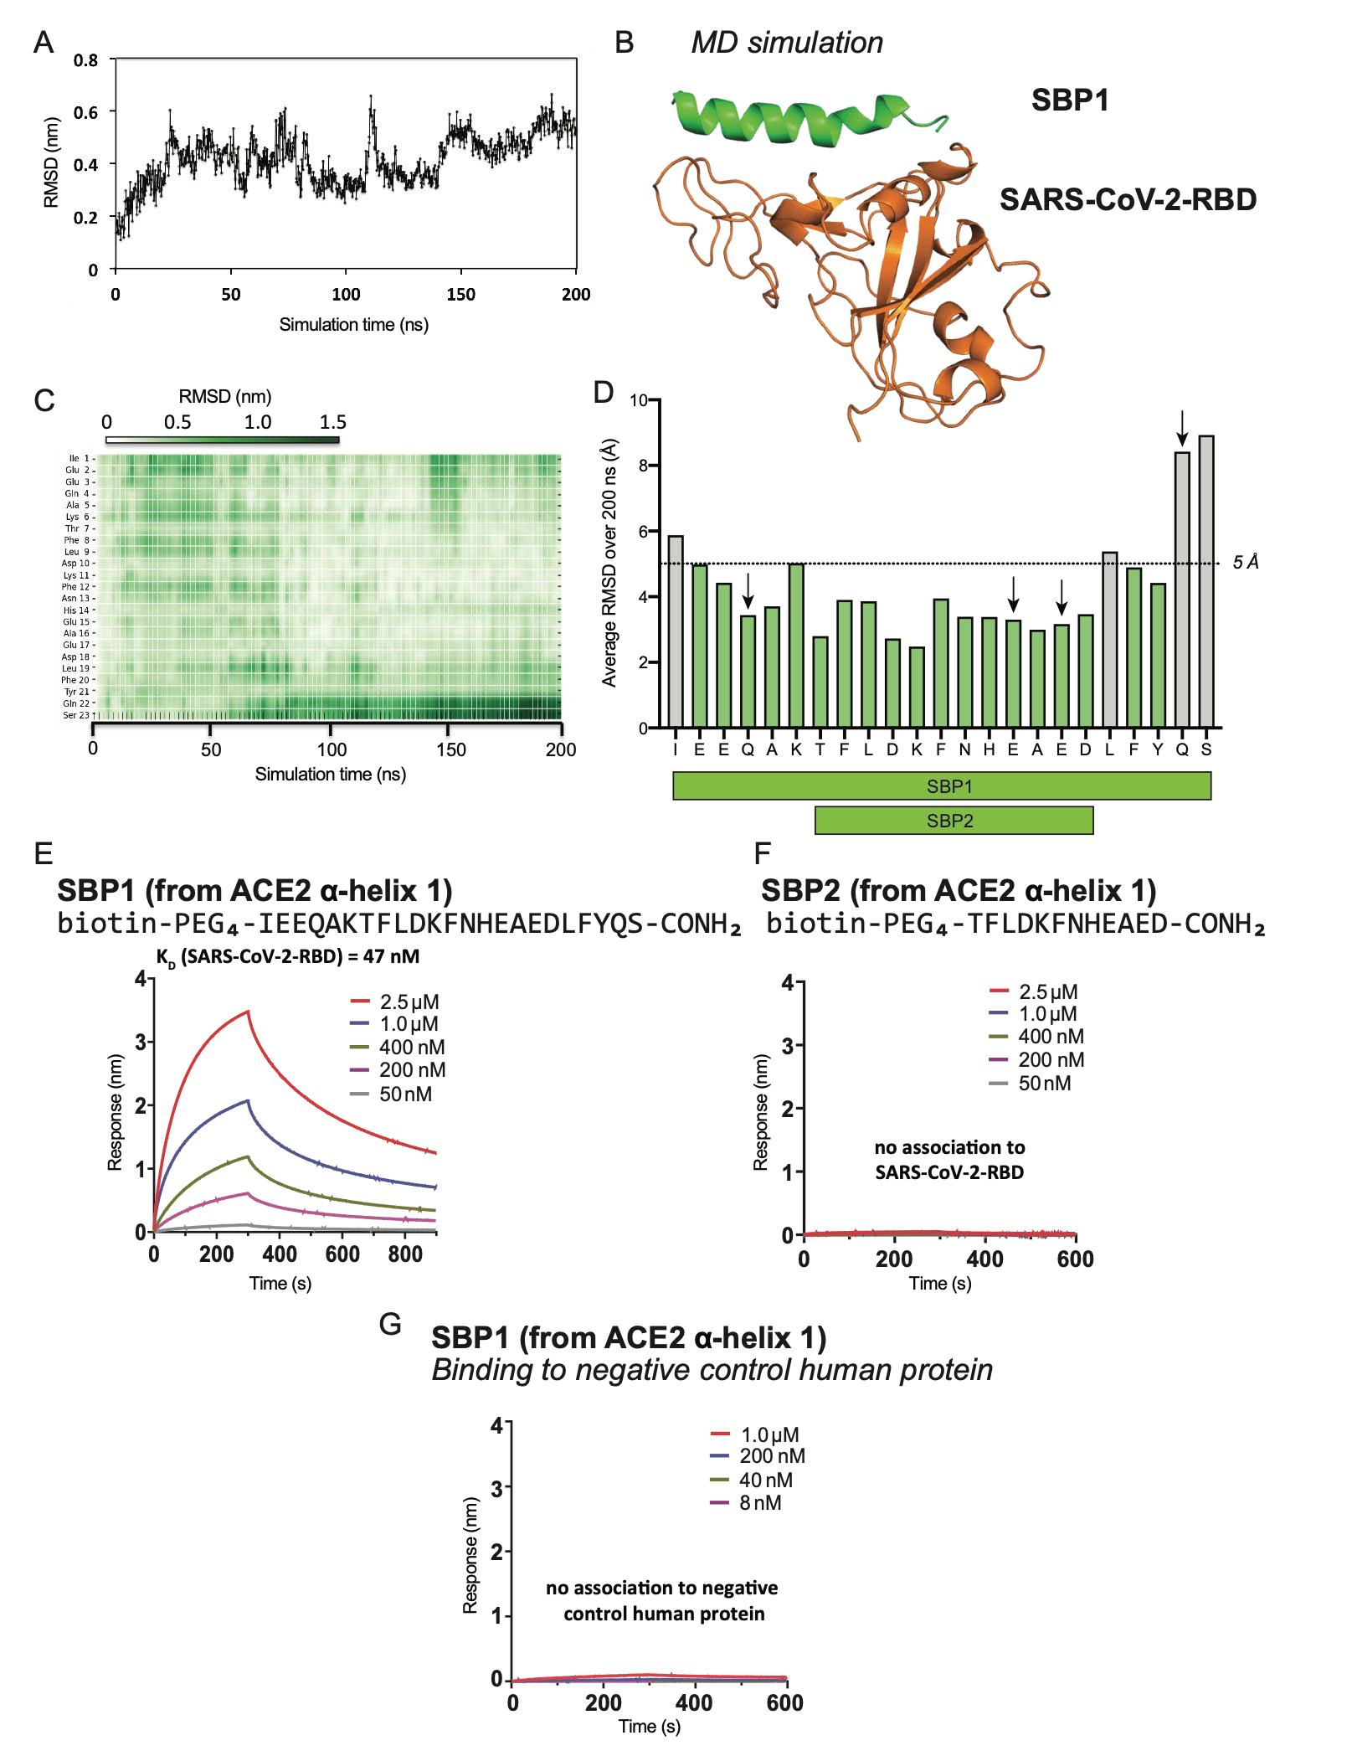
MD Simulation
RMSD is stable

Slide 20
Advantages of using peptides
Peptide is taken from the alpha1 helix of ACE2
Claim is that it should be well tolerated in the immune system as a result
Easy to make 10’s of milligrams in 1.5 hours with 95% purity

Slide 21
Approach comparison
Smith and Smith used small molecules, but screened from thousands of them, some of which are used in clinical medicine
Zhang et. al. used larger molecules – pointed out that small molecules are much harder to obstruct protein-protein interactions
These potential drugs have not been used in clinical trials except for some of the small molecules in treatment of other diseases

Slide 22
NMR
Much computational work, especially by Smith and Smith
BLI used in experimental work in Zhang et. al.
Could be useful to examine NMR saturation difference transfer experiments for binding and structure
Not aware of a full MD simulation of the glycosylated Spike S protein, but this is in the works at UGA for example
Conformations are important for binding, which means longer MD trajectories are required to explore the dynamics (1 millisecond?)

Slide 23
Conclusions
Different types of molecules have been found computationally and experimentally that suppress or obstruct the Spike S protein of SARS-Cov-2 with the ACE2 part of the host cell
Experimental work with a peptide (SBP1) done to show its high affinity to ACE2 in the lab, not with the reported small molecules although are used in treatment of diseases
Further MD should be performed to analyze the dynamics of the Spike S protein and its binding with these molecules; conformations are important, i.e. micro to milli seconds
NMR STD experiments have not been reported; these are useful for binding analysis and structure work; Haddock could be used with NMR experimental data, without computational work from Vina or AutoDock

