Slide 1
NMR Calculations: Simulations, Theory, Exp
Gordon Chalmers,
University of Georgia
CS Dept, CCRC

Slide 2
Goal
to make software that will improve molecular simulations
compare theory and exp to improve modeling
experimentalists to improve their work
(potentially save money doing the experiments)
Bridge the gap of theory and experiment.
Goal

Slide 3
Talk will go over some of the programs and explain what the programs do – package
noes, 3J couplings are measurable
20,000 lines of code.
The programs make the user able to compare exp with the simulations of most of what is measured. The user can also estimate the calculations, i.e. how precise.
The talk will go into some of the programs.
Will show some of the programs
Package is documented. Also bash files are given as templates.
Software Package

Slide 4
Programs
Calculate observables from trajectories
Calculate presicion of calculation
Compare Theory with Exp
Programs

Slide 5
The programs use Amber trajectories.
Usually 100 ns of simulations, which take days.
Observables are calculated.
Amber trajectories

Slide 6
Software
Uses c++, c, java
Downloadable
GLYCAM
Molecule Structures
Many files are output
Internet based -~GUI
- Output can be limited
NMR pipe compatible - almost
Program

Slide 7
//double totaltime = string_to_double(argv[3]);
//displaytime = string_to_double(argv[4]);
//samplefrequency = string_to_int(argv[5]);
//double bfieldz = string_to_double(argv[6]);
//double fourier = string_to_double(argv[7]);
//double total_time = string_to_double(argv[8]);
//double unit = string_to_double(argv[9]);
//distanceatom = string_to_double(argv[10])
.adjacentnoe_init ../disac5.prmtop ../delete.txt 100 4 10 10.0 .1 1000 10 5 all jpeg
Programs could generate 1000s of files. Options are given to limit the files that are made.
Example – NOE program – 12 inputs

Slide 8
Programs are documented with >20 pages
Bash files are given to use
Should be simple to download, use
Downloading, Using

Slide 9
Programs
User specifies input output
3J couplings from simulations
noe from simulations (1d,2d)
conformations
Checks of calculation – e.g. correlated motion, isotropic tumbling, simulation , precision of calculation
Important for comparison of theory with exp
Noe, 3J coupling, Conformations

Slide 10
Comparing theory with exp
Improve models which use simulations
Improve exp work, e.g. signal to noise
Moleculer interactions
Theory and experiment

Slide 11
About 20 programs have been made
These programs calculate various observables, e.g. noes, different relaxation rates, 3J couplings, …
The programs check the simulations, e.g. ergodicity of the motion, isotropic tumbling, correlation of the motion to make the calculations as precise as possible. This improves the simulations, especially when compared with exp. Also improves theory to experiment comparison.
Software

Slide 12
The software will enable a computation to be compared with experiment.
Sucrose, Gags, Peptides, Polysaccharides, and some Proteins have been used.
The software will be given to the GLYCAM site, also for anyone’s use.
Exp and Simulation

Slide 13
Noes, build-up curves, mixing times
1-d, 2-d noe experiments
3J couplings
These calculations improve the modeling with the simulations. Also experimentalists can decrease (possibly) the time of experiments.
Measurements

Slide 14
Will show the programs.
Demonstrate the programs.
Feedback is important for improving the software.
The talk

Slide 15
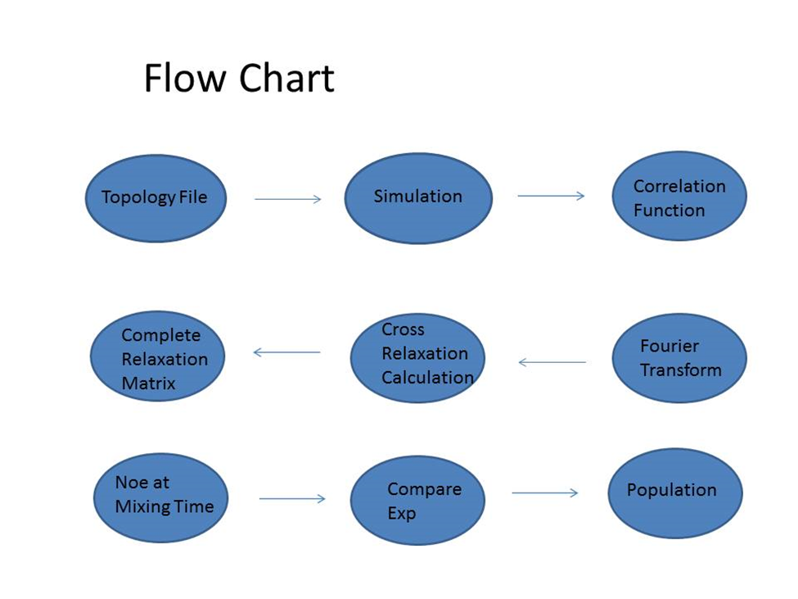
Noe program

Slide 16
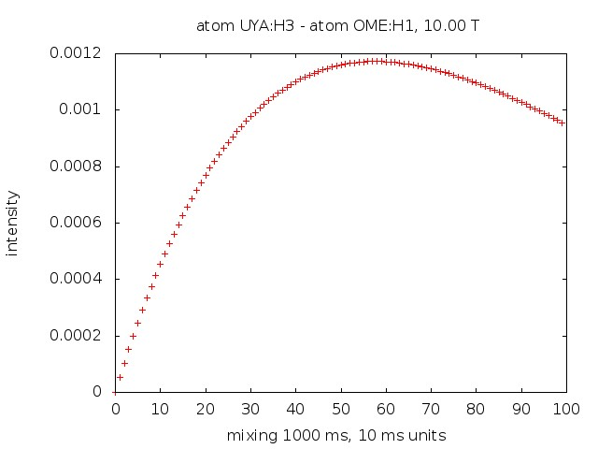
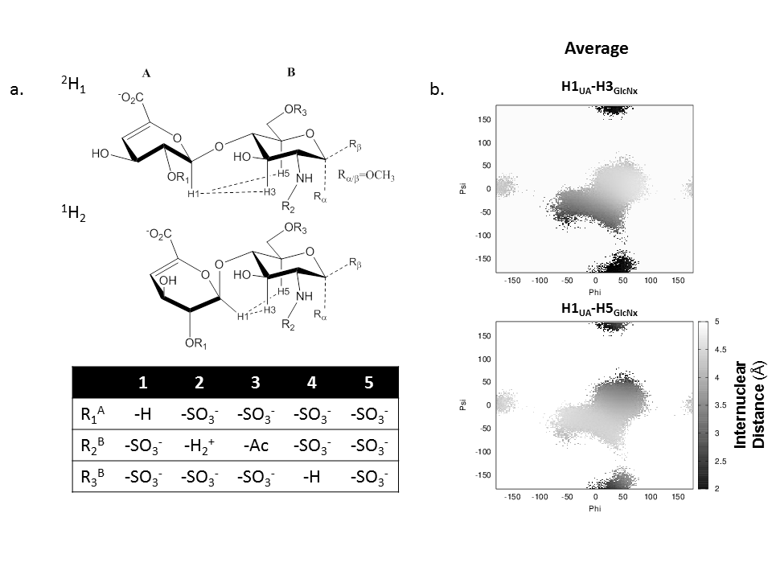
NOE curve

Slide 17
Calculates complete relaxation rate matrix and uses any mixing time.
Gives files of all the relaxation rates, the time evolution, the inter-proton distances.
Takes various inputs for sampling and precise calculations.
Noe program

Slide 18
Used to improve the simulations by changing the population of the conformations.
Used to make good choices of mixing times for the exp.
Topology file has 100s of parameters. The Noe calculations improve the models.
Program usage

Slide 19
The calculation of the noes
random motion
good sampling
The programs will
Calculate the conformations
Tell if the motion is correlated
Tell if the tumbling isotropic
Different programs

Slide 20
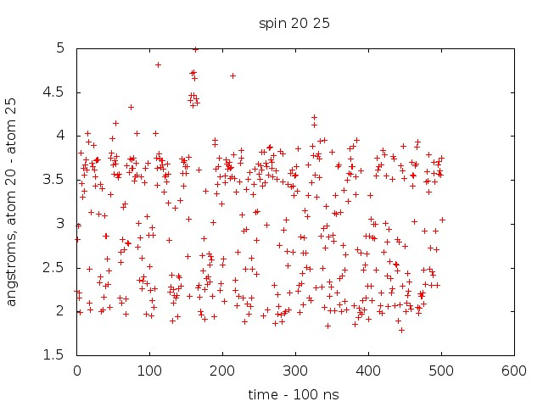
Sucrose – 2 Conformations

Slide 21
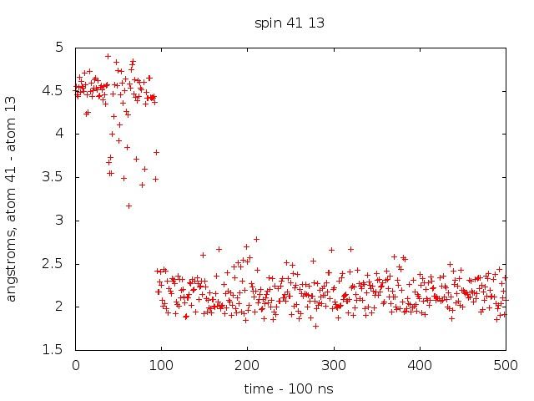
Delete or add frames to change population
Gag – 2 Conformations

Slide 22
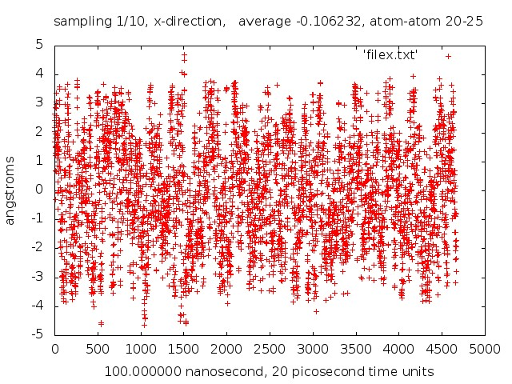
GAG – Molecule is tumbling correct, This figure Shows if the simulation is correct

Slide 23
Simulations are not accurate with the population of the conformations.
The noes are compared with exp which improves the simulations. Force field is improved by comparing theory with exp.
The populations are changed to agree with exp.
The changing of the population will improve the modeling of interactions with different molecules.
Population changing

Slide 24
The work showed that if the box of the simulation is not correct then the calculations are not precise.
Isotropic box of the correct size is necessary.
This is overlooked in many of the simulations.
Simulations

Slide 25
We can now compare simulation with exp using
noe
3J couplings
different relaxation rates (spin-spin, spin-lattice,…)
This improves the molecular modeling theory and what goes into the Amber simulations.
Modeling

Slide 26
Factor of 2-3.
Table 1 H1-H3
 | Experiment |  |  | Simulation
 | H1-H3 | H3-H5 |  | H1-H3 | H3-H5
Disaccharide1 | 3.6057 | 8.9491 | .4029 | .06487 | .04828 | 1.3436
Disaccharide2 | 2.7689 | 10.8763 | .2546 | .02456 | .04603 | .5336
Disaccharide3(alpha) | - | 10.4866 | - | .001435 | .04727 | .03036
Disaccharide3(beta) |  |  |  | .001412 | .04112 | .03434
Disaccharide4 | 7.02750 | 13.5104 | .5202 | .002283 | .05503 | .04149
Disaccharide5(alpha) | 20.4486 | 13.4205 | 1.5237 | .02450 | .05007 | .4893
Disaccharide5(beta) |  |  |  | .04290 | .04860 | .8827
2^(1/6)=1.12
This is about the precision of the exp.
Disaccharides.

Slide 27
User will be able to use software to compare theory and experiment using different observables.
Theoreticians can use.
Experimentalists can use
Conclusions

Slide 28
Citations, collaborators
Rob Woods, James Prestegard, Lachele Foley, John Glushka
Aknowledgements

