Slide 1
Theory and Practice of Residual Dipolar Coupling (RDC) Measurements in Proteins
Montelione NMR Meeting 5/27/20
Gordon Chalmers, CBIS, RPI

Slide 2
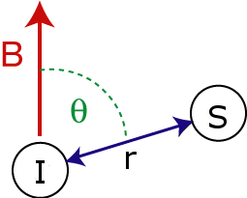

Residual Dipolar Coupling
Residual dipolar coupling between 2 spins occur if molecule in solution exhibits a partial alignment – incomplete averaging of spatially anisotropic dipolar couplings.
Would average to zero without an external frame reference, i.e. alignment, if isotropic tumbling
Dipolar energy of 2 spin system
must be averaged over time
I and S are the 2-spin system in presence of magnetic field
Angle is between inter-nucleus vector and B-field

Slide 3
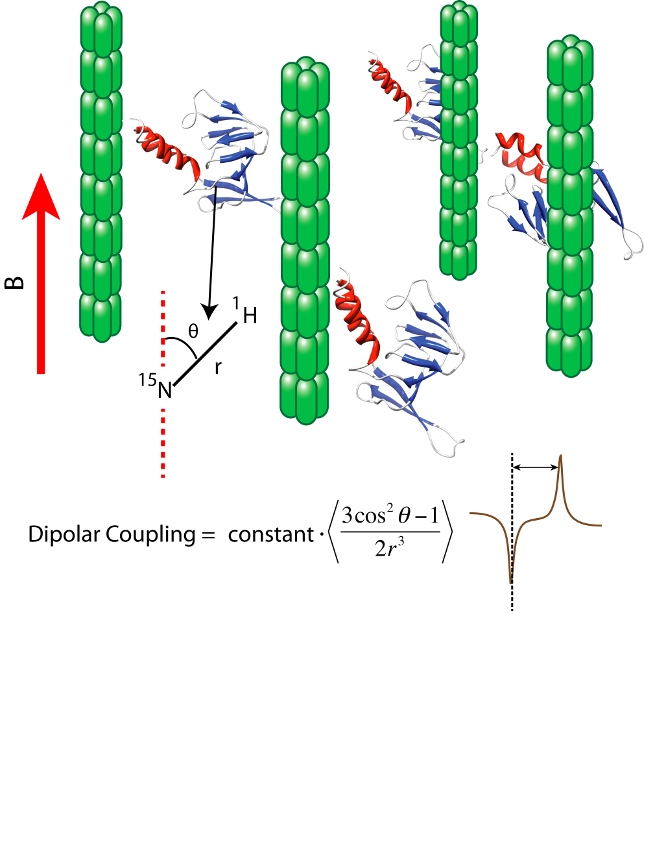
Aligning a molecule in an orienting solution
Alignment of a protein in an orienting solution (the molecules of the orienting medium are depicted as green rods).
The rods align with the magnetic field due to their large magnetic anisotropy; the protein interacts weakly with the rods, yielding a partial alignment of the protein molecules.
This allows the measurement of residual dipolar couplings for bond vectors, e.g. the ¹H-¹⁵N moieties.
N. Tjandra and A. Bax, Science 278, 1111-1114 (1997).

Slide 4
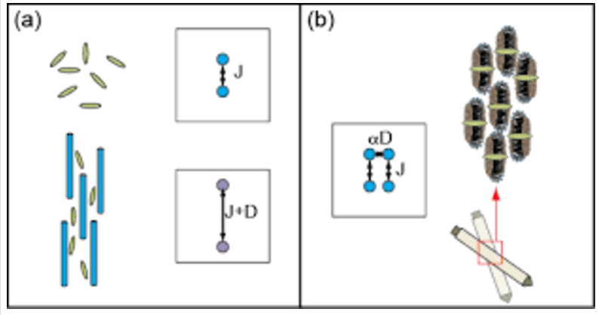
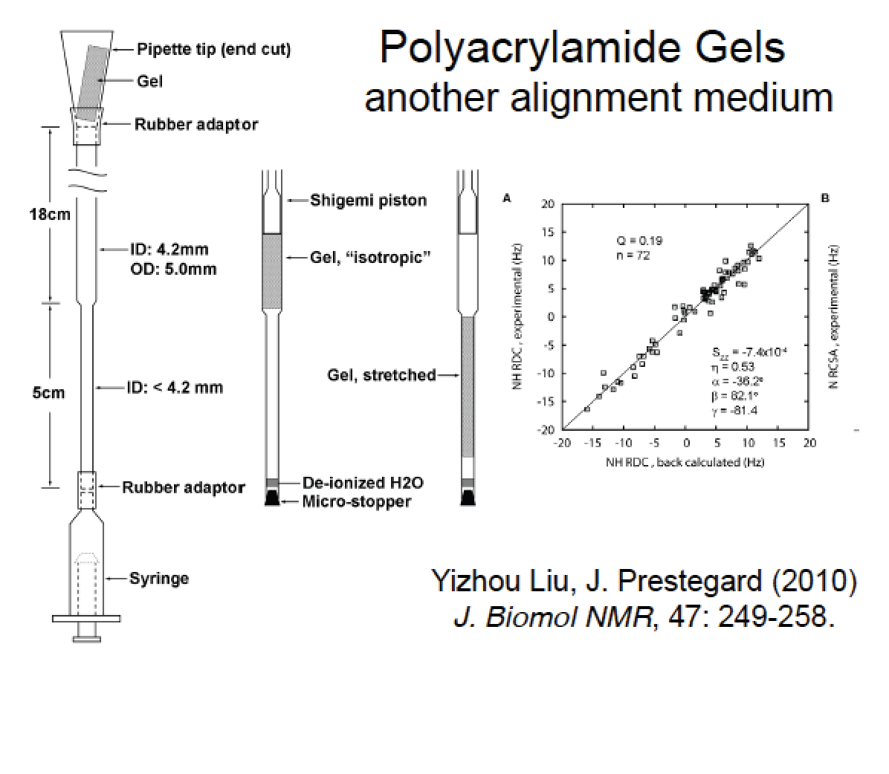
Methods of Alignment
bicelles
Liquid crystals
phage
particles

Slide 5
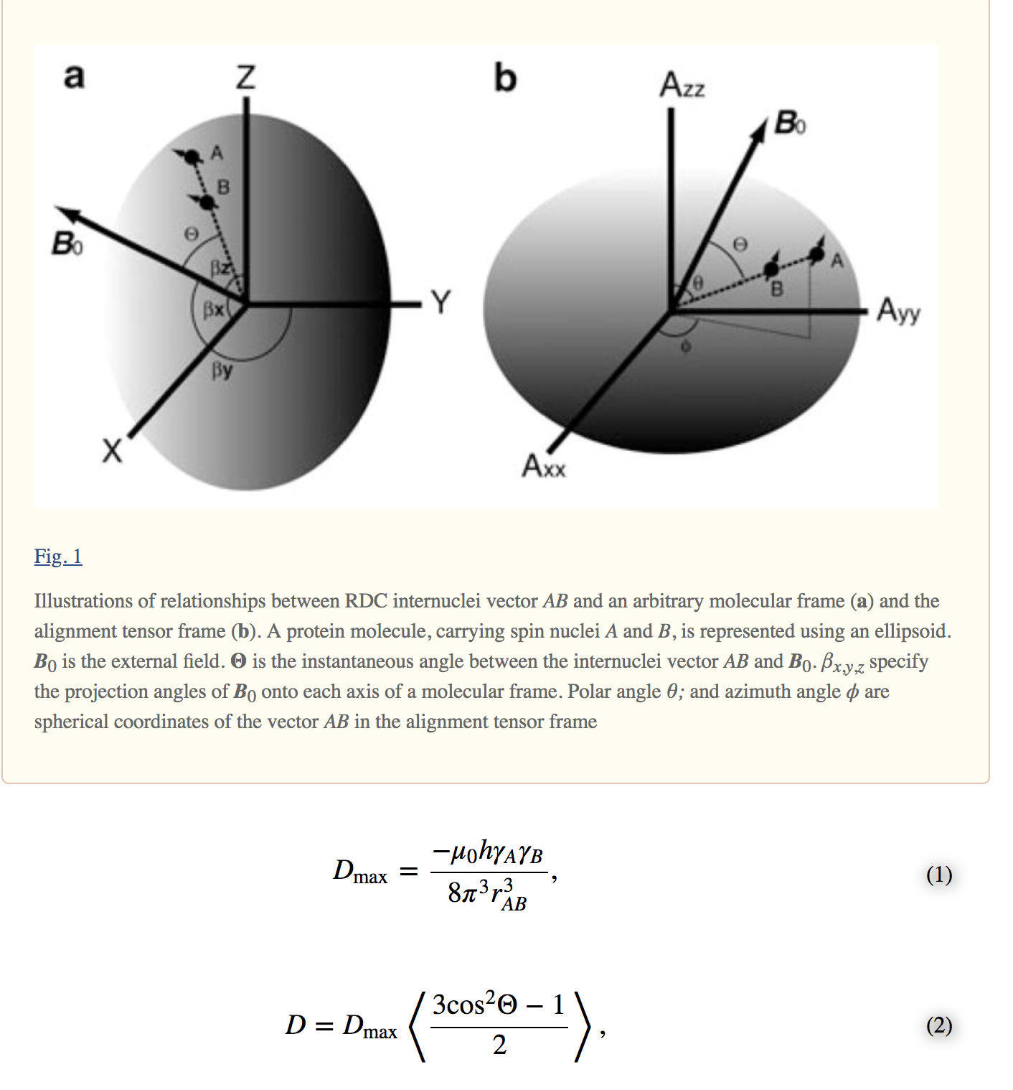
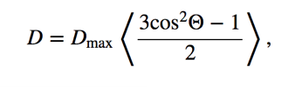
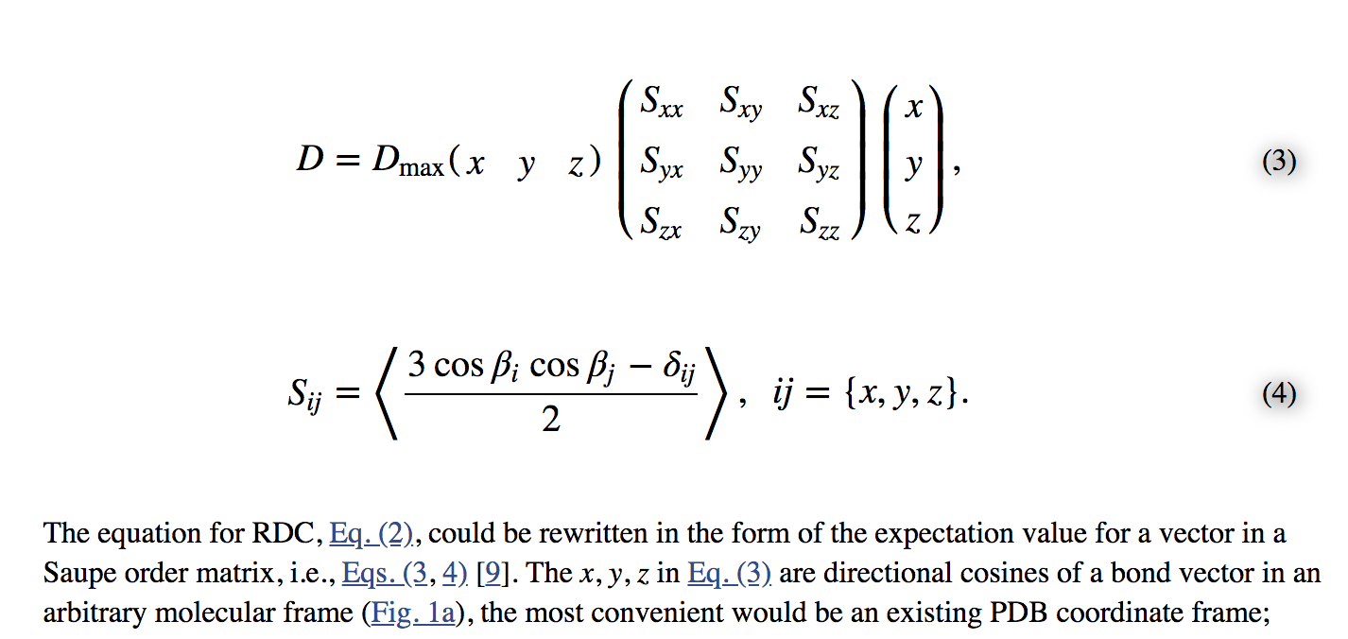
Condensed form with Saupe order tensor
Chen and Tjandra Top Curr Chem 2012 326: 47-67

Slide 6
Vector notation
S_{ij}=(3 cos\theta_{i} cos\theta_{j}-\delta_{ij})/2
\theta_{i} being angle of molecule frame direction i to B-field
Equations are linearized due to parameterization of S_{xx}+S_{yy}+S_{zz}=0
and symmetry
D_{ij}=D_{ij,max}/r_{ij}³ [ (x_{ij}²-z_{ij}²) s_{xx} + (y_{ij}²-z_{ij}²) s_{yy} + z_{ij}² s_{zz}
+ 2 x_{ij} y_{ij} s_{xy} + 2 x_{ij} z_{ij} s_{xz} + 2 y_{ij} z_{ij} s_{yz}]
Dipolar interaction in matrix form:
D_{ij} = D_{ij,max}/r_{ij}³ {\vec \nu}^{T} S {\vec \nu}
S is a 3 x 3 symmetric traceless matrix, the Saupe order tensor, coming from the frame rotation on the vector between the 2 nuclei, e.g. N-H or C-H
\nu are the normalized components of the inter-nuclear vector
S can be found from the Euler angles of the rotation and the direction of the B-field

Slide 7
Finding the S order tensor – jumping ahead
What is the best fit of 5 order parameters, i.e. 3 Euler angles and 2 order parameters to match many measurements? 5 because a 3x3 symmetric traceless matrix has in 5 components
This is an underdetermined problem – 5 parameters, N observables
Overdetermined if less than 5 RDCs, need at least 5 for a back calculation (potential problem in carbohydrates where ring vectors point in the same direction)
The energy changes per pair due to the reference of the B-field (z-direction)
Singular value decomposition (SVD) is used – equations are linear in S
Find the S-parameters via this fit – Euler angles of rotation can then be calculated
Involves all ‘coupled’ geometrically by residue structure coordinates in a static body by rotation
J.A. Lozonsci, A. M. Andrec, M. W. F. Fisher, J.H. Prestegard (1999). Order matrix analysis of residual dipolar
couplings using singular value decomposition. J. magn. Reson. 138, 334-342.

Slide 8
Some background
1st measurement maybe (1981)
Aksel A. Bothner-By, Peter J. Dornaille, C. Gayarthi, Ultra-high field NMR spectroscopy: observation of proton-proton dipolar coupling in paramagnetic bis[tolyltris(pyrazolyl)borato]cobalt(II), J. Chem. Soc. 1981:103,18, 5602-5603
J.R. Tolman, J.M. Flanagan, M.A. Kennedy, J.H. Prestegard, Nuclear magnetic dipole interactions in field oriented proteins: Information for structure determination in solution, Proceedings of the National Academy of Sciences, 92 (20), 9279-9283 (1995)
Tjandra, N.; Szabo, A.; Bax, A. (1996). "Protein Backbone Dynamics and ¹⁵N Chemical Shift Anisotropy from Quantitative Measurement of Relaxation Interference Effects". Journal of the American Chemical Society. 118 (29): 6986–6991
Tjandra, N.; Bax, A. (1997). "Measurement of Dipolar Contributions to 1J CH Splittings from Magnetic-Field Dependence of JModulation in Two-Dimensional NMR Spectra". Journal of Magnetic Resonance. 124 (2): 512–515
Saupe et. al. (1963), Lohman and Maclean (1978)
Use in PSD
Ten-fold increase in alignment, no lack of spectral resolution
Order tensor

Slide 9
Uses of RDCs
Structure evaluation and determination – can be used to refine coordinates of structure and create coordinates
Domain orientation
Fold determination
Can be used in conjunction with other NMR observables, e.g. NOEs for protein assignment (carbohydrates also, e.g. heparin one of the first)
In principle, RDCs should be used independently in different conformational states due to the angular averaging, 1/r³ is essentially constant for an N-H or C-H unlike the 1/r⁶ issue with NOE proton pairs;
time scale of changes is relevant
...

Slide 10
Experiments about RDCs
Frequency domain:
Separation of peak centers, HSQC, selective coupling enhanced SCE-HSQC, TROSY,
in-phase anti-phase IPAP, exclusive correlated E-COSY
Intensity based:
J-modulation
Good discussion of experiments -
Prestegard, J. H.; Al-Hashimi, H. M.; Tolman, J. R. (2000). "NMR structures of biomolecules using field oriented media and residual dipolar couplings". Quarterly Reviews of Biophysics. 33 (4): 371–424.
Pulse sequences are an art …

Slide 11
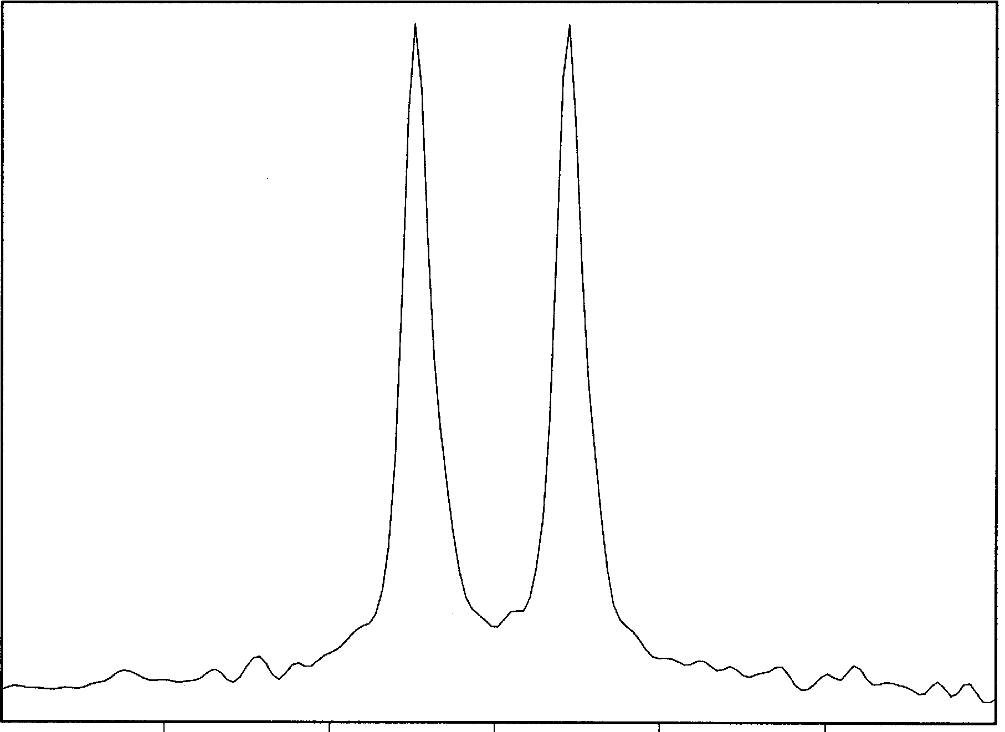
Peak splitting
10 Hz 0 Hz -10 Hz
²H 1D spectrum of water deuterons in a 5% bicelle prepared in D₂O at 35 mC. The size of the
splitting is ~10 Hz and increases almost linearly with bicelle concentration. The presence of two well
resolved and equally intense doublets suggests that the sample is homogenous.

Slide 12
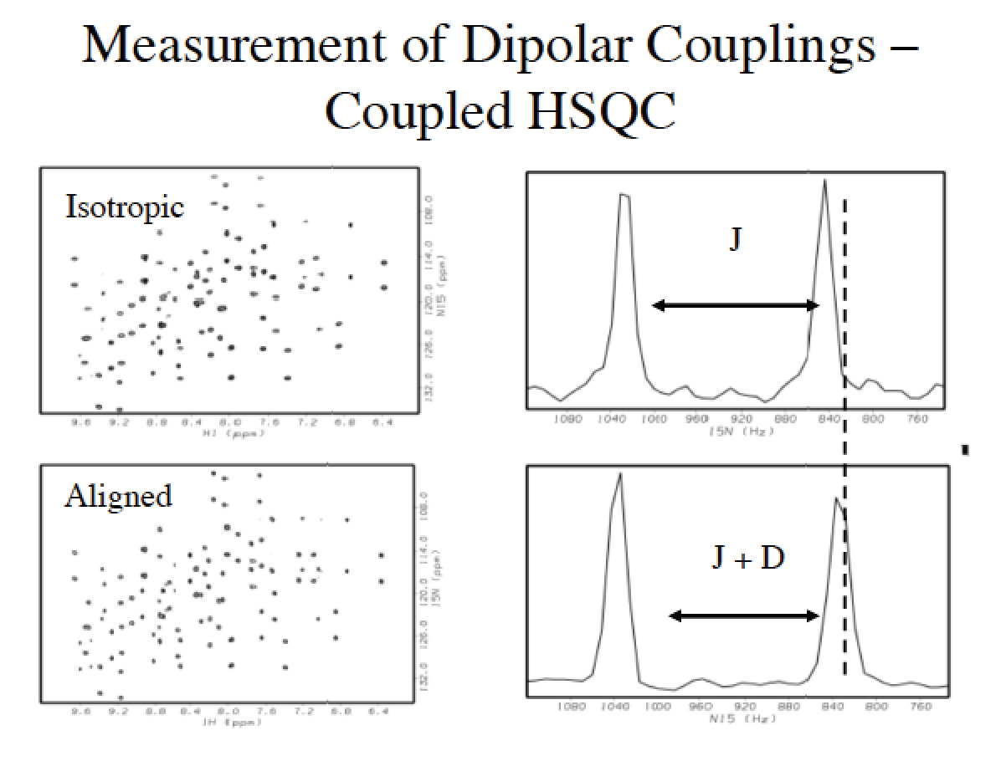
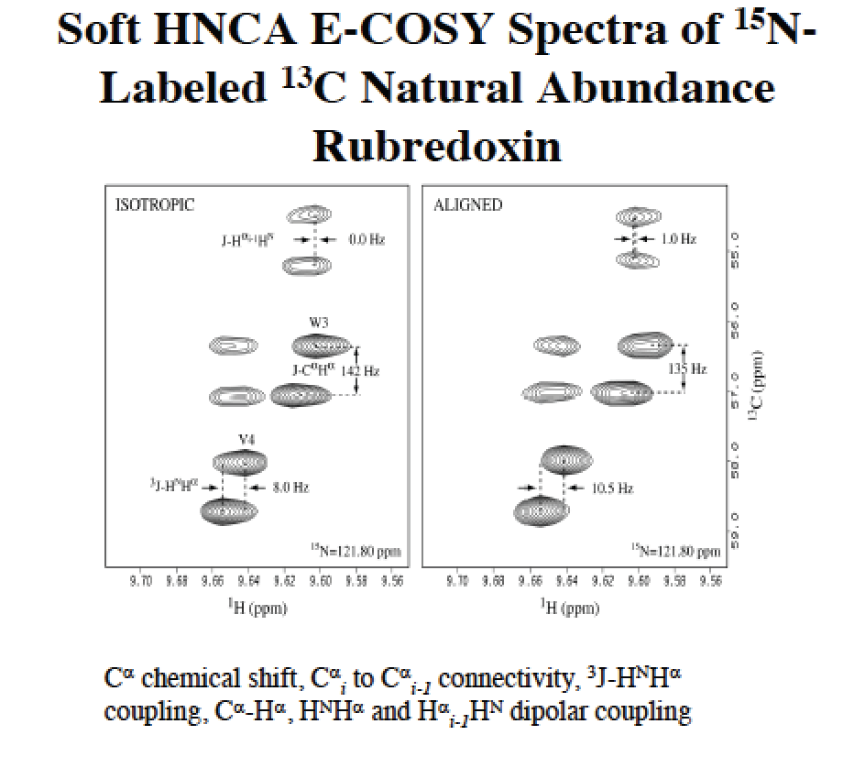
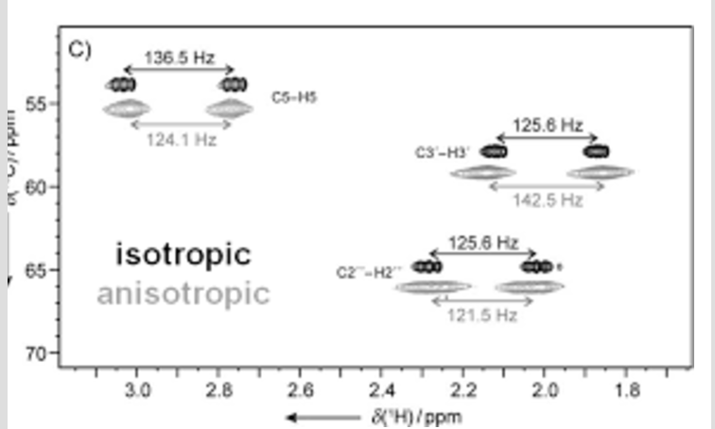
From the James Prestegard Lab web site

Slide 13
Calculating RDC’s
Dipolar interaction energy is found by averaging the bond motion with the 1/r³ potential and angular dependence
Complicated to treat in entirety, but can be done, as was in MD2NOE_Protein trajectory work
Calculation is simplified by using an ‘effective’ inter-nuclear distance between spins
and an alignment of the ‘rigid’ molecule – Saupe order tensor, principal alignment frame; small corrections due to incorrect mean inter-nuclear distance and isolated angular effects are neglected
Incorrect if conformational changes and wobbling of the N-H or C-H bonds; distance not so much in N-H or C-H which is extremely stable
1) treat the molecule as a rigid body – a molecular structure effectively couples all pairs in rotation
2) rotate it to find the mean orientation in the presence of a B-field to match RDC data
3) back calculate the dipolar interactions then compare structure with RDC observables

Slide 14
3 Euler angles
Rotation in 3-d requires 3 angles for an orthonormal matrix
alpha, beta, gamma
translates to order parameters via rotation matrix
Chen and Tjandra Top Curr Chem 2012 326: 47-67

Slide 15
Order tensor simplification and modifications due to internal motion
Treating molecule as rigid body
Dipolar interaction is
D^{ij}=D_{max}/r_{ij}³ \nu^{T} TS \nu
Modified dipolar interaction away from rigidity and fixed angular orientation (and mean distance)
S is order tensor, made of 5 parameters: S_{xx}S_{yy}S_{xy}S_{xz}S_{yz}
Calculated from principle frame alignment
T is just identity matrix if molecule is a static rigid body, but can contain dynamical
information if fluctuations of N-H or C-H wanted or better use of model MD trajectories
T can compensate in accordance with the wobbling of the N-H or C-H vector; uses a different order tensor which is calculable from internal motion of MD for example, or guessed to
interpret measurements
T is perturbation order matrix
J.R. Tolmon, A Novel Approach to the Retrieval of Structural and Dynamic Information from Residual Dipolar Couplings Using Several Oriented Media in Biomolecular NMR Spectroscopy". Journal of the American Chemical Society. 124 (40): 12020–12030 (2002).

Slide 16
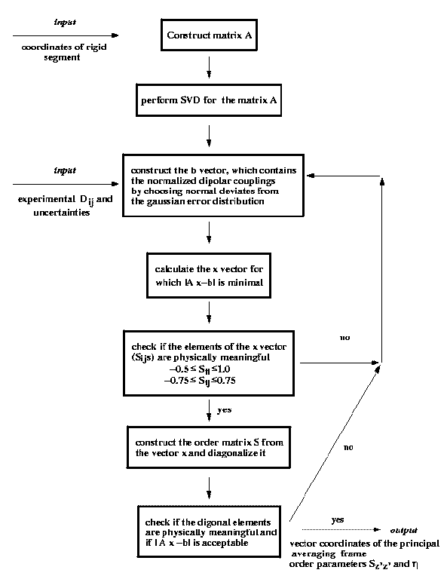
Flow of calculating order tensor

Slide 17
REDCAT software
Valafar, Homayoun, and James H. Prestegard. "REDCAT: a residual dipolar coupling analysis tool." Journal of Magnetic Resonance 167.2 (2004): 228-41.
Chris Schmidt, Stephanie J. Irausquin and Homayoun Valafar, Advances in the REDCAT software package, BMC Bioinformatics 2013, 14:302
No multi-frame capability, highly GUI based
Demo for order tensor calculation
Matlab software (improved and generalized from
previous work at CCRC)
Demo for RDC calculation, and order tensor calculation
Versions for single-frame (i.e. single structure) and order parameter angular corrected for trajectories (not in this presentation)
No GUI, under development
Lots of references – not mentioned

Slide 18
Database of 150 proteins – almost all are 1 domain
149 different aligned proteins, 90 distinct proteins, from the NESG
Approximately 3000 models, 15000 measured RDCs, 300000*4 calculated RDCs
Database has much information: data, back calculations, locations of outliers and close outliers, comparison plots, analysis of residuals of linear regression fits, and more
Analysis of different definitions of well-defined regions: DAOP, FindCore2, Cyrange,
NoRestrictions
Analysis of different observables over all of the database, e.g. mean,median,std of rmsds,
Pearson coefficients, RDC comparison by residue type, ...

Slide 19
Organization
Protein (NESG_PDB)
Alignment 1 Alignment 2 …
Data Well defined 1 Well defined 2 …
Comparison plots Difference plots Linear regression info
Database info
documentation
protein list
analysis, statistics
well defined residues, regions
RMSDs, Pearson
box plots, histograms
software,
calculations
Proteins can be added
Database not released yet

Slide 20
Show database

Slide 21
Use of RDCs in Structure Validation and PSD
3 examples with RDCs, measurement and back calculation
Comparison can be used to validate regions of a protein structure, including all models
First, 2LE1 Phage (20 models), external strand of residues well modeled even though flexible
Second, 2KIF PAG (20 models) well modeled by RDCs over entire set of residues
Third, 2KWB StretchGel (20 models) not modeled well
Lots of information about proteins in RDC database
E.g. Can ask if certain media are better for particular types of proteins

Slide 22
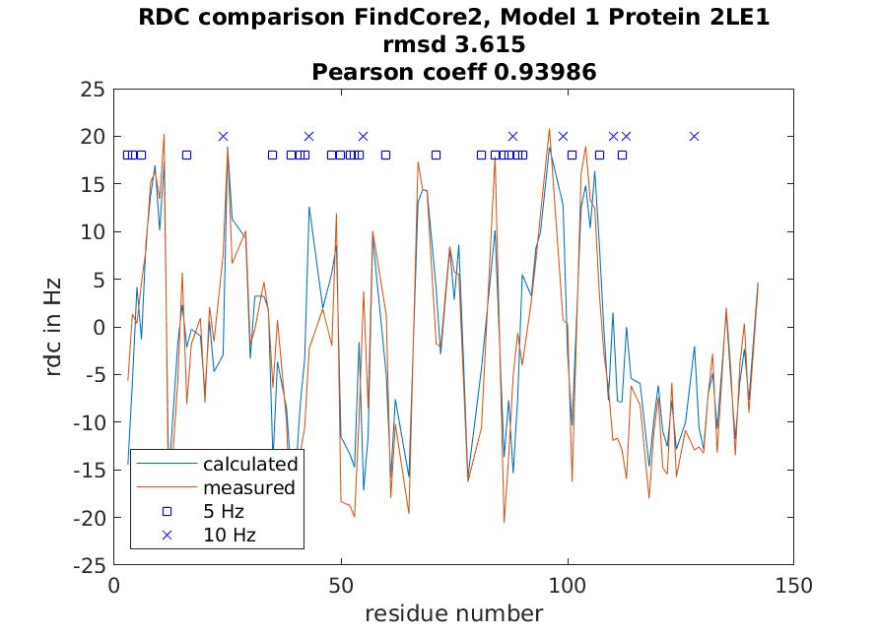
2LE1 Phage
Note residues >120
Bunch of Histidines
Evaluation of database showed that Histidine RDCs are generally more accurate

Slide 23
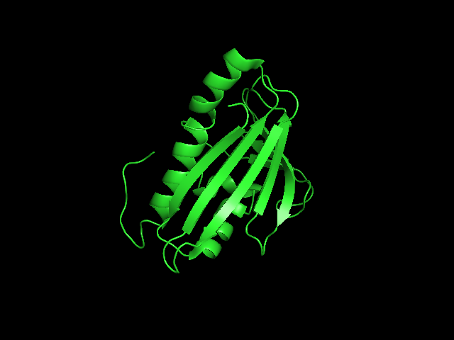
2LE1
Note the exterior isolated segment
These residues are close to residue 140
The residues are clearly well-defined in RDCs
Could play PyMol movie of structures

Slide 24
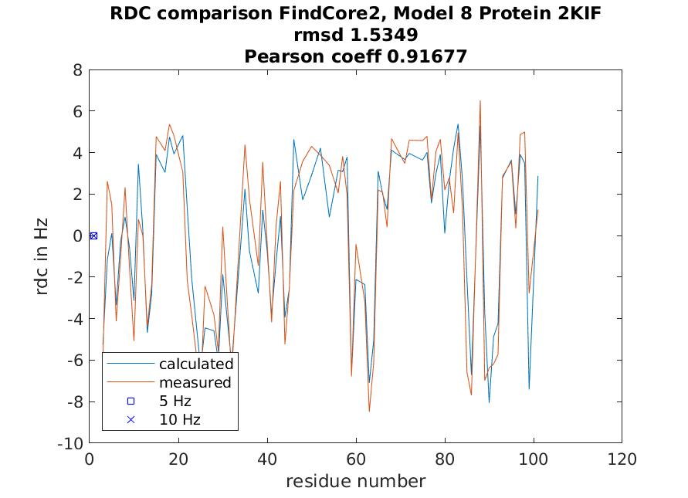
2KIF PAG
No outliers or 5-10 Hz differences
Low RMSD - good

Slide 25
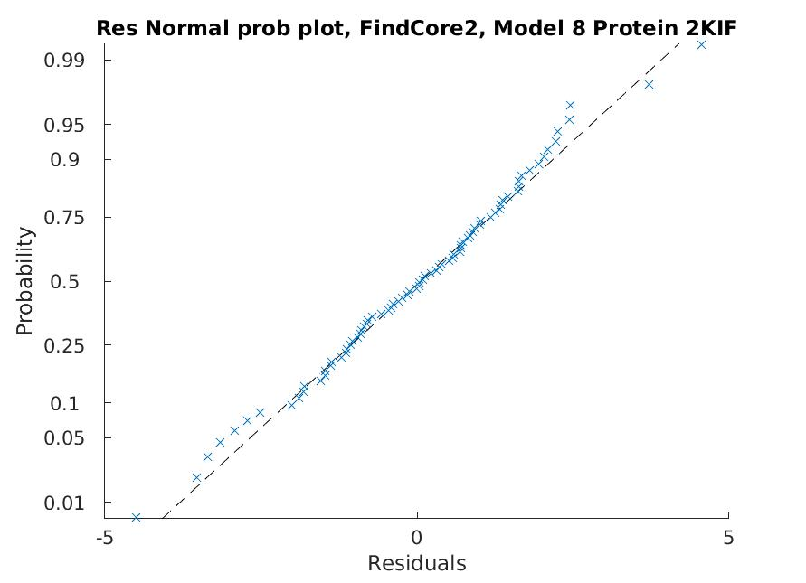
2KIF PAG Residuals
Residual evaluation shows a normal distribution over the entire protein
Not always the case

Slide 26
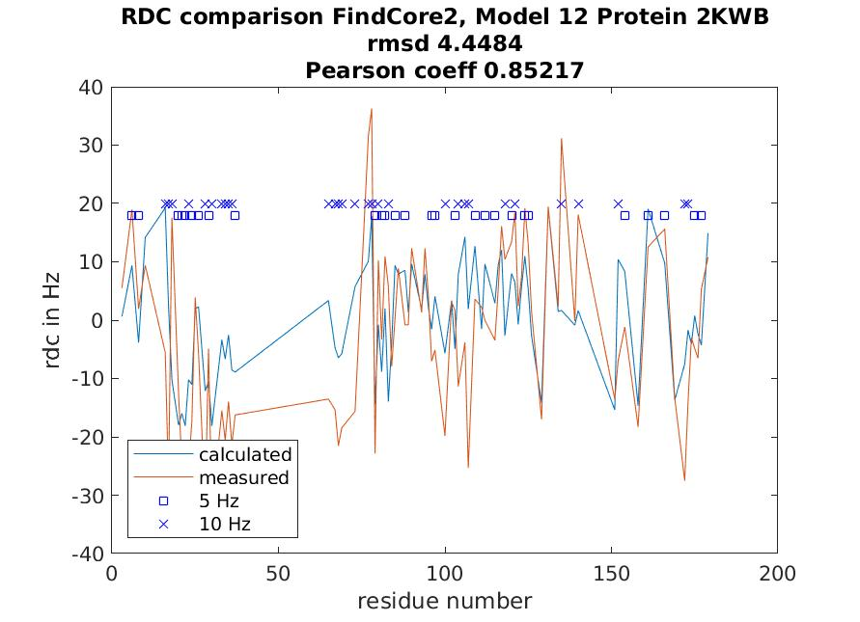
2KWB Stretch Gel
Certain regions not modeled well in RDCs
Examining all 20 models give similar comparison
Could be used in refinement

Slide 27
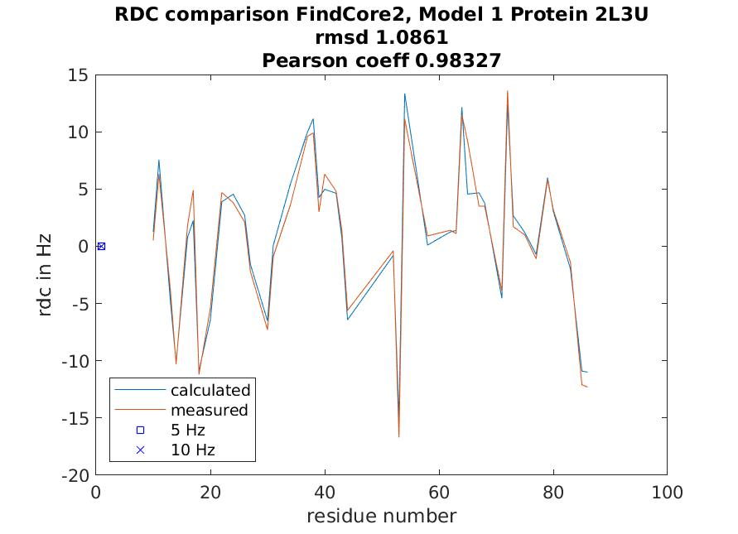
2L3U PAG
Very good match
Pearson coefficient essentially 1.0

Slide 28
PSD – Protein Structure Determination and database
RDCs can be used to determine domain orientation in multi-domain proteins
Calculations and figures could be used in finding domains
Bad fit of RDCs across regions of proteins could be used to refine/ improve the structure geometrically with the RDC information
Structures are not determined by just RDCs, e.g. NOE’s, …; weights of importance from different experiments could be changed and the structure re-evaluated maybe only in certain regions – possibly important due to measurement errors

Slide 29
Summary
Defined RDC and back calculation from data and structures
Experimental origin of data
Software
Introduced 150 protein RDC database
Uses of RDCs in structure calculations and structure evaluations

