Slide 1
RDC’s and Databases
In progress

Slide 2
Introduction
New database easily accessible by the user
BMRB has most of the data?
Used to build PDB’s
150 proteins, all assigned
An additional approximate 200 proteins
Statistics of this set of data
Improve the use of the data with restrictions on the data, e.g. well-defined regions

Slide 3
Databases
150 NESG proteins
Fully assigned
Many rdc measurements (150 proteins, 100 rdc’s each)
Easily accessible rdc database
Protein structures deposited in the PDB
20 structures typically for each

Slide 4
Additional proteins
Approximately 200 additional proteins
Not all are in the BMRB or used in the PDB
100 rdc’s for each
Not examined yet
Many FID’s – not examined the way these rdc’s are (should mention in paper)

Slide 5
Check PDB structures
Back calculations of rdc’s can be used to validate the measurements and PDB structures
Improved back calculations can be made by restricting to well-defined regions where the is a good convergence of the deposited structures
Detailed analysis for each protein – comparing measured to back calculation
General summary can be made for all proteins by statistically examining all the proteins together

Slide 6
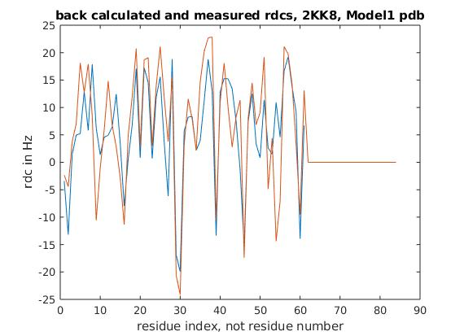
Example back calculated rdcs from pdb’s
PDB 2KK8 – 20 structures
Some points are absent due to missing rdc’s or missing H’s
Not well-defined region corrected

Slide 7
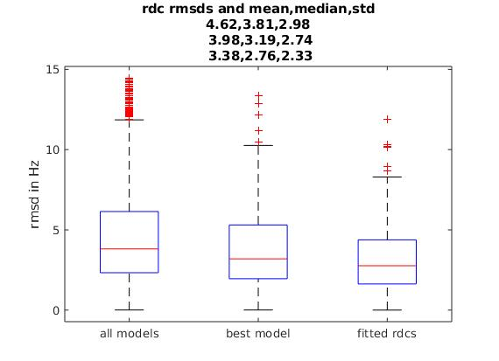
RMSD statistics of all protein structures
Can the statistics be improved?
All models (300,000 rdc’s),
Best model from each pdb
nlsq fit to population of models
Expect larger mean, median, std for larger proteins

Slide 8
Question:
Can back calculated rdc’s fit the measurements better if only well-defined regions of proteins are used? Should if structures are more reliable
Back calculation involves all of the protein N-H’s together
Restriction to well-defined regions could improve the individual rmsd’s of the measurement-calculated
Dihedral angle order parameter restrictions can be used to define these regions (PdbStat-DAOP, Cyrange)
Variance metric technique restrictions can (PdbStat-FindCore2)

Slide 9
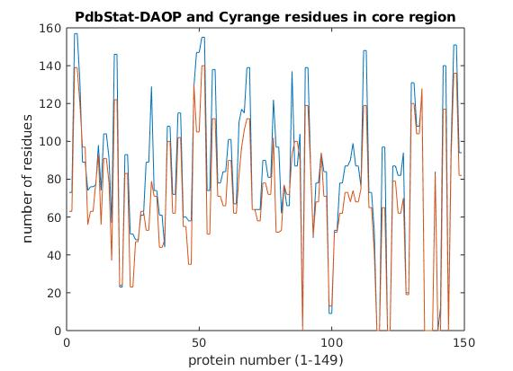
Dihedral resctrictions
Flexible regions not included in the 150 proteins
PdbStat-DAOP (blue) and Cyrange (orange)
PdbStat-FindCore2 not yet included
Rdc statistics not done

Slide 10
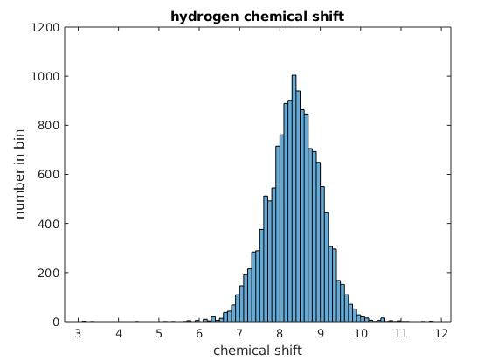
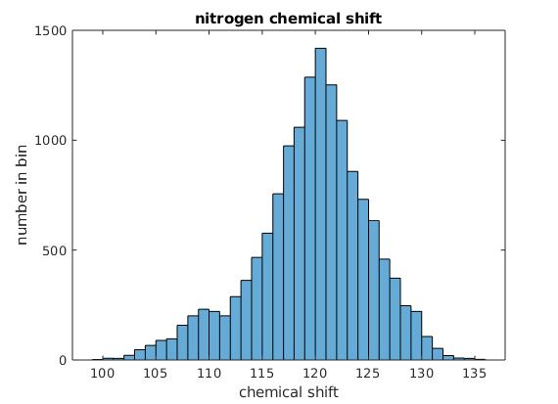
Chemical shift predictions
Can this improve prediction software by region restriction?

Slide 11
How much data is there?
E.g., each protein has 100 residues
Rdc’s, H and N chemical shifts
Approximately 45000 measurements
PDB has 20 structures for each, 900,000 points in total to match
Important to validate the measurement input into the PDB

Slide 12
To do
Compare statistically PdbStat-DAOP, PdbStat-FindCore2, and Cyrange in overall improvement of rdc measurement match to PDB files
Present the database in an easy to use on-line MySql form (MySql part is done)
150 proteins (additional 200)
Secondary-
Maybe use MD to improve the not well-defined regions
Provide more documentation of PdbStat
Check if use of PdbStat and Cyrange increase the reliability of chemical shift predictions. These databases use hundreds not thousands of proteins in single frame predictions (i.e. one model)

Slide 13
Improving the calculations
Some slides about using ‘core regions’ from protiens
No missing rdc measurements are included and only core residues are used

Slide 14
Figure of core regions by residues from DAOP and Cyrange, blue is Cyrange and orange is DAOP, generally about 80 percent of residues per protein

Slide 15
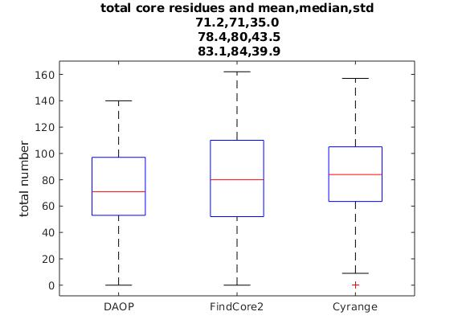
Number of core residues by different programs

Slide 16
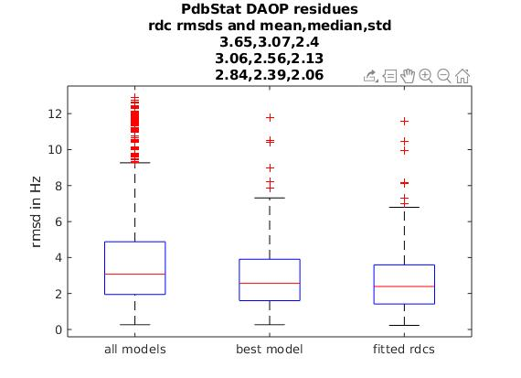
Pdb-Stat DAOP evaluation of rdc’s with core residues

Slide 17
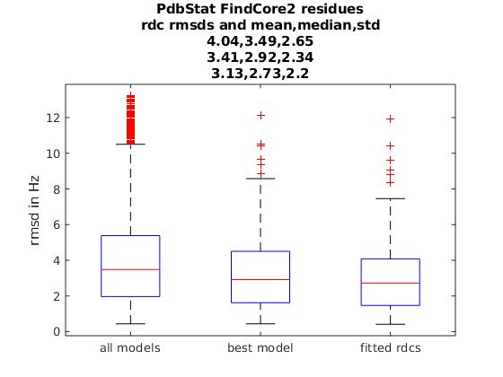
Pdb-Stat FindCore2 residues and rdc’s

Slide 18
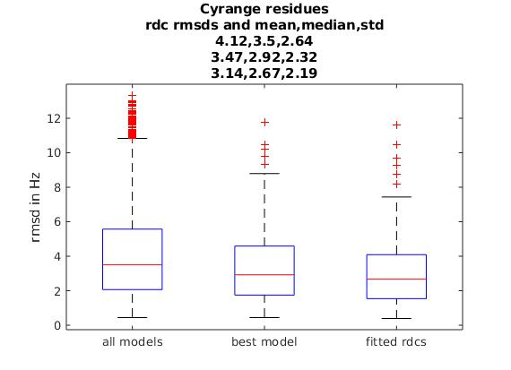
Cyrange core residues and rdc’s

Slide 19
Can improve the rmsd by using the core residues as determined by Pdb-Stat and Cyrange
Maybe 30% in general.
Number of core residues is about 80% of total on average.

