Slide 1
Protein Noe’s, Spectral assignment
Gordon Chalmers
Complex Carbohydrate Research Center
Department of Computer Science

Slide 2
Calculate noes of large and small molecules
Proteins – e.g. rST6Gal1, Skp1 with glycosylation, …
Predictions of spectral intensities at arbitrary mixing times
Can be used for different reasons – including assignments of spectra – Assign_SLP_MD
Used in genetic algorithm peak assignment software
Goal

Slide 3
Correlation functions – general use in NMR calculations
Noe’s, relaxation rates, chemical shifts, rdc’s
Spectrum assignment – proteins, carbohydrates, molecules with different times scales of motion
Statistics of spectral assignment
Output of programs

Slide 4
1) Calculate noes’ for large molecules, e.g. proteins
2) Steps in calculating from MD
3) Calculate spectral information and assignment
4) Results
Figures taken from st6Gal1
Calculations are made memory intensive and for long trajectories
outline

Slide 5
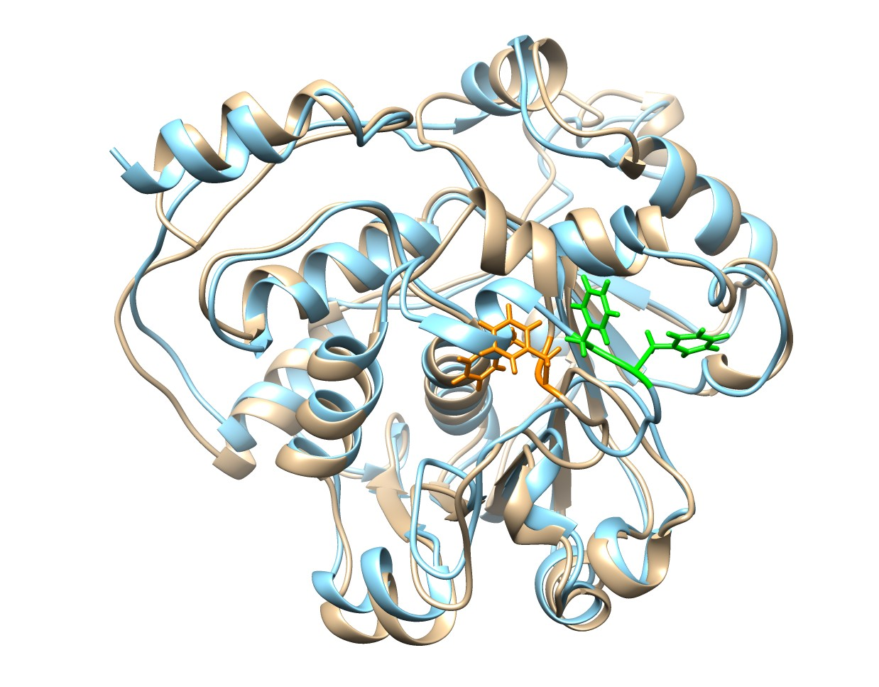
rST6GAL1

Slide 6
Will use rST6gal1 to illustrate the use
Protein of 36 kDaltons. Used 500 ns trajectories for predictions. 303 residues. PHE were labeled, 16 residues. Aim is to assign the 3d Noesy HSQC spectrum to these residues.
Difficult to assign
Have access to noe’s, rdc’s, chemical shifts, and trajectories
rSt6Gal1 – pdb 4mPS (rat) we used human form after changing the loop portion

Slide 7
Noe’s used to be calculated by an 1/r^6 approximation.
Called either weak, medium, or strong
Not good for larger molecules due to the lack of spin diffusion, and conformational changes of the molecule.
This work is an improvement in that it treats the molecule as a whole, with the group of protons
Quantitative in this approach
We use the Bruschweiler correlation function and complete relaxation rate formalism
Historical Noe’s

Slide 8
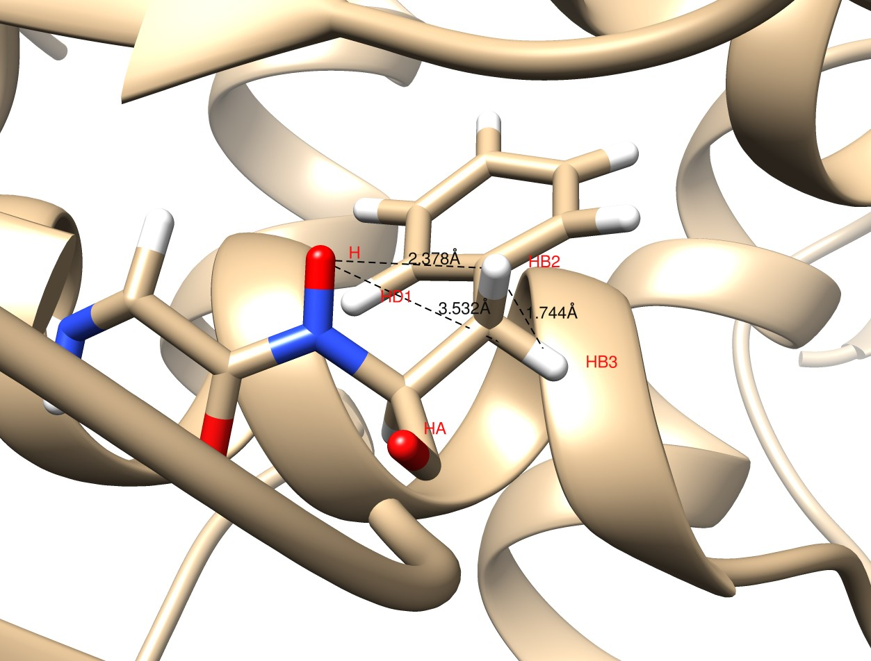
Example of Problem: F115 in ST6Gal1
Expected NOE results from 1/r⁶: I_{HD1}/I_{HB3} = 4.7, which is incorrect
Notes:
HN-HD1 2.73 A
<number>

Slide 9
Calculate correlation functions from trajectory (no b-field, frequency, or spin system information)
Calculate spectral density function (no spin system information)
Calculate noe’s, … (spin system initialization/finalization)
Any type of experiment – uses the initial and final spin states
Next package includes saturation transfer difference calculations
Time consuming
Not time consuming, real-time
Programs – partitioned into segments for ease of use and reproducibility of calculation such as different b-field without recalculating
Can be used to improve modeling and also to increase signal to noise in experiment

Slide 10
2 types of average coordinates – N H corrected, usual
MD2NOE_Protein flow
Calculate order parameters
Order parameters, tensor
noe vectors in excel sheet and csv format
Calculate spectrum
Calculate internal correlation functions
Calculate relaxation rate matrix
Correct for Amber nomenclature
Peak list
Calculate nmr observables – noe buildup curves
Calculate predicted chemical shifts

Slide 11
Programs are memory intensive
Time consuming to calculate noe’s
MD trajectories take time to create, 5 days, for 5000 atoms and 1 microsecond
Many people don’t have the computing resources, new single frame software package will help in that – not discussed
Experimentalists would like real-time calculations for tuning of parameters
Lots of neighboring protons – unlike carbohydrates
1/r^6 approximation is not good
Noe programs – difficult to calculate and would like no approximations, such as curve fitting of spectral density functions

Slide 12
BruechsweferCorrelation function
We use the internal motion correlation function in calculating the spectral density function.
Computationally expensive
Uses trajectories
N frames – cost of computation
100,000 frames –
Multiplies, additions, memory calls, … increase computation
Software designed to use only on-chip memory, however, Intel won’t allow user dedication of memory
Correlation functions

Slide 13
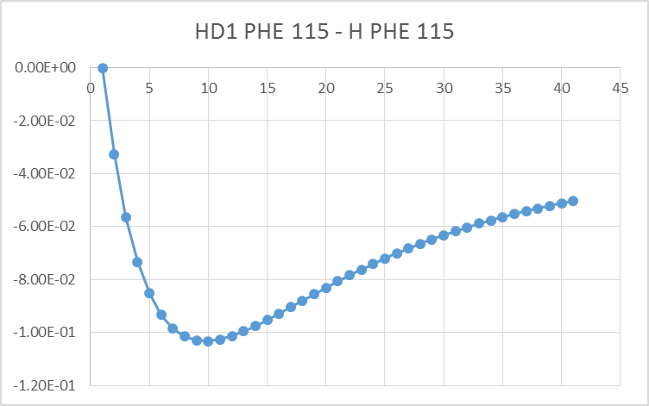
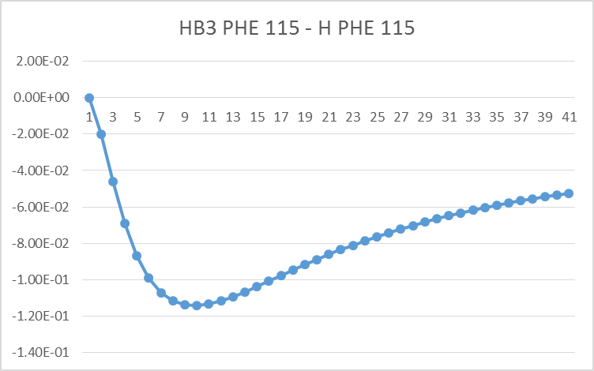
Results from Simulation
Indirect noe – little concave at first
50 ms
At 40 ms I_{HD1}/I_{HB3} = 0.9; not 4.7
Even at 10 ms I_{HD1}/I_{HB3} is only 1.2

Slide 14
Programs
Correlation function calculation
Complete relaxation rate matrix calculation
Noe or relaxation rate calculation
Efficient
Real-time calculations
Can change spin system initialization/finalization, B-field, …, in real-time, which is good for computational and experimental work
Spin diffusion is important. Complete relaxation rate formalism includes this.
These are separate programs in the MD2NOE_Protein package.

Slide 15
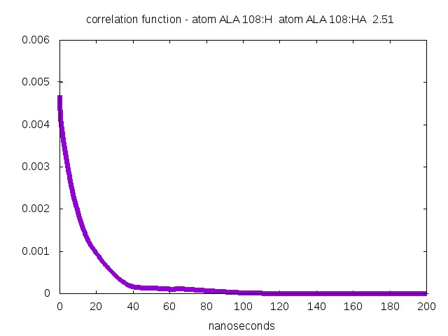
Correlation function. what looks like bumps – multiple processes not pathological. No approximations or curve fitting is done. Bad sampling – bad bumps.

Slide 16
Matrix of magnetization transfer
Transfer of magnetization to different spins, then relaxation of transfer
These are the ’s and ’s
Uses correlation functions and fourier transform, calculates rhos and sigmas. It details the relaxation of a spin system.
Noe’s, relaxation rates, …, require evaluating the spectral density function
Complete relaxation rate matrix

Slide 17
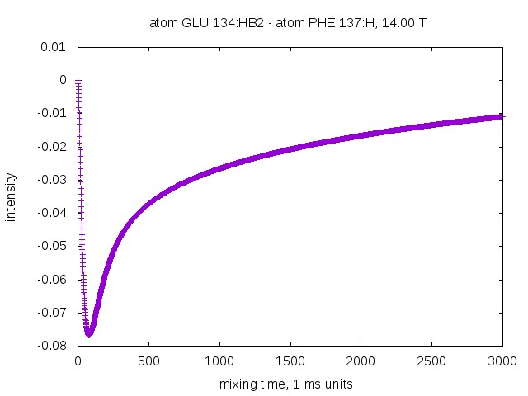
: negative
Bad signal
Good linear model
This is the case for proteins.
Can be used to maximize signal to noise in experiment. Especially if many spin pair measurements are to be maximized.
Good signal
Needs complete calculation
Example Noe curve

Slide 18
Trajectories are not long enough
Accurate calculations require good sampling of tumbling and internal motion – overall tumbling a problem
Correlation function roughly goes as
Small molecules ok
Large molecules require an approximation
MD good at internal motion
Calculate internal motion part and add in to aligned trajectory the artificial tumbling
$e^{−τ_{o}}e^{−τ_{i}}$
approximations

Slide 19
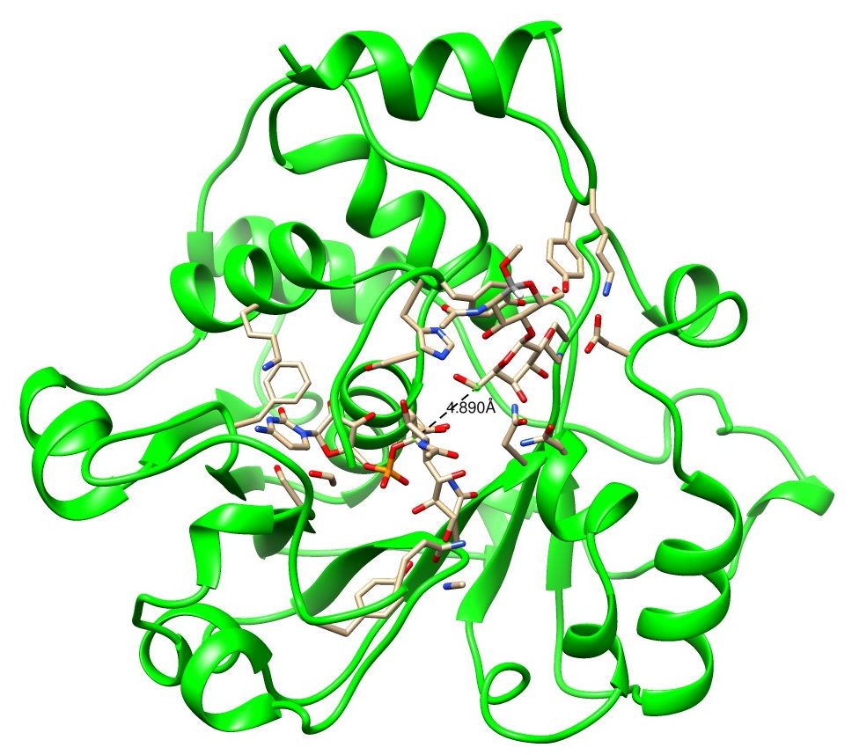
Include all spin pairs with inter-distance < e.g. 5 A in complete relaxation rate matrix.
All spin pairs are within this this
sphere of radius R. Larger sphere, more spin pairs, more accuracy. More calculation.
How do we do this – ‘Sphere approximation’. Quasi-local, nonlinear.

Slide 20
Cannot calculate this noe
Can calculate
Noe calculations and spin system – initialization/finalization

Slide 21
Assigning spectral intensities with a genetic algorithm and Amber trajectory
http://tesla.ccrc.uga.edu/software/
Assign_SLP_MD

Slide 22
The output of the noe-protein programs from MD trajectories give predicted noe information.
Assign_SLP_MD uses predicted noe’s, rdc’s, chemical shifts and compares with experimental info to find best peak to residue match, i.e. assignment
The genetic algorithm has been used to sparsely label small and large proteins, including HtpG and rST6Gal1.
rST6Gal1 was initial protein used with recent software
Assigning using genetic algorithm

Slide 23
Uses evolution to model a population of possible solutions to the problem
As the iterations continue, the population ‘flows’ to the hopefully optimal solution.
Local minima in the fitness function could trap the solution, but there are ways to deal with this.
This is one of the best approaches to finding approximate solutions to NP Hard or complete problems.
Genetic algorithms

Slide 24
All of these use measurements and predictions are from the entire trajectory
Noe’s at mixing time
Rdc’s
Predicted noe vectors (1-d spectra)
Chemical shifts
also >1 media (e.g. phage, peg for alignment),
Additional work to be added, e.g. methyl noe’s
ingredients

Slide 25
Assign_SLP_MD Assignment flow
Order parameter files, predicted chsmical shift files, noe file
Noesy spectrum
Rdc’s, chemical shifts, weights
Make input files
Experimental measurements
Tedious, but much simplified
Probability density statistics figure of assignment
Run genetic algorithm
Text file with possible solutions
Run output analysis program
Optional - Run statistics program
Validation

Slide 26
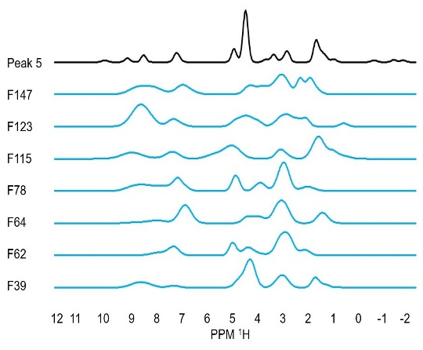
Experimental and predicted noe vectors
Example of matching – noe vectors

Slide 27
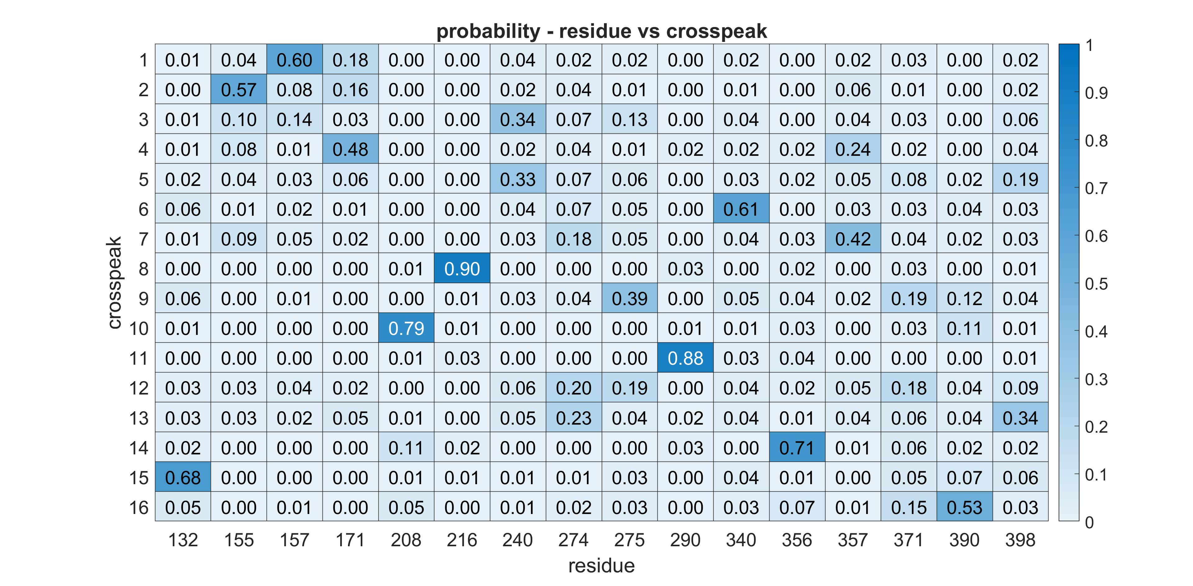
Statistics part of package. experimental data. Weights are used in estimating likeliness of correctness.

Slide 28
rST6Gal1
Mutagenisis was used as a check in 4 of the residues Assign_SLP_MD got all correct with high Probability

Slide 29
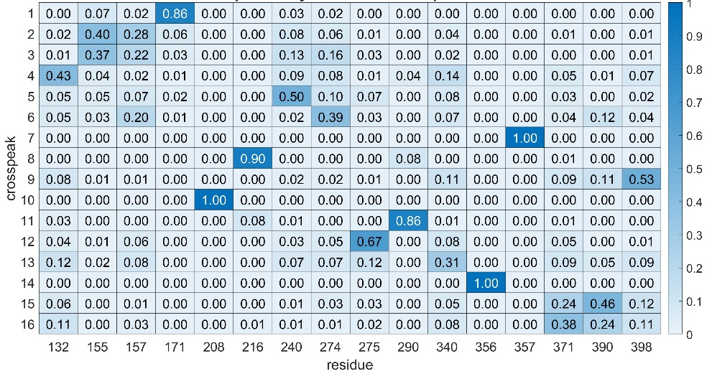
Program also can take in constraints – this is the assignment with the mutational constraints

Slide 30
Proteins have ‘conformations’
Noe’s and genetic algorithm can be used to identify and calculate populations using trajectories
Still not good enough sampling
Rdc’s and chemical shifts also are used
States of proteins – additional use of Assign_SLP is population determination

Slide 31
rST6Gal1 1μs MD Final Structure
Note that Phe 264 in the final structure (orange) is buried
Good hydrophobic contacts – Asp 255 also has new H-bonds
Transition between 2 distinct states, about residues 263/264
Genetic algorithm used to identify population
3 different trajectories were used finding states and comparing assignments

Slide 32
MD2NOE_Protein, Assign_SLP_MD
Has been used in assigning sparsely labeled rST6GAl1, 5 smaller proteins, …
Software will be further developed by others
Programs were used in a successful NIH grant application
Collaborators:
Professors Prestegard, Woods, Moreman
Alex Eletsky, Qi Gao, Rob Williams, Kari Pederson, Laura Morris
Graduate this semester.
conclusion

