Slide 1
Analysis of well defined residues
Residues (i.e. amino acids) can be floppy, i.e. mobile
Would like to know if some regions of proteins are well defined among structures
PdbStat and Cyrange can be used to find these and quantify the stability
MD can also be used for refinement

Slide 2
Well defined regions of proteins
Several methods for determination
DAOP, DAOP extended, Cyrange
Use dihedral constraints amongst structures
Use variance method with dihedral constraints
Cyrange also uses dihedral constraints

Slide 3
Different techniques references
(many references including Kabsch et. al.)
PDBStat: A Universal Restraint Converter and Restraint Analysis Software Package for Protein NMR. Roberto Tejero, David Snyder, Binchen Mao, James M. Aramini,1 and Gaetano T. Montelione. J Biomol NMR. 2013 Aug; 56(4): 337–351.
The expanded FindCore Method for indentification of a Core Atom Set for Assessment of Protein Structure Prediction. Jennifer Gullon, Yuanpeg J. Huang, Roberto Tejero, Gaetano T. Montelione. Proteins 2014 Suppl 2 (0 2): 219-30.
Cyrange: D.K. Kirchner and P. Güntert, BMC Bioinformatics 2011, 12:170.

Slide 4
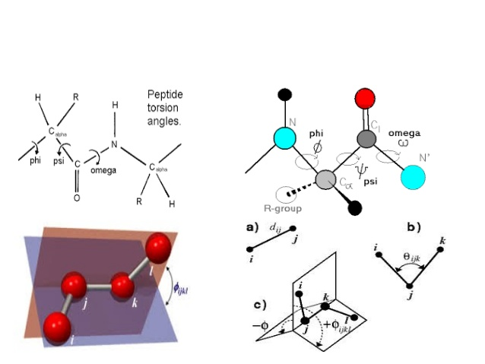
Dihedral order parameters
N conformers
Dihedral angles

Slide 5
Quantifying DAOP
N conformers from structure calculation
S(φ_{i})=√( (Σ sin φ_{i,j})²)+(Σ cos φ_{i,j})²)
Also for S(ψ_{i})
If S(φ)+S(ψ)>1.8 then well-defined

Slide 6
Variance method - FindCore2
Uses an iterative superposition of coordinates and a superposition of structures (i.e. conformers)
Uses inter-atomic variance matrix and superposition to compare structures and enlarge core set from FindCore (i.e. DAOP)
If mu^2 small enough then additional atoms not included in well-defined regions are included

Slide 7
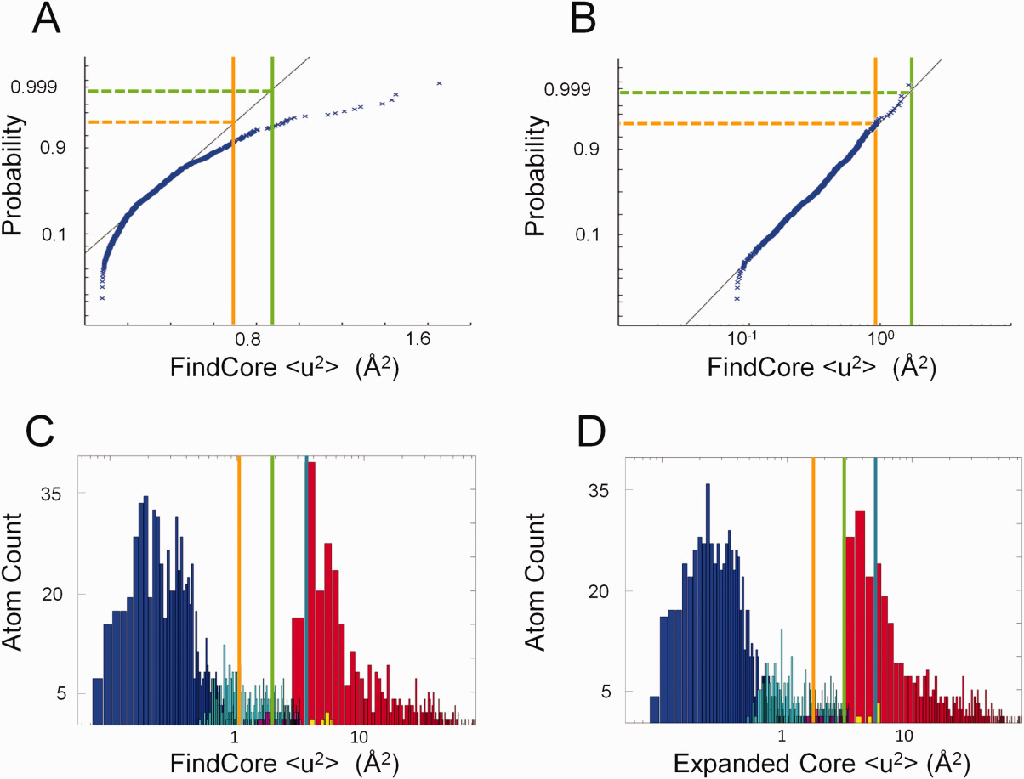
Comparison FindCore and Expanded
(C ,D ) Histograms (with a logarithmic scale for the abscissa) of <u 2> values for heavy atoms in T0655, with <u 2> calculated from (C) the original FindCore superimposition and (D) the superimposition calculated in the first iteration of the Expanded FindCore method. Blue bars correspond to atoms in the original FindCore core, cyan bars to atoms added to the core in the iteration process, magenta bars to atoms removed from the core during the editing process, which ensures all atoms in the final core belong to residues for which all backbone atoms are in the core. Yellow bars correspond to carbonyl oxygens added to the core in the editing process. The orange, green, and blue lines mark Z score cut‐offs of 2, 3, and 4 respectively. Note that the Z score = 3 cut‐off (green lines) is (B) a tight upper boundary for the distribution of <u 2> values for the core atom set and (D) is a tight lower boundary for the second (non‐core) mode of the distribution of <u 2> values calculated using the final Expanded FindCore superimposition.

Slide 8
Couple of images
https://pubmed.ncbi.nlm.nih.gov/24327305/

Slide 9
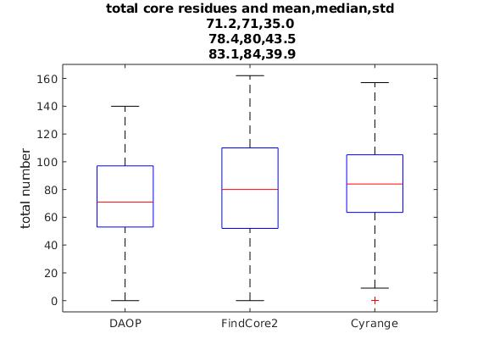
Distribution of number of residues
Generally about 80% of the residues in protein

Slide 10
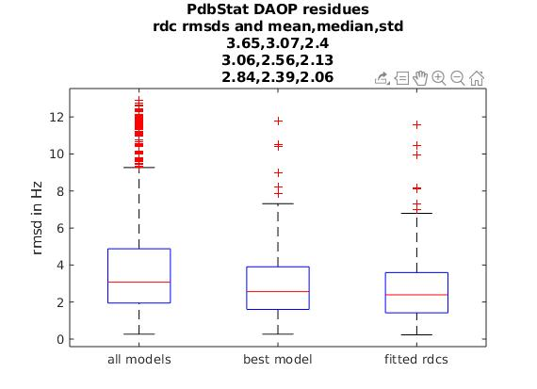
Comparison of well defined regions by RDC information

Slide 11
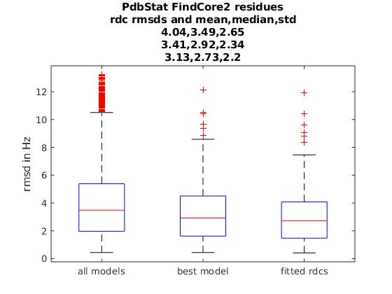
Expanded FindCore and RDC rmsd’s

Slide 12
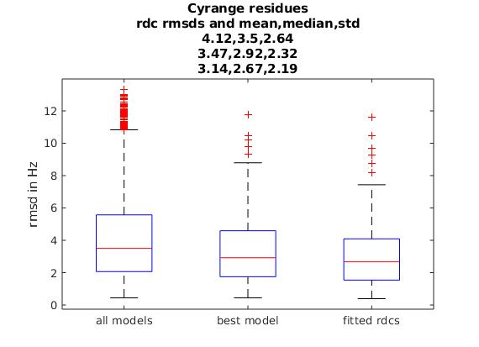
Cyrange well defined regions and RDC RMSD’s

Slide 13
Discussion
Relevant to use ‘good’ well defined residues/atoms
Important for RDC calculations, which use all residues in protein or selected set
Important for other reasons
Superimposing structures, does however, represent partially comparing different
conformations of proteins and should be examined
Various techniques for finding well defined regions, DAOP, Expanded FindCore
(FindCore2), Cyrange

