Slide 1

Ligand GA: Inhibitor construction via a genetic algorithm
Gordon Chalmers

Slide 2
Motivation
Repurposing known drugs and molecules is limited by database size, molecular space size is 10^{100} not 10^{13} (largest known) for ~100 atoms
Binding sites of proteins can be technically complicated both in chemical composition and geometry
Small changes of molecule generate large effects, e.g., morphine and -CH2
This approach creates molecules based on the protein site, e.g., building with Legos or playing scrabble
Very flexible in input of molecular restrictions and in GA evolution of molecules
Can include toxicity, e.g., 20,000 human proteins and in principle given unlimited resources find a uniquely binding molecule barring protein similarity
This is a math optimization problem subject to chemical information and computation. Synthesis and laboratory aspects can partially be addressed.

Slide 3
Ligand GA Essentials
Uses a specially designed GA with 14 different mutation functions and 2 crossover functions
Chromosomes are textual graphs via the non-isomeric SMILES implementation with possible pseudo-atoms
39 short functions, files in the software package with documentation
Designed for incorporating much information about both the small molecules and protein sites
Uses Cambridge Structural Crystallographic Center/Glaxo-Smith-Kline docking software GOLD, est. 2001, for docking (or AutoDock Vina)
Uses Corina Classic, est. 1998, for pdb/mol2 generation
Stores the population at each iteration – enables post-processing and a determination of synthesis pathways, chemical steps, to ligands

Slide 4
Computation
Inherently parallel and scalable, 30 cpu’s now and automatically recognizes available
Written for computational efficiency without accuracy loss and GA search completeness (so far, 4 revisions). Compact code.
Software designed to be generalized in purpose
Modular in that the fitness function can include
Chemical properties about small molecule and/or protein sites
E.g., Required ADME inclusion
E.g., H-bond requirements and locations – relevant
Additional blocked protein sites for toxicity prevention (unwanted binding)
Access to known databases of molecule for sub-structure comparison, e.g., chemical properties and comparison, K_{ow} partition coefficient, known molecules, …
Can include totally different molecular fitness function, such as density of organic molecule
Generates sets of different molecules
Software is –very- easy to use. On command line – one command with 4 arguments to run

Slide 5
Parameters
Mutation and crossover function probabilities, not GA probabilities
Atomic abundances
Atom, pseudo-atom inclusion is user choice
Large tuning in principle but generic now
Include detailed input of protein site or small molecule structure
Can tune probabilities and other parameters as evolution proceeds
Correlate with large databases for chemical information based on sub-structure (PubChem has 1.2 10^7 molecules and is downloaded) in process or en media res
.

Slide 6
Examples
Aspirin/COX-2, Celecoxib/COX-2, Simeprevir/Mpro SARS-Cov-2
---
Different mechanisms of inhibition: reversible, irreversible, site non-specific (inhibitory conformational change)
Site information, topography and chemical info of substrate interaction, necessary for more specific molecular construction and could be included.
All resulted in high binding scores (2x) and of approximate same size
---
40 slide ppt outline with details of project and software

Slide 7
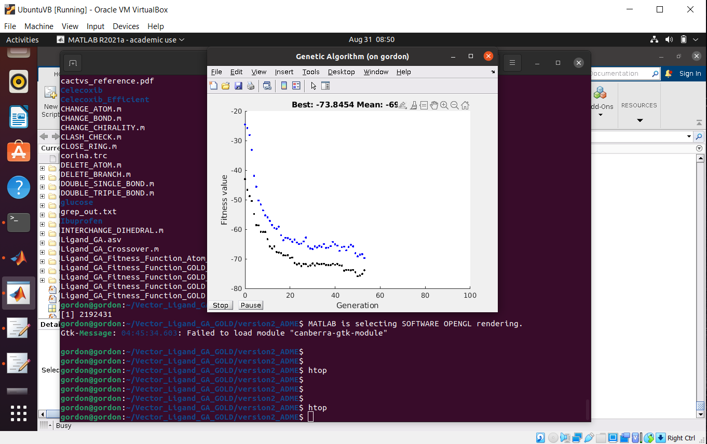
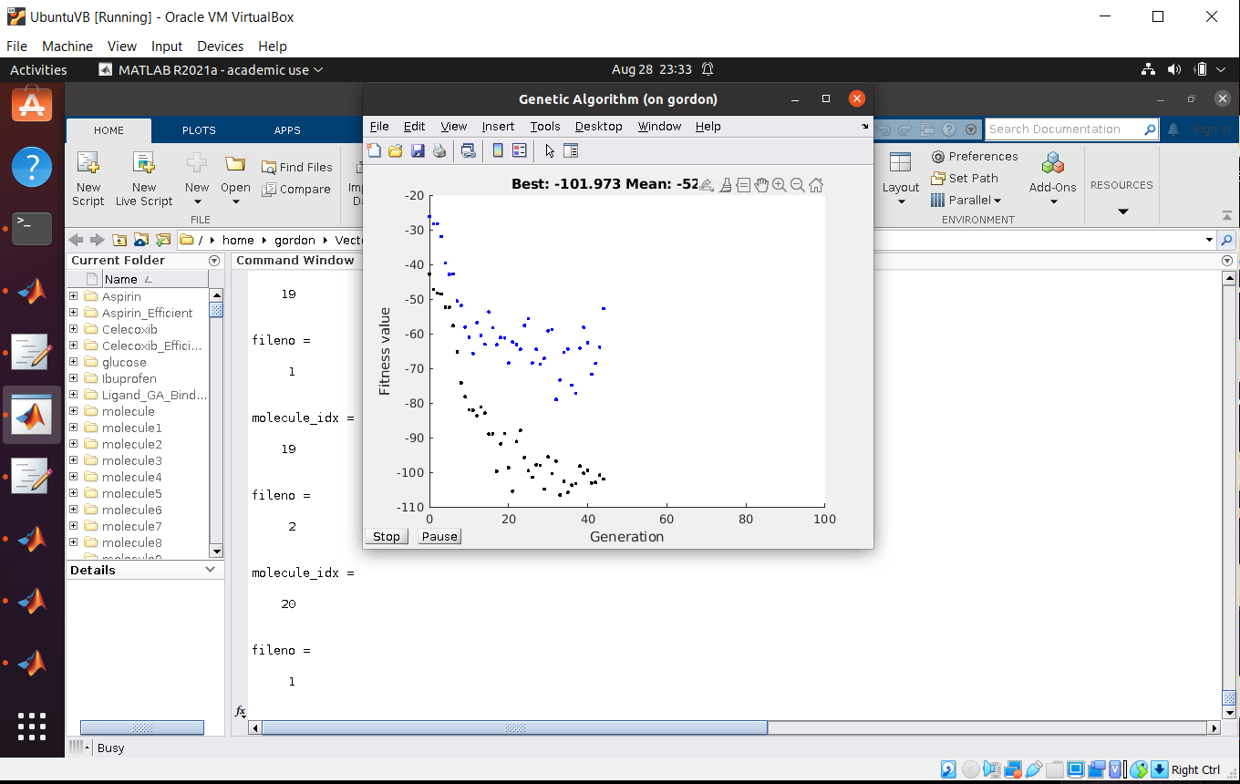
Aspirin run with ADME and without
LHS is with ADME restriction. Note that the PLP docking score is less, due to the ADME restrictions.
The result of these both overnight runs are at least max 2x the PLP score of modified Aspirin (40 dimensionless) localized at SER 531 of COX-2. The thousands of generated molecule are similar in atom number to Aspirin. Population of 50 identical Aspirins is starting point.
Other examples, Celecoxib and Simeprevir, are similar in their runs and in binding score increases.

Slide 8
Content of background
Demonstration
Various sub-programs
Directory structure and output directories/files (from CSD GOLD and Corina)
The results list(s) for a molecule(s)
Open up Chimera to illustrate some docking fits
Detailed 40 slide ppt (outdated) in the background
Discussion about what to do with software

