Slide 1
Small Molecule Construction via Molecular Binding
Gordon chalmers

Slide 2
Goal – find small molecules
Find the binders to a protein that have the least dissociation from a protein with user specified ligand restrictions (type of sites, site geometry and glycan structure, specificity, size, polar/non- polarity, hydrophobicity, glycan substructure, …)
Drug design can require:
1) search for small molecules that bind and inhibit other protein interactions
2) screening of such candidates for toxicity, effectiveness, and synthesis
This work addresses 1) finding best fits of small molecules from physical and binding geometric properties
Flexible in definition of ‘good’ binding or dissociation
Searches very large space of possible candidates and returns a list
Uses state-of-the-art in docking and physically real sets of interactions, e.g., force field at atomic scale

Slide 3
Existing Database Searches
Good video demonstration from the Exscalate E4C in Nanome: News (exscalate4cov.eu)
Desired: good binding to site in protein
while preventing binding to a set of other sites and proteins
This is a min/max problem with a complicated but usable objective function.
Molecular landscape of branched N residue small molecules is finite size and –far larger- than a database of 10^12 ligands. It is still completely searchable in a genetic algorithm.

Slide 4
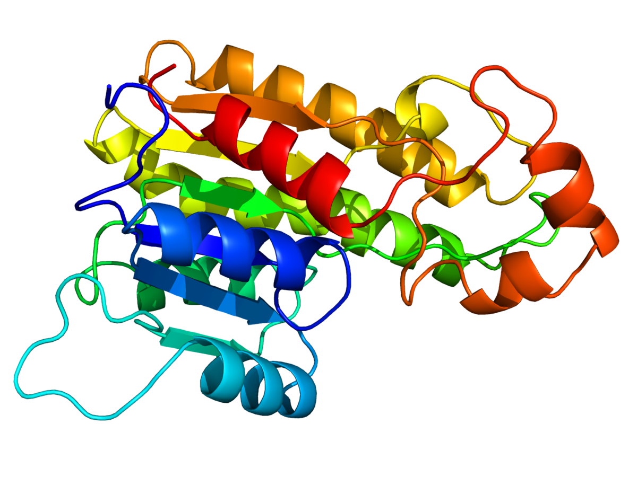
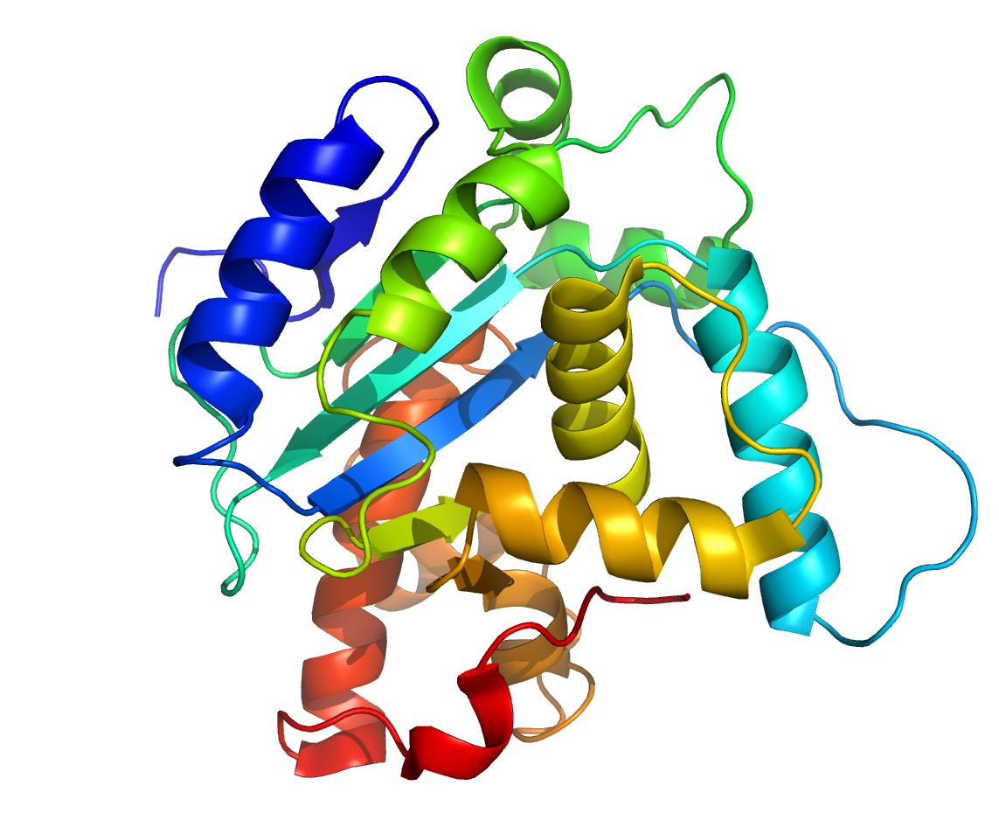
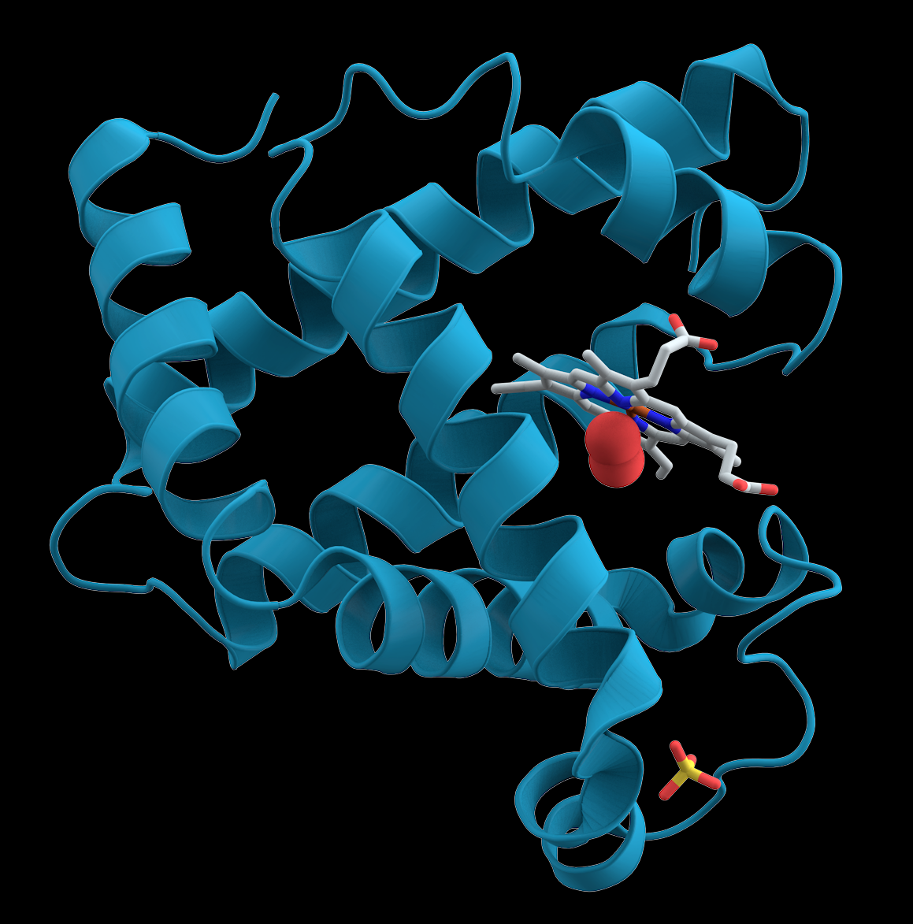
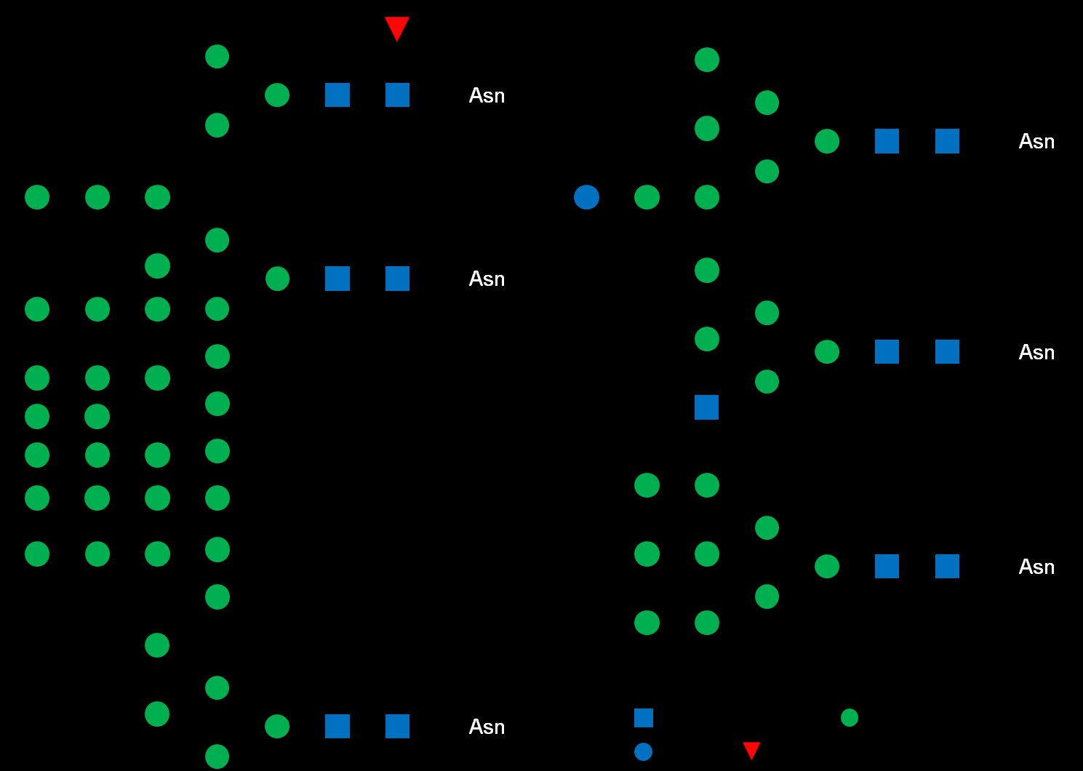
Glycans (i.e., Oligosaccharides) via Molecular Search
Wanted glycoprotein with site specific glycan (Oligosaccharide)
Unwanted site specific binding to glycan(s)
Protein-ligand interactions are local in topological setting
‘Good’ = satisfying user criteria,
physical and geometric properties
Penalized in GA
Glycan Search Space
‘Good’ Binders

Slide 5
Why GA?
Molecule-molecule interactions are local
Electrostatic, Van der Waals, Hydrogen bonds, Torsion angles, …, do not depend on global structure
Global structure does play a role, indirectly
Ideal for local deformations in structure for the GA to search
Search is very large, much greater than 10^13 structures and information in a data base
GA flow and diagram presented in last part of this document

Slide 6
Simplest Objective Function
Simplest function to maximize is Binding Energy in proportion, or measure of tightness of binding, then next is dissociation rate
Input protein, binding site region
target
GA : search oligosaccharide molecule structures
Output list of ‘best binders’ to region of target protein
Input different proteins and regions that prefer non-binding
Of course, objective can be more complicated and ligand constraints - discussed
blocking

Slide 7
Genetic Algorithm (GA) Computational Part
Calculate binding properties of individuals (e.g. glycans) at each iteration
accuracy, precision < 1 kCal
modeling, amount of
computation
Individual 1
Iteration j
Individual 2
Iteration j
New Iteration of Population found from Binding Properties
Multiple GPUS, CPUS used at each iteration, per population
Individual Npop
Iteration j
Docking is computational part
Parallelizable, scalable, to large scale

Slide 8
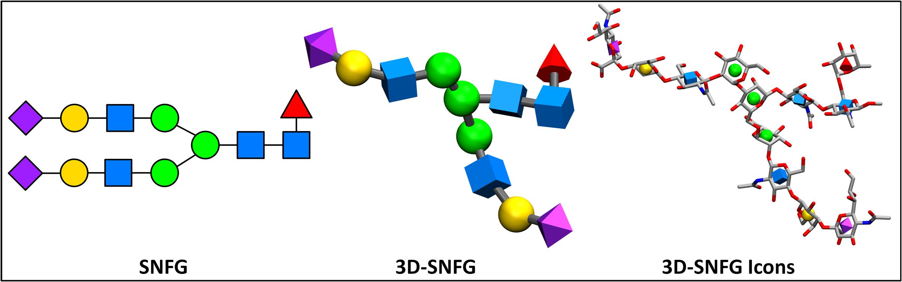
Glycan Chromosome (GA)
3D-Symbol Nomenclature For Glycans (3D-SNFG) | Other Tools & Services (glycam.org)

Slide 9
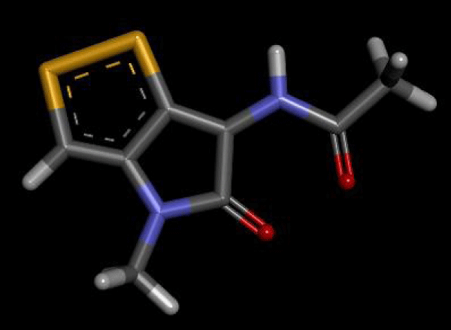
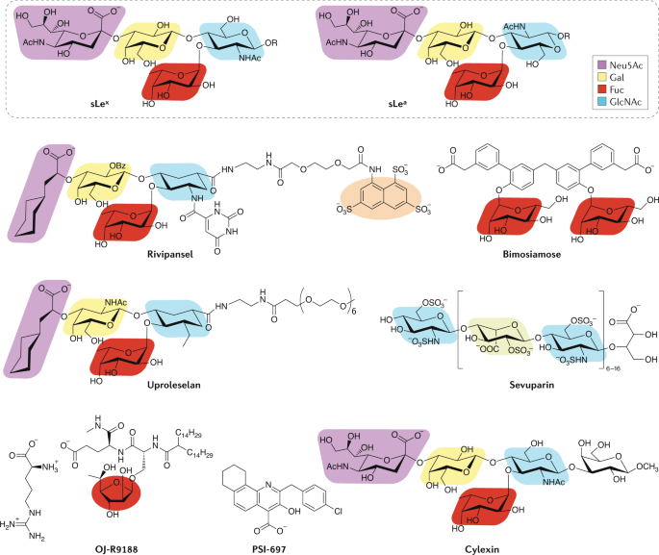
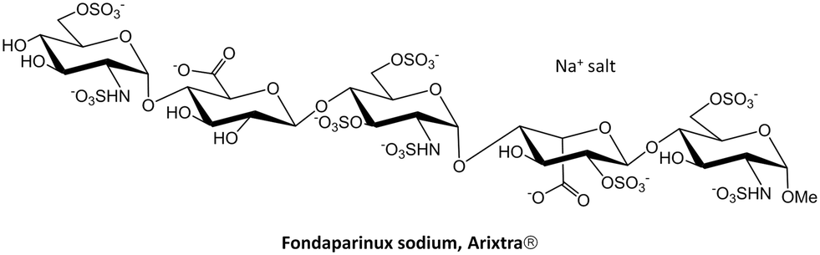
Some small molecule examples
Some have fused rings – base residue units

Slide 10
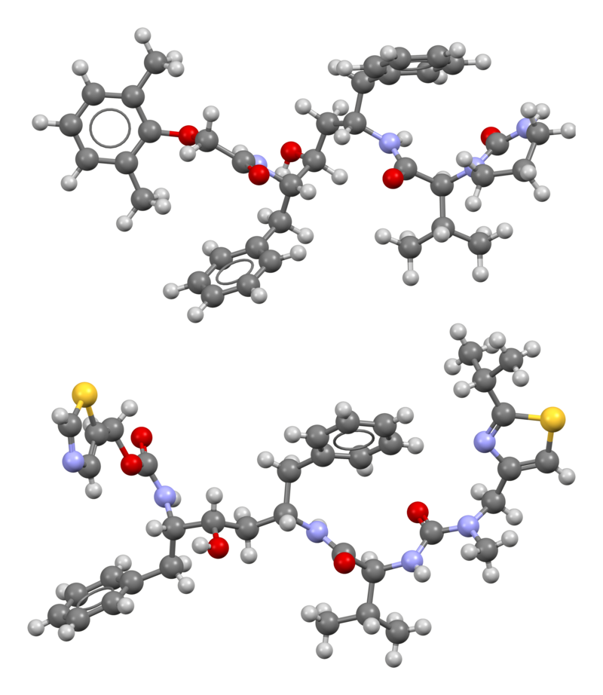
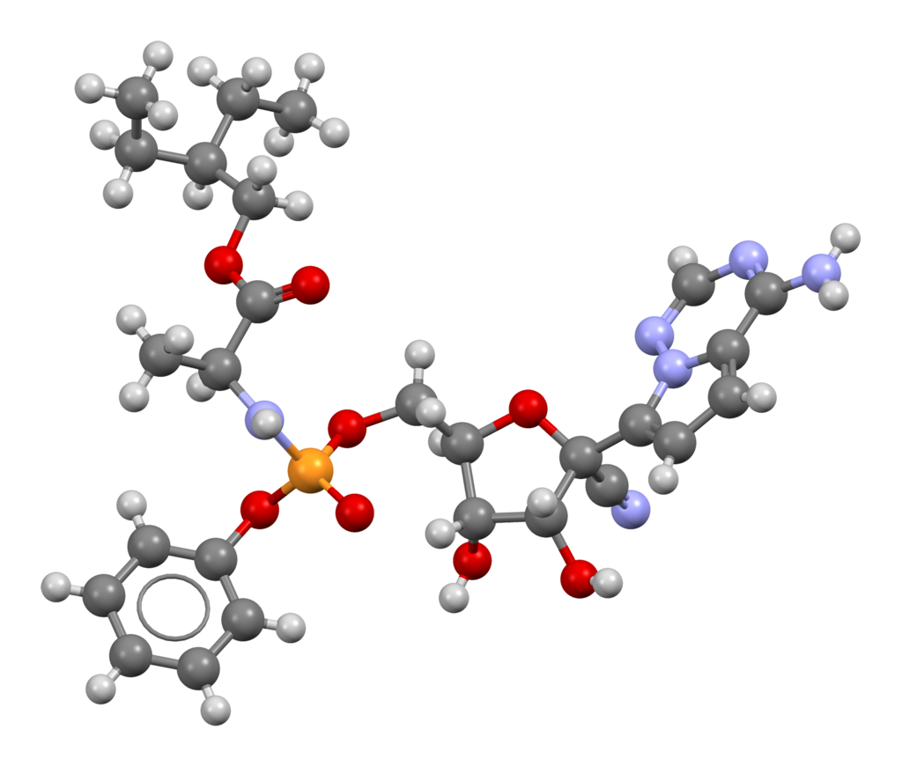
Remesdivir – viral RNA polymerase binding, Hep C Lopinavir, Ritonavir – HIV protease and other inhibitor purposes
These molecules are in search if building residue units are included in construction.

Slide 11
Chromosome
Chromosome is a set of atoms graphically linked together to create molecule
Couple of choices – 1) use atoms, 2) use atoms and n-cyclic rings as basis gene set
Examples are presented
Choice is to use a set of 1-cycle rings and set of atoms in branches and rings.
Trade-off in larger set of possible genes versus complexity in molecular construction, contrasted with using only atoms and not minimal ring set, or a combination.
Avoids complicated IUPAC notation, amenable to SMILES format of linking atoms, fusing rings is simple, and different types crossover of mutation functions are represented from chemical processes (e.g, hydrolysis, ring formation, …)

Slide 12
SMILES based Chromosome
This software uses SMILES based chromosomes.
To illustrate much of complexity, the glycam condensed notation of monosaccharide linked branched oligosaccharides is discussed. Monosaccharide database is also examined briefly.
This example illustrates complexity of SMILES based chromosomes.
Adding branches is not significantly more complex.

Slide 13

Simple but not general Chromosome: set of monosaccharide rings without extended linear chains or fused rings
Glycam: a-D-Glcp-(1-2)-b-D-Fruf or b-D-Fruf-(2-1)-a-D-Glcp
Condensed: DGlcpa1-2DFrufb or DFrufb2-1DGlcpa
e.g., 7 residues + OH
a-D-Manp-(1-2)-a-D-Manp-(1-3)-a-D-Manp-(1-6)-[a-D-Manp-(1-3)]-b-D-Manp-(1-4)-b-D-GlcpNAc-(1-4)-b-D-GlcpNAc-OH
DManpa1-2DManpa1-3DManpa1-6[DManpa1-3]DManpb1-4DGlcpNAcb1-4DGlcpNAcb1-OH

Slide 14
Simplified molecular input line entry system (SMILES)
Very applicable to changing molecular structure, particularly in crossovers and mutations
Very useful for molecular structural relations and substructure searches
General small organic molecules follow
X=C, O, N, S, P, F, Cl, B, Br, I
linear X, X-X, X-X-X, X-X-X-X, X-X-X-X-X, X-X-X-X-X-X
use symbols (,),[,],\,/=,#, @, @@ to create graphical representation, i.e., branches, ring, double and triple bonds, stereoisomers, aromaticity (lower case letters), and integers for ring number
Hexane CCCCCC Cyclohexane [C1CCCCC1] Benzene (aromatic) c1ccccc1
Glucoronic Acid GlcA O=C(O)[C@H]1O[C@H](O)[C@H](O)[C@@H](O)[C@@H]1O
N-Acetylglucosamine GlcNAc O=C(N[C@@H]1[C@@H](O)[C@H](O)[C@H](O[C@H]1O)CO)C
Ibuprofen CC(C)Cc1ccc(cc1)[C@@H](C)C(=O)O
Glucose OC[C@H]1OC(O)[C@H](O)[C@@H](O)[C@@H]1O
Fused example: Morphine (5 rings) CN1CC[C@]23C4=C5C=CC(O)=C4O[C@H]2[C@@H](O)C=C[C@H]3[C@H]1C5

Slide 15
SMILES usage
pdb file translates into SMILES expression, and vice-versa
Graph building from connectivity of atoms (and excited atomic states linking ,e.g., SO3, SO5) is known as well as most general molecular graph having N atoms
Some graphs are not physical due to bond overlap and clashes -> can be checked by using a pdb builder from SMILES expression, most tools have this
Open Babel, OpenMM, SMILES generation
Extensive use of SMILES in databases, and much molecular and chemical information can be queried with SMILES expression, e.g., in PubChem and many other databases

Slide 16
Next 4 slides for additional ‘details’ – not overview
Base residues, branches – search space
Flexibility and conformational aspects and use of software

Slide 17
Base residues - details
Glycans and others are made of linking base residues and branches
Single ring examples:
Abequose (Abe), Allose (All), Galactose (Gal), Galactosamine (GalN), N-Acetylgalactosamine (GalNAc), Neuraminic acid (Neu),
N-Acetylneuraminic acid (Neu5Ac), Fructose (Fru), Fucose (Fuc)
many more
Not standard names:
Neuraminic acid (Neu)>5-Amino-3,5-dideoxy-D-glycero-D-galacto-non-2-ulosonic acid
Cellotriose [beta]-D-Glucopyranosyl-(1[arrow right]4)-[beta]-D-glucopyranosyl-(1[arrow right]4)-D-glucose
many more
Non-ring forms of monosaccharides
Nucleotides (adenine, guanine, cytosine, thymine [uracil]), nucleic acids, and more
Not base residues - Fused rings: double ring -- 5-atom fused w/ 5-atom, 5-6, 6-6 (e.g. adenine, guanine w/ 5-6)

Slide 18
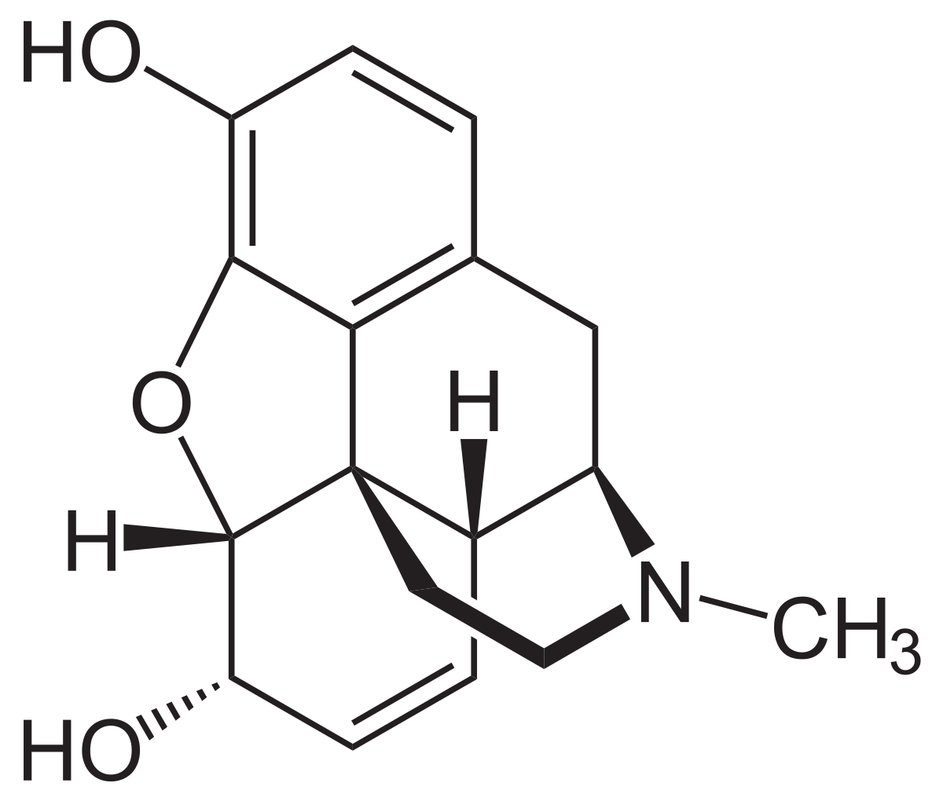
Polycyclicity – from ‘closing branch’, details
Triple fused rings
4 and 5 fused rings: morphine and derivatives have 5 fused rings
Fused rings less common, atypical electronic properties
(examples only of 4 or 5 fused: https://www.researchgate.net/profile/Virender-Singh/publication/320313106/figure/fig1/AS:616349923553298@1523960681812/Selected-examples-of-bioactive-natural-products-and-their-synthetic-derivatives-that_Q320.jpg
Point modifications –, e.g. methyl -> phenyl groups, N<->C
Non-ring branches, e.g. Forosamine
All glycans can be systematically characterized by base residues, extended ‘linear’ additions, point modifications, and linking in SMILES (total number of possible molecular graphs is known in theoretical particle physics)

Slide 19
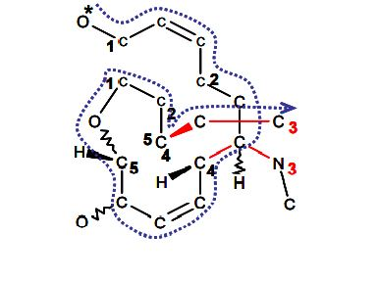
Joining branch example – Morphine
CN1CC[C@]23C4=C5C=CC(O)=C4O[C@H]2[C@@H](O)C=C[C@H]3[C@H]1C5
SMILES graphically
Derivatives of morphine examples – different ring joinings, simple change NCH3 -> CCH2 is 20x more potent
Implemented in GA at single line expression level

Slide 20
Several glycan, ligand databases and tools - details
PubChem: https://pubchem.ncbi.nlm.nih.gov
Glycam: http://www.glycam.org
GlyGen: https://glygen.org
MonosaccharideDB: http://www.monosaccharidedb.org/start.action
Zhang Lab ligand-protein binding databse (~25K): https://zhanglab.ccmb.med.umich.edu/BioLiP/
Bryce Computational Biophysics and Drug Design: http://research.bmh.manchester.ac.uk/bryce
etc…
Amber, OpenMM, Open Babel, …
UPAC

Slide 21
Flexibility and Conformational aspects - details
AutoDock, Vina-Carb, AutoDock Vina
Scans through glycosydic dihedral angles to find geometry of the bound small molecule
Finds possible poses, i.e., epitopes, from given bound state
Can be used in finding binding properties to –user defined local protein regions-
Local regions -> target site specificity
Protein has different states or conformation, each conformation is treated separately in the running of the GA to find conformation specific ligand binders
Population of conformations not generally known but can be used to improve effective action of ligand binding by incorporating conformation dependent binding (i.e. proportions of ligands used to interact with the population proportions of protein states).
This is done with the blocked binding to other protein sites in order to improve ligand effectiveness w/o unwanted biological interactions

Slide 22
Monosaccharide Chromosomal Complexity
N_rt Residue types: monosaccharides (includes L,D isomers and alpha,beta configurations)
generalizable to mammalian and eukaryotic glycans
N_ll Linkage locations: linkage number
complexity of N residues: N_tot ~ N_rt^N N_ll^(N-1)
Grows exponentially in N
Branching also is included – exact count and enumeration is known
Glycam and MonosaccharideDB presented next – residue base set is expandable

Slide 23
Glycam
https://glycam.org
29 residue types
L-, D- isomers
alpha-, beta- configuration
p, f ring
Complexity: N_tot ~ 29^N 8^N 5^(N-1)
roughly 230^N 5^(N-1), less though
Use complete list of possibilities, number
230 residue types, configs, isomers,
linkages - 11, 12, 13, …
21, 22, 23, …
Could use tleap also in constructing glycan.

Slide 24
MonosaccharideDB
Database of monosaccharides (2016):
http://www.monosaccharidedb.org/
N_rt=776
alpha-,beta- , L-,D- , ring types p,f
N = # residues
N_rt=776 : N_tot ~ 1/5 (5 N_rt)^N
Glycan structure | N | number
Monosaccharide | 1 | 776
Di- | 2 | 4E+6
Tri- | 3 | 2E+10
Tetra- | 4 | 8E+13
Penta- | 5 | 4E+17
Hexa- | 6 | 2E+21
Hepta- | 7 | 8E+24
Octa- | 8 | 4E+28

Slide 25
Search space
10^30 is not a large number in search algorithms
Enumeration of individuals is integer based – glycan topology completely integer classified
Geometry of glycan determined by energy minimization and docking through rotating dihedrals
Glycan nomenclature is linear (also in branching) and physically closer to a chromosome in its mutation and crossover in geometry, e.g. linearly correlated in glycan structure <-> chain of words
Search space is much larger than proteins per glycan residue or amino acid (1000 vs 20 each N)

Slide 26
Crossover and Mutation
Fundamental in evolving the population to a local or global minimum
In general GA very many types of crossover and mutation which are chosen effectiveness in particular problem
This GA uses molecular chemical processes as crossover and mutation.
Simplest in Integer GA

Slide 27
Molecular Mutation and Crossover
mutation: add, delete, change - residue or atom
base residue here being single ring with the -OH or -CH2OH branches, typical residues
base rings or cyclo- of carbons and atomic substitutions, commonly one or two of N or S
change linking or orientation of branch to ring
change orientation of double bond twist
close branch segment to add fused ring
break single ring to branch segment
crossover: interchange branch segment of two molecules (2-pt crossover) at non-ring bond
segment could contain (fused) rings
Chemically sensible probabilities to all of these
e.g., rings aren’t known to have only N’s
e.g. Polycyclic fused rings shouldn’t be complicated

Slide 28
Searching with GAs
Crossover and mutation change individuals of a population of glycans
By the mechanism of evolution, the population improves generally towards an optimal ‘fitness’, i.e. the minimum value of the objective function
10^30 is a ‘small’ search space
In GA’s, the mean population fitness decreases exponentially in a few (<10 iterations) and then further calculation is required to obtain minimum – more iterations
There are techniques that can be used to avoid or escape unwanted local minima
Complete record keeping of N_iter * N_pop individuals can be stored for a GA Ouput list of ranked approximate best solutions (i.e. bound glycans)

Slide 29
Constraints on glycans
Restrictions on residue types and linkages
Geometric and chemical (charges, polarity, hydrophobic/philic and hydrogen bond effects) restraints, similarity restraints to analogous ligands
Probability weights can be given to types of residues, e.g., percentage of occurrence of GlcNac in a set of glycans
Probability weights of sub-sequences of residues can be used
Same for linkage type (alpha,beta) and linking number
Replacement of atoms with other non-organic or other organic elements
Almost anything can be included, and is user specified, especially in binding properties
NOTE: Constraint can be included in the objective function or as explicit constraints in the GA

Slide 30
Docking Software and Binding
AutoDock
AutoDock Vina
Vina Carb
Calculate binding properties to protein
Binding energy, probability of disassociation, protein-ligand potential well structure, …
Output is used in objective function
200*50 = 10000 calculations
parallel, serial
wanted: accuracy and precision < 1 kCal

Slide 31
Specificity Issue
There are proteins and sites that glycan is chosen preferably not to bind to
Docking is used for each of these proteins to prohibit interaction by binding information, giving target specificity
Output is used in the objective function
Constraints, or rather objective penalties, can be used in GA search
(Technical – constraint violations in evolutionary search are necessary to search disconnected regions in high-dimensional search space)

Slide 32
Objective function
Naively, just binding energy
Pose selection
Glycan substructure aspects
Types of residues or subsequences, branches
Structural and chemical constraints, e.g., geometric, charge, hydrophobic/philic, bond effects, due to site or other
Any information from output of docking software
Penalties

Slide 33
Genetic algorithm – Setup, Initialization, Iterations, End
Flow of the algorithm is presented in next 3 slides
This is the conventional GA
Sophisticated GAs use modifications to ensure population diversity
avoid or enhance convergence to global minimum
recursive forward use of iteration information
Genetic algorithms are a very active area in computer science and in applications in large scale computing

Slide 34

FLOW - Setup
Initial
GA Parameters
Docking Parameters
Protein
Penalized Proteins
Initial Glycans
Glycan Restrictions
Site Restrictions
Start
Initialization

Slide 35
Flow: Initialization – Iteration 0
Initial Fitnesses
AutoDock Chromosomes
AutoDock Parameters
Site Specific Parameters
Calculate Fitnesses
Initialize Population
(Type of Populatoin)
Iterations
Store Population Docking Results
User Specified Population

Slide 36


Flow: Iterations
End
Crossover
Mutation
Default
User Specified
Complicated
(see notes)
Yes
No
Sort Chrom.
Stopping Criteria Met?
Store Population Info
Optional:
Process Population
Store Docking Info
Dock
Calculate Ftinesses

Slide 37
Flow: End GA
Sort
Post Process
Summary of Results
End

Slide 38
GA output
List of ‘top’ binding small molecules given set of target and blocked protein(s) – this is many body
Topology of molecules and geometry of bound configuration
Found from specified goodness of binding, naively best energy
List can be used for recognition of important sub-structures of molecule in given protein problem
GA can be used in refinement of known small molecules by initializing population with these, i.e. small adjustment to better binding properties or add constraints

Slide 39
Summary
Description of algorithm
Primary points
Small molecule (e.g., glycan) construction with atoms, branches, and linkages
Basic crossover and mutation operations, objective function
Docking software
SMILES representation and use in genetic algorithm chromosome
Genetic Algorithm explained
Computationally feasible in CPUs or GPUs (available in AD, Vina Carb, or ADVina for docking)
Initial project is coded.
Next – test on well-known small molecule drugs.

