Slide 1
Chemical shift prediction software – carbohydrates/proteins
Gordon Chalmers
Department of Computer Science
Complex Carbohydrate Research Center

Slide 2
outline
The information in this talk will be of practical use for interpreting nmr spectra.
Chemical shifts
Chemical shift prediction software
How these are calculated
Advantages/disadvantages
Goal : should be able to use software to predict chemical shifts for both carbohydrates and proteins

Slide 3
Chemical shift predictions
Important for interpreting spectra
Used to make spectra
Difficult to calculate for certain types of molecules – especially proteins

Slide 4
Defn of chemical shift
In nuclear magnetic resonance (NMR) spectroscopy, the chemical shift is the resonant frequency of a nucleus relative to a standard in a magnetic field. Often the position and number of chemical shifts are diagnostic of the structure of a molecule.^{[1][2][3]} Chemical shifts are also used to describe signals in other forms of spectroscopy such as photoemission spectroscopy.

Slide 5
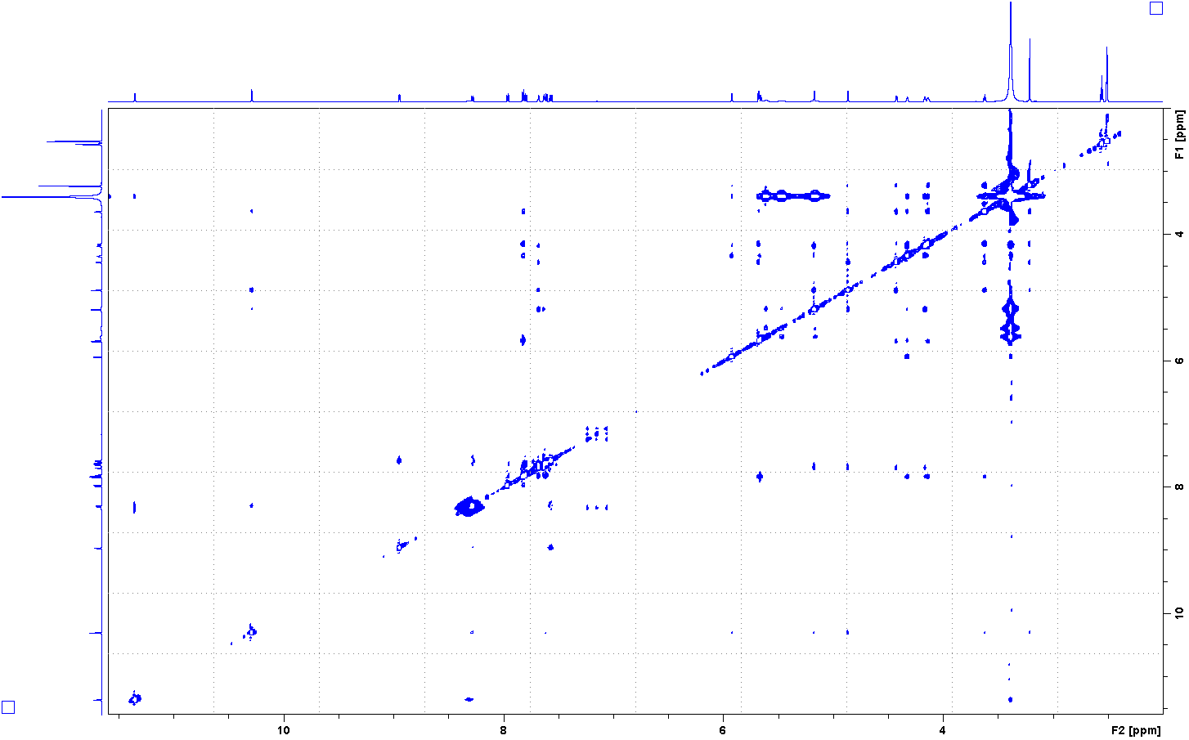
spectrum

Slide 6
Example chemical shifts
Amide protons of proteins 7-9 ppm
Methyl protons of proteins -2 – 2 ppm
Sidechain protons 4-6 ppm - messy
Nitrogens approx. 120 ppm

Slide 7
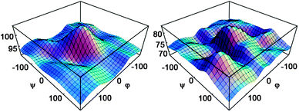
Fig. 8 13C NMR chemical shift surfaces for two transglycosidic carbons of α-(1–4)-linked D-Glcp disaccharides, as a function of the glycosidic bond dihedrals151 (reproduced with permission, © Elsevier Ltd., 2005).
Sergeyev and Moyna, Carb.Res. 2005 - “...ab initio chemical shift surfaces”
Chemical shifts can be complicated

Slide 8
Software packages
Carbohydrates - Casper, RU-Glycoscience
Proteins – ShiftX2, ShiftY, PPM, PPM1

Slide 9
comment
The prediction software uses databases of known chemical shift assignments.
This can work well for carbohydrates. Carbohydrate chemical shifts are found from monomers (0th), disaccharides (1st), trisaccharides (2nd). The chemical shifts are very correlated with sugar type and linkages
Not well for proteins. Too much variation in the sidechain protons, for example. Through space interactions are important for protein chemical shift calculations, unlike carbohydrates.

Slide 10
Before carbohydrate chemical shift software
Carbon chemical shifts of carbohydrates can be almost predicted based on linkage analysis.
This was done before chemical shift prediction software.

Slide 11
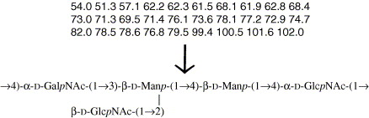
1st Package - Casper
http://www.casper.organ.su.se/casper/
Structure Analysis of Glycans by NMR Chemical Shift Prediction M. Lundborg and G. Widmalm; Anal. Chem. 2011, 83, 1514-1517. Doi: 10.1021/ac1032534.
http://www.sciencedirect.com/science/article/pii/S0008621506000942?via%3Dihub
Input observed carbon chemical shifts
Output possible structure

Slide 12
2 examples
Input structure – calculate chemical shifts
Input chemical shifts and some information of the sugars – output best match in structure
Internet interface is useful
Can also be used without internet

Slide 13
How casper calculates
Starts with monomers from a database of chemical shifts
Corrects these chemical shifts by including linkages of the sugars using a database of disaccharide chemical shifts
If possible, corrects again using a database of trisaccharide chemical shifts
The database includes approximately 40 carefully selected disaccharides and hundreds of monosaccharides in D20

Slide 14
Protein chemical shifts
Two well used packages –
ShiftX2 - http://www.shiftx2.ca/
PPM/PPM1 - http://spin.ccic.ohio-state.edu/index.php/ppm
Both use databases of known chemical shifts. Proteins from the BMRB database are selected and used to create algorithms to generate chemical shifts.
Neural networks are used in ppm1

Slide 15
Shiftx2, ppm1
Examples
Both use a pdb file
ShiftX2, PPM – single frame
PPM1 - trajectory

Slide 16
Ingredients in predictions
Table 5
Relative (%) influence of the top 20 features or atomic property descriptors for the SHIFTX+ prediction module
The subscripts i−1, i and i+1 indicate the preceding, current and following residue (AA amino acid type, SS secondary structure)
Feature | ¹³C′ | ¹³Cα | ¹³Cβ | ¹HN | ¹Hα | ¹⁵N
R. coil shift | 22.5 | 50.0 | 58.5 | 3.0 | 21.3 | 35.9
AA_{i} | 0.6 | 11.6 | 15.4 | 0.5 | 0.8 | 3.4
AA_{i−1} | 0.4 | 0.1 | 0.1 | 0.4 | 0.2 | 2.9
AA_{i+1} | 2.3 | 1.0 | 0.3 | 0.3 | 0.7 | 0.3
φ_{i} | 5.8 | 11.0 | 8.1 | 4.4 | 29.9 | 4.5
φ_{i-1} | 0.6 | 0.4 | 0.3 | 2.1 | 1.0 | 2.1
φ_{i+1} | 3.6 | 1.1 | 0.6 | 0.9 | 1.3 | 0.9
ψ_{i} | 13.9 | 10.4 | 5.7 | 5.3 | 3.8 | 7.1
ψ_{i−1} | 1.4 | 0.3 | 0.2 | 15.3 | 0.4 | 18.7
ψ_{i+1} | 8.6 | 0.9 | 0.3 | 0.6 | 0.6 | 0.5
ψ_{i−2} | 0.4 | 0.2 | 0.2 | 5.9 | 0.4 | 0.5
χ_{1i} | 4.1 | 2.6 | 1.3 | 0.8 | 1.3 | 5.9
χ_{2i} | 3.1 | 2.2 | 1.4 | 0.5 | 0.4 | 1.6
θ_{i} | 2.3 | 0.6 | 0.3 | 5.3 | 0.8 | 0.5
κ_{i} | 2.5 | 0.3 | 0.2 | 3.1 | 0.4 | 0.4
SS_{i} | 8.1 | 0.1 | 0.1 | 0.1 | 0.6 | 0.0
Electric field | 0.0 | 0.3 | 0.0 | 2.7 | 12.9 | 0.0
Ring current | 0.0 | 0.5 | 0.9 | 11.5 | 11.2 | 0.6
Surface area | 4.2 | 0.3 | 0.2 | 1.2 | 0.6 | 0.5
Hbond effect | 0.0 | 0.0 | 0.0 | 18.4 | 0.3 | 0.0
This model uses linkages.
Unlike carbohydrates, this is not sufficient to model the database of protein pdbs.

Slide 17
Accuracy of predictions
The accuracy of protein chemical shift predictions is arguable.
Errors of predictions are underestimated.
Correlation coefficients 0.9800 (15N), 0.9959 (13CA), 0.9992 (13CB), 0.9676 (13CO), 0.9714 (1HN), 0.9744 (1HA)
RMS errors of 1.1169, 0.4412, 0.5163, 0.5330, 0.1711, and 0.1231 ppm,
The predictions do not accurately model the statistical distributions of the protein data bank.

Slide 18
Shiftx2 Problem PPM1 advantage
Uses a ‘corrected’ re-referenced database to create chemical shift prediction models.
Side chain atoms are a problem for both packages.
PPM1 can use the trajectory, unlike ShiftX2

Slide 19
The accuracy of software
Selected proteins from the databank are used in estimating how good the predictions are.
The selection is not representative of the databank of deposited structures, unfortunately.
Experience with the predictions shows that much work needs to be done for protein chemical shift predictions.

Slide 20
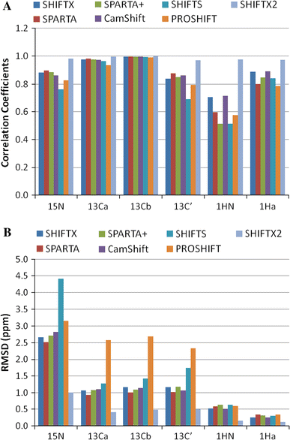
RMSD’s between exp and calculated for backbone atoms

Slide 21
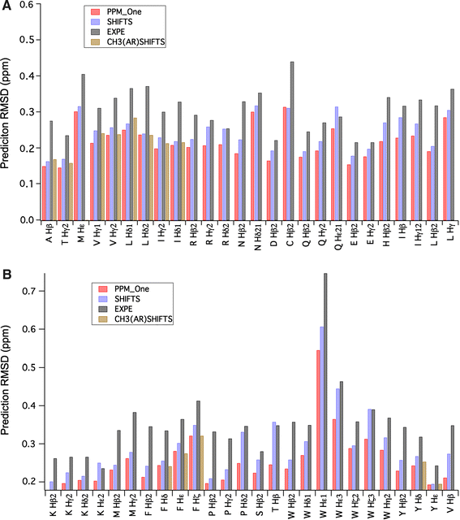
Sidechain Atom RMSD’s

Slide 22
Chemical shift software
Much work has been done in developing chemical shift prediction software.
The protein databank has tighter restrictions in depositing information now, which should improve protein chemical shift prediction software.
Trajectory calculations have been shown in st6 calculations to give better chemical shift predictions than from a pdb file.

Slide 23
comment
Chemical shift predictions are accurate for carbohydrates
Through bond calculations for carbohydrates
Not so accurate for proteins, especially large proteins. Work has to be done to improve these calculations.
Through space calculations for proteins.

Slide 24
conclusions
2 packages are described
Casper, RU-Glycoscience,
Shiftx2, PPM/PPM1
Much information has not been given about how these predictions were created. Technical for proteins.
These predictions can be used in spectrum prediction programs and peak assignment programs.

