Slide 1
Molecular Modeling in Drug Discovery
Gordon Chalmers
Complex Carbohydrate Research Center, UGA
5/10/22 Prepared for …

Slide 2
Goal of modeling in drug discovery
Find small molecules that inhibit protein function
ligand structure, ADME, specificity, geometric aspects, polar/non-polar, substructure and groups, …
interaction is important, and chemistry. inhibition of biochemical function is at amino acid scale
e.g., Aspirin on COX-2 requires acetylation, positional placement of oxygens is relevant pre-covalent reaction
SARS-Cov-2 inhibition requires strong CYS 145, HIS bonding
Computational drug discovery and design can require:
Screening for binding and also toxicity, effectivity, synthesis
Tuning, modification to specific protein target
through modeling and computation.
Easy to find rough fits, hard to find those with site specificity which satisfy constraints.
Searches very large space of possible candidates and returns a list
Uses state-of-the-art in modeling interaction and physically real sets of interactions, e.g., force fields at
atomic scale
Bottleneck in molecular design now is in accessing the total search space, not in accuracy of models or conformational sampling. ML/AI techniques

Slide 3
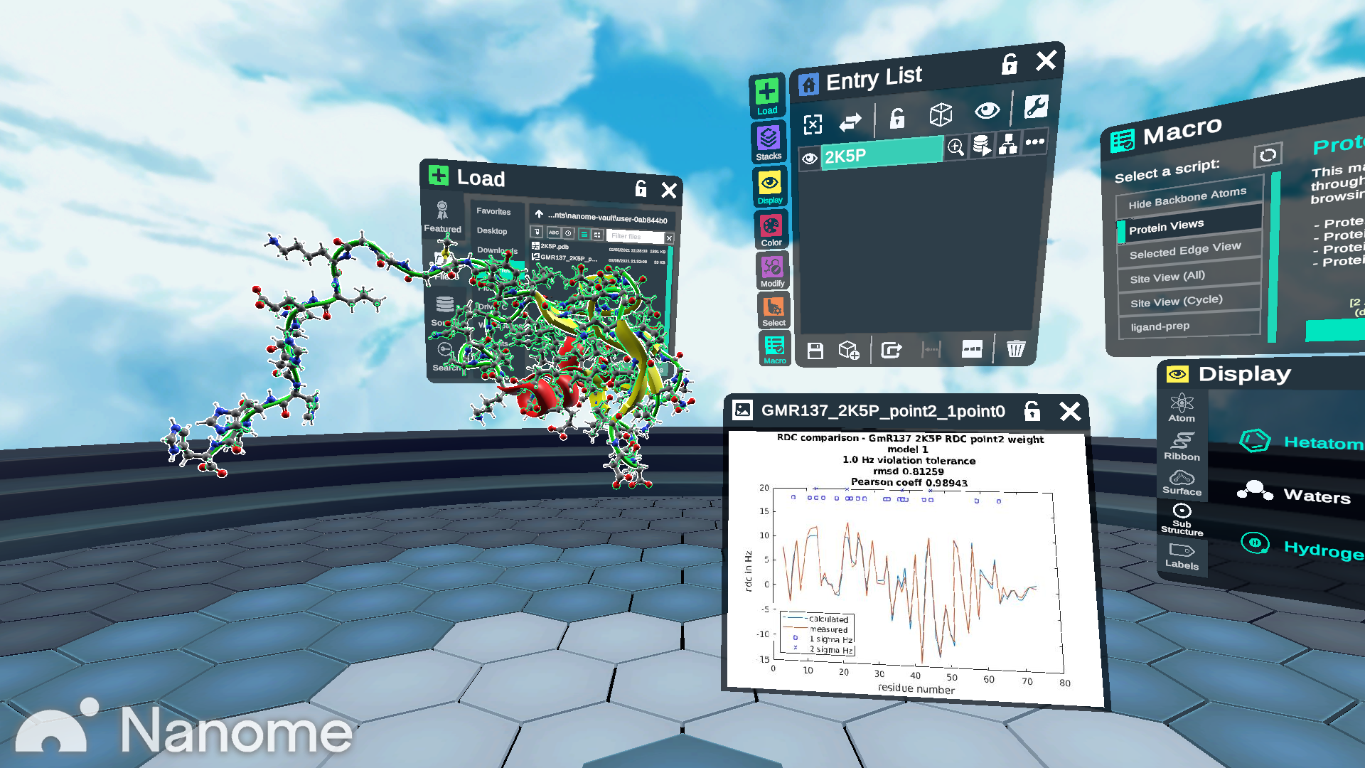
Computational tools in molecular modeling
pdb/mol2 file generation, SMILES
Data analysis, NMR/X-ray
Amber, Gromacs
Structure validation, various, PSVS
Dynamics MD tools
Cpptraj
Biochemical activity tools, various, SwissADME
ML tools
PubChem, Zinc, …
Visualization 2d, 3d
Database searching
Collection of useful tools
PDB, ePDB, CCDC
Synthesis tools, various, MLDPS
Programming Matlab, python, C++, bash
Docking GOLD, Maestro, AutoDock
Protein Structure Cyana, Rosetta, Phenix, AlphaFold, ConSurf

Slide 4
Other practical modeling purposes
Good modeling analysis can eliminate unnecessary lab work
modeling eliminates molecules to examine
can also screen individual small molecules against large set of proteins
(~20000 in the body) for toxicity and unwanted interactions
test computationally for activity or also practical synthesis route capability
set of state-of-art computational molecular tools is growing and evolving
Resources improving, e.g., only in past 10 yrs have GPUs been the standard for MD
Finding small molecules is a min/max problem with a complicated but usable objective function and chemical constraints.

Slide 5
Small Molecule Drug Space
ideal
total space
Large, but not that large
50 heavy atoms, N~10^50 100 heavy atoms, N~10^80
10^100 is not enormous computationally
Biggest database EC4 Consortium 10^13 (2 M screened per sec for various properties)
Zinc 165M purchasable molecules (COX-2 screened in 30 hours with Cluster GOLD),
PubChem 1G, CCDC 1M (X-ray)
Drawback of screening and repurposing is in lack of diversity and specificity in results
Advantage is from prior molecular studies, FDA regulated, and lab work/synthesis/testing
Curated smaller databases of molecules help in reducing size of search and in finding better results

Slide 6
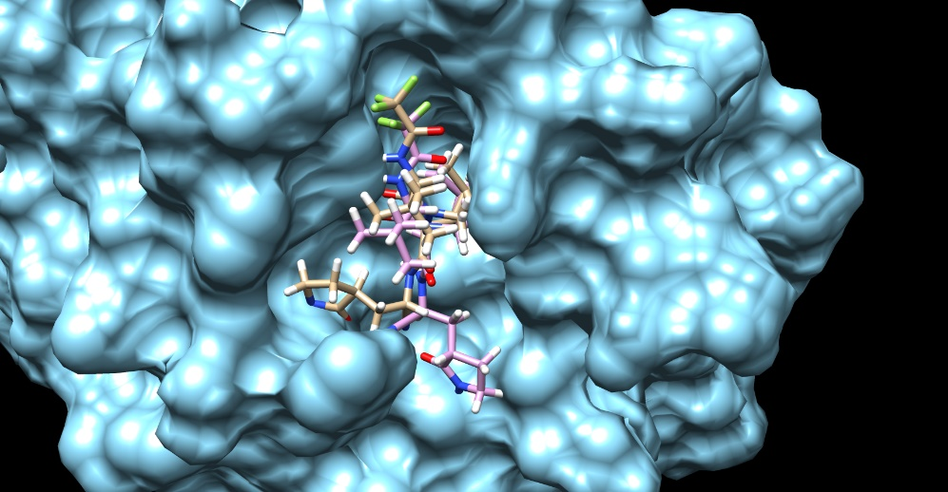
Quantify protein-ligand interaction
Docking: CCDC Gold, Cluster Gold, Maestro, open source
Purpose: Use molecular models in search of realistic conformation and binding, quantified
Tested by x-ray crystallography, NMR
Molecular dynamics, MMGBSA
Ingredients
Atomic, Atom-Solvent
Model parameters from database and
quantum orbital calculations
Efficient for large scale, but reasonable
Want more accurate ->
then more computation
Constraints, Substructure
Non-covalent, Covalent
2 ligand conformations, ~same score

Slide 7
Computational quantifiers of drug effectiveness
Many types, heuristics, and uses – wrong to think of one score as defining good binding
Includes Interactions and Biochemical activity
Interaction score – overall protein-ligand int Score per atom -- specificity
Necessary for non-covalent binding ~1 to 1.5 common natural
13 types in GOLD, different reasons ~2 typical pharmaceutical
PLP most reliable and widely applicable ~2.4 high and specific
roughly energy 3.2 is highest encountered
interatomic and solvent
cavity sub-region characteristic (individual amino acids)
ADME Desired Chemical Multiple Proteins/Enzymes, Toxicity, Specificity
Lipinski’s Rule of 5 Hbonds High interaction to target, low to others
other variants Functional groups Many possible unwanted mol interactions
Synthesis
stereocenter restriction, other
All currently implemented in work

Slide 8
Types of local interactions
Van der waals
Solvent, hydro- phobic/philic, water surface
Hydrogen bond networks or bonds
Electrostatics, charges and partial charges
Torsion angles, entropy of rotation
Quantum orbital effects (above), pi interaction, ring stacking, …
Force fields and computationally efficient models are used to model interactions and quantify, from single frame docking to dynamics in molecule trajectories
Importance of each type is protein and cavity specific, and inhibition problem dependent.

Slide 9
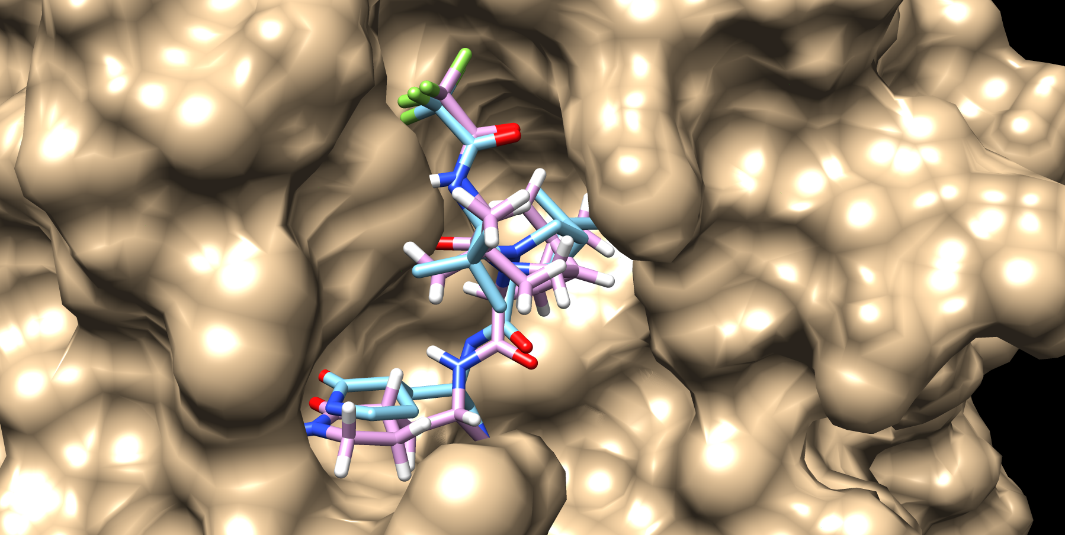
Example of an X-ray and modeled structure
Point: docking is generally ok, this is an overlay, RMSD comparable to x-ray
7SI9 x-ray, 2.7 A res
Lowest energy ligand conformation
Can be used to explore different protein conformational data (NMR)
and small molecule design

Slide 10
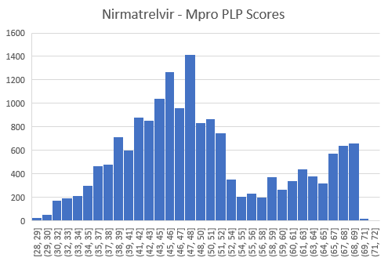
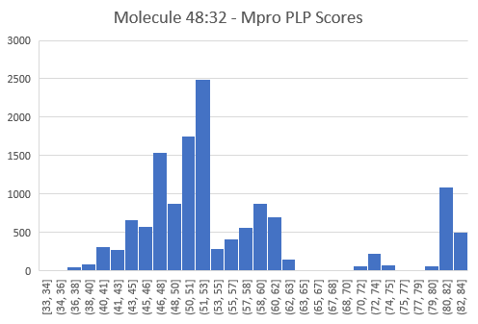
Non-covalent binding modes, specificity
Can characterize ligand conformations in cavity and discrete modes of non-covalent binding
Analogous to density of states and modeling of thermal binding, flexibility
More specific – bumps at 73, 81 are
disconnected and different conformations
gap
Distributions show not only energy but possible probabilities of binding and dynamics to the bound state. Can also show false positives, e.g., isolated conformation with high score
This is an efficient mimicking of an MD trajectory and sampling of dynamic ligand epitopes.

Slide 11
Molecular dynamics, non-static, tools
Molecular dynamics used to simulate bound ligand stability and time-scale of on/off
Calculate more in-depth the solvent interactions and effects, MMGBSA, etc…
Secondary to docking, computationally expensive
Conformational changes of protein/enzyme due to small molecule, i.e., less rigidity in protein structure even if amino acid side-chain rotations previously included
Conformational sampling of target -- drug interactions are conformation specific
there can be small molecular inhibitors that are only effective for a single protein conformation
in the population of conformations

Slide 12
Molecular Design: Ligand Multi-Protein GA
Uses an evolutionary algorithm, genetic algorithm, to find highly interacting molecules to protein cavities
Problem is to optimize or maximize/minimize a coupled set of functions together with constraints
Mimics the process of screening or molecule optimization with constraints, without database
Special GA was written for molecular modifications to find inhibitors
13 mutation functions ADME requirements
1 crossover functions Molecule localization in cavity Substructure constraints
Multi-Fitness Covalent bonding
Molecule constraints Multiple proteins Localization constraints
Protein interaction constraints Multiple scoring functions Pseudo-atom inclusion
Increasing search or adding constraints is simple, but computational efficiency is always a concern
crossover
Mutation + Crossover is Evolution
of population - the initial molecules
mutate
Mol 1 lhs
Mol 1 rhs
Initial mol
Final mol
Mol 1 lhs
Mol 2 rhs
Mol 2 lhs
Mol 2 rhs

Slide 13
Genetic algorithms in machine learning
2nd PhD is on this topic
Computational problems can be hard and complex
Although formally solvable, not in practice
Genetic algorithms are one of many optimization algorithms used to solve or approximately solve these types of problems
Large active area in computer science, alongside neural networks/AI techniques
In molecular design and drug discovery, Ligand GA is used by starting with user defined initial population and creates ‘hit’ or ‘hit-to-lead’ small molecules or fragments
Unlike other approaches, no databases of molecules or fragments are required, but optional

Slide 14
Example use: Show complexes interactively in Chimera
Single fitness, include ADME : molecular modification
SARS-Cov-2 Mpro x1/100 in IC50
Multi-Protein, ADME : multi-protein molecular optimization
Mpro and CYP 3A4 x1/1000 and x10
2 Fitnesses 1 Protein, add fragment, ADME : fragment addition
Haemagglutinin NSiaGal x1/5000
These are examples, simple modifications
of molecules is suitable
If time and interest:
glycopeptide enrichment bead molecule construction
COX-2 Aspirin’, Celecoxib’, Ibuprofen’
Information in output GOLD docking files:
Overall ligand scores, by interaction type
Atomic scores, can be used in guiding alg
Active residues in cavity
Scores broken down by interaction type
Rotated amino side chains

Slide 15
SARS-Cov-2 Main Protease – inhibit viral replication
Ligand GA Molecule 48:32
Nirmatrelvir (repurposed from 2003)
 | Nirmatrelvir | Molecule 48:32
Mpro | 70.68 | 82.61
CYP 3A4 | 84.44 | 86.55
Difference | 13.76 | 3.94
PLP score/atom is 2.02, average in pharma
6.5 PLP score difference
1 kCal, x1/10 in IC50
PLP score/atom is 2.95
Very high, x1/100 than Nirma
Fewer atoms, much better
total score
Mass (Da) | Heavy atoms | Rotat. Bds | Hbond-don | Hbond-acc
354 | 28 | 6 | 2 | 6
Mass (Da) | Heavy atoms | Rotat. bds | Hbond-don | Hbond-acc
499 | 35 | 9 | 3 | 9

Slide 16
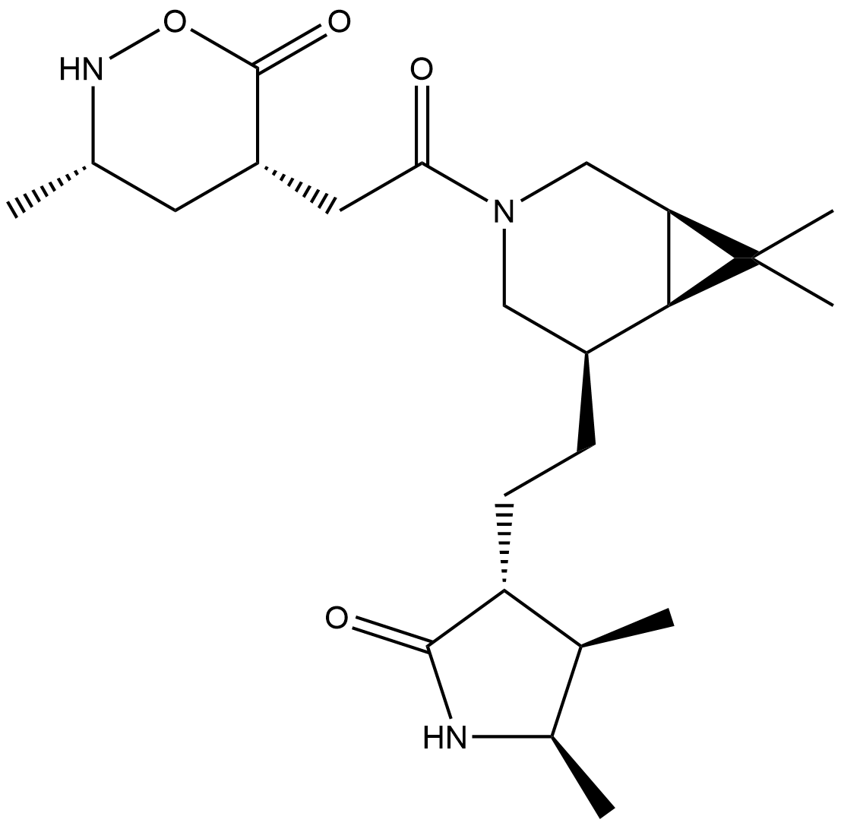
Ligand Multi-Protein GA Mpro Molecule 8:25
 | Nirmatrelvir | Molecule 8:25
Mpro | 70.68 (69) | 89.04
CYP 3A4 | 84.44 | 79.29
Difference | 13.76 | -9.75
Much reduced interaction with CYP 3A4
binds in a perpendicular to heme iron planar network
30 atoms, not 28 and not 35
PLP score/atom is 3.0, very high, x1/1000
CYP 3A4 interaction decreased by x10
explanation is in binding pose from large number, 5000,
docks
class of these molecules and SARS-Cov-2 Mpro
Used Ligand Multi-Protein GA
design towards high interaction Mpro
low interaction CYP 3A4
Mass (Da) | Heavy atoms | Rotat. Bds | Hbond-don | Hbond-acc
382 | 30 | 6 | 2 | 7

Slide 17
Ligand GA 2Fitness Hemagglutinin fragment design - inhibit viral entry into cell using natural anchor
12 atoms, adds 3.7 kCal
x1/5000 to IC50 molarity
With Nsialic acid and/or further Galp
Fragment attached to N5 of NSia
Gal
Used 2 scores in multiGA, total and total/atom for specificity (recent version of design tool)
hydrophobic environment of fragment
2.4 PLP/atom, high and specific
Could reduce by chopping Gal or reducing, ADME is different for sugars
NSia
Attach to naturally occurring NSiaGal (2->6 linked)

Slide 18
Parameters
Defaulted
Used to guide algorithm to results
Ligand GA is very flexible in constraints in
molecular design and in including db info
Tool improved after multiple iterations
Changing parameters can be used to focus towards types of molecules or optimize in small changes
Many, but simple to use
Ligand GA molecular parameters
Ligand GA genetic algorithm parameters
CCDC GOLD parameters
MN+AM Corina Classic parameters
Ligand GA file input/output parameters
Ligand and Protein-ligand constraints

Slide 19
Practical use
Input: initial starting point (set of molecules or guesses, e.g., from screening)
protein .mol2 file(s)
Ligand Multi-Protein GA configuration file (parameters)
Output: sets of high interacting and specific molecules, satisfying user molecular
constraints/requirements
Current version is Ligand Multi-Protein GA (multiple proteins and fitnesses, with constraints)
Use in starting, stopping, starting, stopping, …, to explore solutions and improve solutions
Ligand Multi-Protein GA
multiple proteins with weights and score, score per atom with multiple-proteins
option of covalent binding, fixed substructure, or positional constraints
Either whole molecule design (hit) or small modifications of near goal molecules (hit-to-lead optimization)

Slide 20
Drug discovery and molecular modeling
Exciting area given developments and advances in computational molecular modeling
Both in types and number of tools, and quality of these
Computing requirements have greatly decreased due to improvements in resources
Databases have expanded, increased in number, and more accessible
Contributed a potent molecular design tool for therapeutics, Ligand Multi-Protein GA
Clear that computational work in modern drug design is very important and practical to
implement both in discovery and refining lab work/guidance

Slide 22
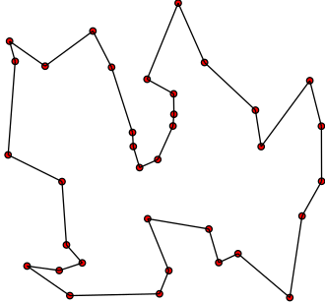
Classic example: Traveling Salesman Problem Optional
Given distances of N places, what is the shortest closed path such that each is arrived at once?
Complexity is naviely N! (exponential N!~N^N)
Prototype problem to benchmark new algorithms for computationally hard problems
1,904,711 inhabited places including research bases in Antartica – 2021 7,515,755,956 meters K. Helsgaun
Complexity: 1 with 12 million zeros
Found with a sophisticated GA and this record improved by 7604 m from 2011
Problem of determining ideal small molecule inhibitors has this complexity

Slide 23
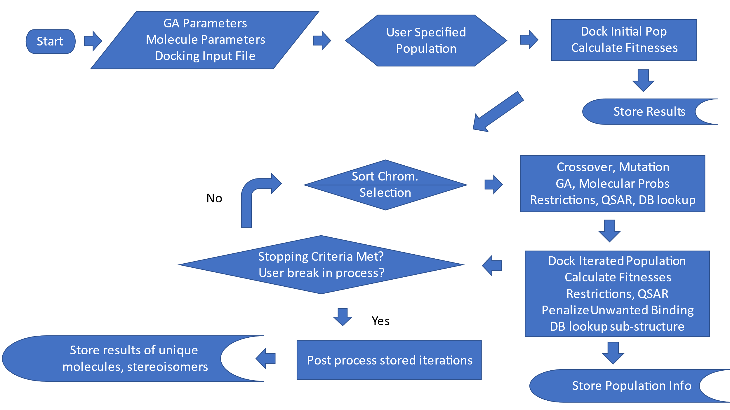
Ligand GA Flow Very Optional

