Slide 1
Continuous Integration and Database change management made possible
Tony Wilsman
Notes:
Good morning.
My name is Tony Wilsman.

Slide 2

We process medical discharge records to prevent readmission
Ingest ~100K records per day
We schedule and receive the results of 8 - 10k automated phone calls and emails every day
3 Web portals
3 Web services
9 Windows Services
4 MSSQL Databases
Notes:
What is Connect?
Connect is a joint venture between National Research Corporation and Nebraska Global.
The real product is reporting, and therefore, our database.

Slide 3

Planning
Adoption of best practices, principles and patterns
Well designed architectures that allow for…
Building complex software systems
Teams of individuals working on the system
Evolving / changing requirements
Ease of extensibility / maintainability
Containing volatility
Agile Processes
Allows for iterative design and emerging requirements
Implementation
Unit test coverage / “Test-driven” development
Ownership of quality at the developer
Notes:
At Nebraska Global, we write software following a set of core values.
TEAMS OF INDIVIDUALS WORKING SIMULTANEOUSLY
Prevents dependency on other devs
Allows isolation for testing/debugging
Gives dev flexibility / mobility
Allows devs to be stupid, in a good way

Slide 4
Becoming the “Build Master”
< Self-indulgent story goes here >
Hourly automated builds
Run full unit test suite
Automatically deploy to Dev
I’m basically awesome
Except…
Notes:
Tell the “story” of setting up CI/AD
One of my first tasks was to set up CI/AD
Two to Three iterations.
Set up all the build steps. Automated Builds.
Run All unit test.
Set up the full Dev/QA environments
I was feeling pretty great

Slide 5

Notes:
We were still performing database changes manually.
Developers work on their own story/features.
These features almost always require database changes.
Database scripts get written, applied locally, then dropped in a network folder.
Dev build breaks because unit tests require database changes. Those are applied manually to dev.
Another dev pulls from master, and their unit tests break, because they didn’t know which scripts to apply manually.
QA breaks eventually for the same reasons.
Stage breaks.
Going to production is terrifying.

Slide 6
Options
VisualStudio DB Project
Great for schema/data changes
Not-ideal for administrative tasks
Schema Comparison (Redgate)
Great for comparing two database instances
Not great for managing 10 databases in different states
T-SQL script-based migrations
Existing team expertise
Right tool for the job
Notes:
We have some obvious needs and problems. The next logical step was to automate this part of the process.
We looked at existing options
VS DB Project
Schema comparison works between two databases, but how to we reconcile changes from multiple devs, working on multiple branches, with multiple DB states. We could do this manually, but we want automation.
SQL server runs on TSQL scripts. That’s what they were made for.

Slide 7
Inspirations
Alex Papadimoulis – Indeo, thedailywtf.com - Database Changes Done Right http://thedailywtf.com/Articles/Database-Changes-Done-Right.aspx
Script-based changes
Track changes
Script may only run once!
Martin Fowler – Author of Refactoring http://martinfowler.com/articles/evodb.html
Local developer instances
Automated updates
Beehive Industries
KADS
Full application deployment to any given version
Local developer instances
Notes:
Coincidentally, I had been reading the daily WTF Prior to this project.
Script-base changes give control, granularity, source control.
LOCAL INSTANCES

Slide 8
Criteria / Requirements
Work with source control
DB scripts need to be unattended / automatable
Update software needs to integrate with our CI/AD software
The solution needs to support our values:
Multiple devs working on the system simultaneously
Local dev instances of the application
Notes:
We have a clear set of values, we have clear process for how we want to build this product. We had some strong inspirations and inclinations as to how we wanted to go about this.
This lead us to a fairly clear set of criteria for the tool we needed.

Slide 9
FAUST
Fully Automated Update SQL Tool
Notes:
We had some meetings, and we “created” this high-level approach:
Script-based changes.
We would track the changes that have been applied to each database.
Scripts would be tracked in source control.
The library of scripts would allow us to “FAUST” a given database and bring it up to date.
Now, I say we “created” this approach. However, we “created” this in the same way Columbus “Discovered” America.
This is a known approach to database management known as “transformation-based updates”. It was new to us, and it’s new to a lot of people I’ve talked to.

Slide 10
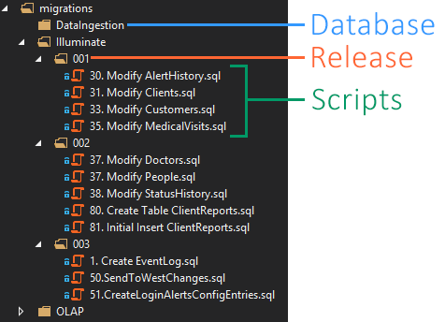
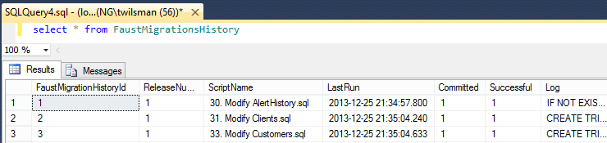
Notes:
If it doesn’t exist, Faust creates the “FaustMigrationsHistory” table.
For each Release folder, run each .sql file.
If that file has been committed, skip it. If not, try to run it.
If there is an error, Faust rolls back the transaction for the whole release. It is possible for a script to have run successfully, but not been committed due to a transaction roll back.
LastRun, and Log are mostly for debugging/troubleshooting.

Slide 11
Visual Studio Time
Notes:
Traverse the migrations directory
Check each script against the history table
If a script is committed, ignore it
If there is an error, roll back the transaction
No transaction mode
Debug mode – Explain on Slide 12
Faust engine calls are just wrapping up certain operations

Slide 12
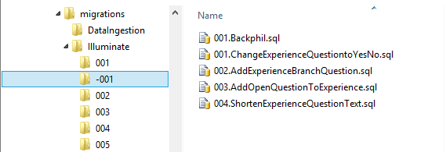
<appSettings>
<add key="Illuminate" value="IlluminateDB" />
<add key="OLAP" value="OLAPDB" />
<add key="DataIngestion" value="DataIngestion" />
<add key="DefaultDatabase" value="Illuminate" />
<add key="MigrationsDirectory" value="migrations\" />
<add key="RunDebugMigrations" value=“true" />
</appSettings>
Notes:
Default Database is allows us to specify the connection string we want to use. This is extremely useful for just F5ing Faust from inside VS.
Explain RunDebugMigrations.

Slide 13
Benefits
500 + migrations tracked
Our Previous release - 3.6 – we performed 112 builds in 3 weeks
We now say things like:
“It’s just a backfill script.”
“We just need to add a few columns.”
“Just drop the table and rebuild it.”
Notes:
We can say these things because we know that all of our changes will be tested 100+ in 4 different environments.
We also know they’ll run automatically. Once they’re committed, they’re going to run.

Slide 14
Next Steps
Mixed DLL and TSQL-base Transformations
Remove Database-level separation
Separate, configurable loggers for Teamcity and Octopus deploy

Slide 15
The code is boring, but…
Github.com/twilsman/FAUST
.DLL project
.EXE project

