Slide 1
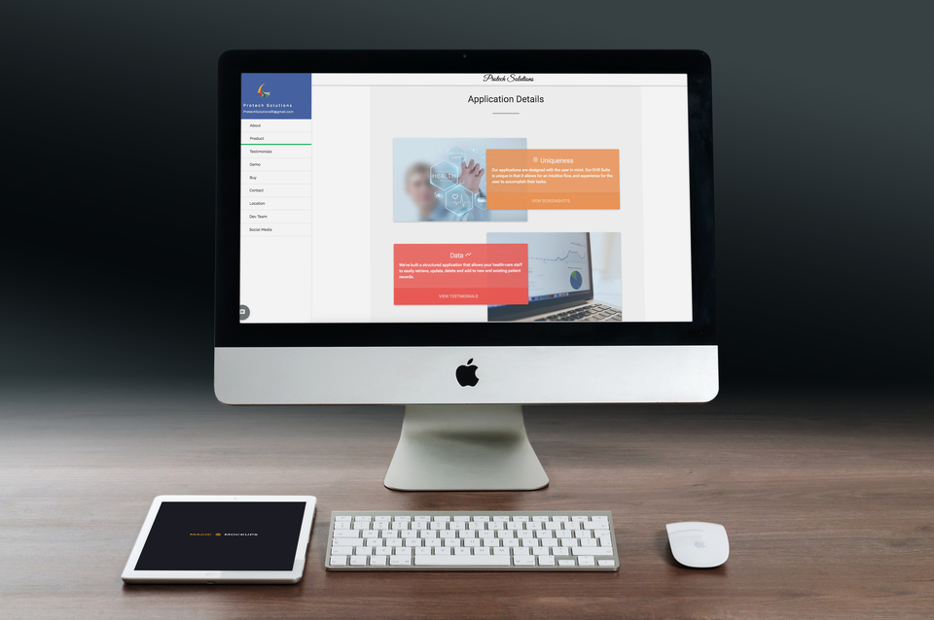
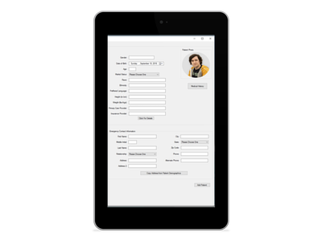

Protech Solutions RI
AS Capstone Project

Slide 2
Team Developers:
Ian Arsenault Responsibilities: Main focus on company website
Jameson Arsenault Responsibilities: Main focus on E.H.R Application

Slide 3

Project Overview

Slide 4








Languages + Tools

Slide 5
Website Overview
Company website about applications we design + engineer
Interactive design with different functionalities
Allows customers to purchase an application and download it
Sending customer data to database + email

Slide 6
C# Application Overview
E.H.R. - Electronic Patient Medical Record application
Intuitive patient record keeping for healthcare facilities
Allows user to login and search patients
Add + Update Patient Records

Slide 7
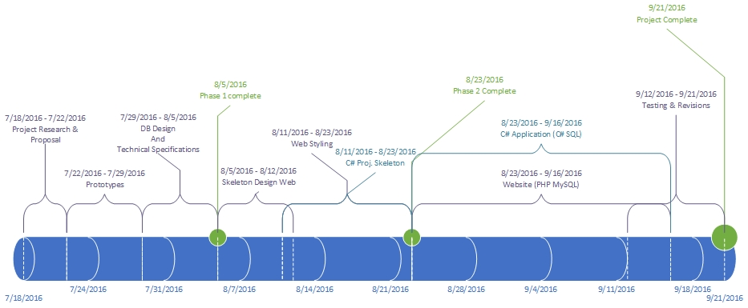
Timeline

Slide 8

Database Design

Slide 9
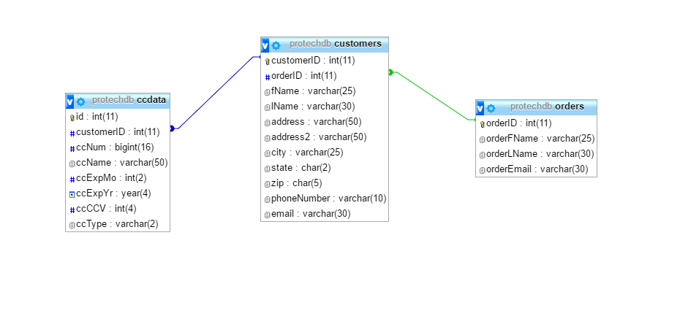
Website Database

Slide 10
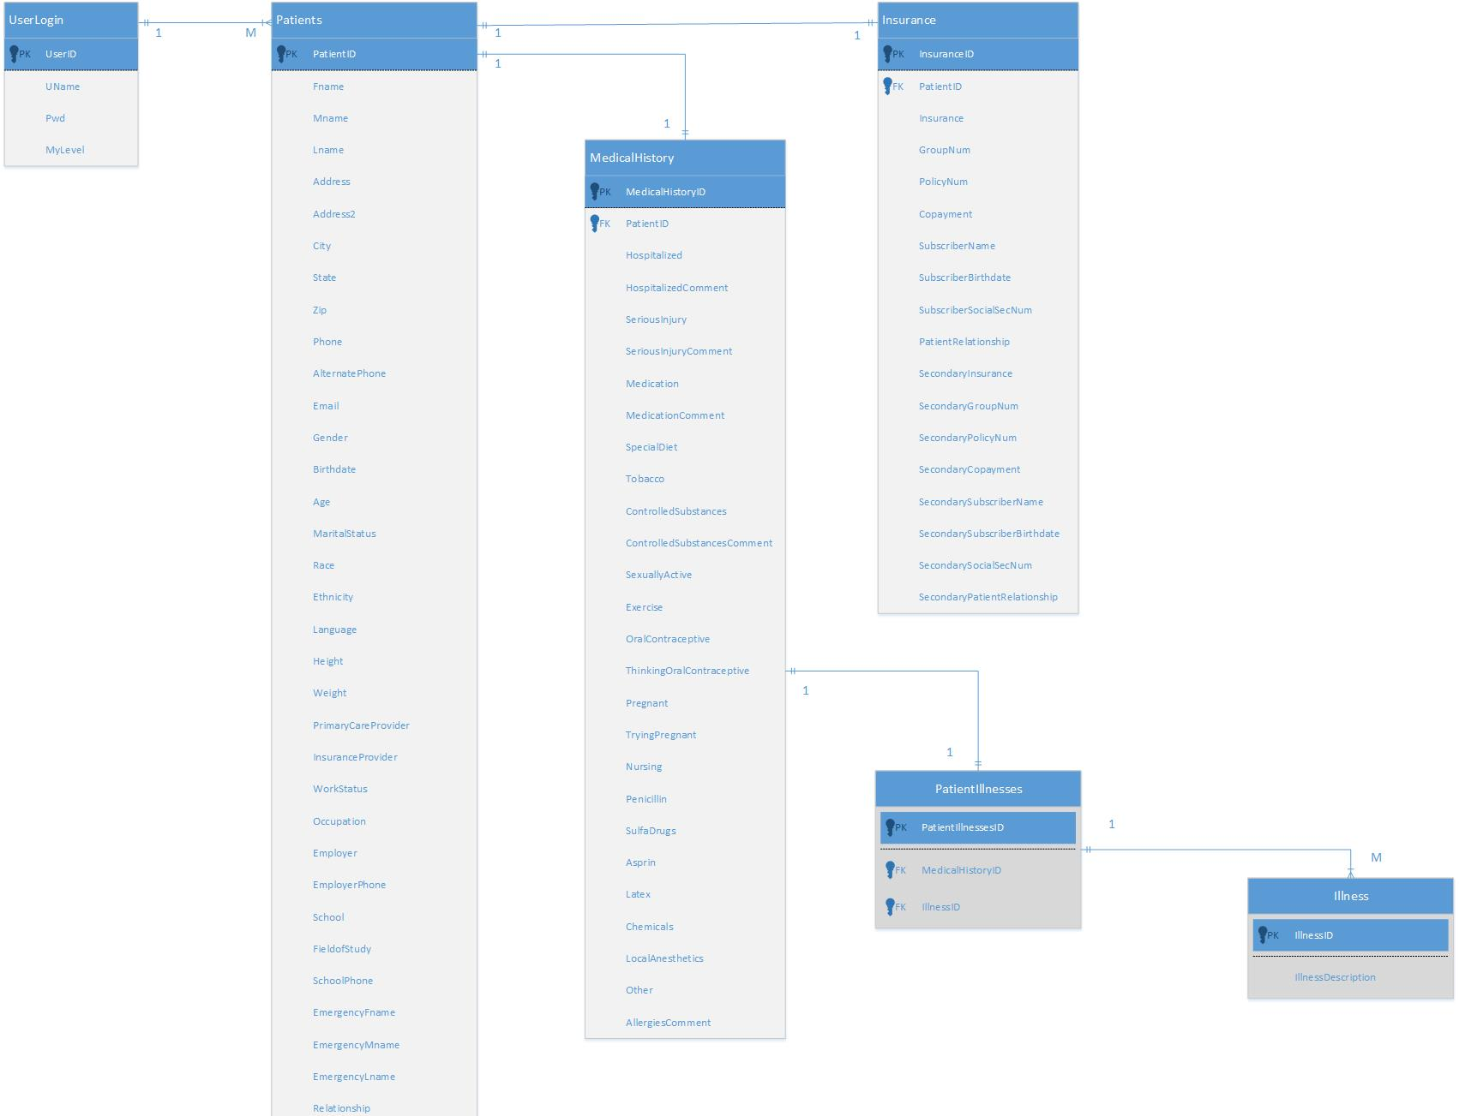
C# App Database

Slide 11

Obstacles
Two in-depth applications that come together as one program
Short time frame for scope of project
Ability to map out project timeframe
Working around programming issues + bugs
Pair programming on two different projects at the same time

Slide 12

Technical Design
MVC – Model View Control for Website
Scrolling functionality – scrollTop, scrollSpy, scrollFire
CSS animations + transforms with jQuery
Google Maps API with designed map to show location
Using Classes
Validation for form elements

Slide 13

Summary
Interactive website and E.H.R. application
Working Databases for both applications
Intuitive user interface design
Valuable teamwork experience
Met majority of our goals in 10 week period

