Slide 1
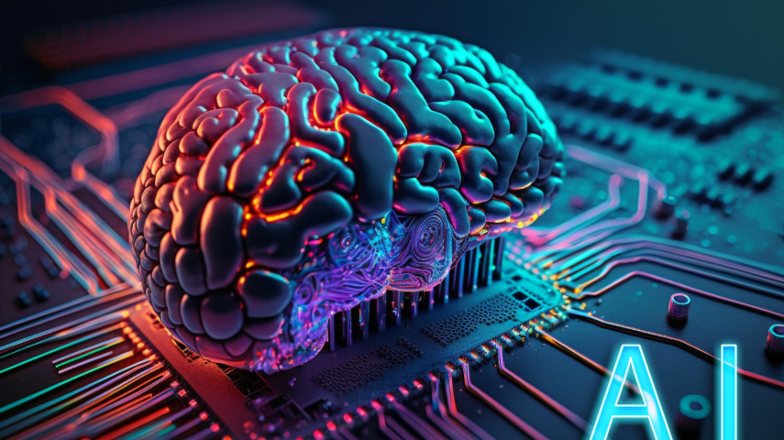
HOW TO TRAIN AN AI

Slide 2
Prepare The Data
Before we even start to train the AI, we first need to prepare our data. We need to collect, clean, preprocess the information that we are going to use.

Slide 3
AI Model
I used neural networks as my AI model. A neural network is a machine learning model inspired by the structure and function of the human brain. It consists of interconnected nodes (called neurons) organized in layers that work together to recognize patterns in data.

Slide 4
Training Technique
My model uses supervised learning with a 1D Convolutional Neural Network (CNN) trained via backpropagation and gradient descent optimization.

Slide 5
Train, Validate and Test
Feed the prepared data into the model to identify errors and make adjustments to increase accuracy. (Train)
Validate the performance of the AI model by evaluating how it performs on a separate and often more complex dataset not used during the training process. (Validate)
The final step is to test the AI model on an independent dataset to assess it’s real-world applications. (Test)

