Slide 1
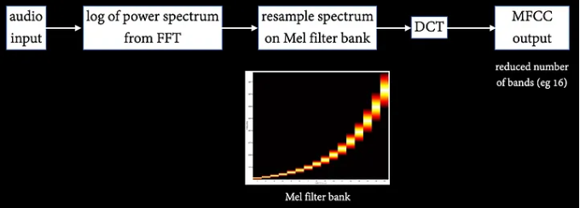
MFCC
A log power spectrum is evaluated from the audio input. The power spectrum is resampled on the mel scale. The MFCC output is the Discrete Cosine Transform of the resampled spectrum. A significant dimensionality reduction comes from the resampling to the 16-band mel filter bank.

Slide 2
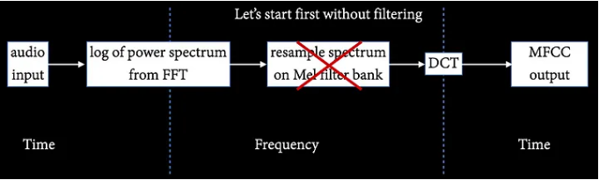
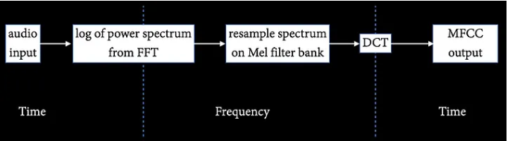
MFCC
The evaluation of the MFCCs involves two changes of domain: from time domain to frequency domain (FT) and then back to time domain (DCT). MFCCs are expressed in the time domain, the unit for MFCC coefficients is a unit of time.

