Slide 1
CS4101 嵌入式系統概論 Tasks and Scheduling
Prof. Chung-Ta King
Department of Computer Science
National Tsing Hua University, Taiwan
(Materials From Using the FreeRTOS Real Time Kernel, Richard Barry, Study of an operating system: FreeRTOS, Nicolas Melot, and
http://www.eecs.umich.edu/eecs/courses/eecs373/Lec/RTOS2.pptx)

Slide 2
Outline
Tasks in FreeRTOS
Task states
Task creation and deletion
Task scheduler of FreeRTOS
Priority and ticks
Delaying a task
Suspending and resuming a task
Idle task hook
Changing priority
Representative RT scheduling algorithms(real time)

Slide 3
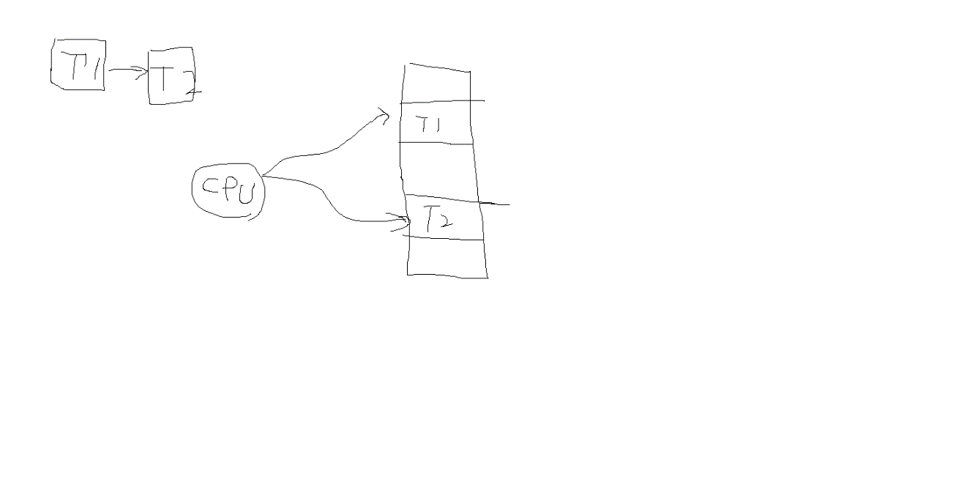
Tasks in FreeRTOS
In FreeRTOS, computations are organized around tasks, which are the most basic unit of scheduling
A task is a thread
A task is a function that must return void and take a void pointer parameter:
void ATaskFunction(void *pvParameters);
A task normally runs in an infinite loop and must not return
You inform the scheduler of
The task’s resource needed (stack space, priority)
Any arguments the task needs
Notes:
Why independent stack for each task? Thread Concept.
Each thread has its own stack. Can keep its own data structure, would not be inadvertently disrupt by others.
直接切到原來的stack，不用push或pop

Slide 4
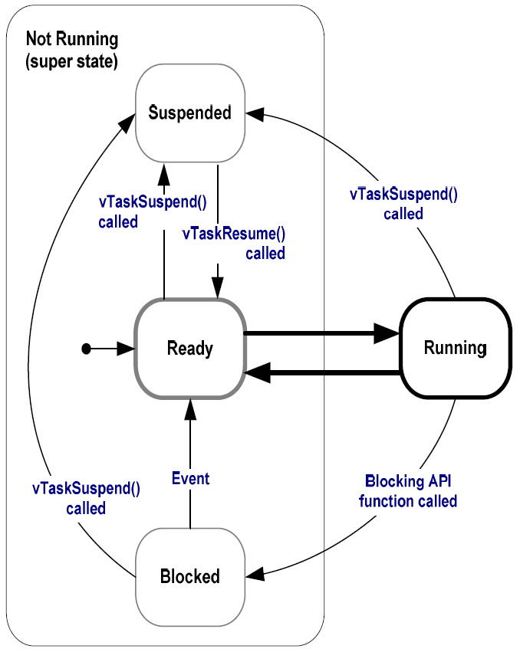
Task States in FreeRTOS
Running:
Task is actually executing
Only one task can exist in Running state at any one time (assuming 1-core system) 假設只有一顆cpu
Ready:
Task is ready to execute but a task of equal or higher priority is Running
Notes:
CPU有一個task queue→

Slide 5
Task States in FreeRTOS
Blocked:
Task is waiting for some event
Time: if a task calls vTaskDelay() it will be blocked until the delay period has expired
Resource: tasks can also block waiting for queue and semaphore events
Suspended:
Much like blocked, but not waiting for anything
Tasks will only enter or exit the suspended state when explicitly commanded to do so through the vTaskSuspend() and vTaskResume() API calls respectively
有可能別人叫他進去suspend
可以達到synchronization.
Notes:
Semaphore是甚麼？
如果priority都設程1, vtaskdelay都一樣，CPU怎麼知道？
有可能同時進行task嗎？像verilog那樣硬體電路
ultrasonic去教stepper做事：Ultrasonic Task 叫 Stepper的task Suspend跟Resumes

Slide 6
Task Creation
xTaskCreate(pvTaskCode, pcName, usStackDepth, pvParameters, uxPriority, pxCreatedTask)
pvTaskCode: pointer to task entry function, implemented to never return
pcName: a descriptive name for the task to facilitate debugging
usStackDepth: size of task stack, specified as the number of variables that the stack can hold
pvParameters: pointer to parameters for the task
uxPriority: priority at which the task should run; low numeric priority values denote low priority
pvCreatedTask: pass back a handle to reference the task

Slide 7
Task Deletion
A created task commonly runs in an infinite loop, but it may be deleted by
void vTaskDelete(TaskHandle_t xTask);
xTask: handle of the task to be deleted; NULL to cause the calling task to be deleted
Remove a task from the RTOS kernels management
void vOtherFunction(void) {
TaskHandle_t xHandle = NULL;
// Create the task, storing the handle.
xTaskCreate(vTaskCode, "NAME", STACK_SIZE, NULL,
tskIDLE_PRIORITY, &xHandle);
// Use the handle to delete the task.
if(xHandle != NULL) vTaskDelete(xHandle);
}
Notes:
Memory allocated by the task code is not automatically freed, and should be freed before the task is deleted.

Slide 8
Outline
Tasks in FreeRTOS
Task states
Task creation and deletion
Task scheduler of FreeRTOS
Priority and ticks
Delaying a task
Suspending and resuming a task
Idle task hook
Changing priority
Representative RT scheduling algorithms

Slide 9
Scheduler of FreeRTOS
Task scheduling: decide which task in “Ready” state has to be run at a given time
RTOS scheduler is started by calling
void vTaskStartScheduler(void);
RTOS kernel now has control over which tasks are executed and when (Arduino invokes it automatically)
An Idle task is automatically created by scheduler when vTaskStartScheduler() is called
Because CPU always needs something to execute → must always have one task that can enter Running state
The idle task has the lowest priority (priority 0) to never prevent a higher priority task from running
Notes:
Embedded OS 和application一起打包。 StartScheduler()就是把 OS 喚醒的功能。
類似Bulk概念：整個電晶體電位最低。

Slide 10
Task Priority
FreeRTOS only uses the priorities of tasks to decide which task to run next
The uxPriority parameter of xTaskCreate() assigns an initial priority to the task being created
Can be changed using vTaskPrioritySet()
Low numeric priority values denote low priority tasks
Scheduler always selects the highest priority task that is able to run
When more than one task of the same priority is able to run, the scheduler uses round-robin

Slide 11
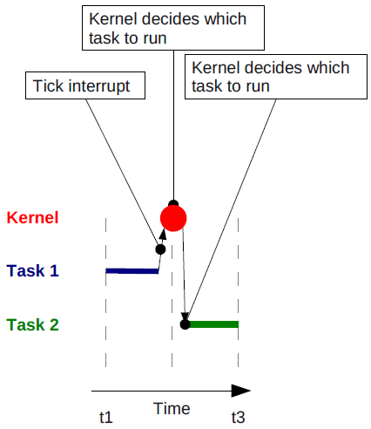
Ticks
To select the next task to run, the scheduler has to be executed periodically
By a periodic interrupt called the tick interrupt
FreeRTOS API calls always specify time in tick interrupts (or just ‘ticks’)
‘Tick count’ is the total number of tick interrupts that have occurred since the scheduler was started
Notes:
每次Tick interrupt -> 看Ready queue有誰可以執行 -> 執行最高的priority。
如果task priority較低：被preempt(先跑去執行其他的
Tick值多少：compile FreeRTOS時可以設定

Slide 12
Sample Code for Task Priority
static const char *pcTextForTask1 = “T1 running\r\n”;
static const char *pcTextForTask2 = “T2 running\t\n”;
void setup() {
/* Create the first task at priority 1. */
xTaskCreate(vTaskFunction, "Task 1", 1000,
(void*)pcTextForTask1, 1, NULL);
/* Create the second task at priority 2. */
xTaskCreate(vTaskFunction, "Task 2", 1000,
(void*)pcTextForTask2, 2, NULL);
/* Start scheduler so the tasks start executing. */
vTaskStartScheduler();
return 0;
}

Slide 13
Running Multiple Periodic Tasks
It is inconvenient to run multiple periodic jobs using a single Arduino loop, e.g.
Measure the light using the photoresistor at 1 Hz
Measure the sound intensity using microphone at 2.5 Hz
Measure the distance of an object using the ultrasonic sensor at 0.4 Hz
Even if we run each job in a FreeRTOS task, we still need a way to schedule the tasks at specified time
Use blocked state with vTaskDelay()

Slide 14
Delaying a Task
void vTaskDelay(const TickType_t xTicksToDelay)
Places the calling task into the Blocked state for a fixed number of tick interrupts
While in the Blocked state, the task will not use any processing time
Note: Frequency of the periodic task depends on the path of the code, as well as other tasks and interrupt activities
void vTaskFunction(void * pvParameters) {
const TickType_t xDelay = 500/portTICK_PERIOD_MS;
for( ;; ) {
vToggleLED(); // toggle LED
vTaskDelay(xDelay); // Block for 500 ms
}
}
duration of a tick in msec
Notes:
portTICK_PERIOD_MS: duration of a tick in msec 1個ticks是幾個msec，所以 不等於 一個msec 幾個ticks
tick interrupt frequency is configured by the application-defined configTICK_RATE_HZ compile time configuration constant within FreeRTOSConfig.h
500msec = ? Ticks?

Slide 15
Delaying a Task
void vTaskDelayUntil(TickType_t *pxPreviousWakeTime, const TickType_t xTimeIncrement);
Delay a task until a specified time → to ensure a constant execution frequency
vTaskDelay() specifies a time at which the task wishes to unblock relative to the time at which vTaskDelay() is called
vTaskDelayUntil() specifies an absolute time to unblock the task
pxPreviousWakeTime: the time that task last left Blocked state
This time is used as a reference point to calculate the time at which the task should next leave the Blocked state
xTimeIncrement: frequency of the periodic task in ‘ticks’
vTaskDelayUntil() will return immediately without blocking if the specified wake time is already in the past
Notes:
比較精準(從 上次哪裡開始 到 增加多少時間 (任意設定一個起始時間
vTaskDeley(起始時間是現在

Slide 16
Sample Code for Periodic Tasks
void vTaskFunction(void * pvParameters){
// Perform an action every 10 ticks
TickType_t xLastWakeTime;
const TickType_t xFrequency = 10;
// Initialize xLastWakeTime with the current time.
xLastWakeTime = xTaskGetTickCount();//作為下次回來的參考起始點
for( ;; )
{
// Wait for the next period.
vTaskDelayUntil(&xLastWakeTime, xFrequency);
// Perform action here.
}
}
Notes:
volatile TickType_t xTaskGetTickCount( void );
Returns: The count of ticks since vTaskStartScheduler was called.

Slide 17
Suspending and Resuming a Task
void vTaskSuspend(TaskHandle_t xTaskToSuspend)
Suspend any task
Task will never get any microcontroller processing time, no matter what its priority
Calls to vTaskSuspend() are not accumulative, i.e. calling vTaskSuspend () twice on the same task still only requires one call to vTaskResume () to ready the suspended task
void vTaskResume(TaskHandle_t xTaskToResume)
Resumes a suspended task
A task that has been suspended by one or more calls to vTaskSuspend () will be made available for running again by a single call to vTaskResume ()
Notes:
叫一百次suspen也只需要一次resume就回到ready state

Slide 18
Sample Code for Suspending a Task
void vTaskMaster(void) {
TaskHandle_t xHandle;
// Create a slave task, storing the handle xTaskCreate(vTaskSlave, "NAME", STACK_SIZE, NULL, tskIDLE_PRIORITY, &xHandle);
// ...
// Use the handle to suspend the created task vTaskSuspend(xHandle);送Null ptr : 把自己suspend
// ...
// Created task will not run during this period
// ...
// Resume the suspended task ourselves.
vTaskResume(xHandle);
}

Slide 19
Idle Task Hook
Recall:
An Idle task is created when vTaskStartScheduler() is called so that there is always at least a task to run
Can add special functionality into the idle task through an idle hook (or call-back) function
void vApplicationIdleHook(void){...}
A function that is automatically called by the idle task once per iteration of the idle task loop
Common uses for the Idle task hook include:
Executing low priority, background or continuous task
Measuring the amount of spare processing capacity
Placing the processor into a low power mode
Notes:
The idle task will only run when all the other tasks have no work to perform, so measuring the amount of processing time allocated to the idle task provides a clear indication of how much processing time is spare.

Slide 20
Changing the Priority of a Task
void vTaskPrioritySet(TaskHandle_t pxTask, UBaseType_t uxNewPriority);
Set the priority of any task
pxTask: handle of the task whose priority is being modified (NULL for itself)
uxNewPriority: the priority to which the task is to be set
Capped to the maximum available priority of (configMAX_PRIORITIES – 1), where configMAX_PRIORITIES is a compile time option set in the FreeRTOSConfig.h header file
A context switch will occur before the function returns if the priority being set is higher than the currently executing task
unsigned portBASE_TYPE uxTaskPriorityGet(xTaskHandle pxTask); //看現在priority多少
Notes:
修改一個task的priority
如果給太大，自動變成最大值(configMAX_PRIORITIES-1)

Slide 21
Sample Code for Changing Priority
void vTask1(void *pvParameters) {
unsigned portBASE_TYPE uxPriority;
uxPriority = uxTaskPriorityGet(NULL); // my priority
for( ;; ) {
Serial.println(“Task1 raises Task2’s priority");
vTaskPrioritySet(xTask2Handle, (uxPriority + 1));
/* For Task1 to reach this point Task2 must
set its priority back down to below Task1. */ }
}
void vTask2(void *pvParameters) {
unsigned portBASE_TYPE uxPriority;
uxPriority = uxTaskPriorityGet(NULL);
for( ;; ) {
vPrintString(“Task2 lower its priority\r\n");
vTaskPrioritySet(NULL, (uxPriority - 2)); }
}
Notes:
在task 1 中把task 2 的priority設成比我還高
Task 2 中把自己priority 又 減掉兩個
因為priority比task 1 低：CPU切換到Task 1 。又把task 2 設定高：跳到task2 … 重複

Slide 22
Sample Code for Changing Priority
xTaskHandle xTask2Handle;
int main(void) { // change to setup() on Arduino
// Create Task1 at priority 2
xTaskCreate(vTask1, "Task 1", 1000, NULL, 2, NULL);
// Create Task2 at priority 1
xTaskCreate(vTask2, "Task 2", 1000, NULL, 1,
&xTask2Handle);
// Start the scheduler
vTaskStartScheduler();
/* If all is well, then main() will never reach here
as the scheduler will now be running the tasks.
If main() does reach here, then it is likely that
there was insufficient heap memory available for
the idle task to be created.*/
for( ;; );
}
Notes:
Void setup(){}

Slide 23
Summary
FreeRTOS runs Fixed Priority Preemptive Scheduling
Static, 還沒做完會被切換所以preemptive
Each task is assigned a priority
Each task can exist in one of several states
Only one task can exist in Running state at any one time
The scheduler will always select the highest priority Ready state task to enter the Running state把現在running的人preempt掉 (進入suspend state?)
不一定，可能回到ready state
Scheduling is made at each tick interrupt
兩個algorithms都是Preemptive嗎?
Notes:
‘Fixed Priority’ because each task is assigned a priority that is not altered by the kernel itself (only tasks can change priorities).
‘Preemptive’ because a task entering the Ready state or having its priority altered will always pre-empt the Running state task if the Running state task has a lower priority.
Lab9 : stepper motor自己把自己suspend掉：等ultrasonic有小於15cm才Resume做事

Slide 24
Outline
Tasks in FreeRTOS
Task states
Task creation and deletion
Task scheduler of FreeRTOS
Priority and ticks
Delaying a task
Suspending and resuming a task
Idle task hook
Changing priority
Representative RT scheduling algorithms
Rate monotonic, earliest deadline first

Slide 25
Real-Time Scheduling algorithms
A scheduling algorithm is a scheme that selects what task to run next
Must be able to meet deadlines in all cases
Can be preemptive or non-preemptive
Dynamic or static priorities
Two representative RT scheduling algorithms
Rate monotonic (RM): static priority, simple to implement, nice properties (preemptive.
Earliest deadline first (EDF): dynamic priority, harder to implement, very nice properties(Non-Preemptive
Notes:
Non-preemptive: 一旦schedule了，一定要做完此task，才能換task執行
Dynamic，scheduler可以改priority/(Static: scheduler不能)

Slide 26
Rate Monotonic Scheduling
RMS [Liu and Layland, 73]: widely-used, analyzable scheduling policy
Assumptions:
All tasks run periodically on single CPU
Zero context switch time
No data dependencies between tasks
Task execution time is constant
Deadline is at end of respective period
Highest-priority ready task runs
Tasks can be preempted
Notes:
劉(在美國發展 (以前清華校長
假設所有task軍週期性
Deadline就是週期
可以被preempted
(To prove this algorithm)

Slide 27
Rate Monotonic Scheduling
Optimal (fixed) priority assignment:
Shortest-period task gets highest priority, i.e., priority inversely proportional to period
Break ties arbitrarily
No fixed-priority scheme does better
In terms of CPU utilization while ensuring all tasks meet their deadlines
Notes:
Rate( Inverse to period.) Like frequency,

Slide 28
RMS Example
Task Execution time Period
P1 1 4
P2 2 6
P3 3 12
Preempted
Resumed
Preempted
Resumed
P3
P3
P3
P2
P2
P1
P1
P1
time
0
2
4
6
8
10
12
Notes:
根據週期短的高：p1 >p2>p3 (p3做到一半：p1又進來了
不是Non preempted嗎

Slide 29
RMS Example
Task Execution time Period
P1 2 4
P2 3 6
P3 3 12
No feasible task assignment to satisfy deadlines:
In 12 unit intervals, execute P1 3 times, P2 2 times, P3 1 times → (6+6+3)=15 unit intervals
Let n be # of tasks, if total utilization < n(2^{1/n}-1), tasks are schedulable (at n=∞ → 69.3%)
This means that RMS algorithm will work if the total CPU utilization is less than 2/3!

Slide 30
Earliest-Deadline-First Scheduling (EDF)
Task closest to its deadline has highest priority
Requires recalculating tasks at every time unit
Dynamic priority assignment: priority of a task is assigned as the task arrives
Tasks do not have to be periodic
EDF is an optimal uniprocessor scheduling algorithm
Can use 100% of CPU
Scheduling cost is high and ready queue can reassign priority
May fail to meet a deadline
Cannot guarantee who will miss deadline, but RMS can guarantee that the lowest priority task misses deadline

Slide 31
Example of EDF Algorithm
T1: period 2; execution time 0.9
T2: period 5; execution time 2.3
T1 preempts T2
At time 4.1, J2.1 completes, J1.3 starts to execute
J1.1 is 2, J2.1 is 5
Priority: T1>T2
J1.3 is 6, J2.1 is 5
Priority: T2>T1
T1
J1.2 is 4, J2.1 is 5
Priority: T1>T2
2
4
6
8
T2
5
10
Notes:
在第四秒時：因為T1的deadline是6，T2的deadline是5：T2 > T1(所以做完
做完第一次T2(1.1 + 1.2 = 2.3 2.9 + 1.2 = 4.1 開始做T1 -> 做完5秒)

