Slide 1
CS4101 Introduction to Embedded Systems Synchronization
Prof. Chung-Ta King
Department of Computer Science
National Tsing Hua University, Taiwan
(Materials from Prof. Insup Lee, Prof. Frank Drews, MQX User Guide, Using the FreeRTOS Real Time Kernel, Study of an Operating System: FreeRTOS)

Slide 2
Why Synchronization?
Synchronization may be used to solve:這三類
Mutual exclusion
Control flow
Data flow
Synchronization mechanisms include:
Message queues
Semaphores
Mutexs
Locks
Correct synchronization mechanism depends on the synchronization issue being addressed

Slide 3
Mutual Exclusion
Problem: multiple tasks may “simultaneously” need to access the same resource
Resource may be code, data, peripheral周邊設備, etc.
Need to allow the shared resource exclusively accessible to only one task at a time, e.g. for atomic operations
Normally by restricting code execution, e.g. critical section
All tasks are equal and play the same role限制程式碼
How to do?
Allowing only one task to lock the resource and the rest have to wait for the resource to be unlocked
Common mechanisms: lock/unlock, mutex, semaphore, disabling interrupts, FreeRTOS queue(freertos是用這個
Notes:
e.g. 更衣室
如果不做mutual exclusion 如果兩個thread都要寫入 會亂掉 一次只能給一個task用

Slide 4
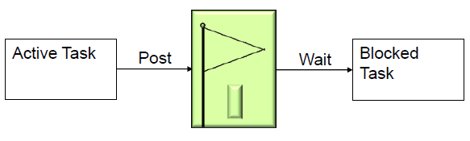
Control Flow Synchronization
Problem: a task or ISR may need to resume the execution of one or more other tasks, so that tasks execute in an application-controlled order
Mutual exclusion is used to prevent another task from running, while control flow is used to allow another task to run, often specific tasks
Tasks play different roles, e.g. caller/callees
How to do?
Common mechanisms: post/wait, signal, FreeRTOS queue, task suspend/resume
Notes:
e.g. night shift wakeup 控制轉移
不一定要傳資料，我做完了，把你叫起來做

Slide 5
Data Flow Synchronization
Problem: a task or ISR may need to pass some data to one or more other specific tasks, so that data may be processed in an application-controlled order
Tasks play different roles, e.g. producer/consumer
How to do?
Common mechanisms: FreeRTOS queue, signal, post/wait
Can data synch be done by control synch? 可
Can control synch be done by data synch? Depends.
Can data synch be done by mutual exclusion?風險：沒有限定下一個進來的人是誰(本來要a拿，變成B拿走! 玩了
Can mutual exclusion be done by data synch?
通常可以(blocking)
Notes:
e.g. deliver ordered dishes 要data丟給別人做
Control synch先把要給人的資料寫好，叫醒別人，別人去你寫好資料的地方去拿：搞定
Depends how your data shnch. Is implement.做 blocking/non-blocking如果後者(資料還沒來，可以做別的事)就不太能完成control syndh.!

Slide 6
Outline
Introduction to task synchronization
Semaphores and mutexs of FreeRTOS
Binary semaphores
Counting semaphores
Mutex

Slide 7

Semaphores
Semaphores are used to:
Control access to a shared resource (mutual exclusion)
Signal the occurrence of an event
Allow two tasks to synchronize their activities
Basic idea
A semaphore contains a number of tokens. The code needs to acquire one in order to continue execution
If all the tokens of the semaphore are used, the requesting task is suspended until some tokens are released by their current owners
vs lock/unlock, mutex

Slide 8
How Semaphores Work?
A semaphore has:
Counter: maximum number of concurrent accesses
Queue: for tasks that wait for access
If a task requests (waits for) a semaphore
If counter > 0, then (1) the counter is decremented by 1, and (2) task gets the semaphore and proceeds to do work
Else task is blocked and put in the queue
If a task releases (posts) a semaphore
If there are tasks in the semaphore queue, then an appropriate task is readied, according to queuing policy
Else counter is incremented by 1
Notes:
7
Mutex is special case where the count =1 so only one task can hold it at a time

Slide 9
Binary Semaphores
Semaphores with counter = 1, used for mutual exclusion (mutex) and synchronization
For synchronization purpose, a binary semaphore can be thought of as a queue that only holds one item
The queue can only be empty or full (hence binary)
Tasks using the queue don't care what the queue holds, only want to know if the queue is empty or full
If more than one task are blocked on the queue, then the task with the highest priority will be the task that is unblocked the next time the semaphore becomes available
Very similar to mutexes, but mutexes include a priority inheritance mechanism (discussed later)
Notes:
Mutexes include a priority inheritance mechanism, binary semaphores do not. This makes binary semaphores the better choice for implementing synchronisation (between tasks or between tasks and an interrupt), and mutexes the better choice for implementing simple mutual exclusion.

Slide 10
Binary Semaphores and Interrupts
The best way to handle complex events triggered by interrupts is not to do the code in the ISR
Otherwise, you might not be able to handle other interrupts in time
Create a task to do the complex works associated with the event and make it to block on a binary semaphore
When the interrupt happens, the ISR just sets (gives) the semaphore and exits給一個token到semaphore內 → control flow synchronization
Task can now be scheduled like any other to do the remaining works
No need to worry about nesting interrupts and interrupt priority
This is called Deferred Interrupt Processing
Notes:
不要讓別人等太久
盡量不要在裡面做太多事，放到外面去左->利用binary Semophore

Slide 11
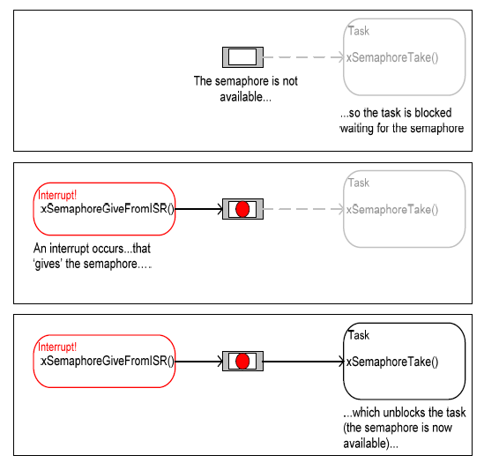
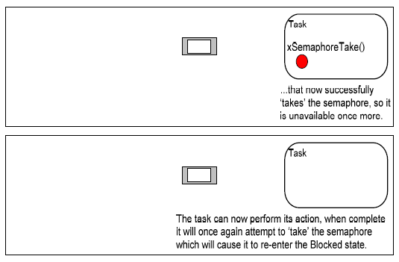
Binary Semaphores and Interrupts
Figure from Using the FreeRTOS Real Time Kernel (a pdf book), fair use claimed.

Slide 12
Create a Binary Semaphore
SemaphoreHandle_t xSemaphoreCreateBinary(void);
Return a semaphore handle.
Function to create a binary semaphore
The semaphore is created in the 'empty' state
A binary semaphore need not be given back once obtained, and can be left in ‘empty’ for an indefinite time
Thus, task control flow synchronization can be implemented by one task/interrupt continuously 'giving' the semaphore while another continuously 'takes' the semaphore
Binary semaphores are assigned to variables of type SemaphoreHandle_t and can be used in any API function that takes a parameter of this type
Notes:
A task only needs to take the binary semaphore without giving it back. So the binary semaphore may be in the ‘empty’ state for a long time.
On the other hand, a mutex must be given back as soon as possible, otherwise the higher priority task will never be able to obtain the mutex, and the lower priority task will never 'disinherit' the priority.

Slide 13
Set a Binary Semaphore
xSemaphoreGiveFromISR(
SemaphoreHandle_t xSemaphore,
signed BaseType_t *pxHigherPriorityTaskWoken)
Set (give) a semaphore
Can be used from an ISR
xSemaphore: handle to the semaphore being released
pxHigherPriorityTaskWoken: set to pdTRUE if giving the semaphore caused a task of a higher priority to unblock, causing a context switch before the interrupt is exited
xSemaphoreGive(SemaphoreHandle_t xSemaphore)
Set (give) a semaphore

Slide 14
Reset a Binary Semaphore
xSemaphoreTake(xSemaphoreHandle xSemaphore,
portTickType xBlockTime)
Reset (take) a semaphore
xSemaphore: handle to the semaphore being taken
xBlockTime: time in ticks to wait for the semaphore to become available
A block time of zero can be used to poll the semaphore
xSemaphoreTakeFromISR(
xSemaphoreHandle xSemaphore,
signed BaseType_t *pxHigherPriorityTaskWoken)

Slide 15
Example of Binary Semaphores
#include <semphr.h> vSemaphoreHandle binary_sem; //Global handler void one_sec_isr(void){ // an ISR xSemaphoreGiveFromISR(binary_sem, NULL); } void sem_task(void *p){ while(1) if(xSemaphoreTake(binary_sem,999999)) puts("Tick!"); } int main(void){ vSemaphoreCreateBinary(binary_sem); xTaskCreate(sem_task, (signed char*)) "t1", 2048, NULL, 1, NULL); vTaskStartScheduler(); return 0; }
Control flow
Notes:
14
Cpu先執行semaphoreTask block住：等到isr有binary token：給回去：再執行task
14

Slide 16
Counting Semaphores
Typically used for two things:
Counting events:
An event handler will 'give' a semaphore each time an event occurs, and a handler task will 'take' a semaphore each time it processes an event
Resource management:
The count value indicates number of available resources
To get a resource, a task must obtain (take) a semaphore
When a task finishes with the resource, it 'gives' the semaphore back
SemaphoreHandle_t xSemaphoreCreateCounting( UBaseType_t uxMaxCount, UBaseType_t uxInitialCount)

Slide 17
Example of Counting Semaphore (1/2)
#include <semphr.h> xSemaphoreHandle count_sem; //Global Handler int main(void){ /* Parameter for uxMaxCount, uxInitialCount */ count_sem = xSemaphoreCreateCounting(2, 2); 有兩個token，初始有兩個 /* Create tasks with priority 1 for both users */ xTaskCreate(task1, (signed char*)) “t1", 1024, NULL, 1, NULL); xTaskCreate(task2, (signed char*)) “t2", 1024, NULL, 1, NULL); vTaskStartScheduler(); return 0; }

Slide 18
Example of Counting Semaphore (2/2)
void task1(void *p){ while(1){ if(xSemaphoreTake(count_sem, portMAX_DELAY)){ xSemaphoreGive(count_sem);//願意無限期的delay(blockin的) } vTaskDelay(3000); } } void task2(void *p){ while(1){ if(xSemaphoreTake(count_sem), portMAX_DELAY){ xSemaphoreGive(count_sem); } vTaskDelay(3000); } }

Slide 19
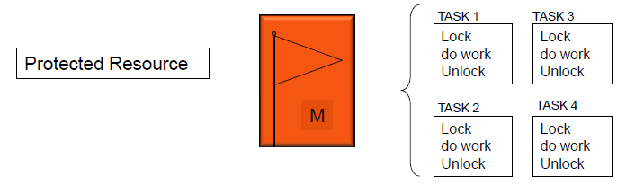
Mutex 一次只能一個人做
Mutexes are used for mutual exclusion, so that only one task at a time uses a shared resource, e.g., file, data, device, ...
To access the shared resource, a task locks the mutex associated with the resource
The task owns the mutex until it unlocks the mutex

Slide 20
Mutex
Mutex acts like a binary semaphore using a single token to guard a resource
When a task wishes to access the resource, it must first obtain ('take') the token
When the task has finished with the resource, it must 'give' the token back - allowing other tasks the opportunity to access the same resource
Mutex may cause a high priority task to be waiting on a lower priority one
Even worse, a medium priority task might be running and cause the high priority task to miss its deadline!
Priority inversion problem 高位階居然要等低位階的
Notes:
Binary semaphore: 依樣效果 有inversion問題

Slide 21
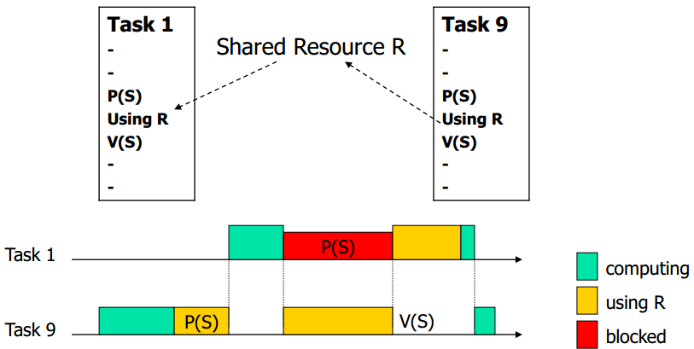
Priority Inversion: Case 1
Assume priority of T₁ > priority of T₉
If T₉ has exclusive access, T₁ has to wait until T₉ releases resource → inverting priority
T₁ has higher priority and preempts T₉
Critical section
(critical section)
Notes:
因為task 9 先拿到critical section : task 1 被block住，等task9 做完才能去做 結果T1 > T9卻要等9(因mutex造成priority inversion.

Slide 22
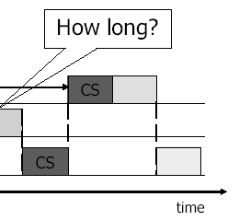
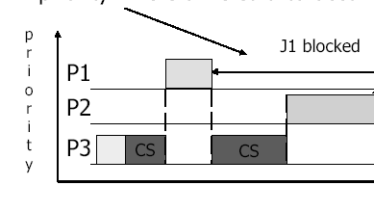
Priority Inversion: Case 2
A medium-priority task preempts a lower-priority task which is using a shared resource, but a higher priority task is blocked waiting for that resource
If the higher-priority task would be otherwise ready to run, but a medium-priority task is currently running instead, a priority inversion is occurred
Notes:
假設P1>P2>P3
P3先進Critical section：P1 preempt 但近不去critical section->block P1 去執行P3的CS，又被P2 preempt: 如果P2不用CS: 一直做P2(P3沒辦法做CS:P1也沒辦法
要等到P2完->P3 CS 做完-> P1才能用CS

Slide 23
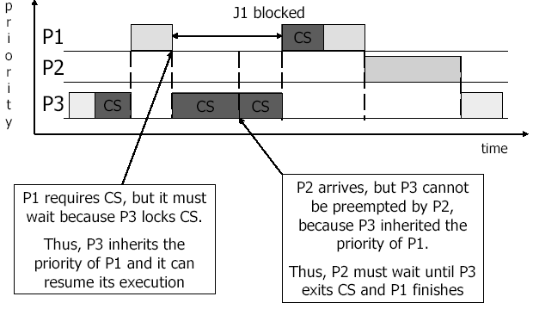
Solving Priority Inversion
Priority inheritance
If a high priority task blocks while attempting to obtain a mutex (token) that is currently held by a lower priority task, then the priority of the task holding the token is temporarily raised to that of the blocking task
FreeRTOS mutex implements priority inheritance
Notes:
動態調整Priority
暫時升高到跟blocking一樣的priority
(Binary semaphore沒有priority inheritance: 所以若用binary semaphore會有問題)

Slide 24
Example of Mutex (1/3)
#include <semphr.h> SemaphoreHandle_t gatekeeper = 0; /* global handler */ void setup(){ Serial.begin(9600); gatekeeper = xSemaphoreCreateMutex(); /* create tasks with priority 1 for both users */ xTaskCreate(user_1, (const portCHAR*)"t1", 128, NULL, 1, NULL); xTaskCreate(user_2, (const portCHAR*)"t2", 128, NULL, 2, NULL); Serial.println("test"); vTaskStartScheduler(); } void loop(){ ... }
Notes:
23
23

Slide 25
Example of Mutex (2/3)
void user_1(void *p){ while(1){ if(xSemaphoreTake(gatekeeper, 100)){ Serial.println("User 1 got access"); /* critical section */(從拿到->到放開) vTaskDelay(200); /* stay in C.S. for 200 ticks */ xSemaphoreGive(gatekeeper); /* release semaphore, exit critical section */ } else{ Serial.println(“User 1 cannot access in 1000 ms"); } vTaskDelay(100); // or do other works /* without delay, user 1 will get key immediately */ } }
Take & give back
Notes:
24
24

Slide 26
Example of Mutex (3/3)
void user_2(void *p){ while(1){ if(xSemaphoreTake(gatekeeper, 100)){ Serial.println("User 2 got access"); /* critical section */ xSemaphoreGive(gatekeeper); /* release semaphore, exit critical section */ } else{ /* fail to get the semaphore */ Serial.println("User 2 cannot access in 1000 ms"); } vTaskDelay(100); /* or do other works */ /* without delay, user 2 will get key immediately after releasing the key */ } }
Take & give back
Notes:
25
25

