Slide 1
CS4101 Introduction to Embedded Systems Lab 13: Interconnection
Prof. Chung-Ta King
Department of Computer Science
National Tsing Hua University, Taiwan

Slide 2
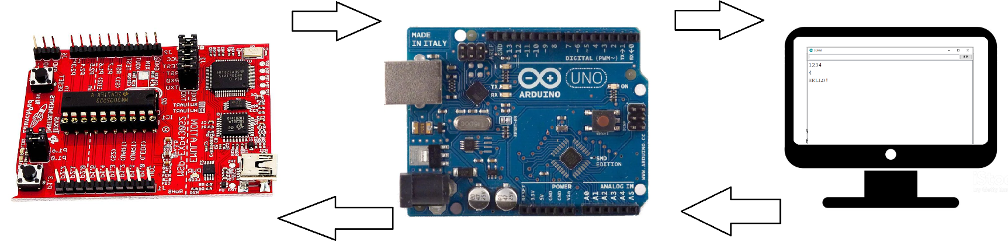
Lab 13
Basic 1: Arduino/LaunchPad interconnect (50%)
Connect LaunchPad to Arduino
LaunchPad to Arduino to PC:
When the button on LaunchPad is clicked once (pressed and released once), send “HELLO!” to Arduino via software UART of Lab 6 using 8-N-1. Handle button events by interrupts.
Arduino then sends “HELLO!” to PC via “Serial” functions
PC shows “HELLO!” on Arduino terminal.

Slide 3
Lab 13
Basic 1: (cont.)
PC to Arduino to LaunchPad:
PC receives the string typed by the user and sends it to Arduino after <enter> is pressed.
Arduino sends the string to LaunchPad.
On LaunchPad, count the number of characters received and send that number and the received string back to Arduino.
Arduino sends the string to PC.
Hint:
Include stdio.h to use sprint() for a string of a number.
For LaunchPad, you may need to modify your Lab 6 code.
For Arduino, UART port is for communication between Arduino and PC. So you need <SoftwareSerial> library.

Slide 4
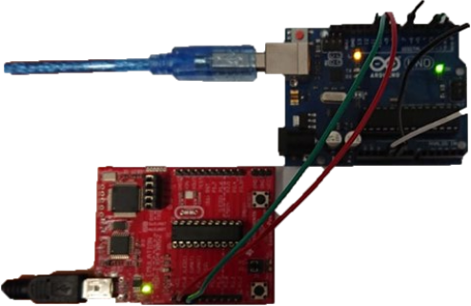
Lab 13
MSP430 P1.1 to Arduino Pin10
MSP430 P1.2 to Arduino Pin11

Slide 5
Sample Code
#include <SoftwareSerial.h>
// use pins 10 and 11 instead of Tx and Rx pins
SoftwareSerial mySerial(10,11);
void setup() {
Serial.begin(9600);
mySerial.begin(9600);
}
// useful functions
Serial.available(); // UART buffer not empty?
mySerial.available();
Data = Serial.read(); //get the data in the buffer
Data = mySerial.read();
Serial.println(data);
mySerial.println(data);

Slide 6
Lab 13
Basic 2: Fishing (50%)
Connect 4 LEDs (blue, green, yellow, red) to Arduino to represent 4 fish. 1 RGB Led
Every 2 seconds, one of them should light for 1 sec and then turn off.
Only when blue LED is turned on, you click the button on LaunchPad.
If you click the button before the blue LED is turned off, Arduino informs LaunchPad to turn on the green LED for 1 second. Otherwise, Arduino informs LauncPad to turn on the red LED for 1 second.

