Slide 1
CS4101 Introduction to Embedded Systems Lab 10: Tasks and Scheduling
Prof. Chung-Ta King
Department of Computer Science
National Tsing Hua University, Taiwan

Slide 2
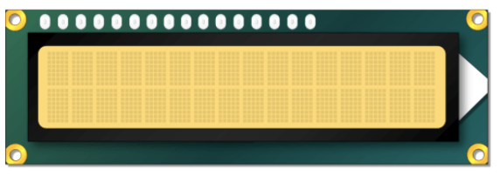
Lab 10
Basic 1: Door lock system (40%)
Connect a keypad and an LCD to your Arduino UNO to implement a door lock, which has a 4- to 8-digit passcode.
The door lock has an initial passcode of “1234”.
Your system starts up in the Enter_passcode mode.
Enter_passcode mode:
Display “Enter passcode:” on the 1st row of the LCD.
Read the passcode typed by the user from the keypad, which ends with a “#”. Display the digits on the second row of the LCD. You do not need to display “#” though.
Enter passcode:
Enter passcode:
1234

Slide 3
Lab 10
Basic 1: (cont.)
Enter_passcode mode: (cont.)
After “#” is entered, the input passcode is compared with the passcode already stored.
If they are the same, display “Correct!” on LCD for 2 seconds; otherwise, display ”Wrong!” for 2 seconds.
Clear the LCD and go to beginning of Enter_passcode mode.
Enter passcode:
Correct!
1234
1234
Enter passcode:
Wrong!
4321
4321

Slide 4
Lab 10
Basic 1: (cont.)
At Enter_passcode mode, if a “#” is entered before any digit, then enter Set_passcode mode to change passcode.
Set_passcode mode:
Display “Set passcode:” on the first row of LCD.
Read the new passcode (4 to 8 digits) typed by the user from the keypad, which ends with a “#”. Display the entered digits on the second row of LCD, but not “#”.
After “#” is entered, store the passcode, clear the LCD, and return to the beginning of the Enter_passcode mode.
Set passcode:
1234

Slide 5
Lab 10
Basic 1: (cont.)
Implement all operations using Arduino functions:
LoginFun(): the only function in loop()
Read the key input from keypad. If the first key is a digit, then compared the input passcode with the stored passcode. If the first key is a “#”, then call SetupFun() to set the passcode.
SetupFun(): called by LoginFun()
Read and store the new passcode from the keypad. After a “#” is entered, return to LoginFun().
DisplayTask(): called by LoginFun() and SetupFun()
Display the text stored in a global array on LCD and return.
void loop(){
LoginFun(); delay(100);
}

Slide 6
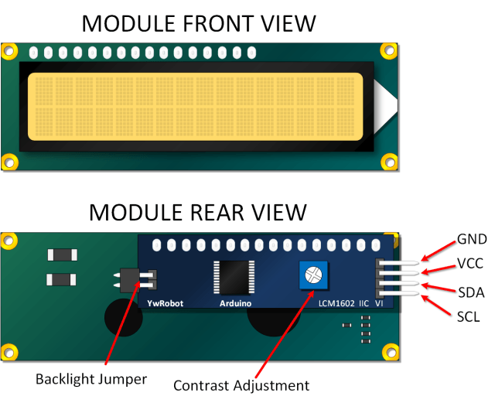
LCD Display
Liquid crystal displays (LCDs) are commonly used to display data in devices such as calculators and home appliances
They can support message scrolling, cursor displaying, and LED backlight
A typical LCD display is 16×2 LCD Module, which can display 32 ASCII characters in 2 lines (16 characters in 1 line)
LCM1602 I2C V1

Slide 7
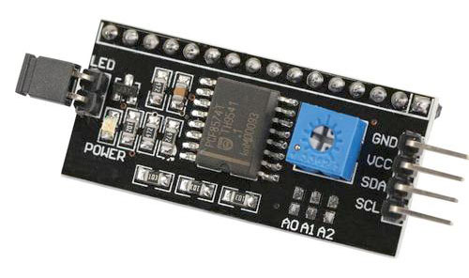
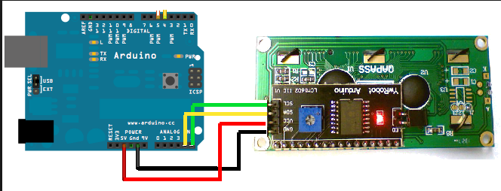
LCM1620 I2C LCD
GND (ground)
VCC (power supply 5V)
SDA (I2C data line)
SCL (I2C clock)
A4
A5
I2C (IIC, I²C): a synchronous serial computer bus

Slide 8
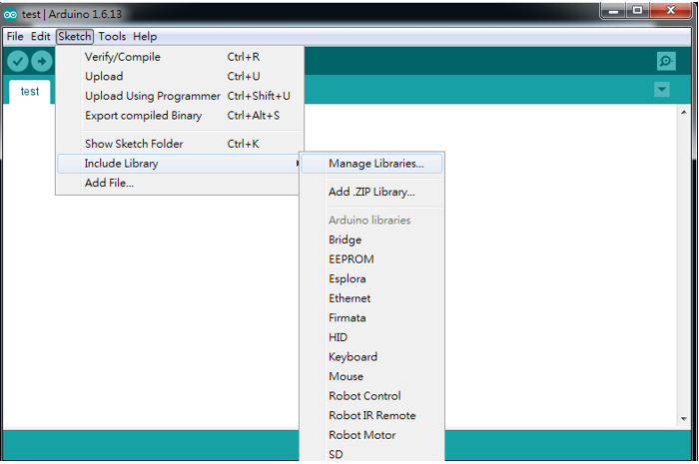
LCD Library
Go to “Sketch” → “Include Library” → “Manage Libraries…” to open Arduino IDE Library manager

Slide 9
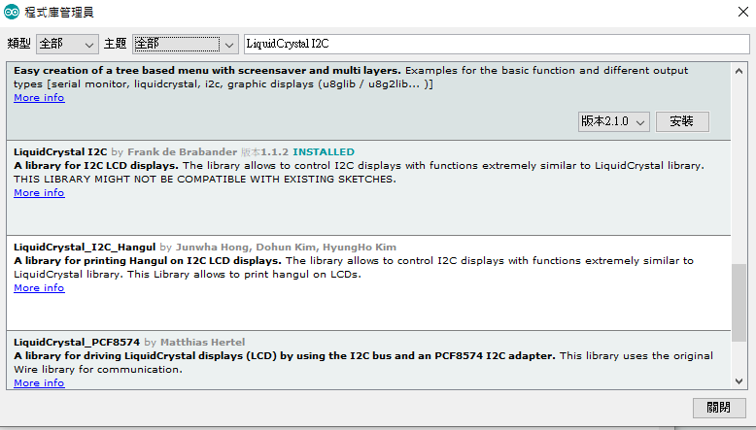
LCD Library
In Arduino IDE Library manager, type “LiquidCrystal I2C” and download LiquidCrystal I2C

Slide 10
Sample Code for LCD
#include <Wire.h>
#include <LiquidCrystal_I2C.h>
// Set pins on I2C chip for LCD connections:
LiquidCrystal_I2C lcd(0x27,16,2);
// Set I2C address and size
void setup() {
lcd.init(); // initialize LCD
lcd.backlight(); // open LCD backlight
lcd.setCursor(0, 0); // setting cursor
lcd.print("Hello, world!");
delay(1000); lcd.clear(); // clear all
lcd.setCursor(0, 1);
lcd.print("Type to display");
}
void loop() { }
Notes:
rs: the number of the Arduino pin that is connected to the RS pin on the LCD
rw: the number of the Arduino pin that is connected to the RW pin on the LCD (optional)
enable: the number of the Arduino pin that is connected to the enable pin on the LCD
d0, d1, d2, d3, d4, d5, d6, d7: the numbers of the Arduino pins that are connected to the corresponding data pins on the LCD. d0, d1, d2, and d3 are optional; if omitted, the LCD will be controlled using only the four data lines (d4, d5, d6, d7).

Slide 11
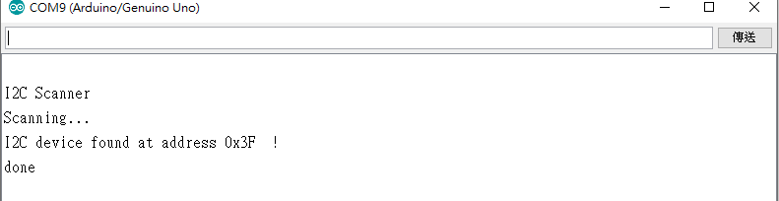
I2C Address
Need to set correct address for different I2C devices
You can try 0x27 or 0x3F
Or use i2c_scanner to find your address https://playground.arduino.cc/Main/I2cScanner/
LiquidCrystal_I2C lcd(0x27,16,2);

Slide 12
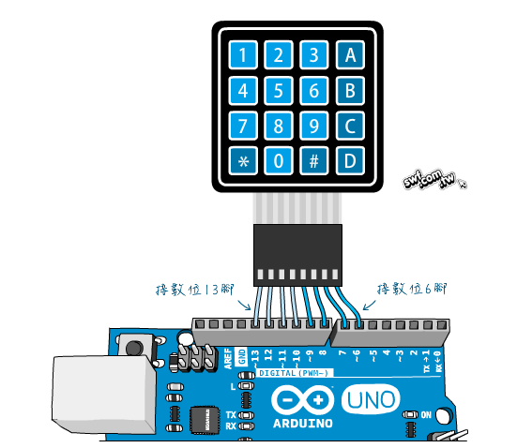
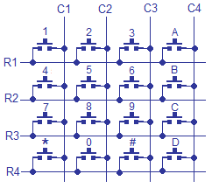
Hex Keypad
Use “column scanning” to identify the pressed key

Slide 13
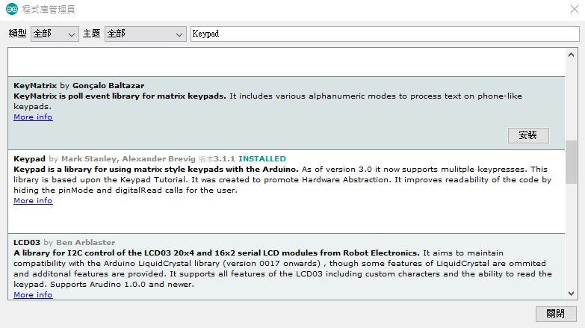
Hex Keypad Library
In Arduino IDE Library manager, type “Keypad” and download Keypad

Slide 14
Sample Code for Hex Keypad
#include <Keypad.h>
#define KEY_ROWS 4
#define KEY_COLS 4
char keymap[KEY_ROWS][KEY_COLS] = {
{'1', '2', '3', 'A'},
{'4', '5', '6', 'B'},
{'7', '8', '9', 'C'},
{'*', '0', '#', 'D'}
};
// Column pin 1~4
byte colPins[KEY_COLS] = {9, 8, 7, 6};
// Column pin 1~4
byte rowPins[KEY_ROWS] = {13, 12, 11, 10};

Slide 15
Sample Code for Hex Keypad
// initialize keypad
Keypad myKeypad = Keypad(makeKeymap(keymap), rowPins, colPins, KEY_ROWS, KEY_COLS);
void setup(){
Serial.begin(9600);
}
void loop(){
char key = myKeypad.getKey();
if (key)
Serial.println(key);
}

Slide 16
Lab 10
Basic 2: (30%)
We implement Basic 1 using C/C++ functions, which have only one thread of execution.
In Basic 2, we Implement all operations using FreeRTOS tasks, which constitute multiple threads of execution.
Create 3 tasks, LoginTask, SetupTask, DisplayTask, in setup().
Let the tasks change each other’s priority so that the door lock system runs correctly.
Note:
Use memory carefully and set the size of task stack properly.
To save memory, you can use print(F(“hello”)) instead of print(“hello”) .

Slide 17
Lab 10
Basic 3: (30%)
Repeat Basic 2, but now set the priorities of the three tasks equal.
Let the tasks communicate their data and synchronize their operations through global variables.
Again, you do not need synchronization primitives in FreeRTOS to complete this lab.
Hint: Identify the critical resource that needs to be protected in order to avoid race conditions.

