Slide 1
CS4101 Introduction to Embedded Systems Lab 8: Arduino DAC and PWM
Prof. Chung-Ta King
Department of Computer Science
National Tsing Hua University, Taiwan

Slide 2
Lab 8
Basic 1: DAC and ADC (30%)
Connect one RGB LED to a PWM pin and control its color through a joystick.
Move joystick up/down to change intensity of the red color.
Move joystick right/left to change intensity of the green color.
Move joystick between 45° and 225° to change intensity of the blue color. Do the same for 135° and 315°.
Click the joystick button once to let the RGB LED flashes in 2 Hz driven by a timer interrupt. Click a second time to stop flashing.
You should detect the button down event by interrupt also.

Slide 3
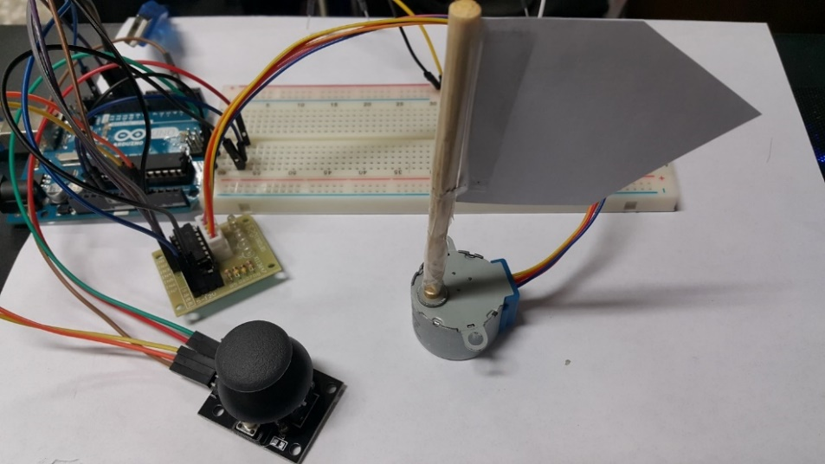
Lab 8
Basic 2: Actuator (20%)
Add a stepper motor to Basic 1. Attach an arrow on its axis.
Turn the flag to follow movement of joystick (8 directions).
The motor should turn towards the correct direction immediate after the joystick changes direction.
You may like to adjust the motor speed or your handling of the joystick so that the stepper motor may follow properly.
Turn all motor pins to Low after rotation to avoid errors.
#define STEPS 2048
Stepper stepper(STEPS, 8, 10, 9, 11);
void setup() {
stepper.setSpeed(15);
}

Slide 4
Lab 8
Basic 3: Sensors and actuator (50%)
Remove the joystick in Basic 2 and add an ultrasonic sensor.
Choose a random direction (left or right) and steps to turn the motor. Stop when the motor reaches the set steps.
You, as a player, move your hand closer to or away from the ultrasonic sensor to follow the turn of the stepper motor.
If the flag turns right, you move closer to the ultrasonic sensor; otherwise, move away from it. The closeness depends on the steps of the motor’s turn.
If your hand follow the motor movement correctly within 2 seconds after the motor starts to turn, the RGB LED will turn green for 2 seconds; otherwise, it turns red.
Return the motor to initial position and restart the game.

