Slide 1
CS4101 Introduction to Embedded Systems Lab 9: FreeRTOS
Prof. Chung-Ta King
Department of Computer Science
National Tsing Hua University, Taiwan

Slide 2
Lab 9
Basic 1: Parking Space Detection (30%)
In this lab, we want to detect whether a parking space is available and count the number of empty spaces.
Suppose there are two parking spaces.
One photoresistor is placed above each space, which detects continuously whether the space is empty or not.
A value below 500 means a car is on the parking space.
Add a seven-segment display to show the number of empty parking spaces.
Implement all operations using original Arduino functions. There is no need to control the timing.
Hint: Analog pins can be used as digital pins, declared as pin 14~19.

Slide 3
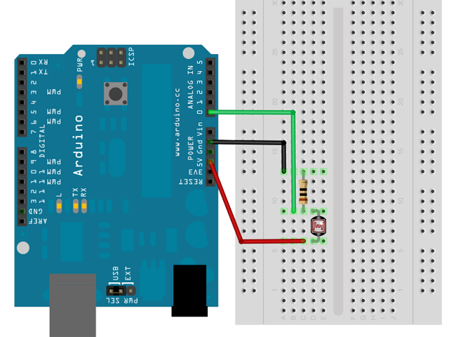
Photoresistor and Arduino
Resistor suggestion: 10k ohm

Slide 4
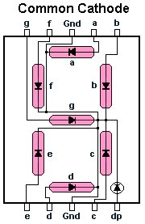
Seven-Segment Display
Essentially 7 LEDs
To display a particular number, turn on individual segments:
Digit | a | b | c | d | e | f | g
0 | on | on | on | on | on | on | off
1 | off | on | on | off | off | off | off
2 | on | on | off | on | on | off | on
3 | on | on | on | on | off | off | on
4 | off | on | on | off | off | on | on
5 | on | off | on | on | off | on | on
6 | on | off | on | on | on | on | on
7 | on | on | on | off | off | off | off
8 | on | on | on | on | on | on | on
9 | on | on | on | on | off | on | on
https://www.allaboutcircuits.com/projects/interface-a-seven-segment-display-to-an-arduino/

Slide 5
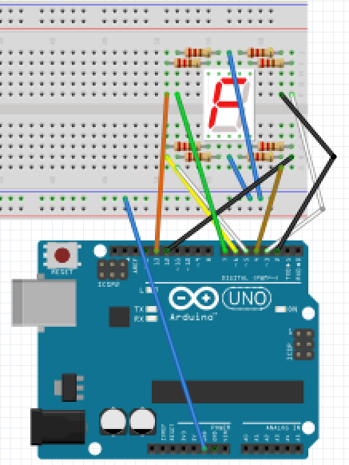
Seven-Segment Display Connection
Digital pin 2 to a Digital pin 3 to b Digital pin 4 to c Digital pin 5 to d Digital pin 6 to e Digital pin 7 to f Digital pin 13 to g (14 Digital pin 12 to dp (15
Resistor suggestion : 220 ohm
Please use resistors

Slide 6
Sample Code for 7-Segment Display
int pins[8] = {2, 3, 4, 5, 6, 7, 13, 12};//pins to 7-seg.
boolean data[3][8] = {
// define the pins to light the 3 number: 0, 1, 2
{true, true, true, ...}, // 0
...
}
// to display the number 0, 1, or 2
for(int i = 0; i < 8; i++){ digitalWrite(pins[i],
data[number][i] == true ? HIGH : LOW); }

Slide 7
Lab 9
Basic 2: Parking Space Detection (30%)
三個task(兩個input, 一個output(控制sevensegment
Implement all operations in Basic 1 using FreeRTOS tasks:
Create ONE FreeRTOS task for EACH photoresistor.
Create one FreeRTOS task to set seven-segment display.
Set the priority of all three tasks to 1.
Now you have a situation in which data has to be passed between tasks. This may lead to race condition if you use a variable, COUNT, to track number of empty spaces. Why?
Hint: What if both photoresistor tasks try to update COUNT?
Implement this lab without causing race condition. Note that you do not need to use any synchronization primitives of FreeRTOS, which will be covered in later labs.
Hint: Do not allow 2 tasks to update 1 variable simultaneously.

Slide 8
Lab 9
Basic 3: Parking Lot System (40%)
Add an ultrasonic sensor to detect whether a car is within 15 cm from the entrance.
Add a stepper motor with a flag to turn to an empty parking space, when a car is within 15 cm from the entrance.
If both spaces are empty, turn the flag to the left space.
If both spaces are full, turn the flag to a third direction.
When the car is away, return the flag to the initial position.
You have to implement all operations using FreeRTOS tasks.
Now you have a situation in which tasks have sequence. Again, you do not need to use any synchronization primitives of FreeRTOS, which will be covered in later labs

Slide 9
DEMO
Basic3
https://drive.google.com/open?id=10zwPeIotGjxWKr412mJF3W_oyC8Pqkh3

