Slide 1

Planetary Gear Reducer
Conceptual Design
Team 10
劉多聞 高子彧 林綠芸 葉蓁 何明耀

Slide 2
Outline
Conceptual Design
Load Condition
Engineering Drawing
Presentation

Slide 3
Outline
Conceptual Design
Load Condition
Engineering Drawing
Presentation

Slide 4
Design specifications confirmation
Reduction ratio = 15.6
Nominal transformed power
Power 32kW
Input 12000 rpm / 25 Nm
Output 770 rpm / 390 Nm
• Max speed condition
Input 20000 rpm / 15 Nm
Output 1300 rpm / 234 N

Slide 5
Conceptual design
The output speed needs to be reduced.
小齒輪(input)帶大齒(output)輪轉，因為大齒輪齒數高於小齒輪齒數，所以output轉速會 < input轉速
Sun gear : Input
Planet gears carrier : Output
Ring gear : Fixed

Slide 6
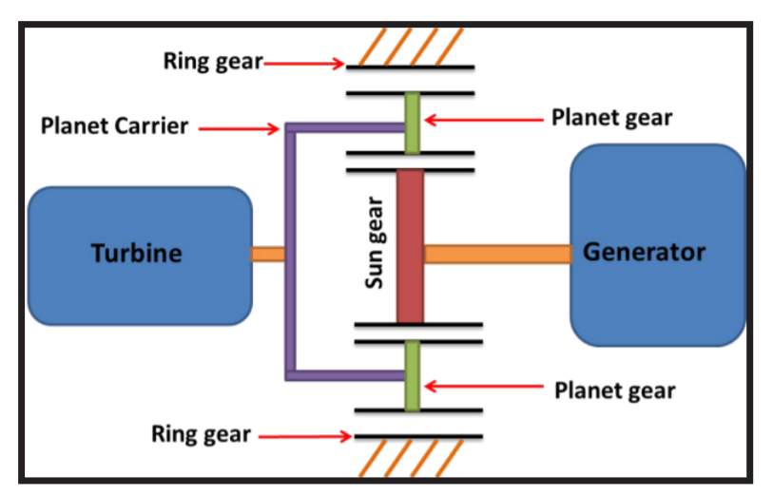
Conceptual design
(設計簡圖)
output
input

Slide 7
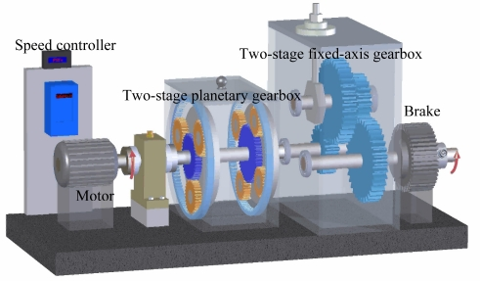
Conceptual design

Slide 8
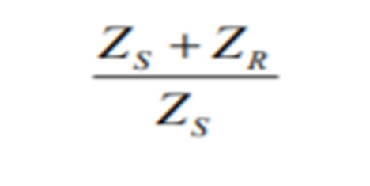
Conceptual design
By formula ： 齒輪直徑跟齒數成正比
Zcarrier = Zsun + (Zring – Zsun) / 2
We calculate from our reduction ratio : 15.6
Two stage reduction ratio : 3 * 5.2
Zring : Zsun : Zcarrier = 20 : 10 : 15(radius ratio)
Zring : Zsun : Zcarrier = 42 : 10 : 26(radius ratio)
模數、齒數、齒輪規格待定

Slide 9
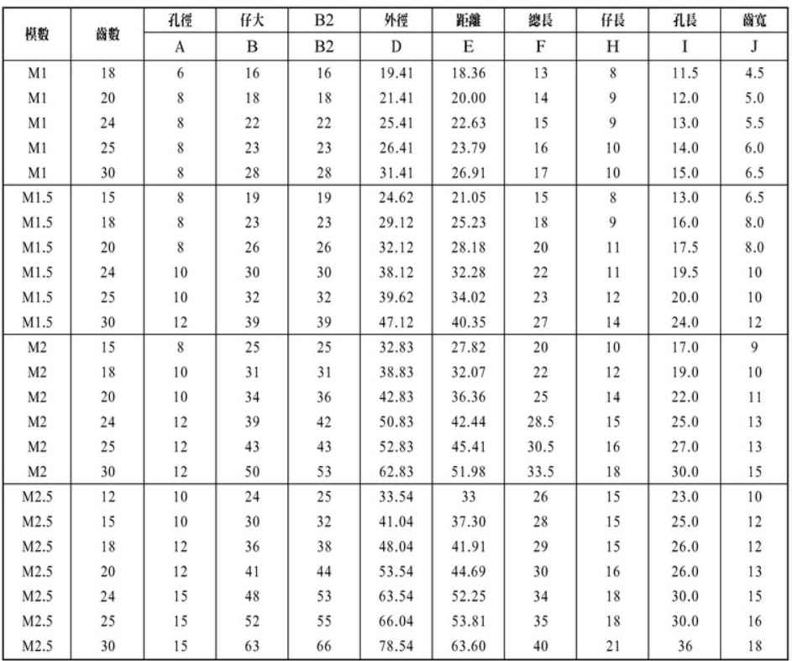
Conceptual design

Slide 10
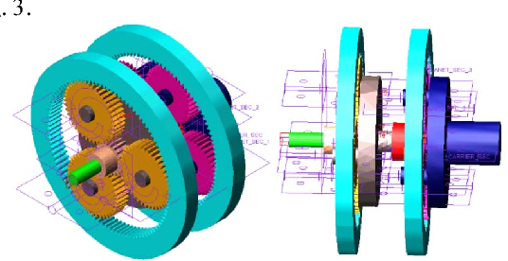
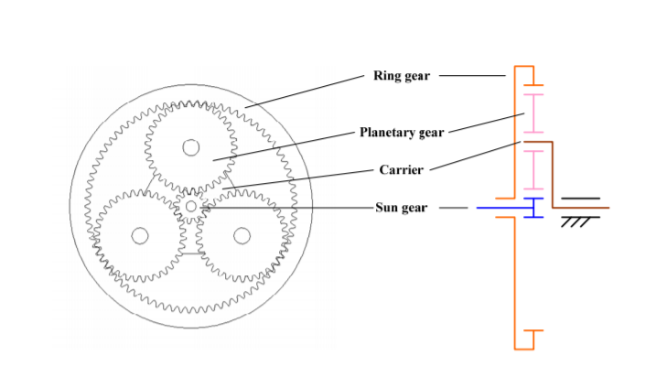
Simple schematics

Slide 11
Outline
Conceptual Design
Load Condition
Engineering Drawing
Presentation

Slide 12
SPEC
Power : 32KW
First Stage : Input :12000rpm/25Nm Output : 3333rpm/90Nm
Second Stage : Input : 3333rpm/90Nm Output : 770rpm/390Nm
First Stage Reduction Ratio : 3.6
Second Stage Reduction Ratio : 4.3
Total Reduction Ratio : 15.5
First Stage 齒數比 29: 22:73 半徑比 29:51:80
Second Stage 齒數比 19: 23:65 半徑比 19:42:65
Diameter < 180mm / Length < 120mm / Volume < 3L / Weight < kg

Slide 13
Load Condition
Design Flow:
Planetary Gear -> Shaft -> Bearings -> Gearbox -> Fasteners (Bolts, nuts.)

Slide 14
Gear
From General Planetary Gear combinations :
We choose these two configuration to meet our goal. (Reduction ratio ≈15.6)

Slide 15
Stage 1
Stage 1 | module | Teeth | Pitch diameter | bore diameter | pressure angle(degree) | Reduction Ratio
Ring | 1.5 | 73 | 109.5 |  | 20 | 3.6
Sun | 1.5 | 29 | 43.5 | 15 | 20
planet | 1.5 | 22 | 33 | 15 | 20
carrier |  |  | 76.5

Slide 16
Stage 2
Stage 2 | module | Teeth | Pitch diameter | bore diameter | pressure angle(degree) | Reduction Ratio
Ring | 1.5 | 65 | 97.5 |  | 20 | 4.3
Sun | 1.5 | 19 | 28.5 | 10 | 20
planet | 1.5 | 23 | 34.5 | 12 | 20 | Total ratio
carrier |  |  | 63 |  |  | 15.48

Slide 17
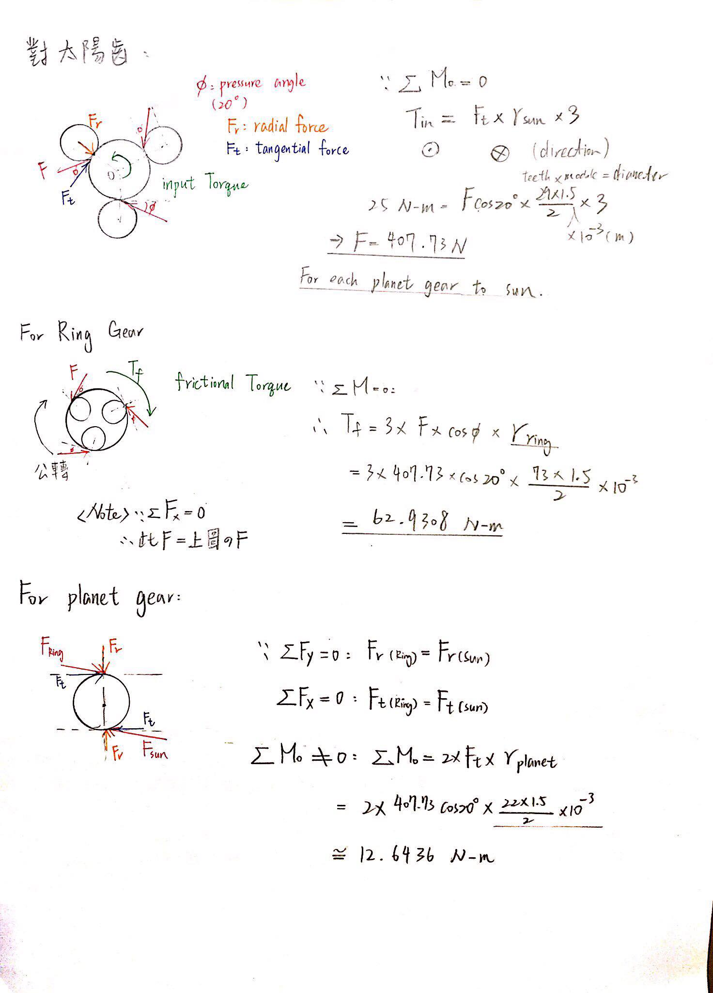
Gear – Load Analysis
Based on Input Torque 25 N-m :

Slide 18
Gear – Load Analysis
Based on Ring Gears are fixed :

Slide 19
Gear – Load Analysis
Based on force-equilibrium equations :

Slide 20
Gear – Load Analysis
Note : We assume that all gears are rotating at constant speed.
That is, we ignore the effect of angular acceleration.

Slide 21
Gear – Load Analysis
Based on Input Torque 25 N-m :

Slide 22
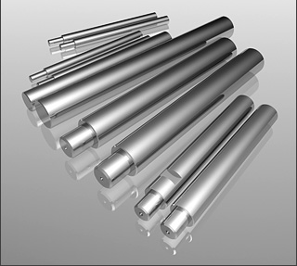
Shaft - Material
軸心：CRS (氣、油壓缸用活塞桿鍍鉻棒)
材質 : 中碳鋼 (S45C)
處理方式 : 研磨、表面鍍硬鉻、不生鏽。
型號：CRS15 / CRS12
外徑公差 f7：-16~-34 (µm)
重量：1.39(kg/m) / 0.89(kg/m)

Slide 23
Shaft - Material

Slide 24
Shaft - Dimension
第x段 | 外徑 (mm) | 長度 (mm) | 重量 (1.39kg/m)
1 | 15 | 17(軸承)+5+5 | 3.753(g)
2 | 15 | 22 | 2.78(g)
3 | 15 | 17+5+5 (gear house外) | 3.753(g)
Connect with gear
第x段 | 外徑 (mm) | 長度 (mm) | 重量 (1.39kg/m)
1 | 12 | 10+12(軸承) | 3.336(g)
2 | 12 | 10+12 | 3.336(g)
Connect with carrier

Slide 25
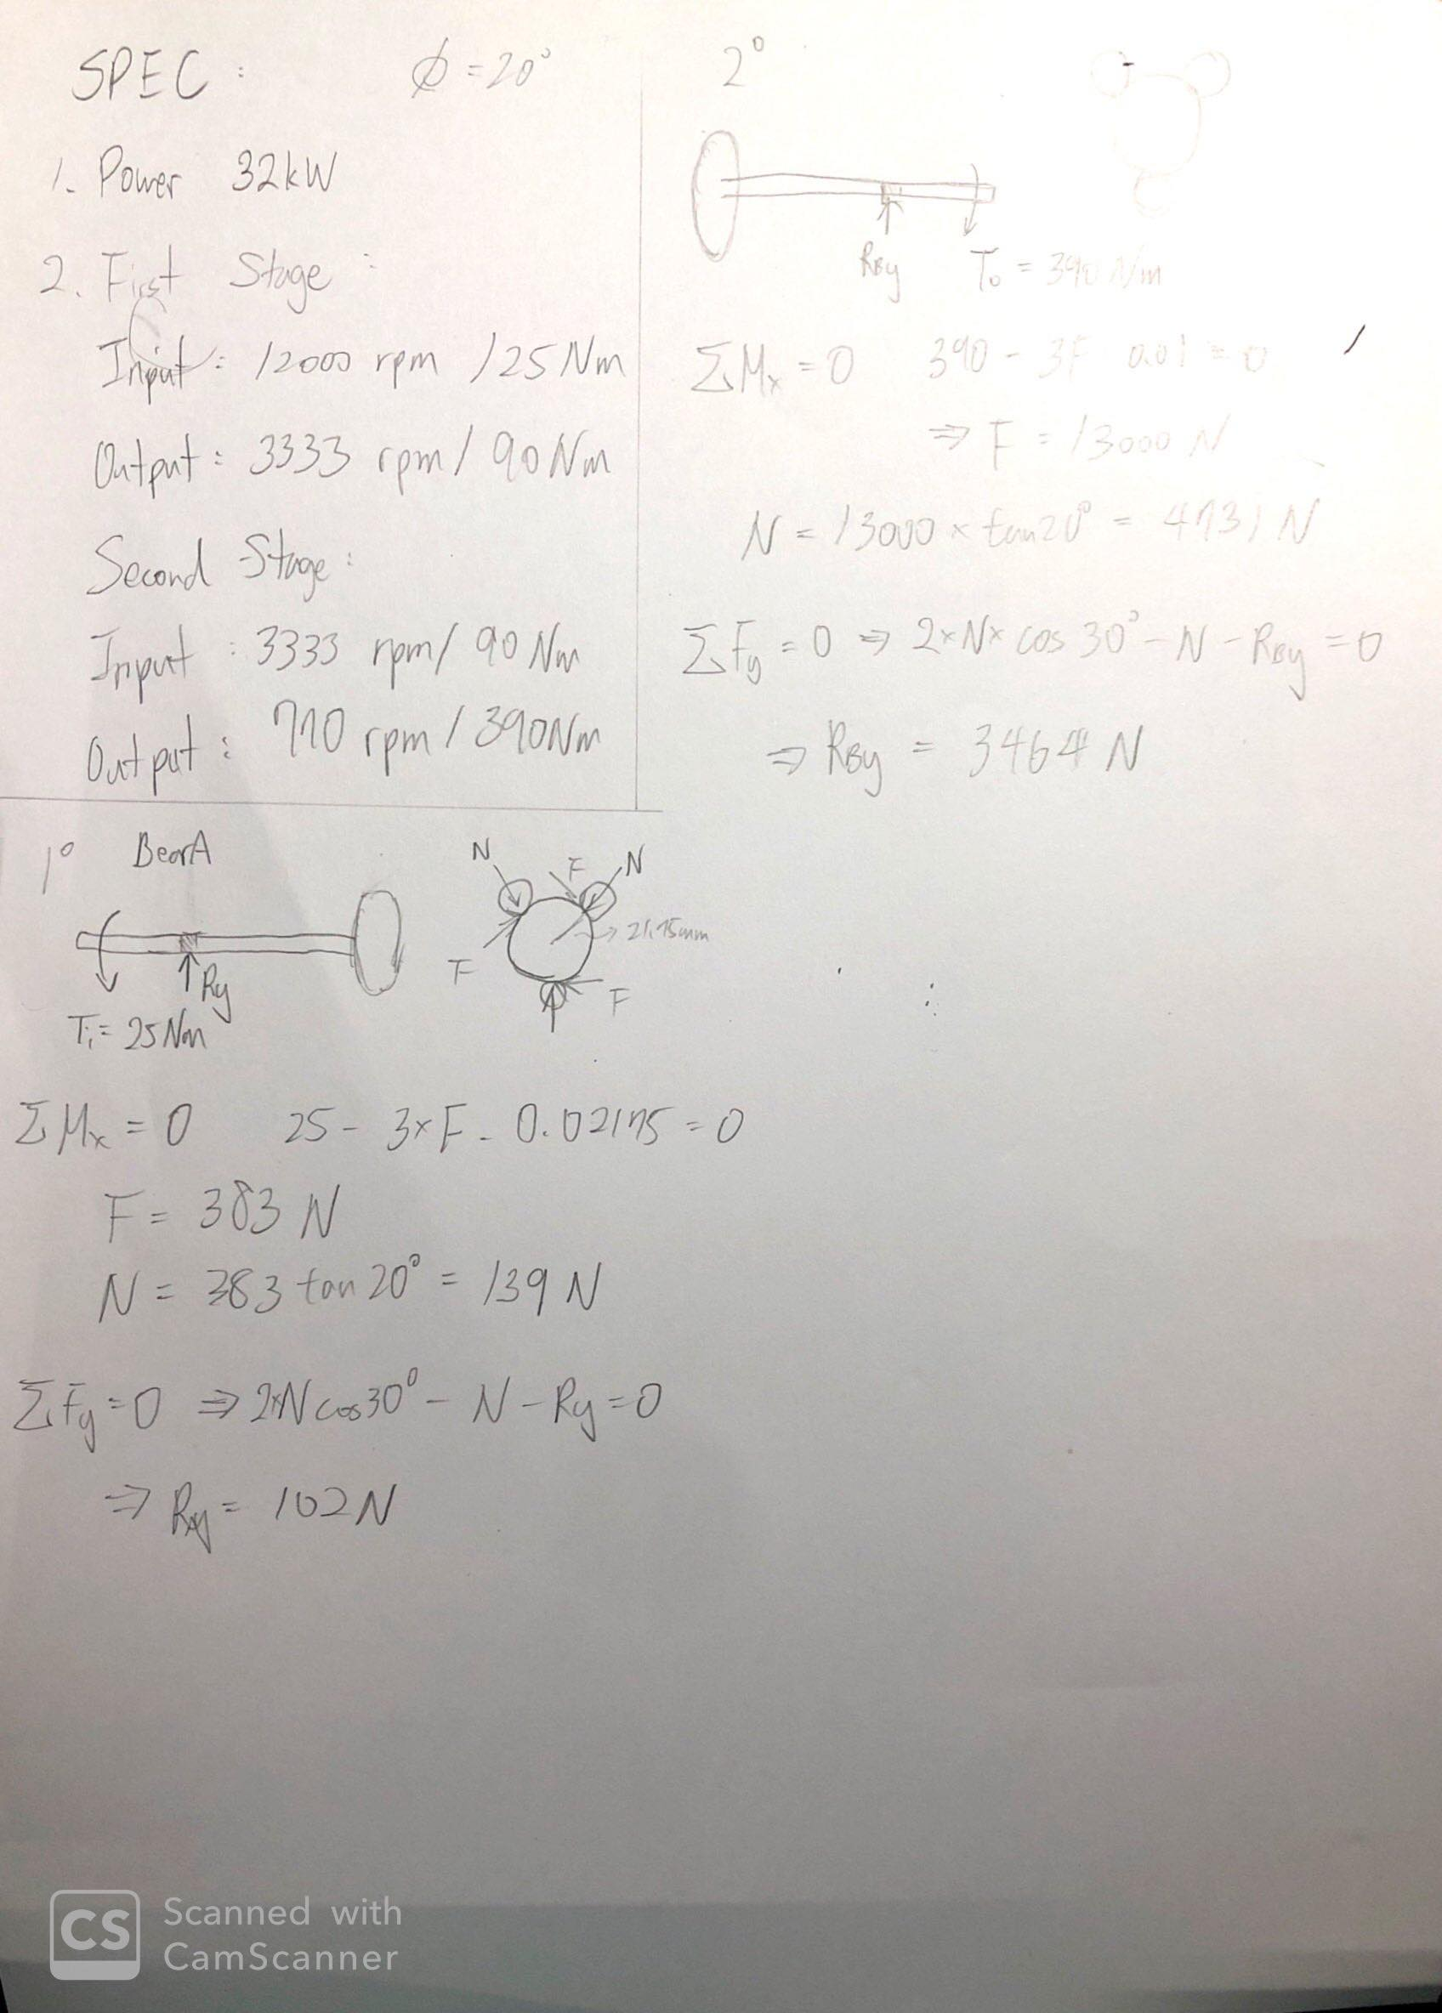
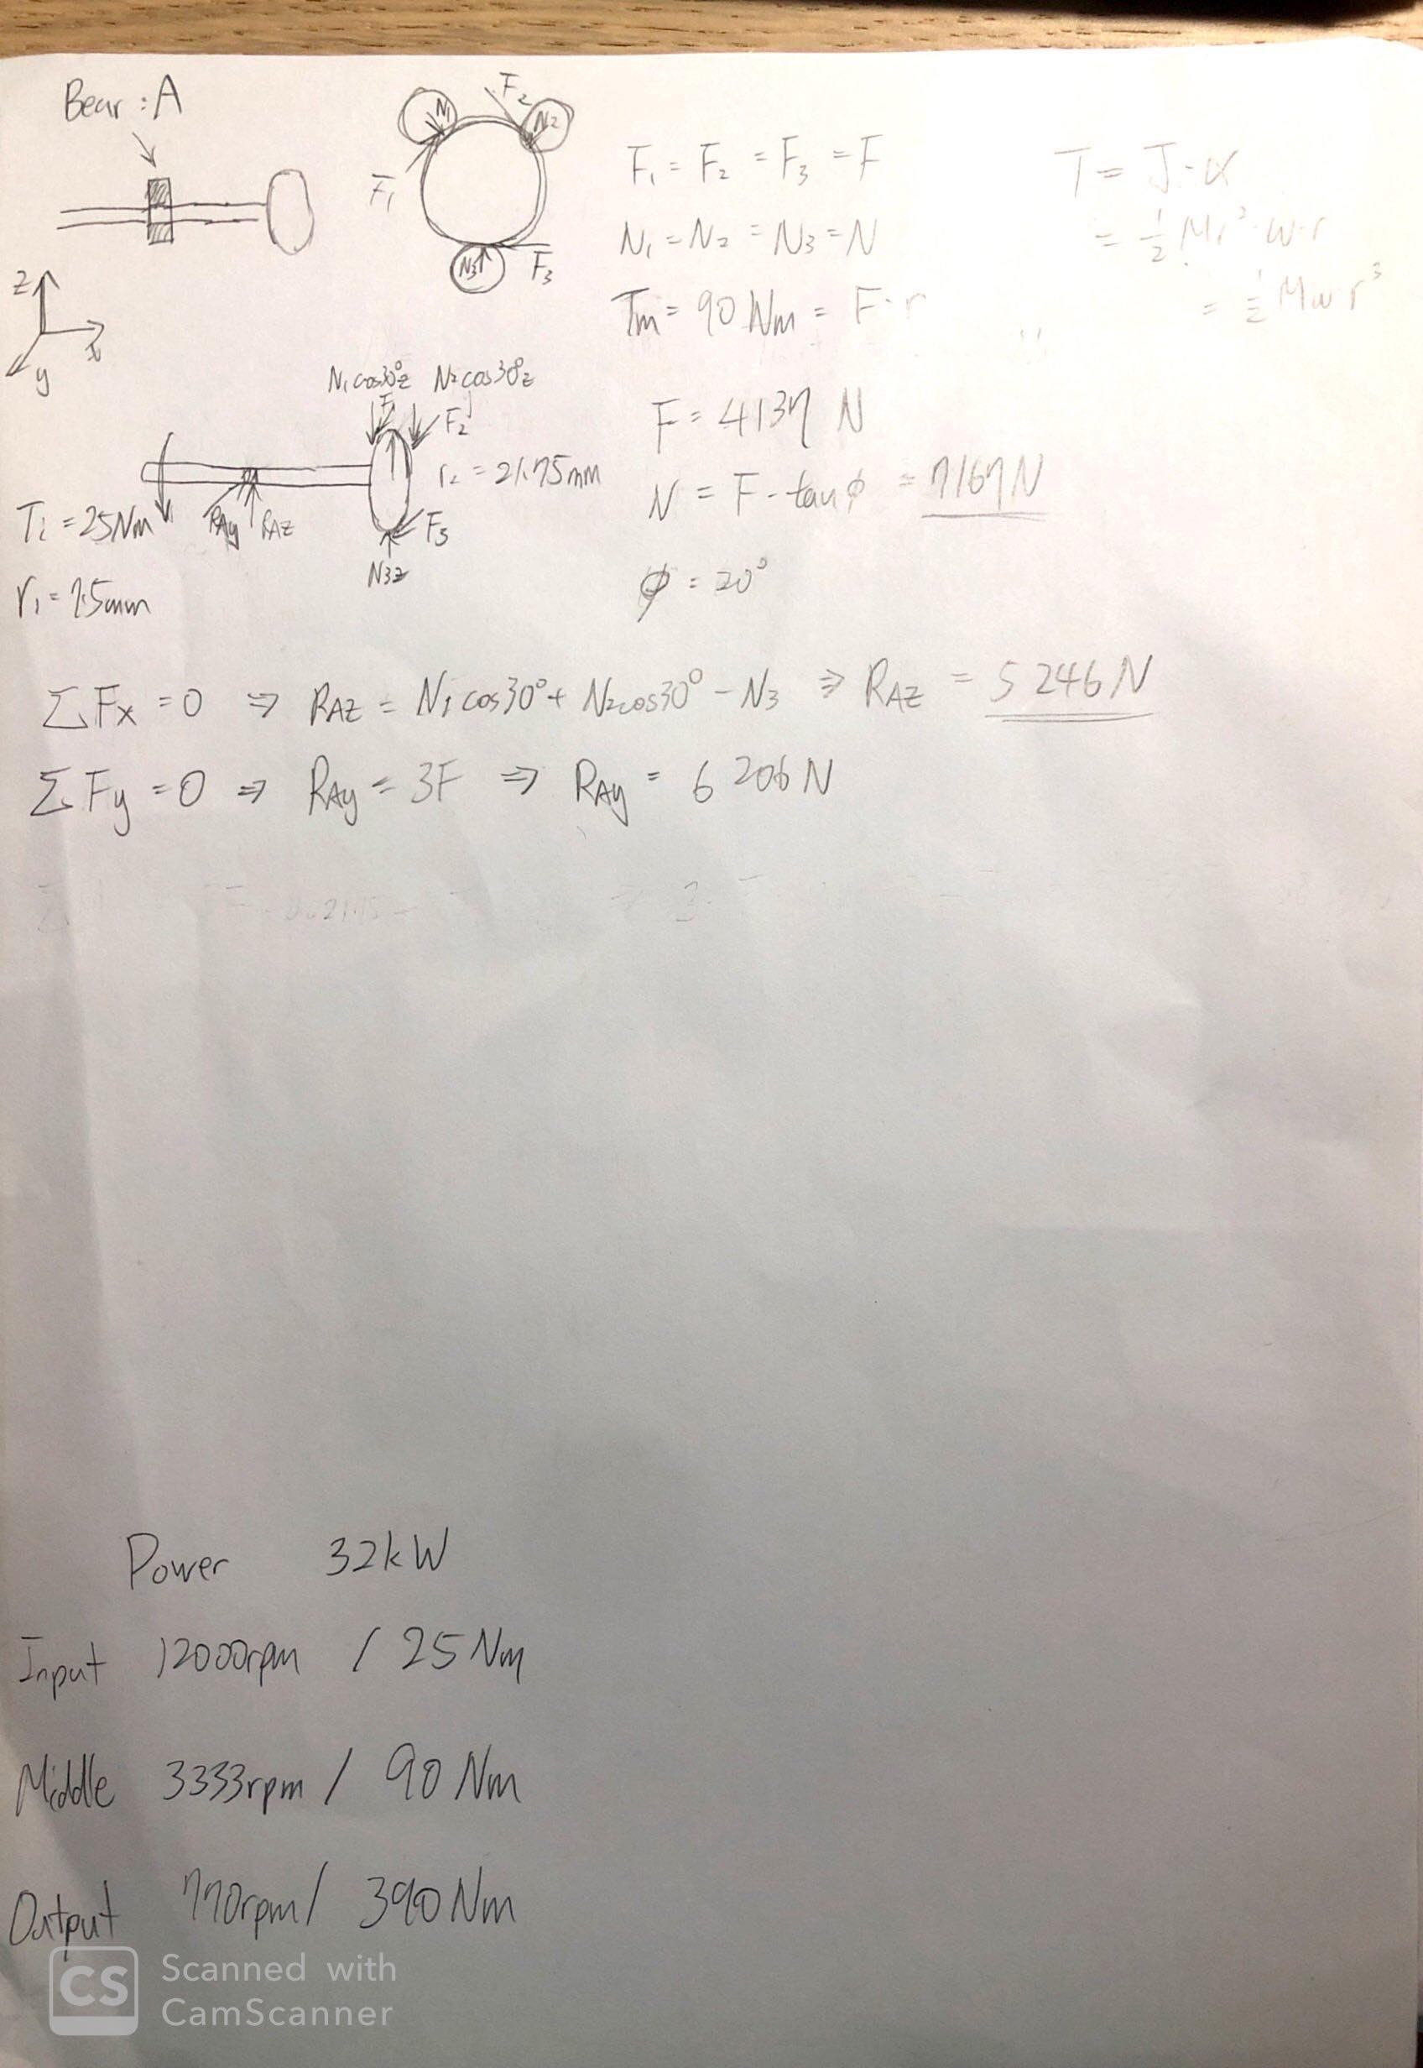
Shaft - Calculation
Precise
Draft

Slide 26
Bearing - What bearing we choose?
Bearing type: deep groove bearing
Why choose it?
1. 安靜
2. 震動小
3. 高轉速

Slide 27
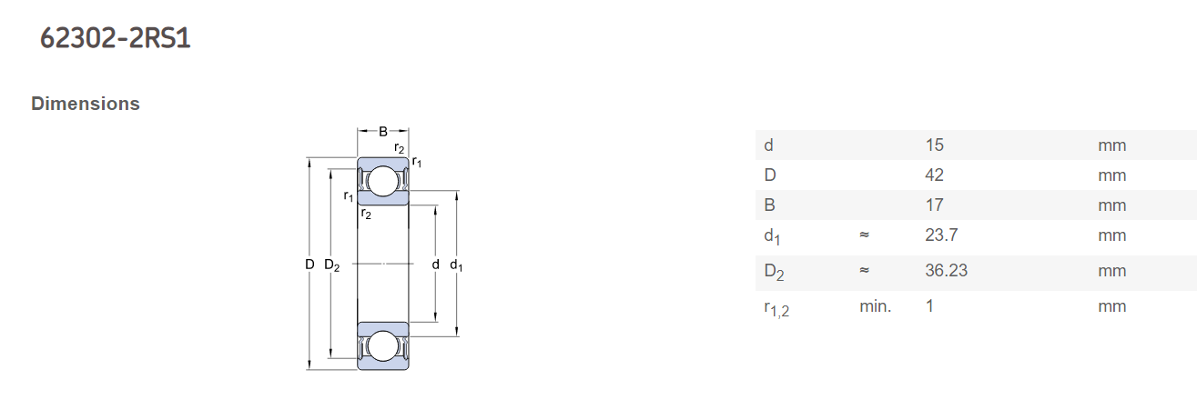
Bearing – How to choose bearing?
Part( a ) 輸入轉軸連接處
根據齒輪尺寸，因此挑選Bore大約為15mm
依照規格表比對，挑選 SKF 62302 2RS1為使用軸承

Slide 28

Bearing – Life Calculating
根據
R
R=0.9
C₁₀=7.8kN(根據規格表)
F_{D}=20.89kN(根據齒輪重量)
L_{R}=10⁶ rev 、 n_{D}=12000rpm
因此可計算出轉軸連接處的life = 0.072 h

Slide 29
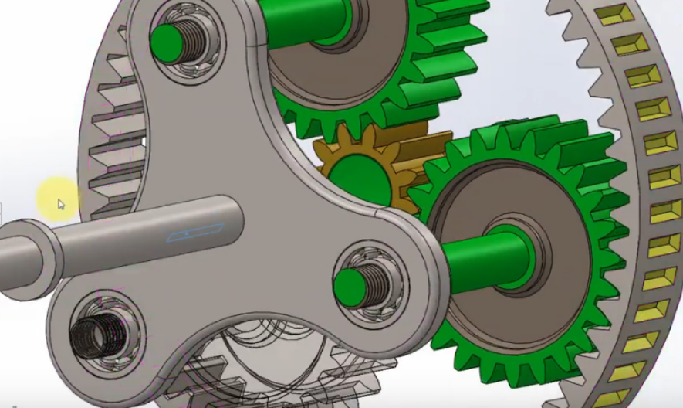
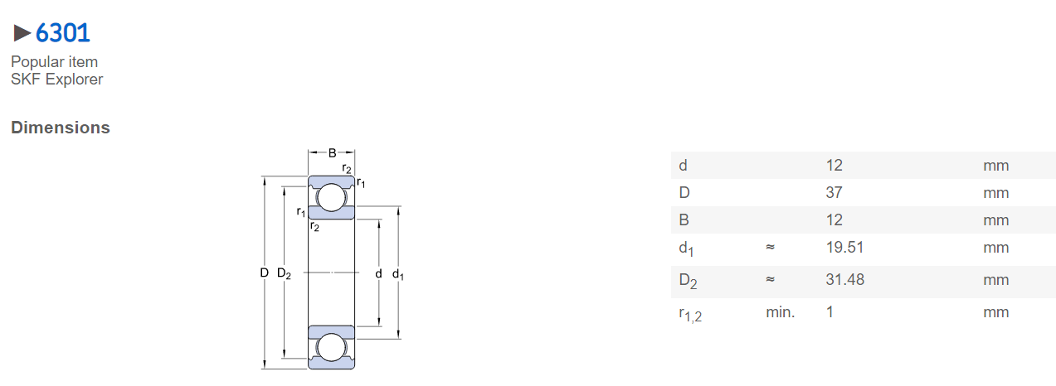
Bearing – How to choose?
Part( b ) 第二級的carrier齒輪上
根據齒輪尺寸，因此挑選Bore大約為12mm
依照規格表比對，挑選 SKF 6307為使用軸承

Slide 30
Bearing – Life Calculating
根據
R=0.9
C₁₀=10.1 kN(根據規格表)
F_{D}= 1.47 kN(根據齒輪重量)
L_{R}=10⁶ rev 、 n_{D}=3333rpm
因此可計算出轉軸連接處的life = 1621 h

