Slide 1

Planetary Gear Reducer
Conceptual Design
Team 10
劉多聞 高子彧 林綠芸 葉蓁 何明耀

Slide 2
Outline
Conceptual Design
Load Condition
Engineering Drawing
Presentation

Slide 3
Outline
Conceptual Design
Load Condition
Engineering Drawing
Presentation

Slide 4
Design specifications confirmation
Reduction ratio = 15.6
Nominal transformed power
Power 32kW
Input 12000 rpm / 25 Nm
Output 770 rpm / 390 Nm
• Max speed condition
Input 20000 rpm / 15 Nm
Output 1300 rpm / 234 N

Slide 5
Conceptual design
The output speed needs to be reduced.
小齒輪(input)帶大齒(output)輪轉，因為大齒輪齒數高於小齒輪齒數，所以output轉速會 < input轉速
Sun gear : Input
Planet gears carrier : Output
Ring gear : Fixed

Slide 6
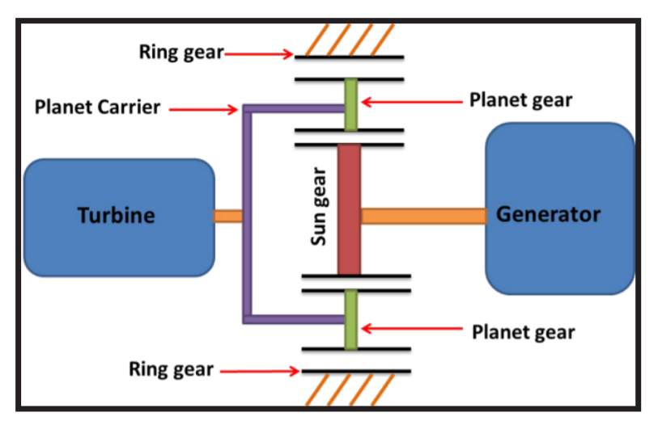
Conceptual design
(設計簡圖)
output
input

Slide 7
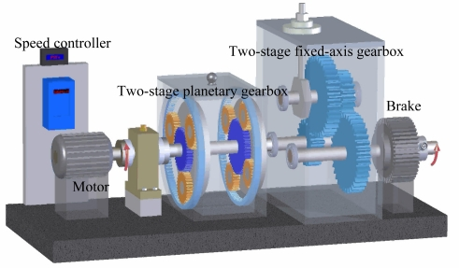
Conceptual design

Slide 8
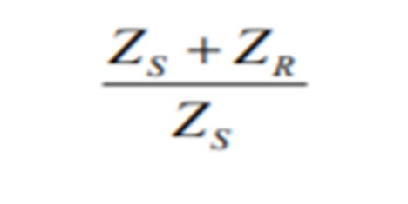
Conceptual design
By formula ： 齒輪直徑跟齒數成正比
Zcarrier = Zsun + (Zring – Zsun) / 2
We calculate from our reduction ratio : 15.6
Two stage reduction ratio : 3 * 5.2
Zring : Zsun : Zcarrier = 20 : 10 : 15(radius ratio)
Zring : Zsun : Zcarrier = 42 : 10 : 26(radius ratio)
模數、齒數、齒輪規格待定

Slide 9
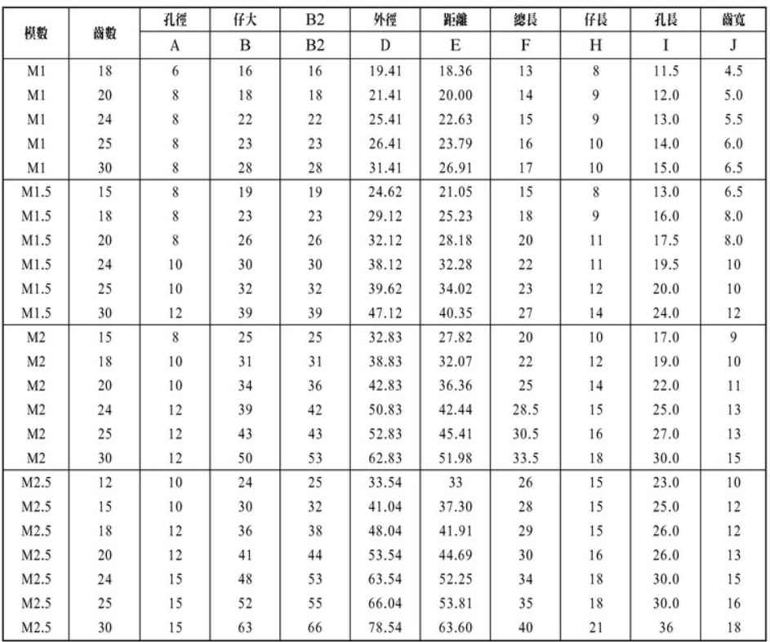
Conceptual design

Slide 10
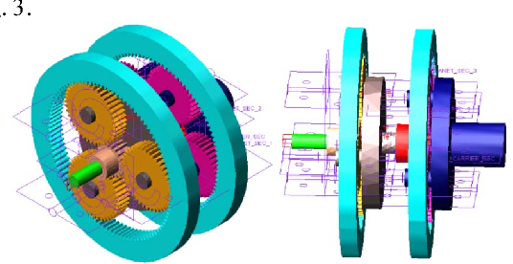
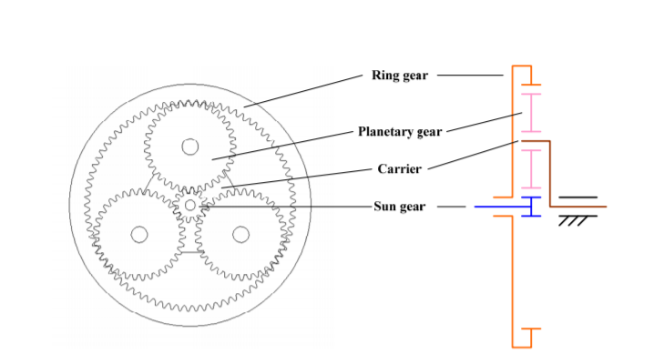
Simple schematics

Slide 11
Outline
Conceptual Design
Load Condition
Engineering Drawing
Presentation

Slide 12
Load Condition - spec
Power : 32KW
First Stage : Input :12000rpm/25Nm Output : 3333rpm/90Nm
Second Stage : Input : 3333rpm/90Nm Output : 770rpm/390Nm
First Stage Reduction Ratio : 3.6
Second Stage Reduction Ratio : 4.3
Total Reduction Ratio : 15.5
First Stage 齒數比 29: 22:73 半徑比 29:51:80
Second Stage 齒數比 19: 23:65 半徑比 19:42:65
Diameter < 180mm / Length < 120mm / Volume < 3L / Weight < kg

Slide 13
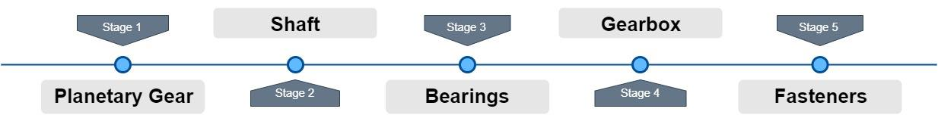
Load Condition - Design Flow

Slide 14
Load Condition - Design Flow

Slide 15
Gear
From General Planetary Gear combinations :
We choose these two configuration to meet our goal. (Reduction ratio ≈15.6)

Slide 16
Stage 1
Stage 1 | module | Teeth | Pitch diameter | bore diameter | pressure angle(degree) | Reduction Ratio
Ring | 1.5 | 73 | 109.5 |  | 20 | 3.6
Sun | 1.5 | 29 | 43.5 | 15 | 20
planet | 1.5 | 22 | 33 | 15 | 20
carrier |  |  | 76.5

Slide 17
Stage 2
Stage 2 | module | Teeth | Pitch diameter | bore diameter | pressure angle(degree) | Reduction Ratio
Ring | 1.5 | 65 | 97.5 |  | 20 | 4.3
Sun | 1.5 | 19 | 28.5 | 10 | 20
planet | 1.5 | 23 | 34.5 | 12 | 20 | Total ratio
carrier |  |  | 63 |  |  | 15.48

Slide 18
Gear – Why we choose these configuration
Co-prime to reduce wear.
The teeth ratios should be <3 to be feasible to work.
The difference of diameter size should not be to extreme to be robust to work effectively.

Slide 19
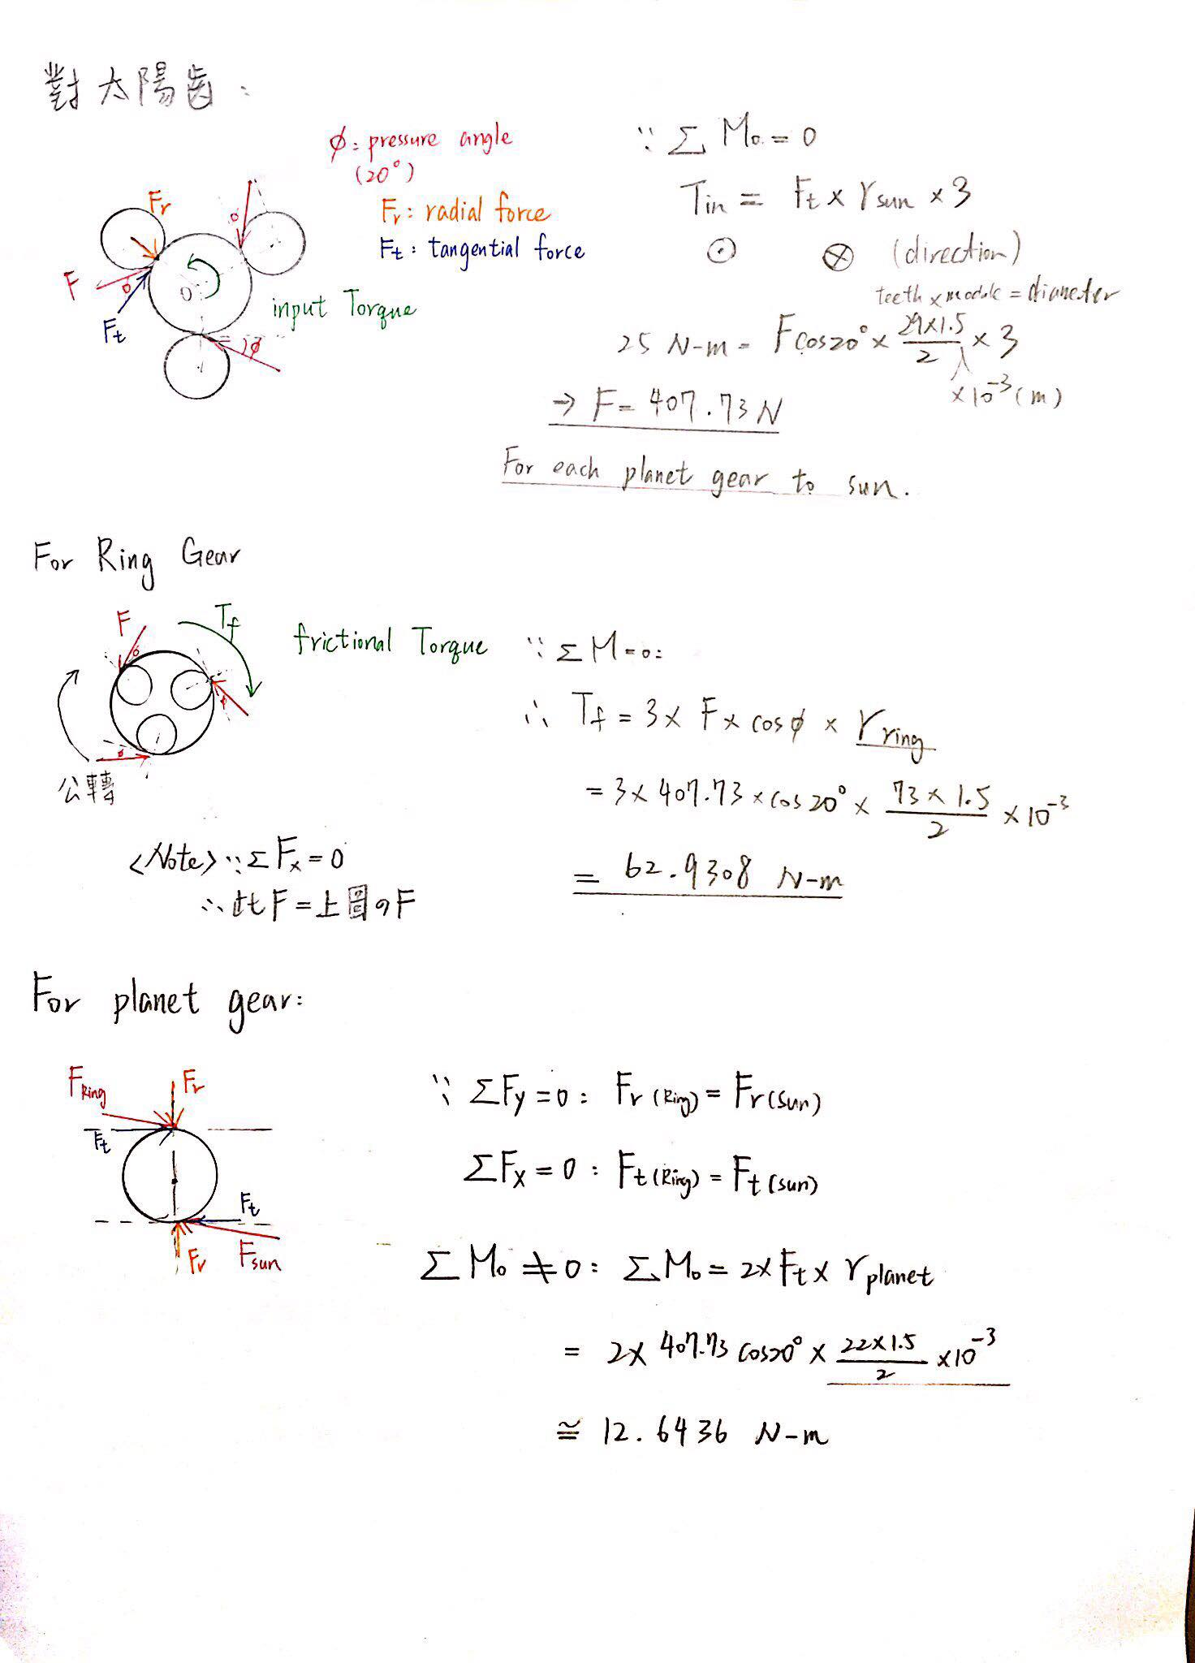
Gear – Load Analysis
Based on Input Torque 25 N-m :

Slide 20
Gear – Load Analysis
Based on Ring Gears are fixed :

Slide 21
Gear – Load Analysis
Based on force-equilibrium equations :

Slide 22
Gear – Load Analysis
Note : We assume that the sun gear is rotating at constant speed.
That is, we ignore the effect of angular acceleration.
But the net torque of each planet gear is not zero.
So they would have angular acceleration.

Slide 23
Load Condition - Design Flow

Slide 24
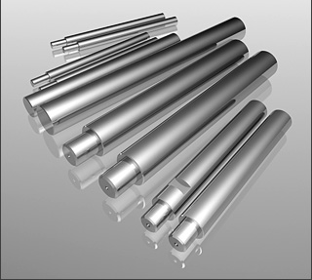
Shaft - Material
軸心：CRS (氣、油壓缸用活塞桿鍍鉻棒)
材質 : 中碳鋼 (S45C)
處理方式 : 研磨、表面鍍硬鉻、不生鏽。
型號：CRS15 / CRS12
外徑公差 f7：-16~-34 (µm)
重量：1.39(kg/m) / 0.89(kg/m)

Slide 25
Shaft – Why this shaft?

Slide 26
Shaft - Dimension
第x段 | 外徑 (mm) | 長度 (mm) | 重量 (1.39kg/m)
1 | 15 | 17(軸承)+5+5 | 3.753(g)
2 | 15 | 22 | 2.78(g)
3 | 15 | 17+5+5 (gear house外) | 3.753(g)
Connect with gear
第x段 | 外徑 (mm) | 長度 (mm) | 重量 (1.39kg/m)
1 | 12 | 10+12(軸承) | 3.336(g)
2 | 12 | 10+12 | 3.336(g)
Connect with carrier

Slide 27
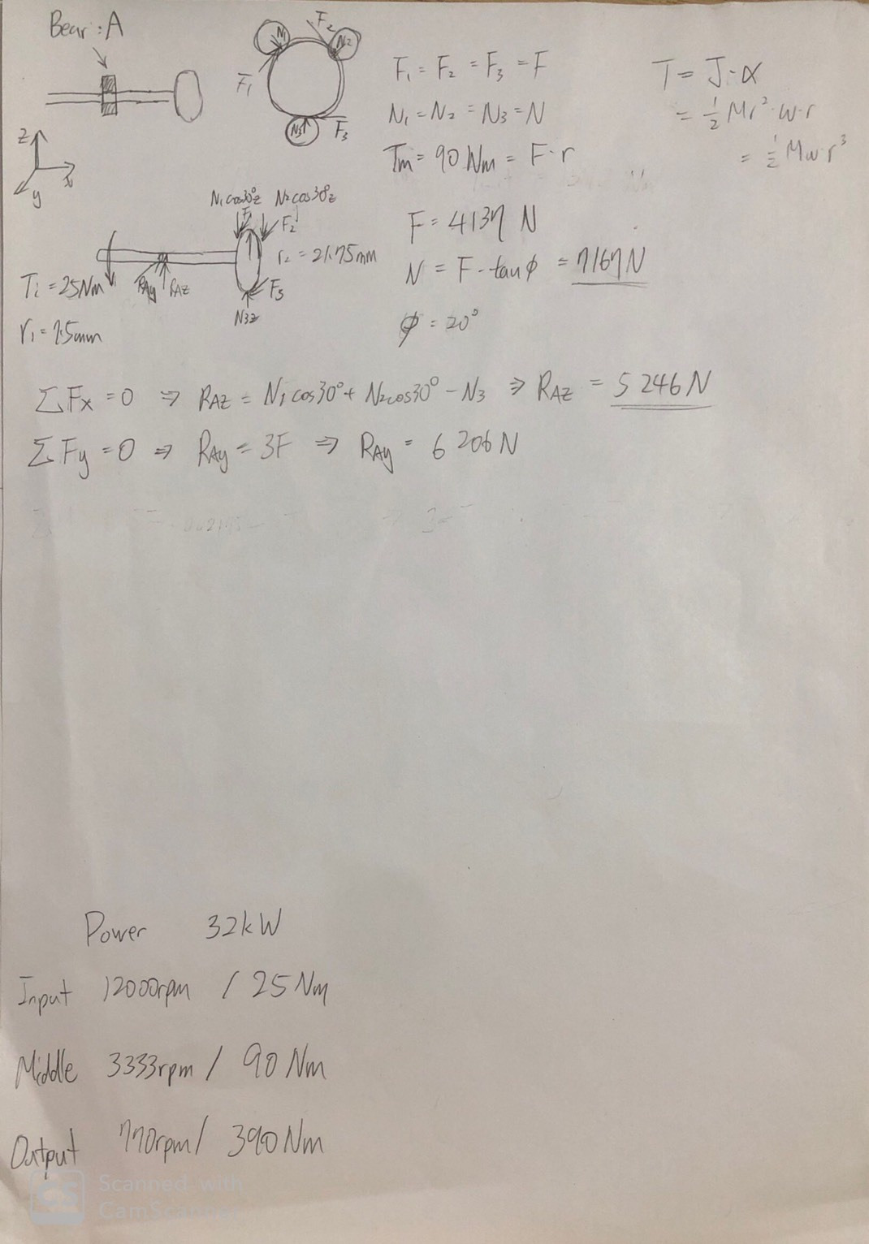
Shaft - Calculation
Draft

Slide 28
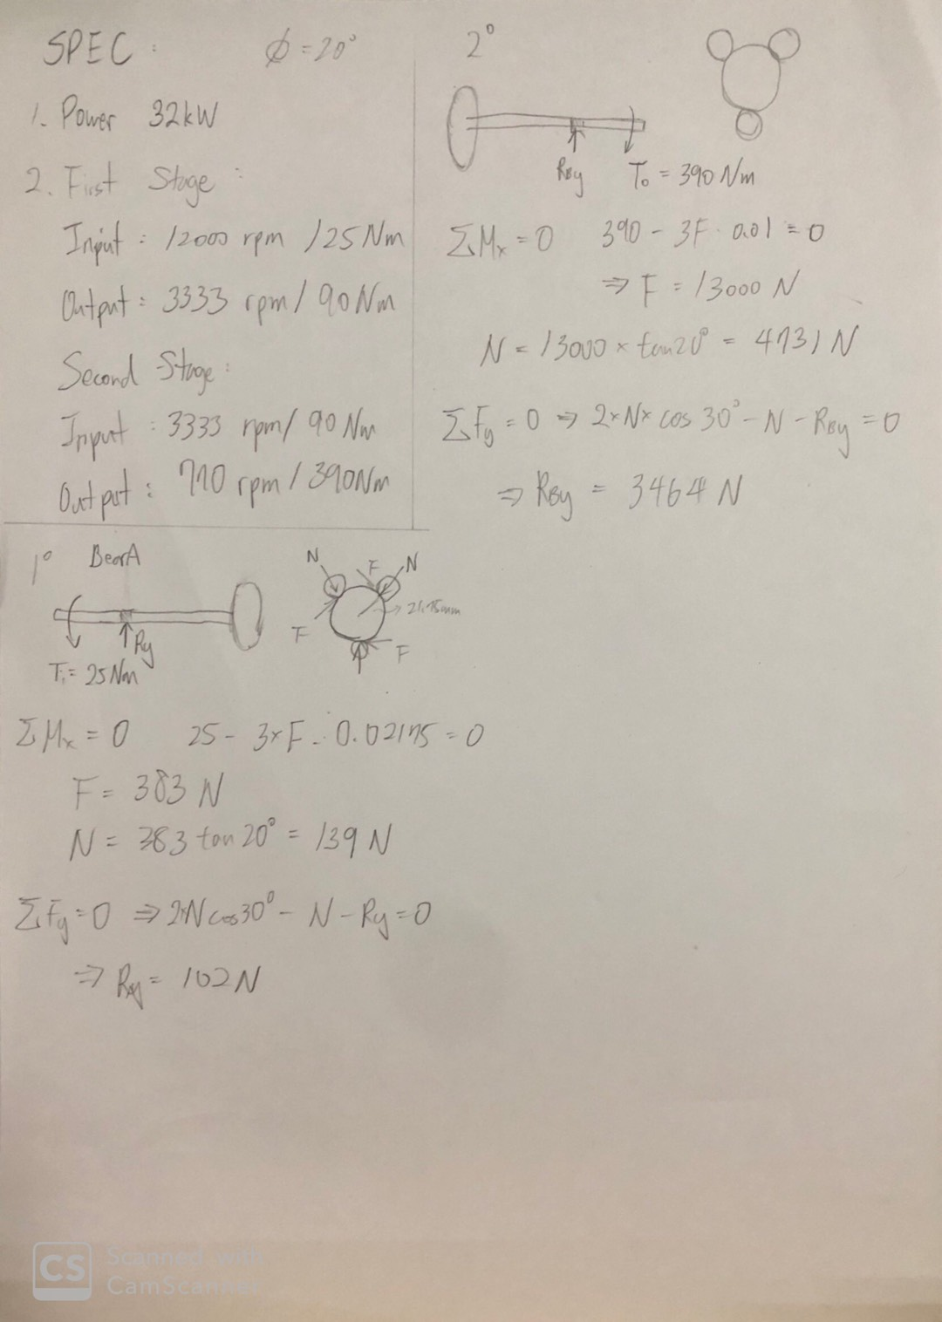
Shaft - Calculation
Precise

Slide 29
Load Condition - Design Flow

Slide 30
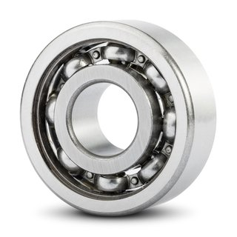
Bearing - What bearing?
Bearing type: deep groove bearing
Why choose it?
1. 安靜
2. 震動小
3. 高轉速

Slide 31
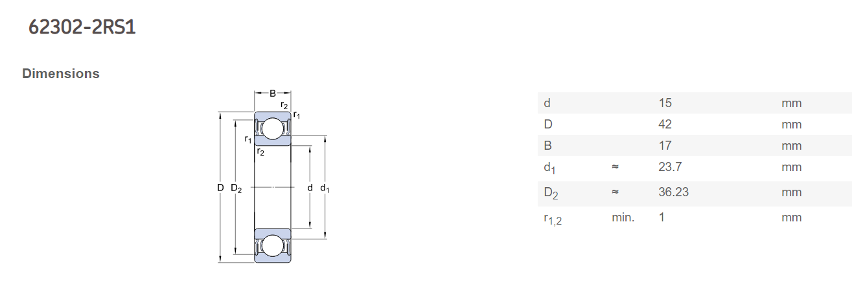
Bearing – How to choose bearing?
Part( a ) 輸入轉軸連接處
根據齒輪尺寸，因此挑選Bore大約為15mm
依照規格表比對，挑選 SKF 62302 2RS1為使用軸承

Slide 32

Bearing – Life Calculating
根據
R
R=0.9
C₁₀=7.8kN(根據規格表)
F_{D}=20.89kN(根據齒輪重量)
L_{R}=10⁶ rev 、 n_{D}=12000rpm
因此可計算出轉軸連接處的life = 0.072 h

Slide 33
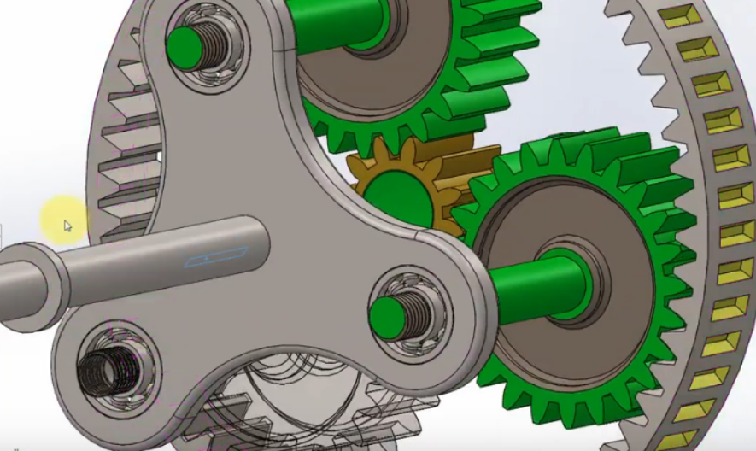
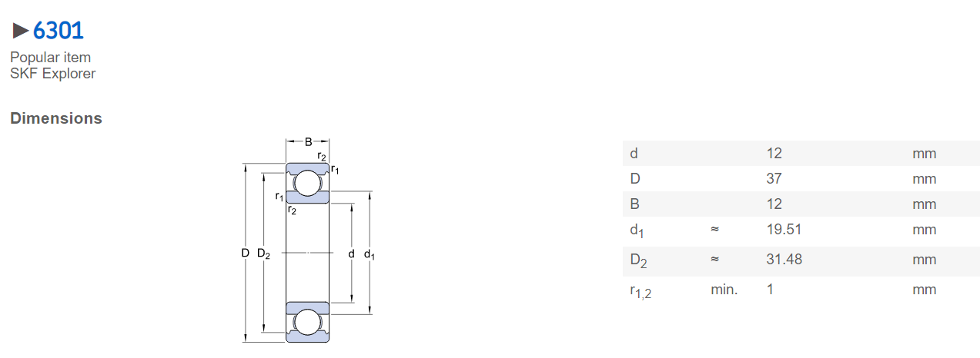
Bearing – How to choose?
Part( b ) 第二級的carrier齒輪上
根據齒輪尺寸，因此挑選Bore大約為12mm
依照規格表比對，挑選 SKF 6307為使用軸承

Slide 34
Bearing – Life Calculating
根據
R=0.9
C₁₀=10.1 kN(根據規格表)
F_{D}= 1.47 kN(根據齒輪重量)
L_{R}=10⁶ rev 、 n_{D}=3333rpm
因此可計算出轉軸連接處的life = 1621 h

Slide 35
Load Condition - Design Flow

Slide 36

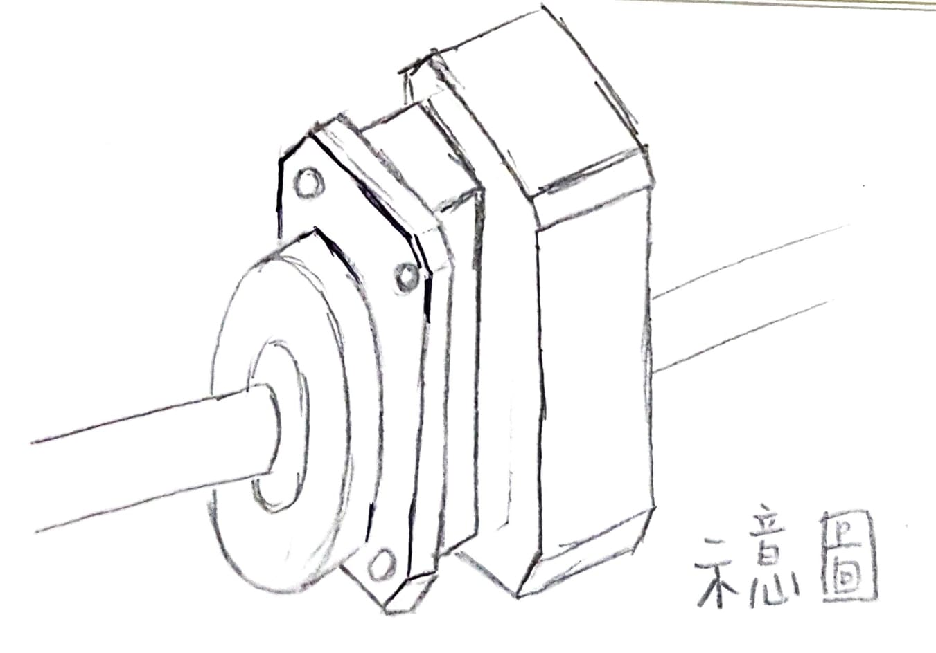
Gear housing

Slide 37
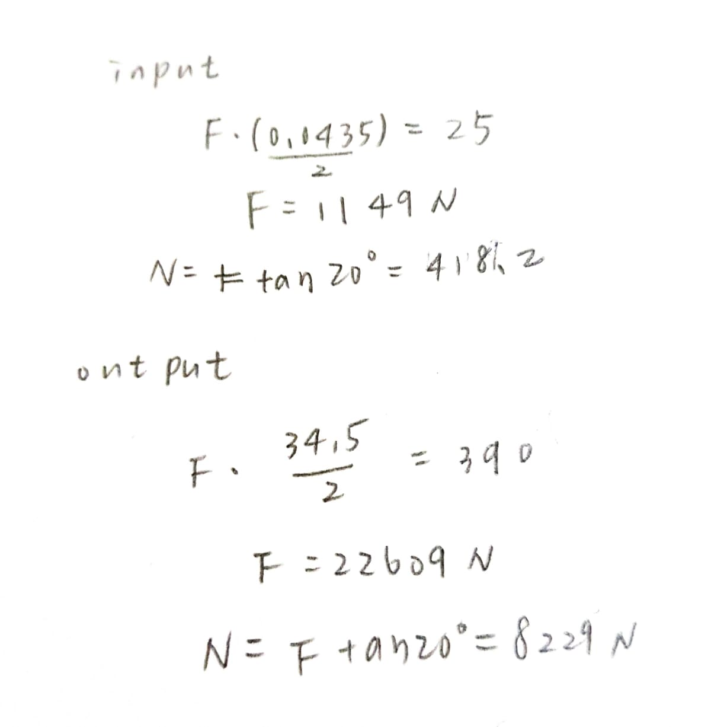
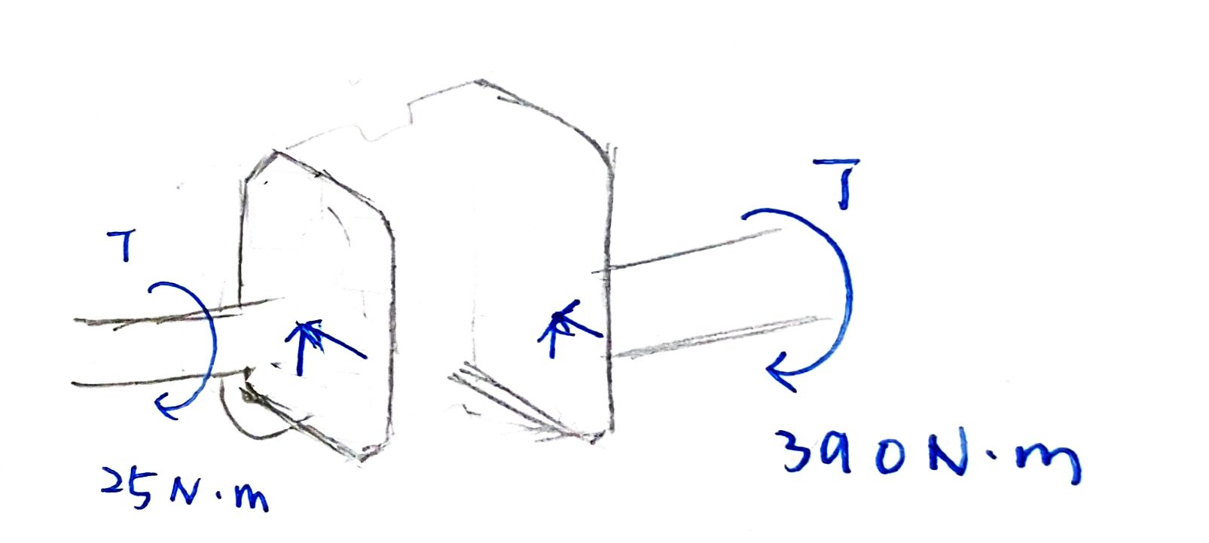
Gear housing – Load Analysis

Slide 38
Load Condition - Design Flow

Slide 39
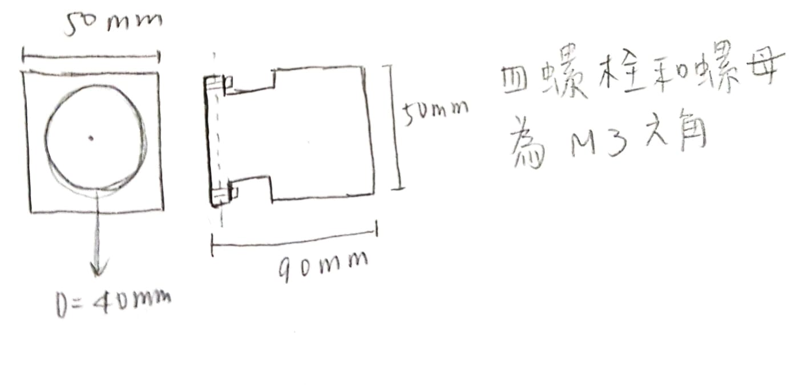
Fasteners (for gear housing )

