Slide 1

Planetary Gear Reducer
Conceptual Design
Team 10
劉多聞 高子彧 林綠芸 葉蓁 何明耀

Slide 2
Design specifications confirmation
Reduction ratio = 15.6
Nominal transformed power
Power 32kW
Input 12000 rpm / 25 Nm
Output 770 rpm / 390 Nm
• Max speed condition
Input 20000 rpm / 15 Nm
Output 1300 rpm / 234 N

Slide 3
Conceptual design
The output speed needs to be reduced.
小齒輪(input)帶大齒(output)輪轉，因為大齒輪齒數高於小齒輪齒數，所以output轉速會 < input轉速
Sun gear : Input
Planet gears carrier : Output
Ring gear : Fixed

Slide 4
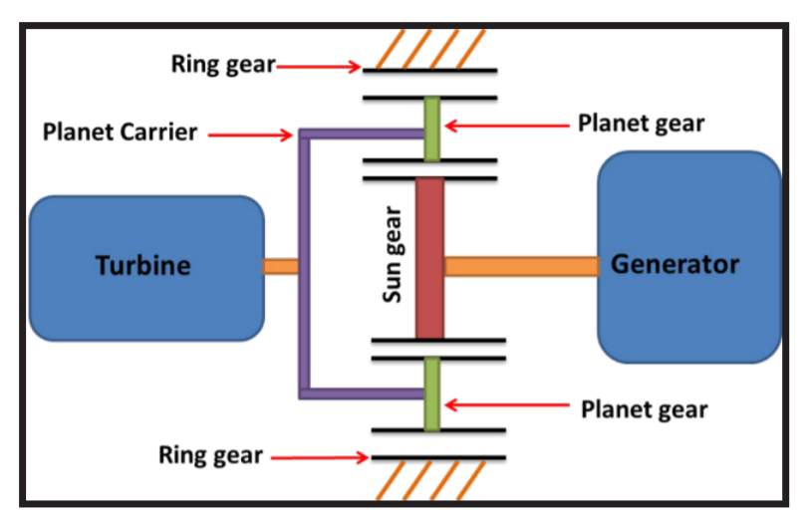
Conceptual design
(設計簡圖)
output
input

Slide 5
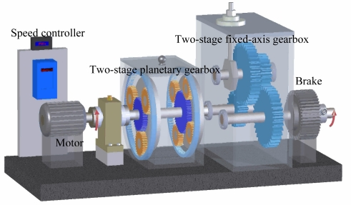
Conceptual design

Slide 6
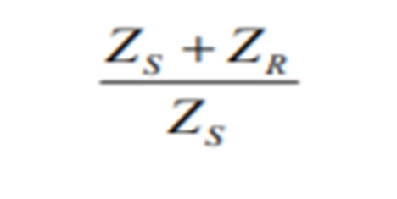
Conceptual design
By formula ： 齒輪直徑跟齒數成正比
Zcarrier = Zsun + (Zring – Zsun) / 2
We calculate from our reduction ratio : 15.6
Two stage reduction ratio : 3 * 5.2
Zring : Zsun : Zcarrier = 20 : 10 : 15(radius ratio)
Zring : Zsun : Zcarrier = 42 : 10 : 26(radius ratio)
模數、齒數、齒輪規格待定

Slide 7
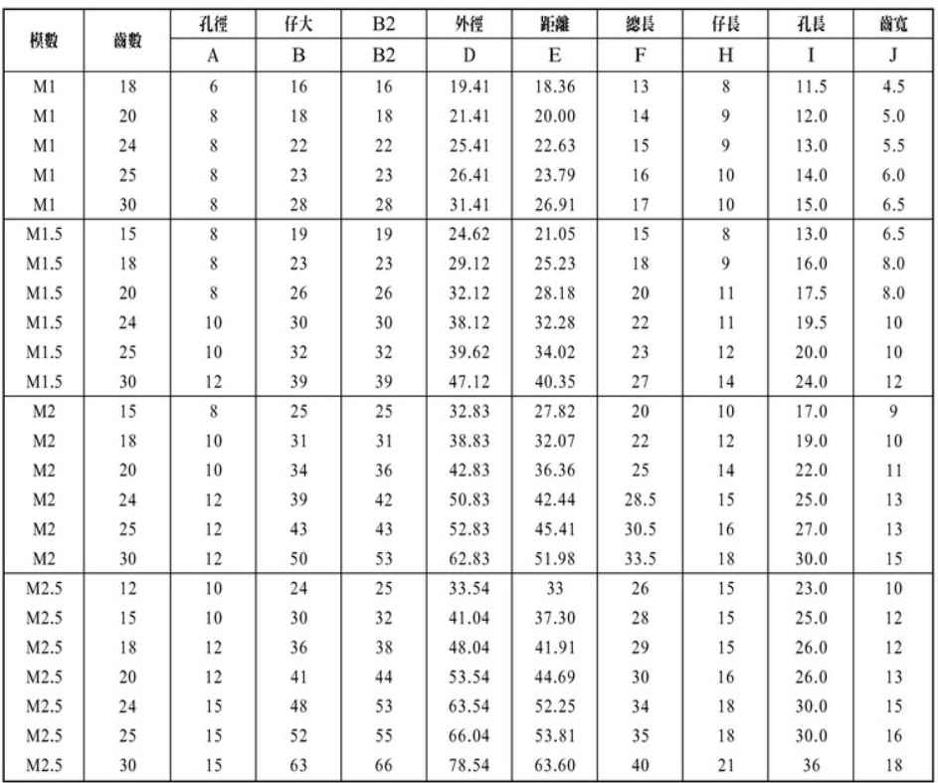
Conceptual design

Slide 8
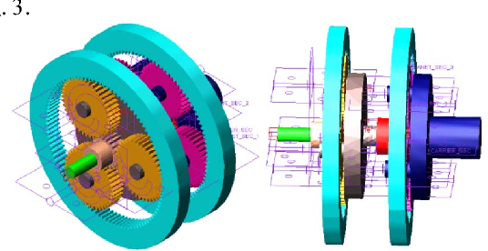
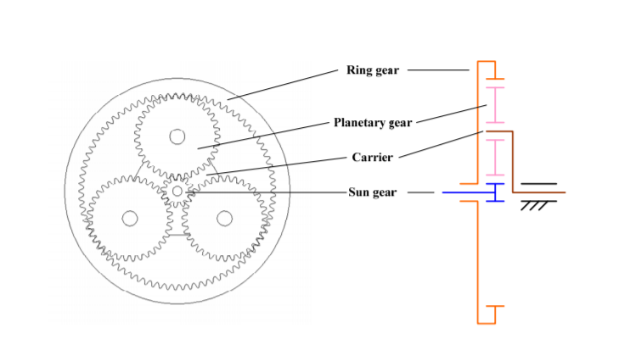
Simple schematics

