Slide 1


AI-Powered Healthcare Advisor
[AIHCA]
Student Name: Gorrang Arora
Guide Name: Dr Ajay kumar
Registration Number: 2427030644
Academic Year: 2026
Notes:
1

Slide 2
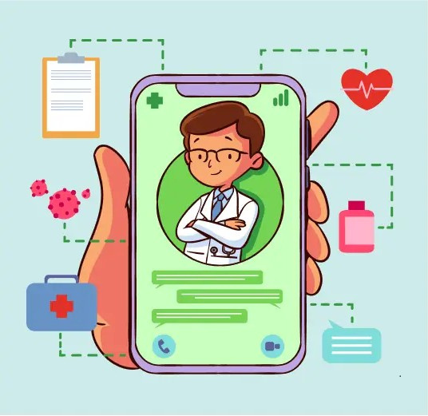






Presentation Outline: Navigating Our Project
Introduction
Literature Review
Problem Statement
Proposed Solution
Objectives
Technical Details
Notes:
2

Slide 3

Introduction: The Need for Conversational Health
The modern patient frequently turns to online sources for health information, leading to potential confusion, misinformation, and unnecessary anxiety. Our project addresses this critical gap by providing a reliable, accessible, and immediate source of preliminary health guidance.
Accessibility
Consistency
24/7 information availability, overcoming geographical and temporal barriers.
Delivering uniform, evidence-based responses every time.
Pre-Triage
Helping users understand symptom severity before seeking professional care.
Notes:
3

Slide 4



Problem Statement: The Burden of Untimely and wrong Information
There is a lack of accessible and affordable AI-driven healthcare assistance that provides reliable symptom analysis, OTC suggestions, and triage recommendations. Many people rely on unverified online sources, leading to misinformation and delayed care. Elderly individuals and rural populations face additional challenges due to mobility issues, long hospital queues, high costs, and limited access to medical services. An intelligent AI-based healthcare advisor is required to provide safe preliminary guidance and timely critical alerts.
Overburdened Systems
Non-urgent health enquiries consume valuable resources in clinics and emergency rooms.
Delayed Care Decisions
Lack of immediate guidance can lead to procrastination in seeking necessary medical attention for serious issues.
Notes:
5

Slide 5




Proposed Solution: The Healthcare Chatbot
We propose a dynamic, multi-functional chatbot capable of handling various health inquiries with a focus on safety and clarity.
Disease Information
Medication Suggestions
Clear, simple explanations of common diseases, symptoms, and causes.
Guidance on common over-the-counter (OTC) drugs and general usage (not prescriptions).
Natural Remedies
Critical Case Triaging
Suggesting scientifically supported natural remedies and lifestyle changes for minor ailments.
Identifying severe symptoms and advising immediate consultation with a qualified doctor.
Notes:
6

Slide 6




Core Project Objectives
Our success will be measured by achieving these key performance indicators and developmental goals.
85% Accuracy
will Achieve more then 90% accuracy rate in classifying symptom severity and providing relevant disease information.
High User Satisfaction
Maintain a user satisfaction (CSAT) score above 4.5/5 for conversational quality and clarity.
Robust Security
Implement end-to-end encryption and comply with all data privacy regulations for patient interaction.
Seamless Integration
Design the API for easy integration into existing hospital or university health portals.
Notes:
7

Slide 7








Literature Review: State of Conversational AI in Health
Our project is built upon established research in Natural Language Processing (NLP) and medical informatics. We analysed existing models to understand best practices and limitations.
Diagnostic Accuracy
Ethical Guidelines
Reviewing benchmarks for symptom checker algorithms.
Responsible AI use.
Model Architectures
User Interface/UX
Random Forest, Decision Tree,
Logistic Regression, SVM, KNN
Identifying optimal conversation flows and user-friendly design.
Notes:
4

Slide 8




Implementation and Training Data
Our knowledge base is trained on a rigorously curated dataset to minimise bias and maximise clinical relevance.
Curated Dataset
De-identified records, guidelines, research
Clinical Validation
Reviewed continuously by medical experts
Bias Minimisation
Rigorous curation to reduce bias
Notes:
9

Slide 9
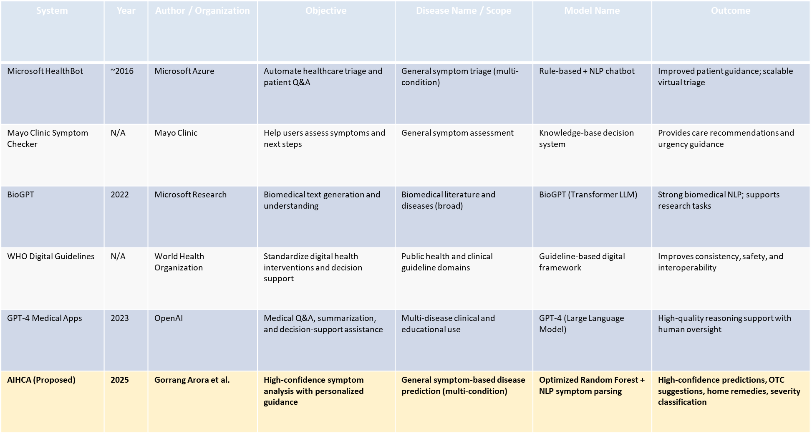
Comparative Analysis of Healthcare AI System

Slide 10



Conclusion: Next Steps and Potential Impact
The AI Healthcare Chatbot represents a significant step towards democratising health knowledge and enhancing patient autonomy.
Clinical Pilot Study
Feature Expansion
Scalable Deployment
Launch a controlled pilot with a university health service to validate performance in a real-world setting.
Future upgrades include multilingual support and AI-based image diagnosis to improve accessibility, usability, and healthcare assistance accuracy.
Prepare the platform for large-scale deployment across multiple institutions and regions.
This solution is not a replacement for a doctor, but a reliable first responder in the age of digital health.
Notes:
10

Slide 11
Thank You
Notes:
11

