Slide 1
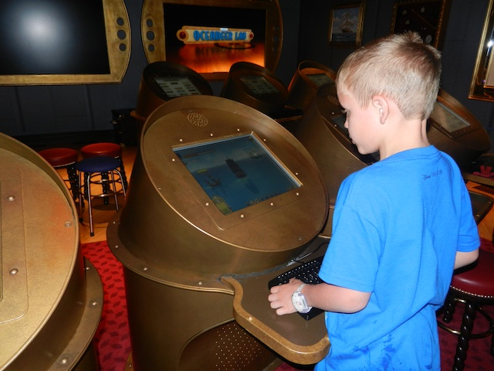

Made by:- Gourav Goyal 06913102711 B.Tech (cse)5th sem GPMCE
The Ping-Pong Game

Slide 2


Goal Of Project
Frustrated from work
Enjoying the game

Slide 3
A Sincere THANKS to the HOD of IT branch Mr. Pradeep Kamboj and our Teacher Mr. Rohit Sir for giving me an opportunity to make this project.

Slide 4
ACKNOWLEDGEMENT
I gratefully acknowledge the inspiration and encouragement received from Faculties of APTECH their valuable and fruitful advice from the very first day of the course.
I am highly obliged and thankful to our revered teacher. who has allotted me project for computerization of “Ping-Pong GAME” and Guided me in solving problems during the course of the project work and suggested me in writing the project report and also actively taking part in checking of preliminary reports. And attest I am grateful to other teachers of APTECH for their valuable Advice and Support; without them this project cannot be accomplished, also to my fellow colleagues for their valuable suggestion and support.

Slide 5
AIM OF THE PROJECT
Our aim is to develop a game majorly based on java.
The Project is based on basically a “TABLE TENNIS GAME”.
It uses JAVA technology & JFrame for its implementation.

Slide 6
ABOUT LANGUAGE - JAVA
Java is JAPL (Just another Programming Language).
Many features of Java are little different from those that are found in other contemporary programming languages.
Much of the syntax of Java is based on that of C++, which in turn stems from C.
Ancester of java is OAK. First version came in 1994 since then 7 versions has been released.

Slide 7
OAK language (1991)
CUI converted into GUI (1993)
1.02 (1994) (hot java browser introduced)
OAK renamed to JAVA (1995)
1.1 (1996)
1.2 (1998)
1.3 (2000) (JREE)

Slide 8
1.4 (2002)
1.5 (2004)
1.6 (2006-12)
1.7 (2013)

Slide 9
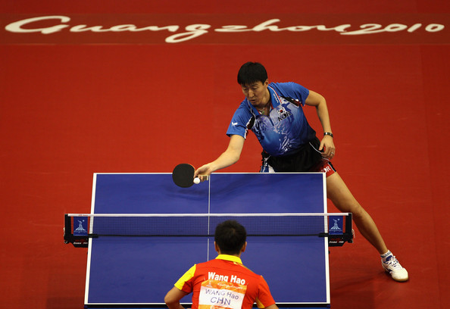
About PING-PONG GAME
Ping-Pong (marketed as PONG) is one of the earliest arcade video games.
it is a tennis sports game featuring simple 2-D graphics.
The player controls an in-game paddle by moving it horizontly across the bottom side of the screen.

Slide 10
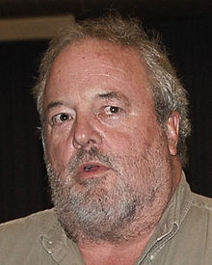
History of game
Atari engineer Allan Alcorn designed and built Pong as a training exercise.
The game was originally developed by Allan Alcorn and released in 1972 by Atari corporations.
Soon, Pong became a huge success, and became the first commercially successful game, On 1975, Atari release a home edition of Pong (the first version was played on Arcade machines) which sold 150,000 units

Slide 11
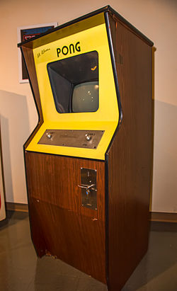
An upright cabinet of Pong signed by Pong creator Allan Alcorn.
Developer - Atari Inc.
Publisher - Atari Inc.
Designer - Allan Alcorn
Series - Pong
Platform - Arcade
Release date - 1972
Genre - Sports game
CABINET - Upright
CPU - Discrete
Sound - Monaural

Slide 12
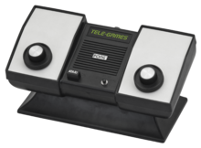
Atari's Home Pong console, released through Sears in 1975

Slide 13
FEATURES
It is PLATFORM INDEPENDENT.
It is EASY TO UNDERSTAND.
It is SECURE in nature.
It is DYNAMIC in nature.
It is ROBUST in nature due to-
Exception handling
Automatic garbage collection

Slide 14
DESCRIPTION
The game can basically be described in three ways
When game is started a Blue ball appears on the screen along with a pad.
One can also see the SCORE at the top of the screen.
Once the game starts the ball hits the screen’s side walls and bounce.
The main objective of a player is to control the movement of paddle to hit the ball.
Speed of ball increases with the time.
Different colors of the ball indicates the changing levels of the game.
Score increases as long as the player continues to Hit the Ball.
When the ball hits ground game Score resets to zero.

Slide 15
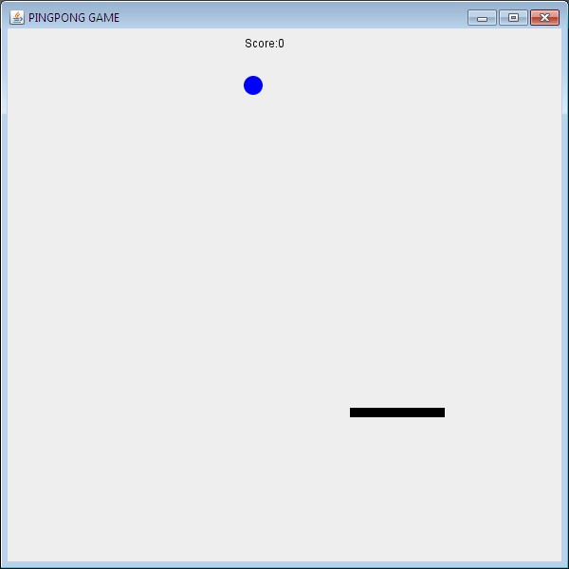
SCREENSHOTS
Initially the color of Ball is Blue and SCORE is zero.

Slide 16
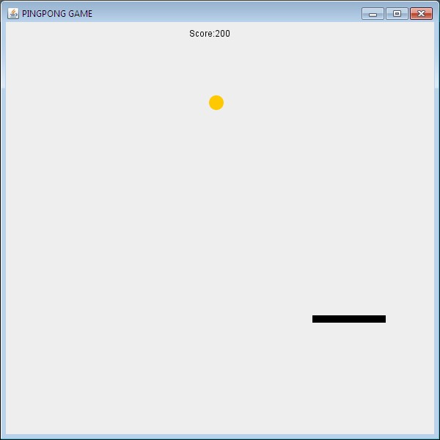
Level 2 with yellow color of ball

Slide 17
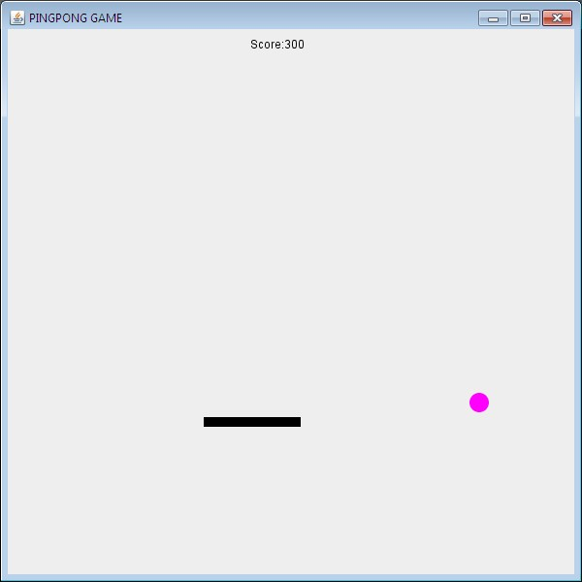
Level 3 with magenta color of ball

Slide 18
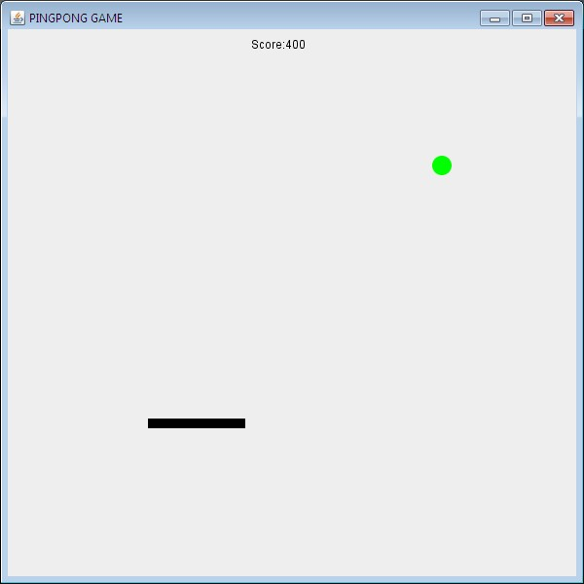
Level 4 with green color of ball

Slide 19
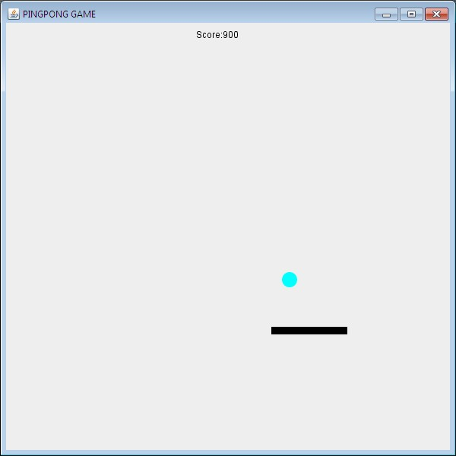
Level 5 with cyan color of ball

Slide 20
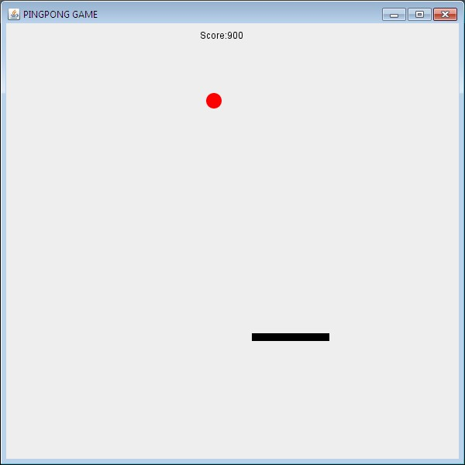
Level 6 with red color of ball

Slide 21
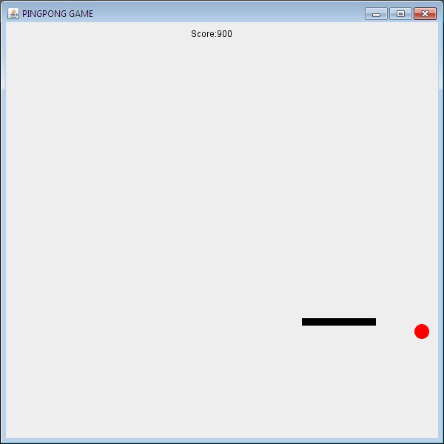
When player miss the ball score reset to zero and sets the default level.

Slide 22
ADVANTAGES
The game is easy to understand and thus a person with minimum IQ can play it with ease.
This is a prototype model of a very old and classic table tennis game whose demand never fades.
No need of second player.
As the level rises the more exciting the game becomes.
Game can be played in quick time.
Since the game is developed using java it can be played in any system.

Slide 23
DISADVANTAGES
This game is the basic prototype of the Table Tennis game so it supports only single player.

Slide 24
Future Scope
I Woluld make this game Multiplayer so friends can play and challenge each other .
I would add more features,levels to make it more exciting and interesting.
It would be able to play online across the internet by using the features of servelets.
It would be supported by various devices like android,apple phones,tablets.

Slide 25
KEY FEATURES FOR THE DEVELOPMENT OF THE GAME
Packages & Classes
Java supplies a huge library of pre-written “code,” ready for you to use in your programs.
Code is organized into classes.
Classes are grouped into packages.
One way to use this code is to import it.
You can import a single class, or all the classes in a package.

Slide 26
Applet class
To create an applet, you must import the Applet class.
This class is in the java.applet package.
The Applet class contains code that works with a browser to create a display window.
Capitalization matters!
applet and Applet are different names.

Slide 27
Java.awt package
“awt” stands for “Abstract Window Toolkit”.
The java.awt package includes classes for:
Drawing lines and shapes
Drawing letters
Setting colors
Choosing fonts
If it’s drawn on the screen, then java.awt is probably involved!

Slide 28
Swing
Swing is the primary Java GUI widget toolkit.
an API for providing a graphical user interface (GUI) for Java programs.
Swing is platform-independent because it is completely written in Java.
In addition to familiar components such as buttons, check box and labels, Swing provides several advanced components such as tabbed panel, scroll panes, trees, tables and lists.

Slide 29
javax.swing.event package
The javax.swing.event package augments the java.awt.event package and defines event objects, listeners, and adapters that are specific to Swing components.
Classes with names ending in "Event" define event types;
their fields and methods provide details about the event that occurred.

Slide 30
BIBLIOGRAPHY
Java All-In-One Desk Reference for Dummies by doug lowe. – 2nd edition.
JAVA COMPLETE REFERENCE by HERBEDT SCHILDT – 7th edition.
Head First Java 2nd edition by Kathy Sierra & Bert Bates.
Thinking In Java by bruce eckel – 4th edition.
Wolrd Wide Web

Slide 31


