Slide 1

Aigital Wi-Fi Extender Analysis
Curcio Salvatore MAT. 263696
Rabbia Marco MAT. 269211
Voci Gregorio MAT. 263711

Slide 2
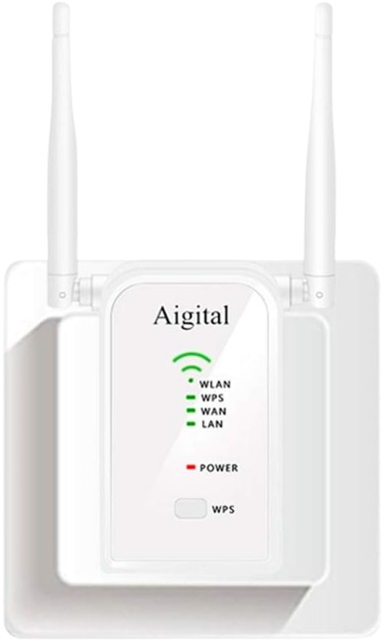
Device & Objectives
Wi‑Fi extender with local web interface
Target: firmware and web security analysis
Focus on CVE‑2023‑30403, CVE‑2023‑30404, CVE‑2023‑30405
Final goal: exploit, analyze and patch the vulnerabilities
Aigital Wi-Fi Extender

Slide 3
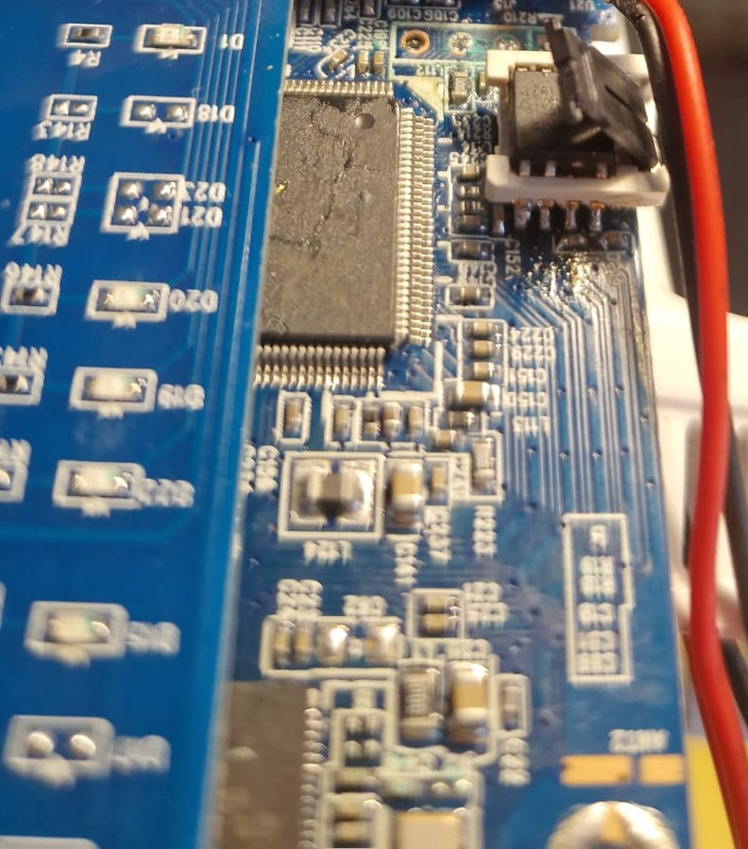
Analysis Workflow and Hardware Issues
UART identification and EEPROM dump
Firmware analysis with Binwalk, Ghidra and Cutter
Custom firmware patching
Hardware damage led to full firmware emulation with Firmadyne
Broken EEPROM

Slide 4
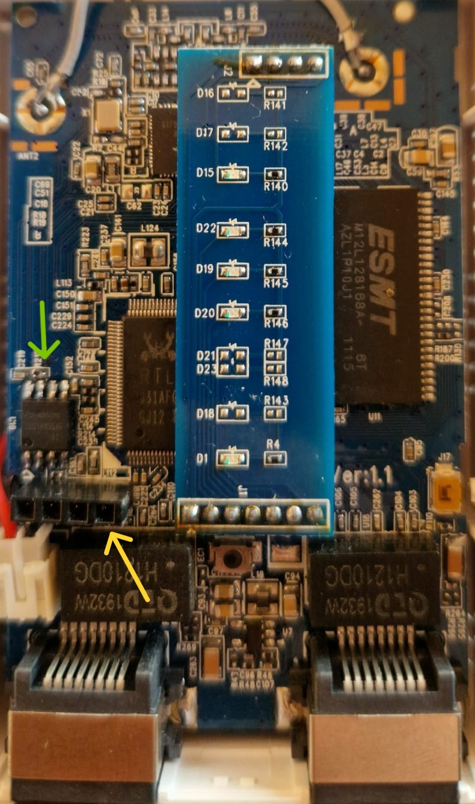
Hardware Analysis
PCB and main components identified
UART interface located
Communication at 38400 baud
EEPROM identified: BoyaMicro 25D16AS – 2 MB
PCB of the Aigital Wi-Fi Extender

Slide 5
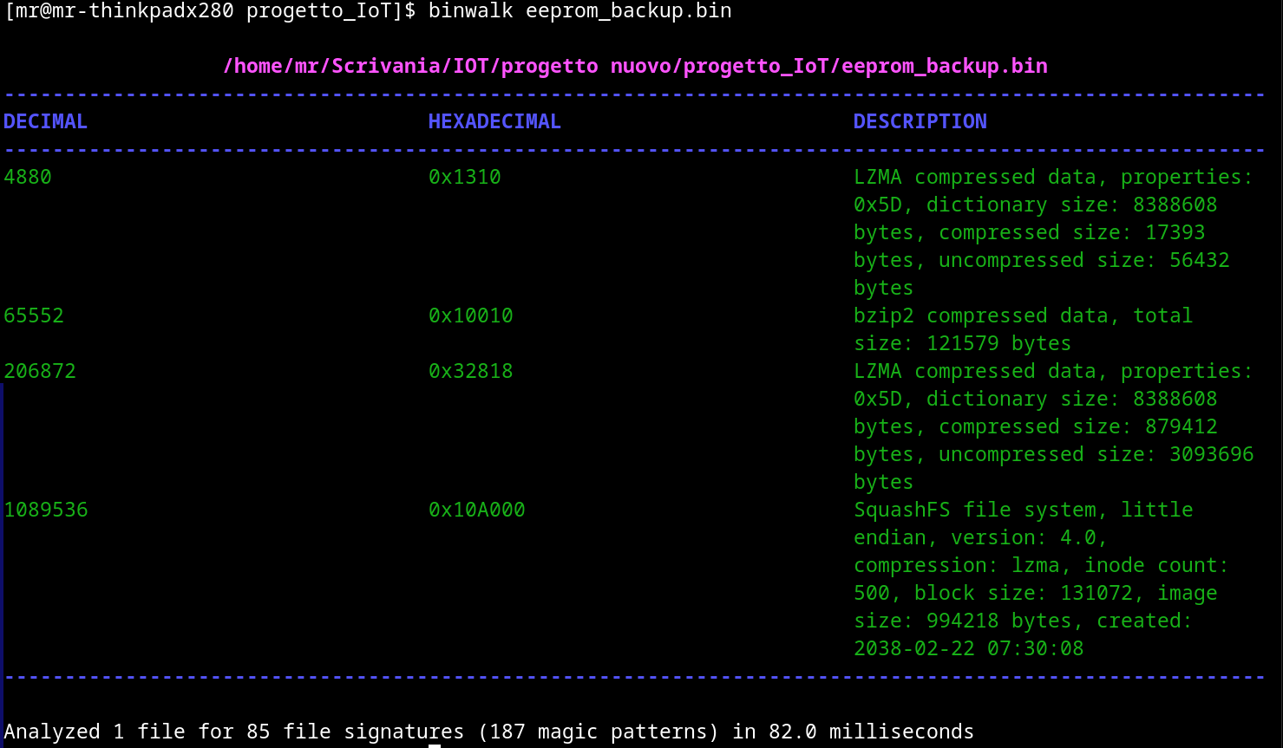
Firmware Extraction
EEPROM dumped using CH341A and Flashrom
Firmware analyzed with Binwalk
Linux kernel and root filesystem extracted
Relevant binaries and web resources recovered
Firmware extraction

Slide 6
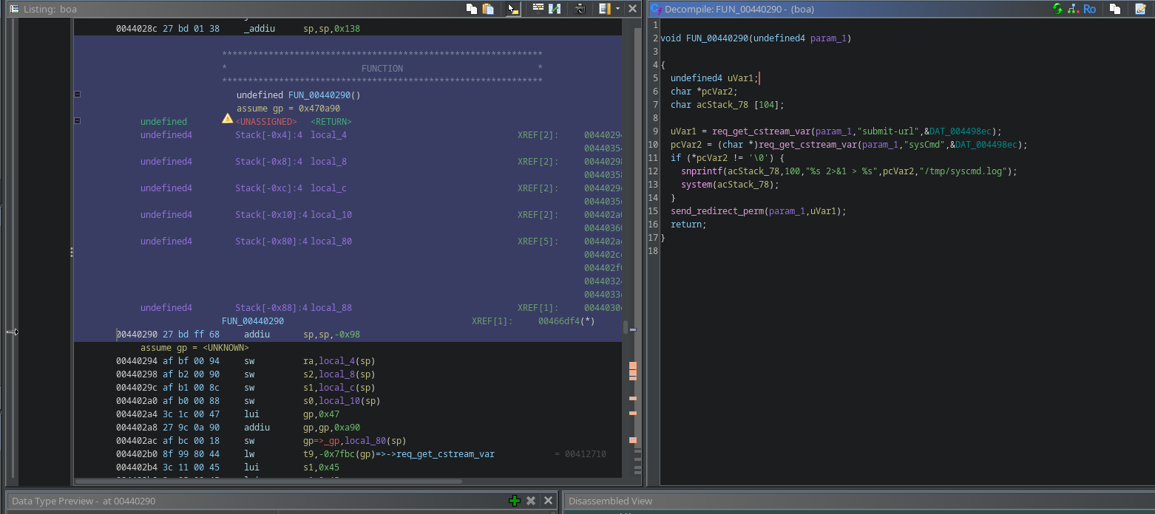
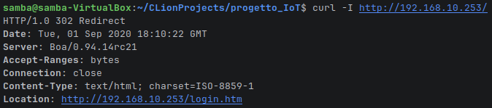
Binary Analysis and Firmware Emulation
Boa identified as the web server
Login and command handlers analyzed with Ghidra
Firmware emulated using Firmadyne and QEMU
Vulnerable and patched versions prepared for testing
Boa binary analyzed with Ghidra
Testing emulated boa response

Slide 7
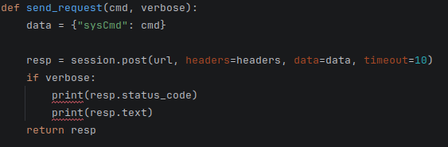
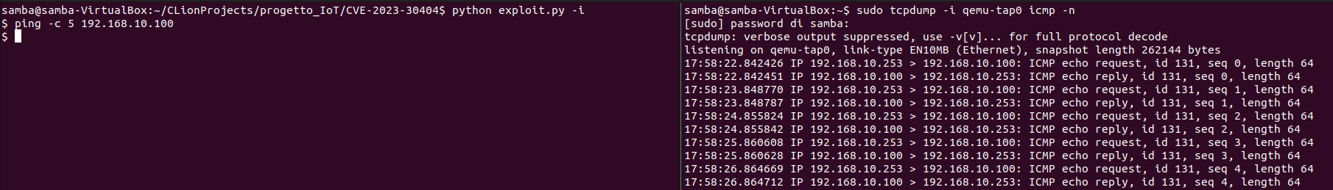
Authentication Bypass & RCE
Fragment of exploit.py script
Login performed with admin:admin
Python exploit establishes an authenticated HTTP session
Exploit sends commands to /boafrm/formSysCmd through sysCmd
Boa executes the supplied command without validation
Execution confirmed through captured ICMP traffic
ICMP packets generated by a command executed through the Boa RCE on firmadyne

Slide 8
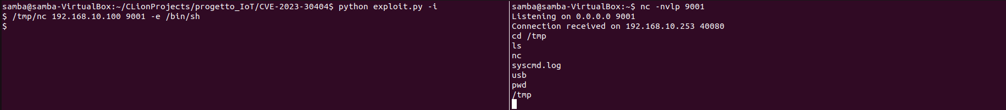

Reverse Shell
Reverse shell
MIPS-compatible Netcat transferred via TFTP
Listener opened on the host machine
Reverse shell spawned through the RCE
Interactive access to the firmware obtained
Success of the attack

Slide 9
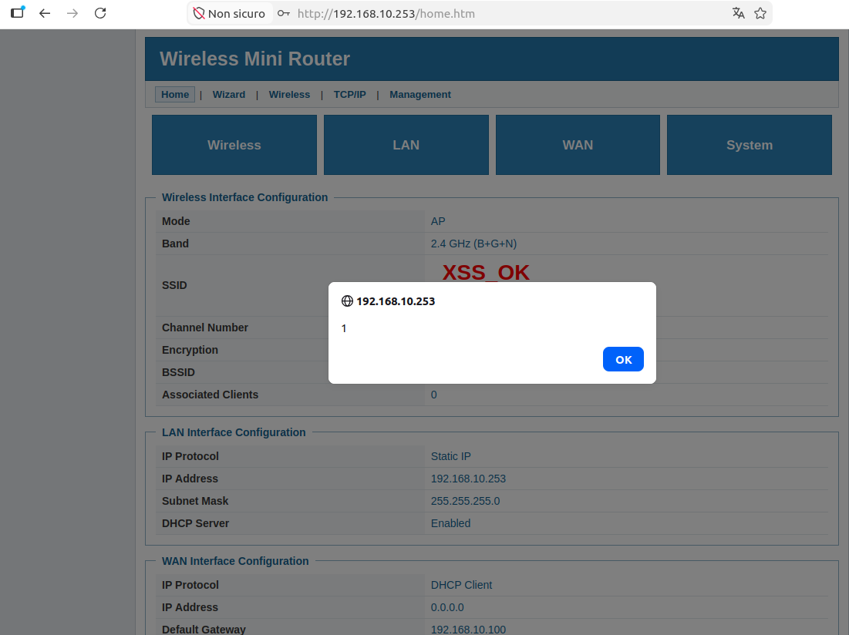
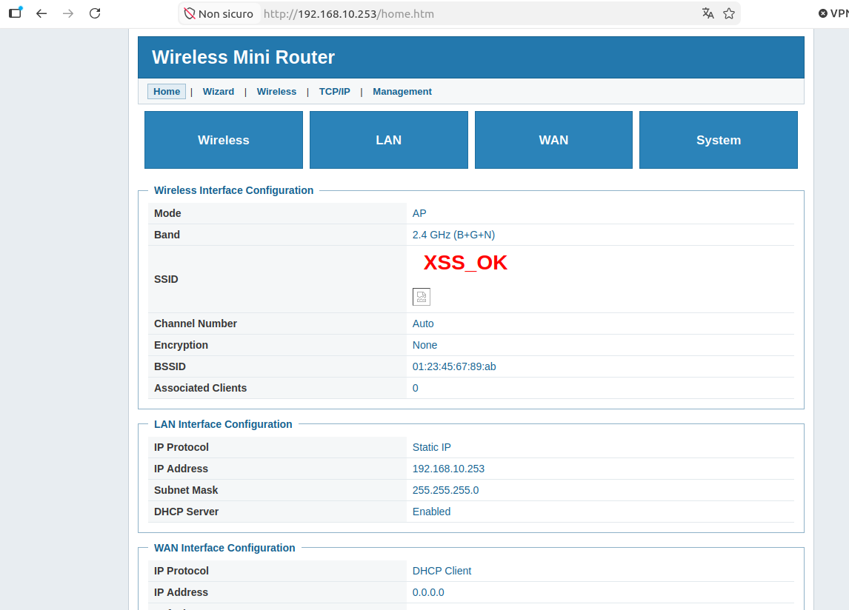
Cross-Site Scripting
Malicious payload injected through the SSID
Unsafe rendering caused by innerHTML
HTML interpreted by the browser
JavaScript execution confirmed with alert(1)
Alert message
Injected SSID rendered as HTML in the vulnerable page

Slide 10
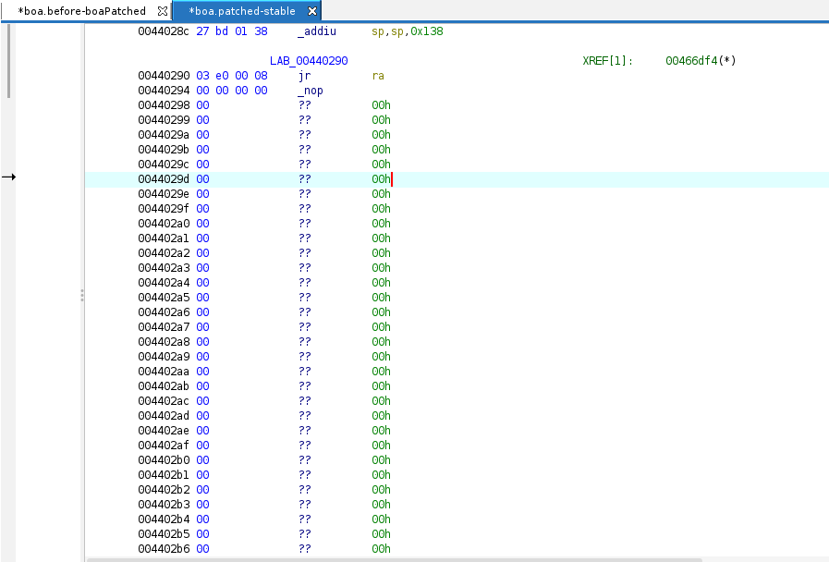

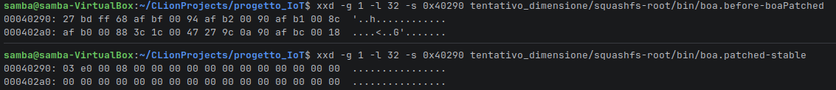
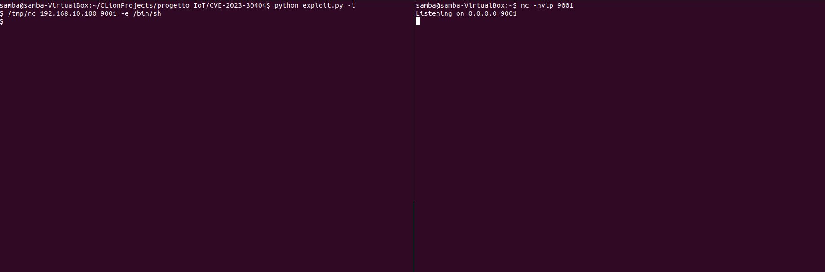
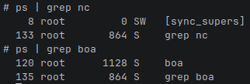
RCE Mitigation
Boa patching
Vulnerable handler identified at 0x00440290
Handler replaced with an immediate return
Reverse shell blocked after patching
boa.patched-stable in Ghidra
Byte-level comparison
No /tmp/nc reverse shell process in firmadyne
No reverse shell connection

Slide 11
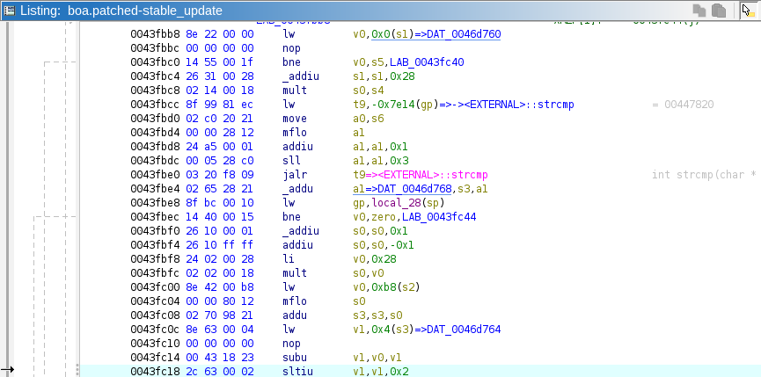
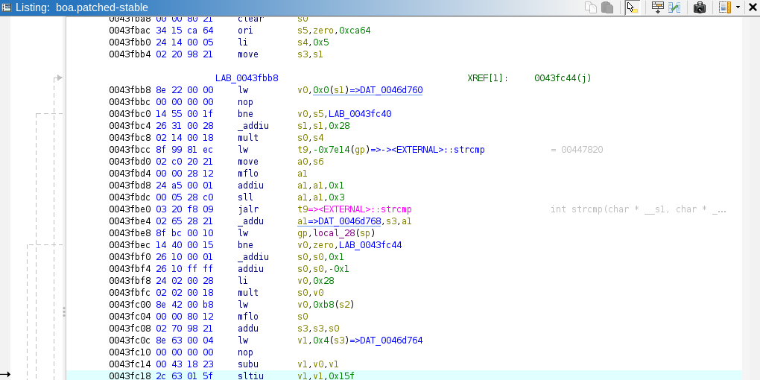
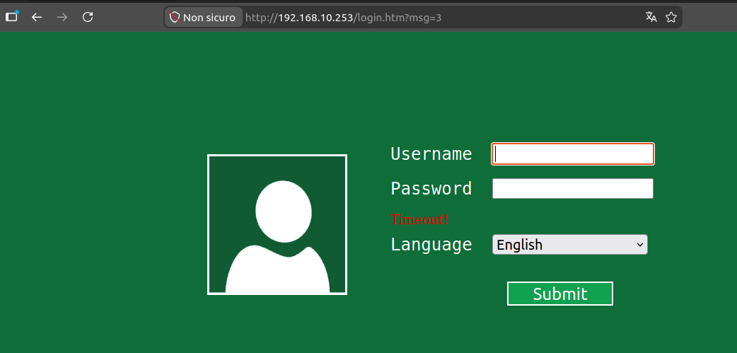
Login Bypass Mitigation
boa.patched-stable with 351-tick
Authentication used a global timestamp
Session was reusable for about 350 seconds
Authentication window reduced to about 1 second
Unauthenticated users are redirected to login
boa.patched-stable with 2-tick
Unauthenticated user redirected to login.htm with timeout message

Slide 12
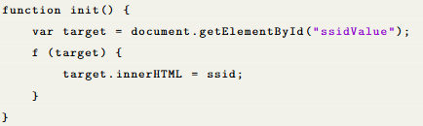
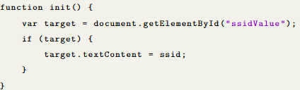
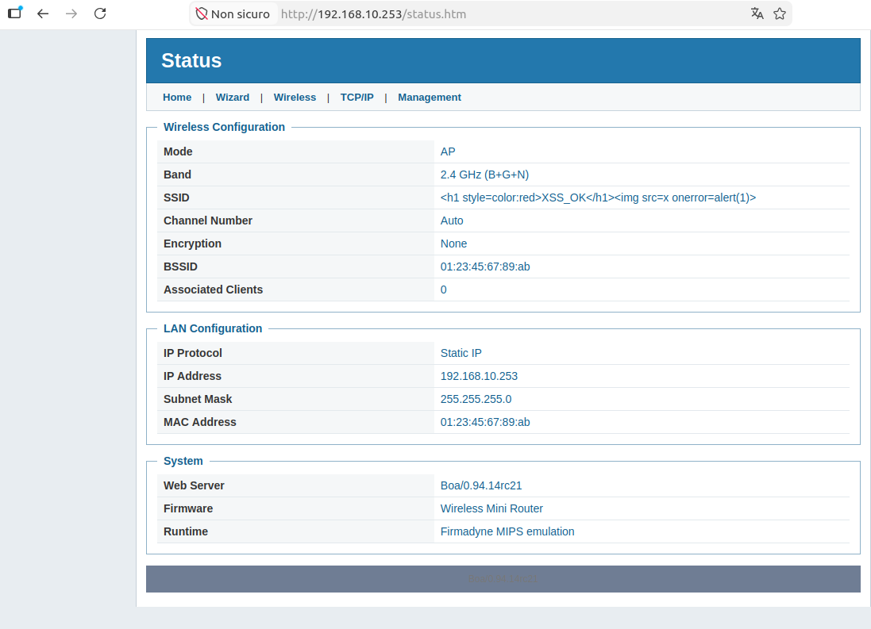
XSS Mitigation
Code before patching
Code after patching
Vulnerability caused by unsafe innerHTML
SSID interpreted as executable HTML
Replaced with the safer textContent
Payload displayed literally, without JavaScript execution
XSS payload displayed as text in the patched page

Slide 13
Conclusion
Firmware extracted and analyzed
Login bypass, RCE and XSS reproduced
Reverse shell obtained through Boa RCE
Firmware patched and retested in Firmadyne

Slide 14
Thanks for your kind attention

