Slide 1


MNotes
Gor Yeritsyan
UFAR IMA|2

Slide 2
The idea
was to make a user friendly Note application using blazor asp.net.
MVP (Minimum Viable Product)
Make notes inside browser easily
Use Microsoft SQL for storing data
Having File Management

Slide 3

Why Blazor?
What is Blazor? Blazor is the Microsoft technology that uses ASP.NET which made for web application ,it has both frontend and backend side. Also NuGet Packages that makes development faster.
It is good for smaller projects like this.

Slide 4
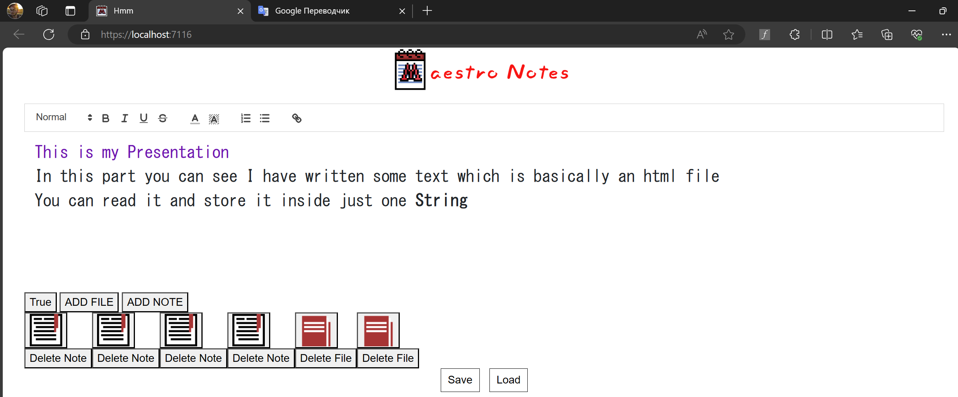
The Application

Slide 5
File Management
File works like a folder.
It contains other files and notes
Has parent and content id
If any File and Note parent is null it appears on the front page.
Notes contain their information and parent id.
file
Note

Slide 6
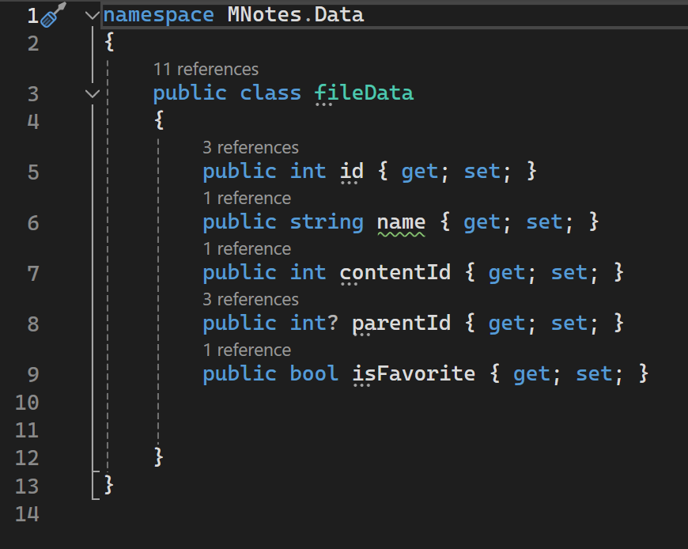
File Management
file

Slide 7
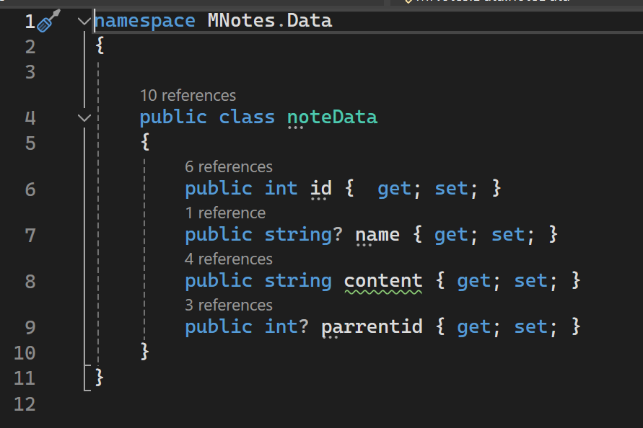
File Management
Note

Slide 8
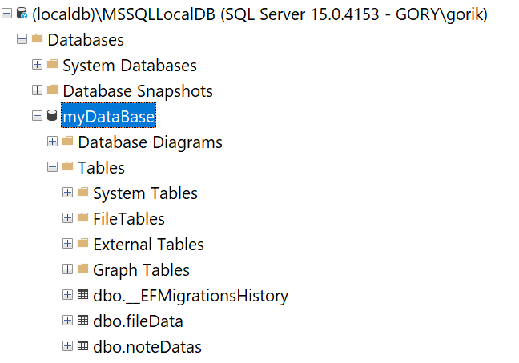
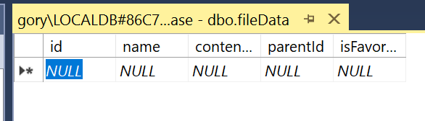
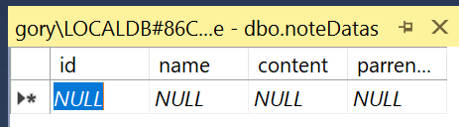

SQL Database

