Slide 1
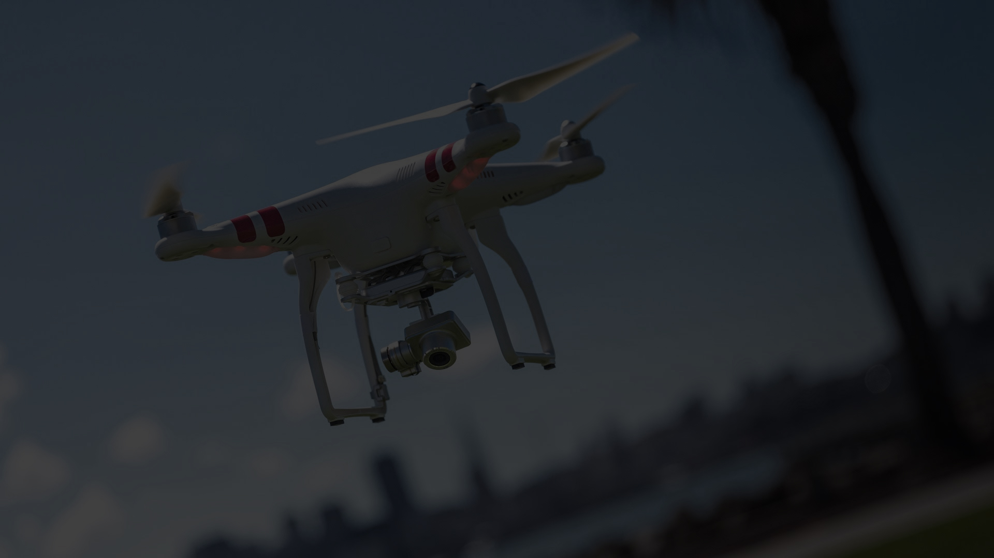


Slide 2
Challenge: Don’t Crash My Drone
Team Members
Dejan Bogatinovski
Nenad Kaevikj
Gavril Ognjanovski
Viktor Veljanoski
Daniel Krstevski

Slide 3
Brief
As a result of an increased drone crashes in the last few years it was necessary to provide a secure flight data to prevent them.
Drones are very sensitive devices to extreme weather conditions like wind, rain, snow and even high temperatures can lead to their damage.
The question is “How to provide flight safety data and display it to the drone pilot?”

Slide 4
The Concept
Our approach to solve this problem was creating a mobile application which combines different API data to evaluate the probability for safe flight of the drone.
Portability
Ease of use
Scalability

Slide 5
Features
Map of flight range
Weather Conditions
Wind Speed and Direction
Humidity
Visibility
Temperature
No Fly zones
Nearby Drones

Slide 6
Implementation
Backend API
Aggregating and analyzing data from different APIs
Probability Calculation Algorithm for safe flights
Client Mobile Application
Sending drone coordinates to backend API
Displaying calculated data
Flight Risk notifications
Unique Device Token registration of drones in flight

