Slide 1

Gosh Resume Builder
Your AI-Powered Career Companion for Creating ATS-Optimized, Professional Resumes
Name: Goshen Robert S M
Mail ID: goshensm@gmail.com
College Name: Panimalar Engineering College
Mobile No: +91 9840596067

Slide 2

INTRODUCTION
Transforming Resume Creation with AI Intelligence
Gosh Resume Builder is an expert AI-powered platform that combines career consulting expertise with advanced content generation to help job seekers create highly professional, role-specific resumes.
Who Benefits:
Students seeking internships and entry-level positions
Fresh graduates entering the job market
Experienced professionals pursuing career advancement
Designed for students, fresh graduates, and experienced professionals alike, our platform ensures every resume is tailored to beat Applicant Tracking Systems while showcasing your unique qualifications.
Career changers requiring tailored documentation

Slide 3

PROBLEM STATEMENT
The Resume Creation Challenge
ATS Rejection Crisis
Time-Consuming Process
75% of resumes never reach human recruiters due to poor ATS optimization and formatting issues
Job seekers spend 6-8 hours creating a single resume, often with suboptimal results
Lack of Personalization
Skill Gap Blindness
Generic templates fail to highlight role-specific skills and achievements effectively
Most candidates don't know which critical skills they're missing for their target roles

Slide 4

Understanding the Core Problem
The ATS Barrier
The Customization Gap
Modern hiring relies heavily on Applicant Tracking Systems that scan resumes for specific keywords, formatting standards, and structural elements. Resumes that don't meet these technical requirements are automatically filtered out, regardless of candidate qualifications.
Each industry, role, and experience level requires different resume approaches. Entry-level candidates need to emphasize education and projects, while experienced professionals must highlight quantifiable achievements and leadership impact.
The Knowledge Deficit
Most job seekers lack awareness of industry-standard requirements for their target roles. Without understanding which skills are essential versus optional, candidates cannot effectively position themselves or identify areas for professional development.

Slide 5

UNIQUE VALUE PROPOSITION
Why Gosh Resume Builder Stands Apart
Intelligent Career Architecture
We don't just generate resumes—we architect your professional story. Our AI acts as your personal career consultant, analyzing your background against industry standards and crafting documents that pass ATS systems while impressing human recruiters.
AI-Driven Personalization
Real-Time Skill Gap Analysis
Role-specific content generation based on your experience level and target industry
Immediate feedback on missing competencies with learning recommendations
Template Flexibility
Choose from professional templates or upload your own—we adapt intelligently

Slide 6






Distinctive Features That Deliver Results
Dual Template System
Achievement-Focused Language
Select from built-in professional templates (Minimal ATS-Friendly, Corporate Professional, Modern Tech, Academic CV) or upload your custom design. Our AI preserves your formatting while intelligently replacing content.
Automatically transforms basic job descriptions into impact-driven, quantifiable achievements using professional, concise language that resonates with hiring managers.
Comprehensive Data Collection
Intelligent Skill Analysis
Guided step-by-step input flow captures all essential information: contact details, education, skills, projects, certifications, and achievements—ensuring nothing important is overlooked.
Compares your qualifications against industry benchmarks, identifies gaps, and provides learning recommendations—all presented separately to keep your resume focused.
Ethical AI Compliance
UX-Optimized Interface
Never invents experience or skills. Maintains accuracy, encourages user review, and protects your data with enterprise-grade security standards.
Dark theme professional design with clean typography, real-time preview capability, and seamless export options in PDF or DOCX formats.

Slide 7




TECHNOLOGY STACK
Built on Modern, Scalable Architecture
Figma
Advanced AI Engine
Professional UI/UX design and prototyping with collaborative workflows
Natural language processing and content generation for intelligent resume creation
Cloud Infrastructure
Template Management
Scalable backend supporting real-time processing and secure data handling
Flexible template engine supporting both built-in and user-uploaded designs
Frontend Excellence
Backend Power
Responsive design optimized for all devices
ATS optimization algorithms
Dark theme with professional aesthetics
Industry-standard skill databases
Real-time preview and editing capabilities
Secure document generation and export
Intuitive step-by-step guided workflow
Performance-optimized processing

Slide 8

Utility and Value Proposition
Time Savings
Career Development
Reduce resume creation from 6-8 hours to just 15-20 minutes with intelligent automation
Skill gap analysis guides professional growth with targeted learning recommendations
1
2
3
4
Higher Success Rate
Professional Quality
ATS-optimized resumes increase interview callbacks by up to 40% compared to traditional formats
Enterprise-grade resumes that reflect industry best practices and employer expectations
75%
40%
15min
ATS Pass Rate
Interview Increase
Creation Time
Resumes optimized to successfully navigate automated screening systems
Higher callback rates with professionally crafted, role-specific content
From hours to minutes with AI-powered intelligent generation

Slide 9
APPLICATION PROTOTYPE
Experience the Interface
Our Figma prototype showcases the intuitive user experience, featuring a dark theme professional design with step-by-step guidance, real-time preview capabilities, and seamless workflow from data input to final document export.
01
02
03
Input Personal Details
Select Template Style
AI Content Generation
Guided form captures all essential information with smart validation
Choose from professional options or upload custom design
Watch as intelligent algorithms craft your professional narrative
04
05
Review and Refine
Export and Apply
Real-time preview with editing capabilities for perfect results
Download in PDF or DOCX format, ready for job applications

Slide 10
Technology Stack:
Technology Stack – AI Resume Builder & Skill Gap Analyzer
UI/UX Design: Figma
Frontend: React.js, TypeScript, HTML5, CSS3, Tailwind CSS, JavaScript
Backend: Node.js, Express.js / Next.js API Routes
AI & NLP: OpenAI GPT APIs, Prompt Engineering, NLP Techniques
Skill Gap Analysis: Rule-based logic + AI reasoning, JSON skill taxonomy
Resume Rendering: HTML/CSS Templates, PDF Generation (Puppeteer / jsPDF)
Database: MongoDB / Firebase (optional)
Deployment: Vercel / Netlify / Cloud Platforms

Slide 11
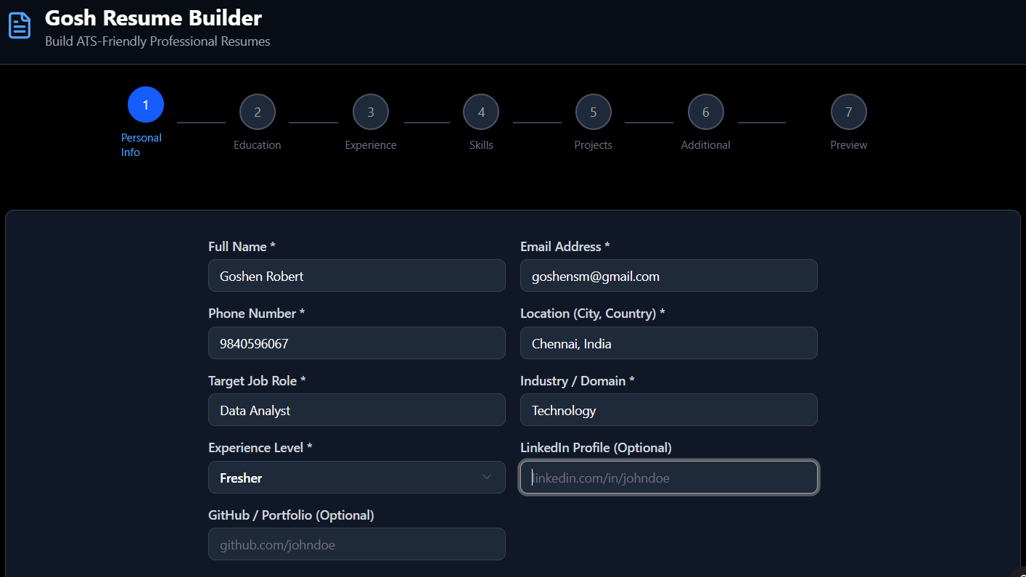
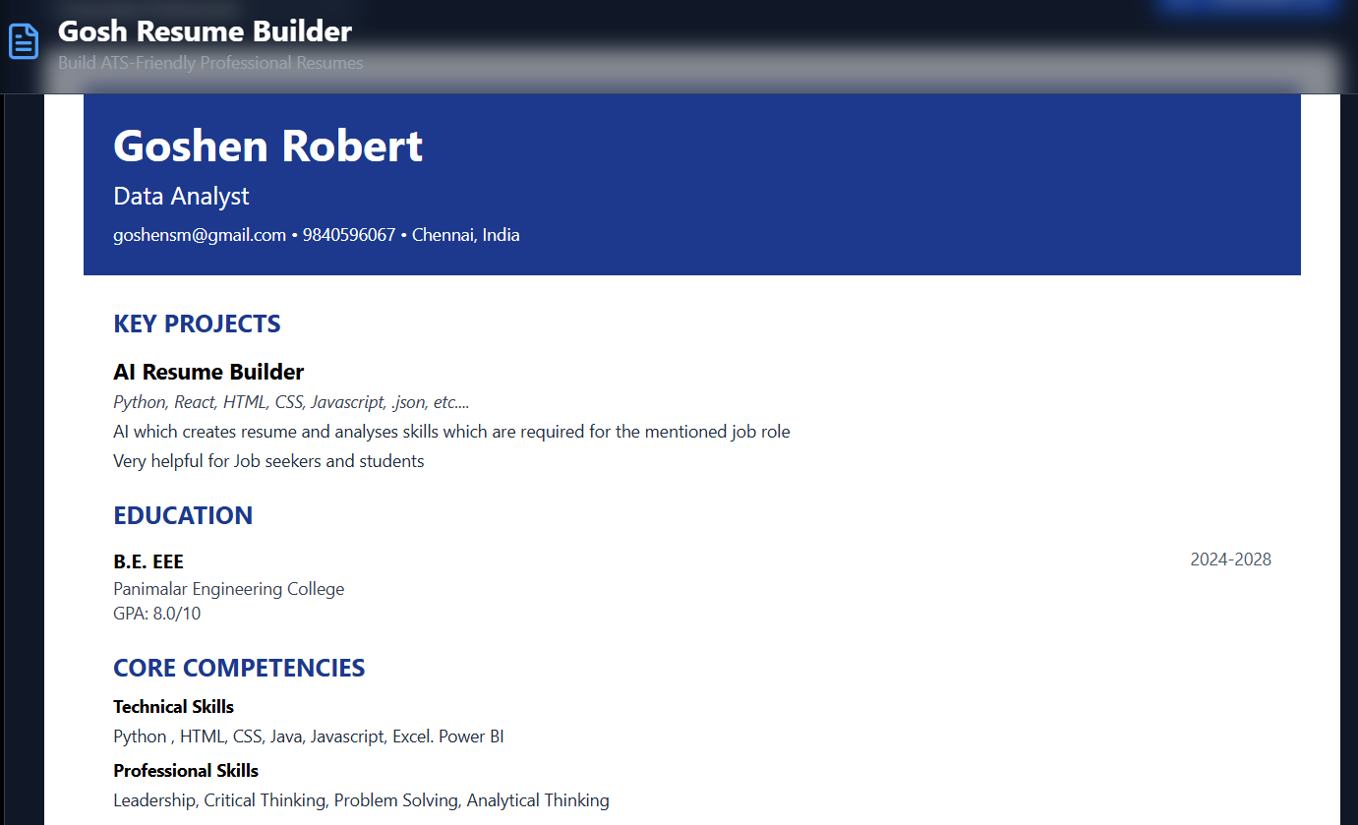
Project Image:
Gosh Resume Builder
Where the Information we Enter, Evolves into a Stunning and Professional Resume with loads of templates

Slide 12
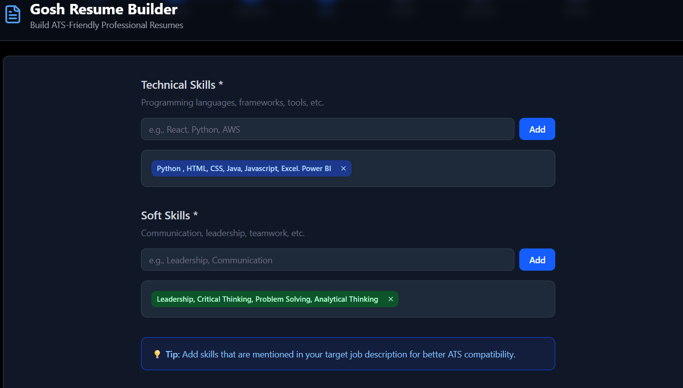
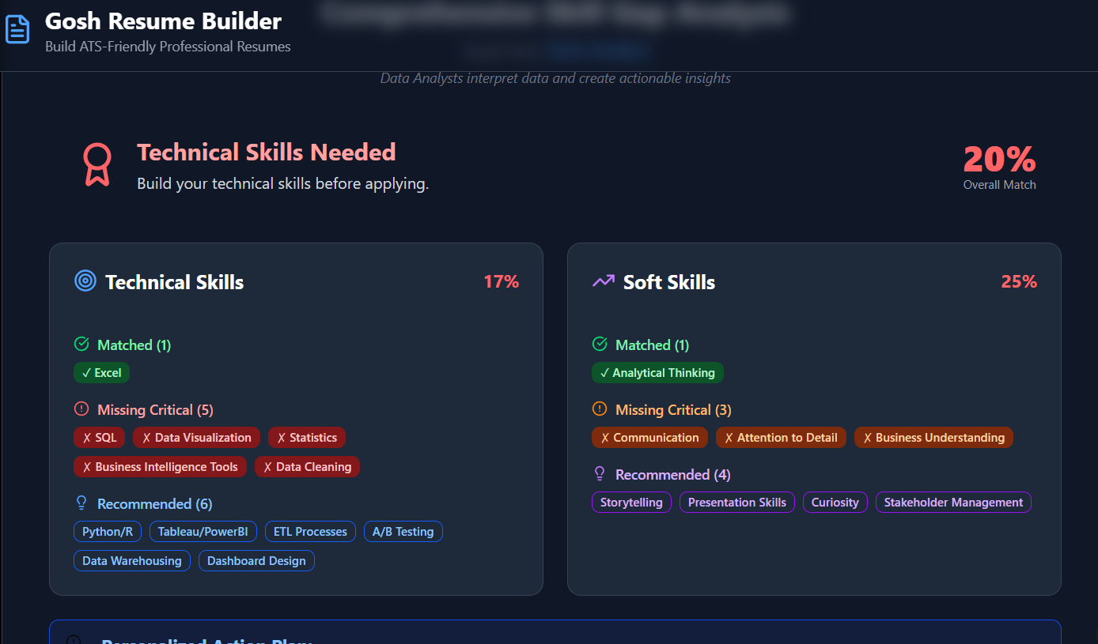
Skill Gap Analysis
Where the Skills we Entered are Checked and Matched with our Selected Job Role and Suggesting the best Skills for the role

Slide 13

Start Building Your Future Today
Explore the Prototype
View our complete design and workflow in Figma to understand the full user experience
Access Figma Prototype
Key Benefits Recap
ATS-optimized professional resumes
Real-time skill gap analysis
Multiple template options
Ethical AI-powered generation
15-minute creation time
"Transform your job search with intelligent resume creation that combines AI precision with career consulting expertise."
Gosh Resume Builder represents the future of professional documentation—where artificial intelligence meets human career aspirations. Whether you're a student taking your first career steps, a fresh graduate entering the competitive job market, or an experienced professional seeking advancement, our platform delivers the tools you need to succeed.

Slide 14
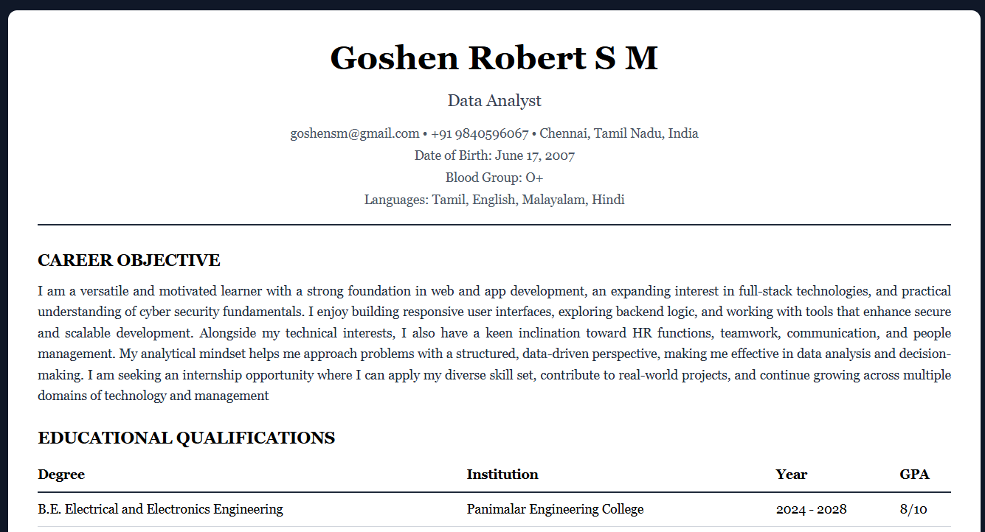
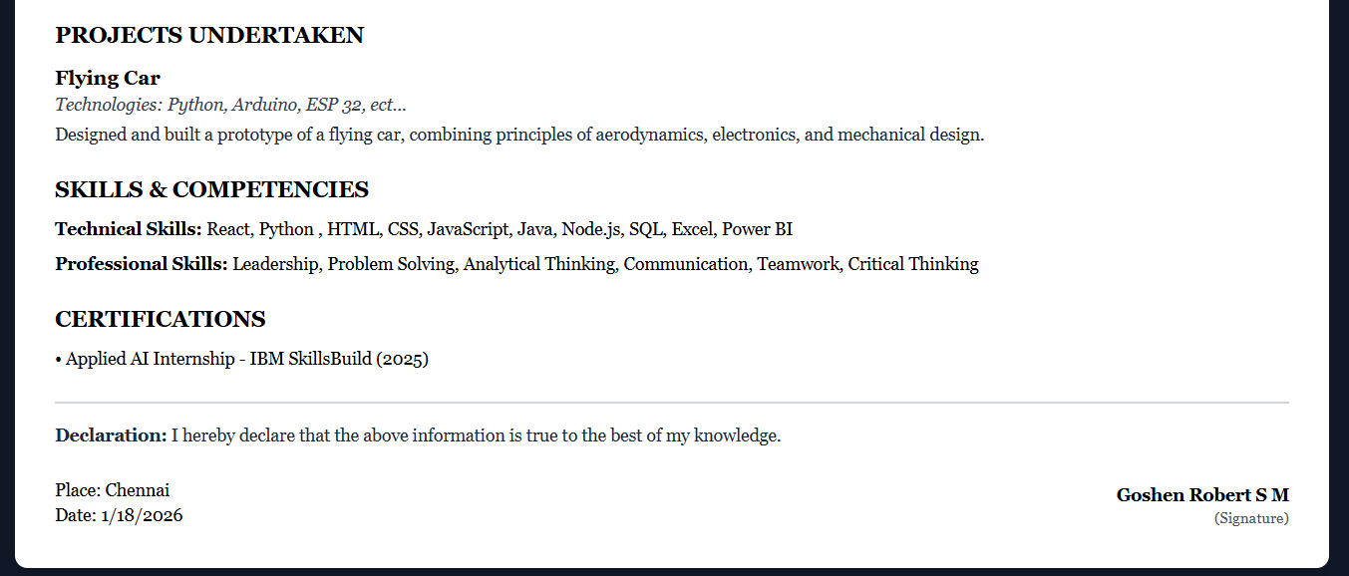
Project Link : ( AI Resume Builder and SkillGap Analyst)
https://github.com/GoshRob/Gosh-Resume-Builder.git
Sample Resume made though the Project:

