Slide 1
NSGA-II Based Multi-Objective Feature Selection For Gene Expression Data
Goshgar ısmayılov - serhat İşcan

Slide 2
Introduction
DNA microarray technology allows us to measure gene expression levels.
It identifies genes that are active, hyperactive or silent in normal and cancer tissues.
The useful genes extracted from microarray data are signatures that help clinical decisions on disease diagnosis, prognosis and treatment.
The selection of proper number of the most relevant genes is a challenge.
Good genes may have bad cooperation.

Slide 3
Motivation
Greatly reducing computational complexity and noise
Bringing down the cost for cancer testing on diagnosis
Bridging relations between genes and cancer development
Contribution
We have considered the multiple conflicting objectives instead of single objective.
We have applied multiple classifiers and selected the best one among them for solution evaluation.
To the best of our knowledge, it is the first systematic approach to apply NSGA-II algorithm to multi-objective gene selection problem.

Slide 4

Gene Selection Problem
Let $O=(X, Y, F)$ be a dataset. $X=\{x_{1}, x_{2},…, x_{n}\}$ is sample set. $Y=\{y_{1}, y_{2},…, y_{n}\}$ is label set. $G=\{g_{1}, g_{2},…, g_{m}\}$ is gene (feature) set. Each $x_{i}$ contains $m$ elements, $x_{i}=\{u_{i1},u_{i2}, …,u_{im}\}$.
The problem is to find a group of features, $T=\left\{g_{1},g_{2},…,g_{k}\right\}⊆F(k≤m)$, which can differentiate the given samples accurately, where two different objectives are simultaneously optimized:
The first objective: Classification accuracy (maximization)
The second objective: Number of features (minimization)

Slide 5
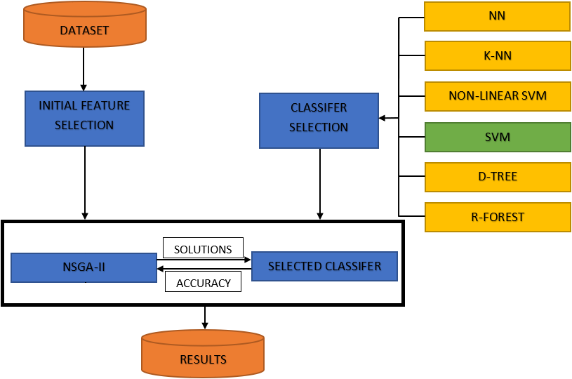
Solution Architecture
Notes:
Univariete Feature Selection: examines each feature individually to determine the strength of the relationship of the feature with the response variable.

Slide 6
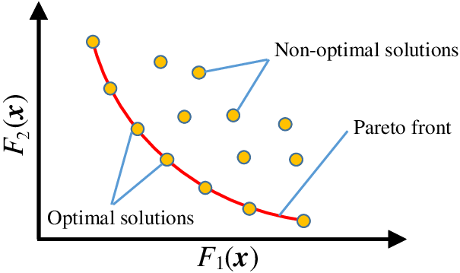

Feature Selection as a Multi-Objective Optimization Problem
Multi-objective objective problem involves more than one conflicting objectives that are optimized simultaneously (trade-off).
$$\operatorname{Minimize}{F=\left(f_{1}\left(x\right),f_{2}\left(x\right),…,f_{n}\left(x\right)\right),} where x∈X$$
$$Subject to:$$
$$g\left(x\right)≤0$$
$$h\left(x\right)=0$$

Slide 7

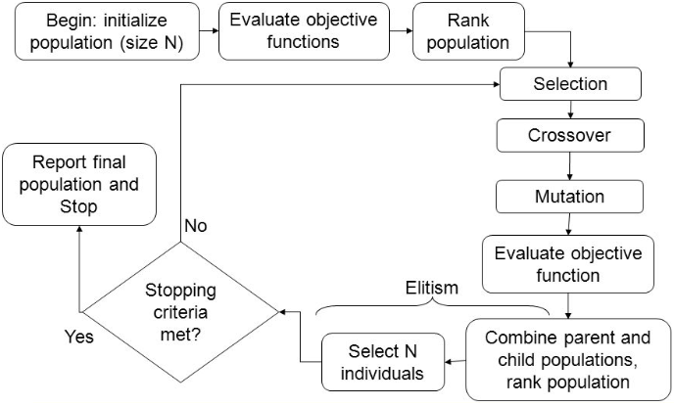
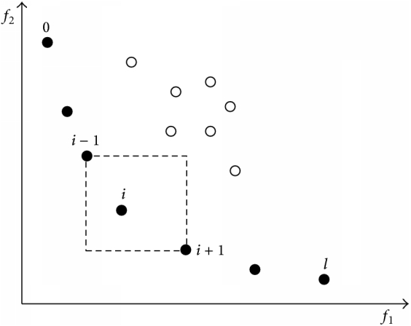
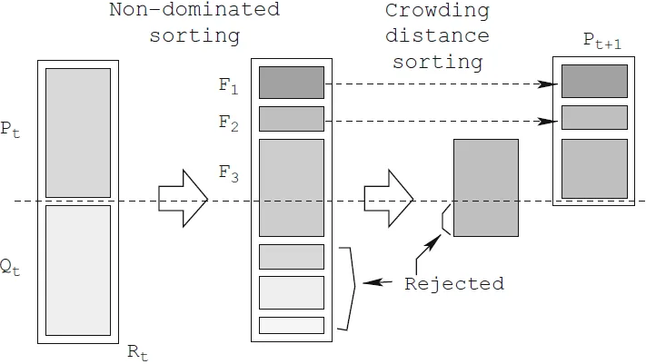
NSGA-II Algorithm

Slide 8
Minimum Gene Subset Selection Classifiers
Support Vector Machine (SVM)
Non-Linear SVM
Neural Network (NN)
K-Nearest Neighbor (K-NN)
Decision Tree
Random Forest

Slide 9
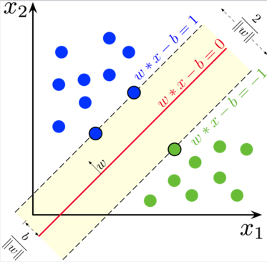

Support Vector Machine (SVM)
SVM is maximum margin classifier that finds hyperplane maximizing the distance between classes.
The decision function is fully specified by support vectors.
$$\min_{w}{|\left|w\right||}$$
$$s.t. y_{i}\left(w^{t}x_{i}+b\right)≥+1, i=1,…,n$$
This is a quadratic optimization problem with a unique global minima.

Slide 10
Datasets
Lung Cancer (Gordon, et al., 2002)
DLBCL (Shipp, et al., 2002)
77 Samples, 7070 Genes, 2 Classes
Diffuse Large B-cell Lymphoma (58 Samples)
Follicular Lymphoma (19 Samples)
Prostate Cancer (Singh, et al., 2002)
Myeloma (Tian, et al., 2003)

Slide 11
Experimental Results
Classifier Selection

Slide 12
Experimental Results
NSGA-II Performance

Slide 13
Conclusion
Feature selection is a very challenging problem:
High number of features
Small number of samples.
It is the first systematic attempt to apply NSGA-II based multi-objective algorithm to gene selection problem.
Multiple classifiers have been explored.
The experimental study has been conducted with respect to different datasets and performance metrics.
Elitism as future work

Slide 14
THANK YOU!

