Slide 1
PegaWORLD Design Track
Solution for schedule app

Slide 2
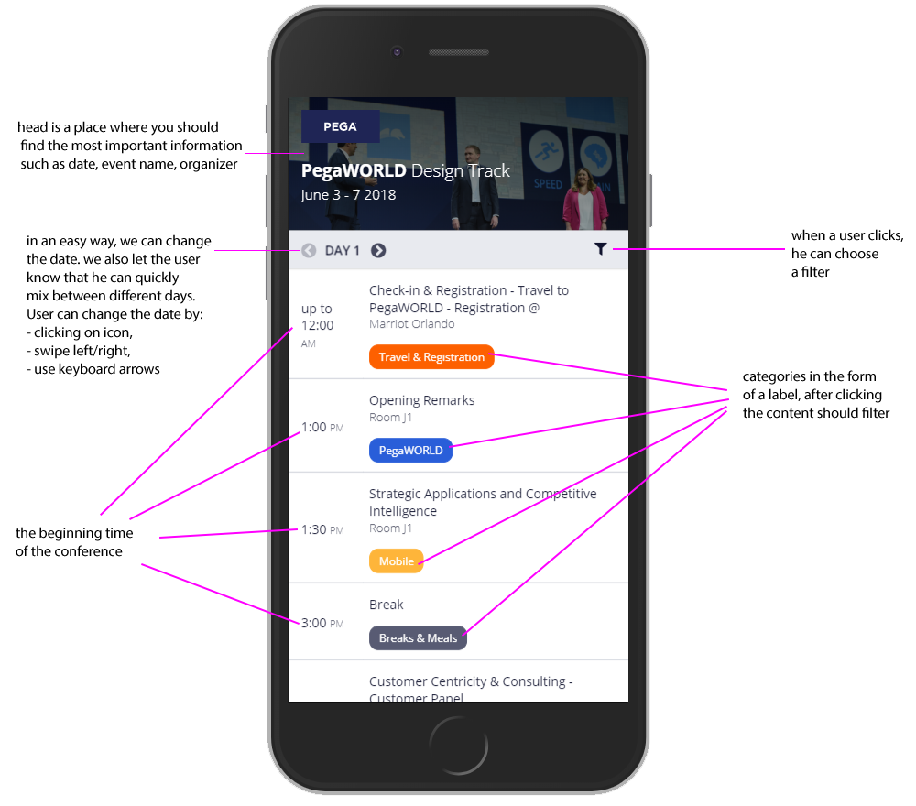
1.1. General: mobile

Slide 3
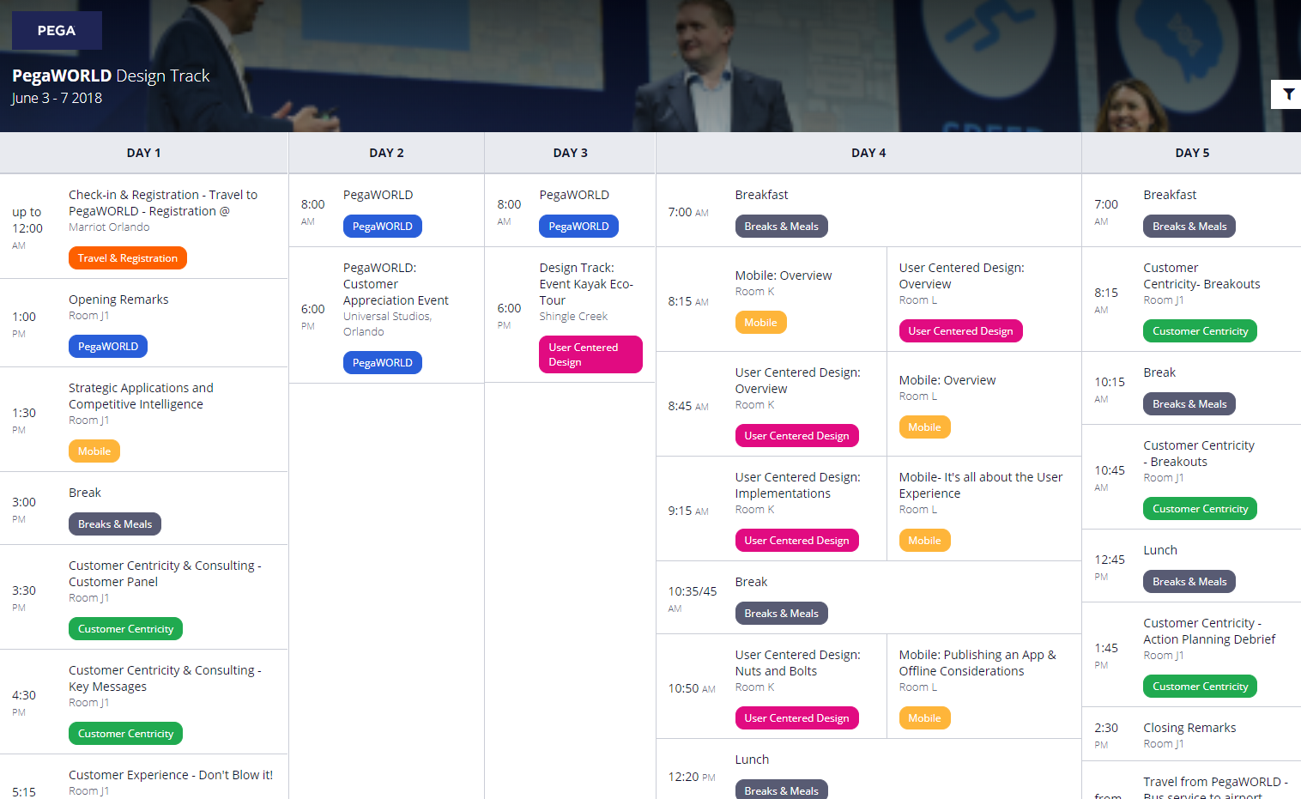
1.1. General: desktop

Slide 4
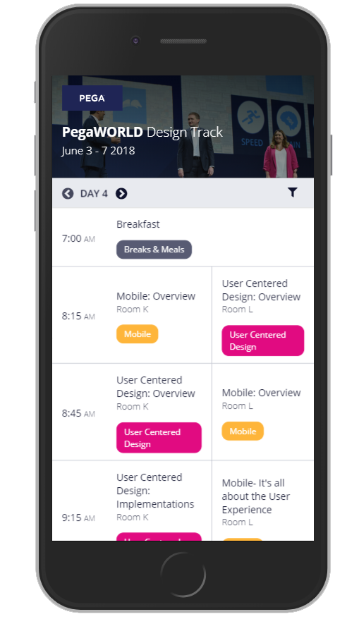
1.2. Solution for two tracks - mobile

Slide 5
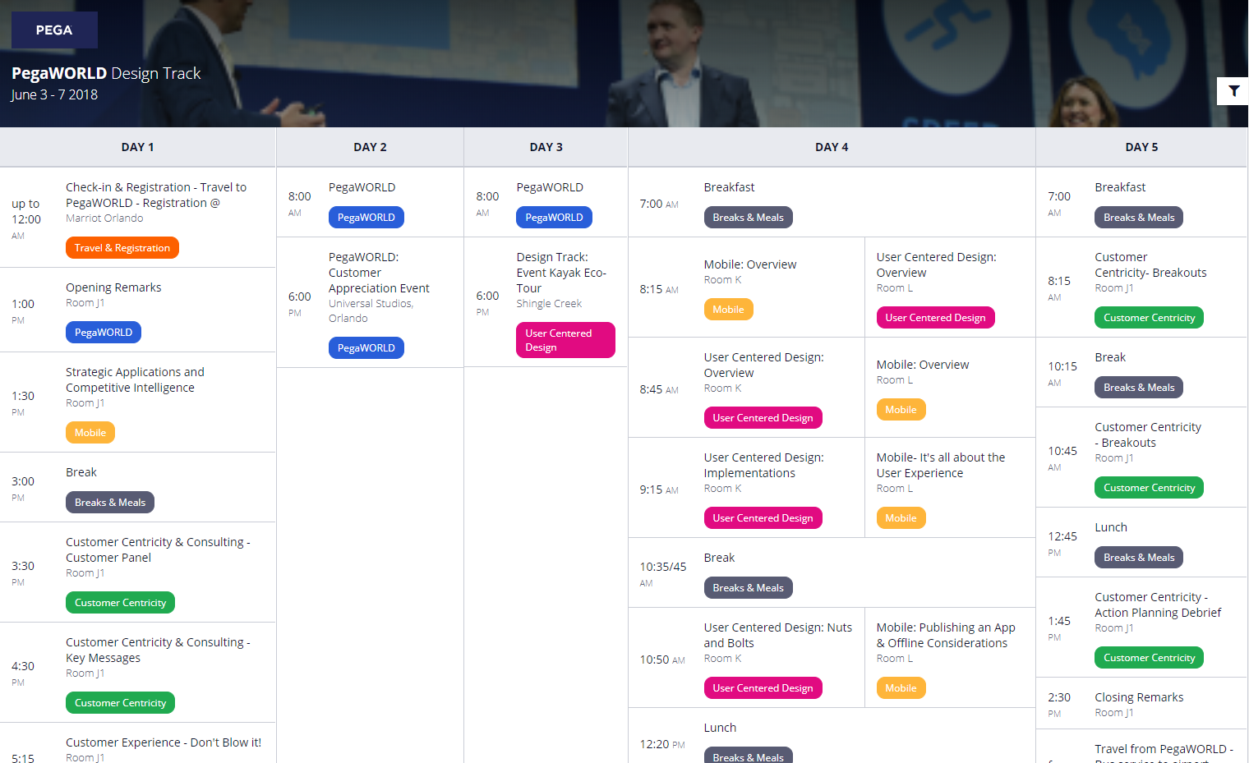
1.2. Solution for two tracks - desktop

Slide 6
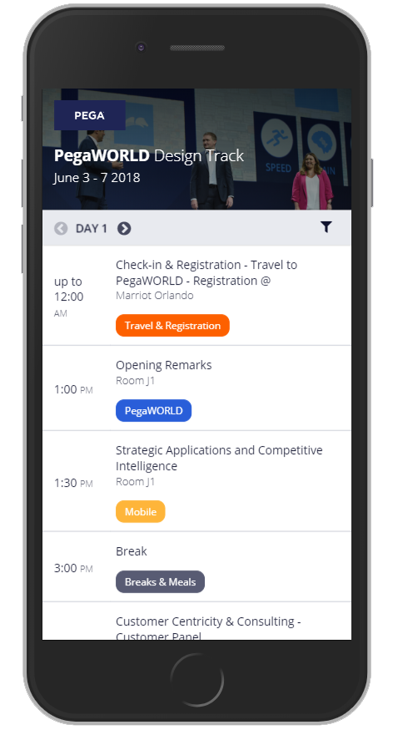
1.3. Categories view

Slide 7
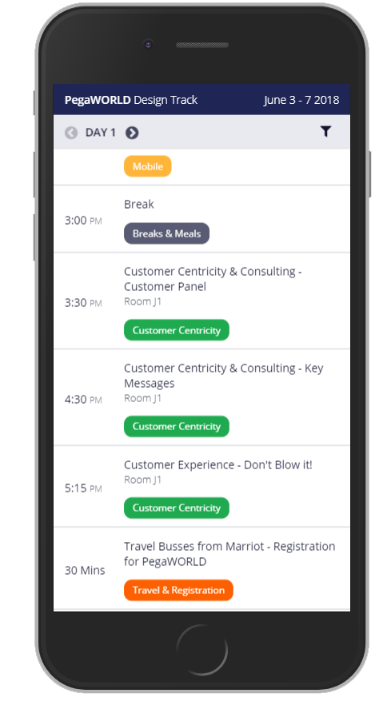
1.4. View when header is sticky - mobile

Slide 8
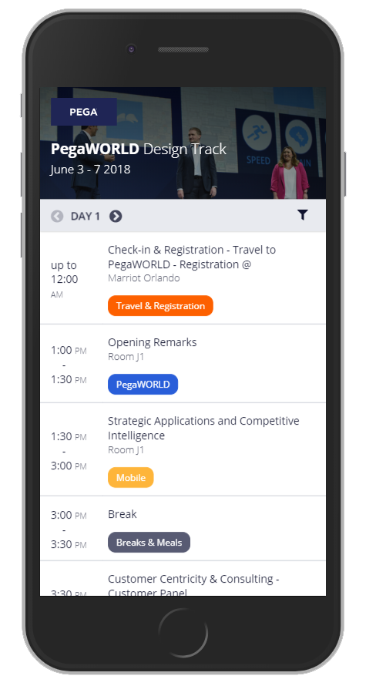
1.5. View of times - mobile

Slide 9
1.5. View of times - desktop

Slide 10
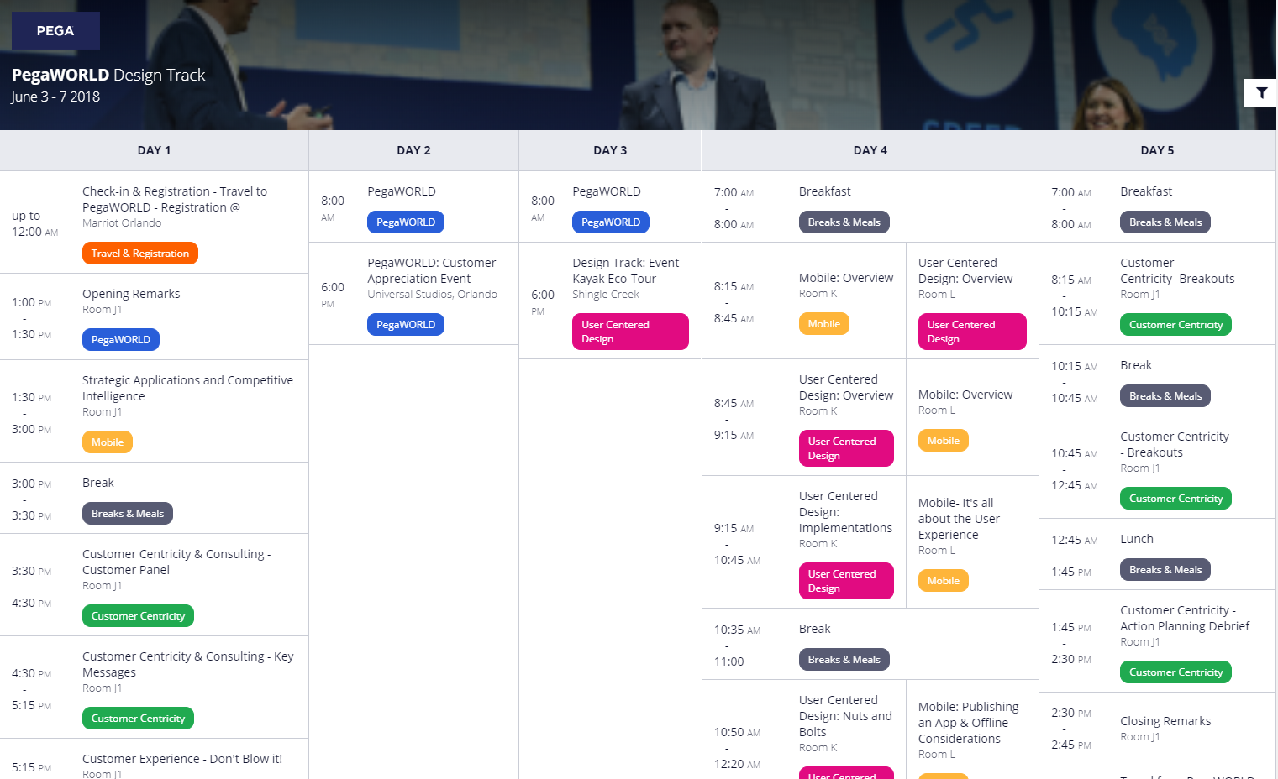
1.5. View of times - desktop

Slide 11
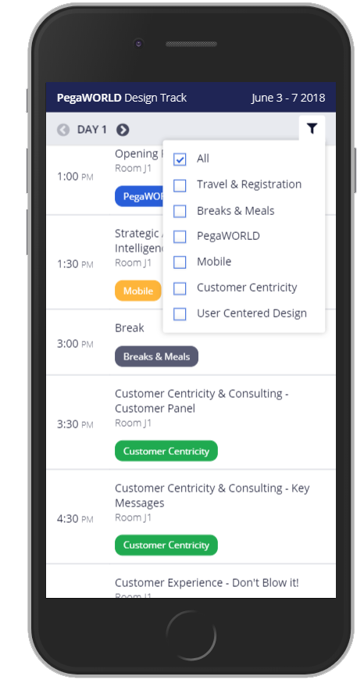
1.6. View when filter is open - mobile

Slide 12
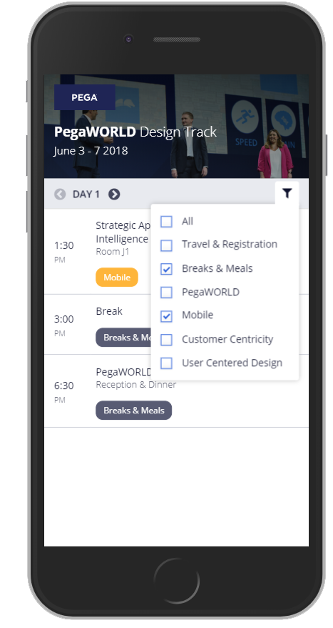
1.7. View when content filtered - mobile

Slide 13
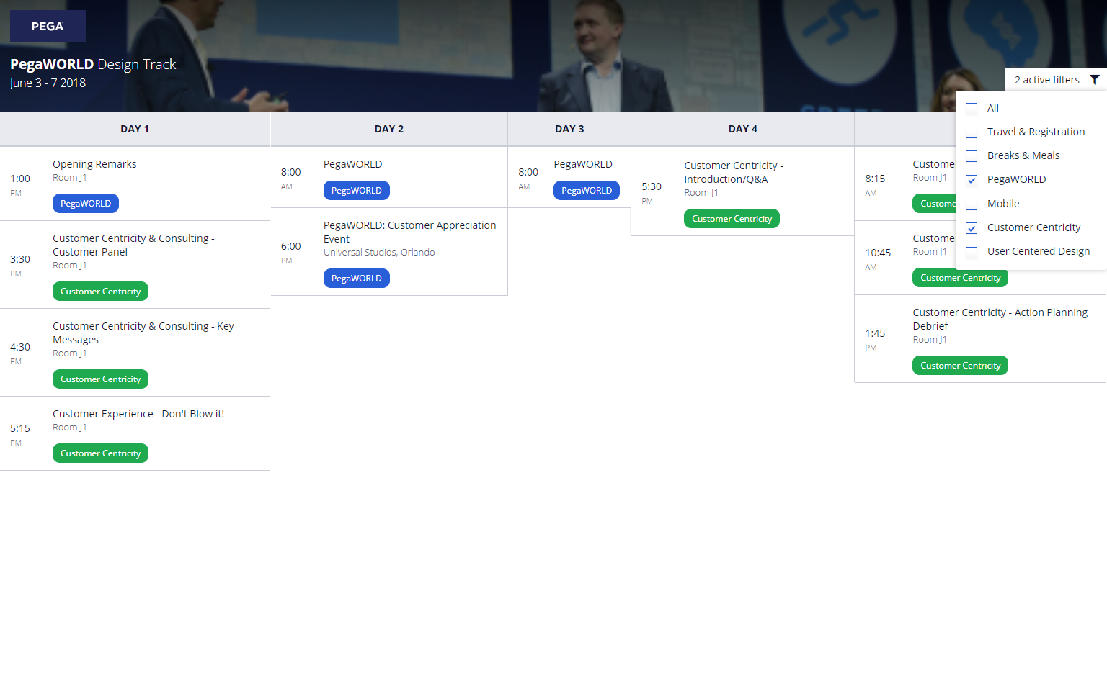
1.7. View when content filtered - desktop

Slide 14
How can we make our app more attractive?
add the possibility that the user can create his timeline by adding events that interest him
effective transitions, animations

Slide 15
Thank you ☺

