Slide 1
Predicting Fazekas with Fundus Photos using CNN
2020. 04. 09.

Slide 2
데이터 셋 - subjects
Original Datasets : 서버2 - /home/mlm08/DATA_FUNDUS_HALLYM_since2009/
Datasets for Training : 서버2 - /home/mlm08/FUNDUS_DATA/all_files_0401/ (extracted from Original Datasets)
Ground Truth label: Datalist_fdmri_v2.csv

Slide 3
Normalization
mean : [0,0,0] / std : [1,1,1]

Slide 4
Data Augmentations
1. Horizontal Flip
2. Vertical Flip
3. Horizontal Flip And Vertical Flip
원본사진 한장과 3장의 augmented 된 이미지파일

Slide 5
학습 Hyperparameters
Dropout 0.5
Start Learning Rate : 1e-3
# of Cycles : 4
Cycle multiplier : 4 / Starting Cycle length : 1
→ Epoch 관점에서,
4 Cycles은 1st cycle : 1 epoch / 2nd cycle : 4 epochs / 3rd cycle : 16 epochs / 4th cycle : 64 epochs 로 구성되어 있음.
→ Early Stopping : 한 사이클 안에서 validation loss 가 최소 되는 지점.

Slide 6
테스트 방법
1. Test Time Augmentations (TTA)
1.1 1개의 이미지를 3번 Augmentations 시킴
(1. Flip Vertical 2. Flip Horizontal 3. Flip Vertical and Horizontal)
1.2 총 4개의 이미지에 대해 예측을 하고 평균값을 도출해냄
1.3 평균 값을 최종 예측 값으로 사용
1.4 Resized 테스트 이미지 사진 사이즈

Slide 7
Datasets – Original (Training & Test)
 | Whole Dataset |  | Training set |  | Test set
 | Image N | Patient N | Image N | Patient N | Image N | Patient N
Overall | 1574 | 1574 | 1416 | 1416 | 158 | 158
ZERO | 989 | 989 | 890 | 890 | 99 | 99
ONE | 439 | 439 | 395 | 395 | 44 | 44
TWO | 118 | 118 | 106 | 106 | 12 | 12
THREE | 28 | 28 | 25 | 25 | 3 | 3
Table 1 Fundus datasets - original classes (split by patient ID, 90% : 10%)

Slide 8
Datasets – Original (Training & Test)
 | Whole Dataset |  | Training set |  | Test set
 | Image N | Patient N | Image N | Patient N | Image N | Patient N
Overall | 1574 | 1574 | 1416 | 1416 | 158 | 158
ZERO | 989 | 989 | 300 | 300 | 99 | 99
ONE | 439 | 439 | 300 | 300 | 44 | 44
TWO | 118 | 118 | 106 | 106 | 12 | 12
THREE | 28 | 28 | 25 | 25 | 3 | 3
Table 2 Fundus datasets - original classes (split by patient ID, 90% : 10%)

Slide 9
Datasets – Binary (Training & Test)
 | Whole Dataset |  | Training set |  | Test set
 | Image N | Patient N | Image N | Patient N | Image N | Patient N
Overall | 1574 | 1574 | 1417 | 1417 | 157 | 157
ZERO | 989 | 989 | 890 | 890 | 99 | 99
ONE ~ THREE | 585 | 585 | 527 | 527 | 58 | 58
Table 1 Fundus datasets - original classes (split by patient ID, 90% : 10%)

Slide 10
Datasets – Binary (Training & Test)
 | Whole Dataset |  | Training set |  | Test set
 | Image N | Patient N | Image N | Patient N | Image N | Patient N
Overall | 1574 | 1574 | 1417 | 1417 | 157 | 157
ZERO | 989 | 989 | 527 | 527 | 99 | 99
ONE ~ THREE | 585 | 585 | 527 | 527 | 58 | 58
Table 1 Fundus datasets - original classes (split by patient ID, 90% : 10%)

Slide 11
Results
[1] Test Results - 4 classes
[2] Test Results - 2 classes

Slide 12
Test Results - 4 classes (performance comparison w.r.t resolution change)
 |  |  | Architecture
resolution | batch size | Seed Number | ResNet 152 | DenseNet 169
 |  |  | TTA(%) | TTA(%)
299 x 299 | 6 | 7 | 58.23 | 58.86
350 x 350 | 6 | 7 | 56.34 | 62.03
450 x 450 | 6 | 7 | 63.29 | 62.03
480 x 480 | 6 | 7 | 63.29 | 62.03
540 x 540 | 6 | 7 | 62.03 | 56,34
600 x 600 | 6 | 7 | 56.96 | 59.49
800 x 800 | 6 | 7 | 58.23 | 55.06
1000 x 1000 | 6 | 7 | 57.60 | 55.70
Table 3 model performance - 4 classes
Notes:
같은 성능일시 cancer를 더 잘 맞춘 모델로 선택

Slide 13
Test Results - 4 classes
 |  |  | Architecture
resolution | batch size | Seed Number | ResNet 152 | DenseNet 169
 |  |  | TTA(%) | TTA(%)
299 x 299 -> 400 x 400 -> 480 x 480 | 6 | 7 | 65.66 | 67.09
299 x 299 -> 400 x 400 -> 480 x 480 | 6 | 77 | 56.96 | 61.39
299 x 299 -> 400 x 400 -> 480 x 480 | 6 | 777 | 52.53 | 56.96
Table 3 model performance - 4 classes
Notes:
같은 성능일시 cancer를 더 잘 맞춘 모델로 선택

Slide 14
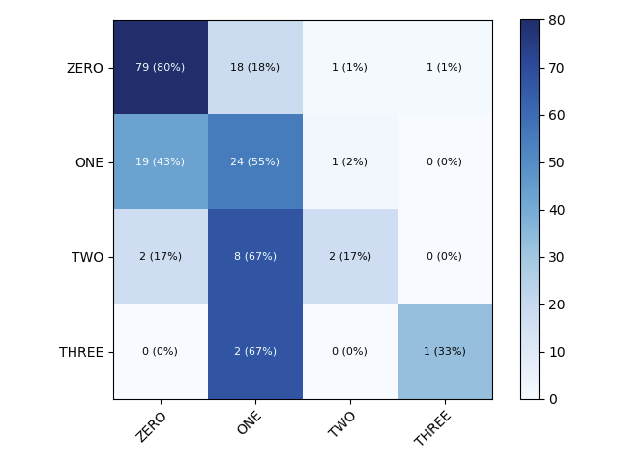
Confusion Matrix
Notes:
같은 성능일시 cancer를 더 잘 맞춘 모델로 선택

Slide 15
[2] Test Results - 2 classes
 |  | Architecture
seed number | batch size | Resnet 152 |  |  | DenseNet 169
 |  | TTA(%) |  | AUC | TTA(%) |  | AUC
8 | 6 | 66.5 |  | 0.692 | 62.0 |  | 0.700
88 | 6 | 66.5 |  | 0.703 | 66.50 |  | 0.725
888 | 6 | 64.60 |  | 0.695 | 62.0 |  | 0.701
Notes:
같은 성능일시 cancer를 더 잘 맞춘 모델로 선택

Slide 16
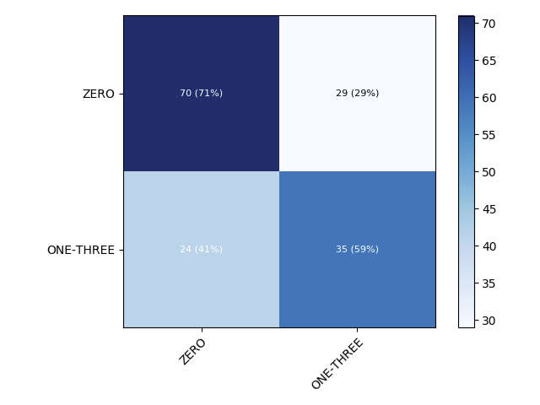
Confusion Matrix
Notes:
같은 성능일시 cancer를 더 잘 맞춘 모델로 선택

Slide 17
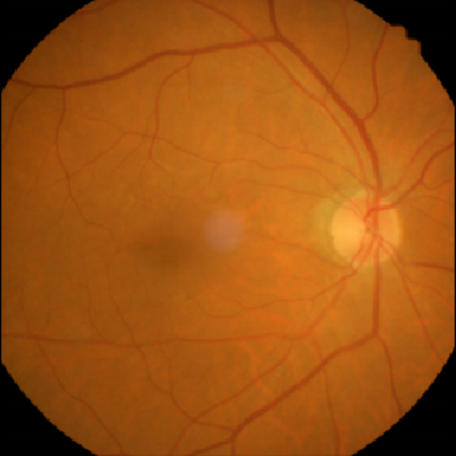
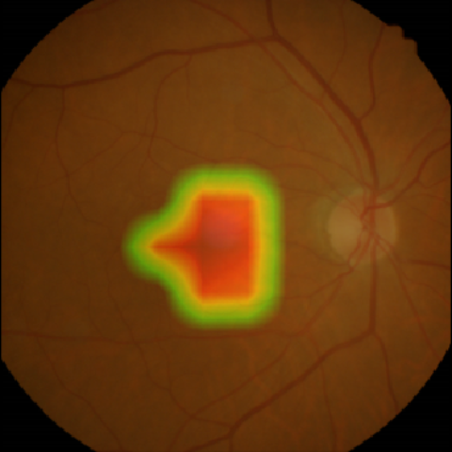
Class Activation Maps, Truth = Prediction = 1

Slide 18
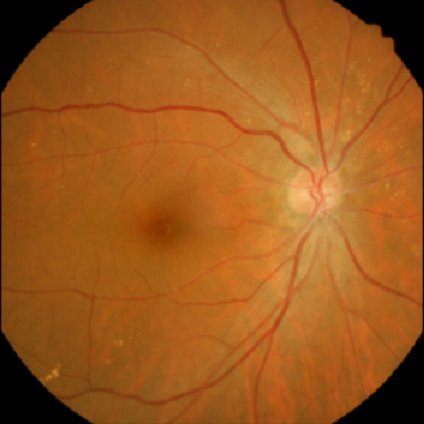
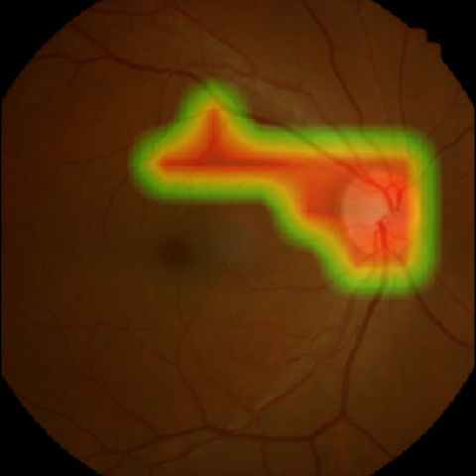
Class Activation Maps, Truth = Prediction = 1

