Slide 1
Predicting Fazekas with Fundus Photos using CNN
2020. 05. 14.

Slide 2
Normalization
mean : [0.485, 0.456, 0.406] / std : [0.229, 0.224, 0.225]

Slide 3
Data Augmentations
1. Horizontal Flip
2. Vertical Flip
3. Horizontal Flip And Vertical Flip
원본사진 한장과 3장의 augmented 된 이미지파일

Slide 4
학습 Hyperparameters
Start Learning Rate : 0.0005
→*0.1 at epoch 70
Epoch : 100

Slide 5
Datasets – Original (Training & Test)
 | Whole Dataset |  | Training set |  | Test set
 | Image N | Patient N | Image N | Patient N | Image N | Patient N
Overall | 1574 | 1574 | 1336 | 1336 | 238 | 238
ZERO | 989 | 989 | 840 | 840 | 149 | 149
ONE | 439 | 439 | 373 | 395 | 66 | 66
TWO | 118 | 118 | 100 | 100 | 18 | 18
THREE | 28 | 28 | 23 | 23 | 5 | 5
Table 1 Fundus datasets - original classes (split , 85% : 15%)

Slide 6
Datasets – Original (Training & Test)
 | Whole Dataset |  | Training set |  | Test set
 | Image N | Patient N | Image N | Patient N | Image N | Patient N
Overall | 1574 | 1574 | 1336 | 1336 | 238 | 238
ZERO | 989 | 989 | 300 | 300 | 149 | 149
ONE | 439 | 439 | 300 | 300 | 66 | 66
TWO | 118 | 118 | 100 | 100 | 18 | 18
THREE | 28 | 28 | 23 | 23 | 5 | 5
Table 2 Fundus datasets - original classes (split , 85% : 15%)

Slide 7
Datasets – Binary (Training & Test)
 | Whole Dataset |  | Training set |  | Test set
 | Image N | Patient N | Image N | Patient N | Image N | Patient N
Overall | 1574 | 1574 | 1336 | 1336 | 238 | 238
ZERO | 989 | 989 | 840 | 840 | 149 | 149
ONE ~ THREE | 585 | 585 | 496 | 496 | 89 | 89
Table 1 Fundus datasets - original classes (split by patient ID, 85% : 15%)

Slide 8
Results [1] Test Results - 4 classes [2] Test Results - 2 classes

Slide 9
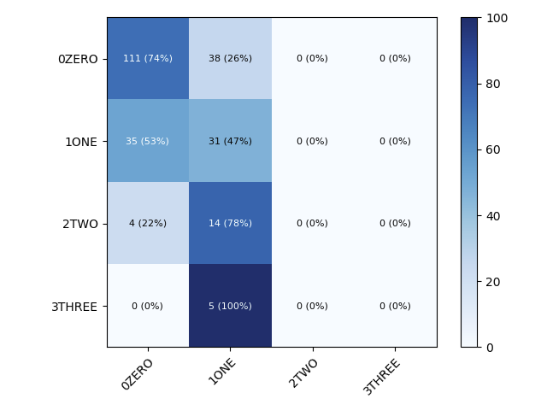
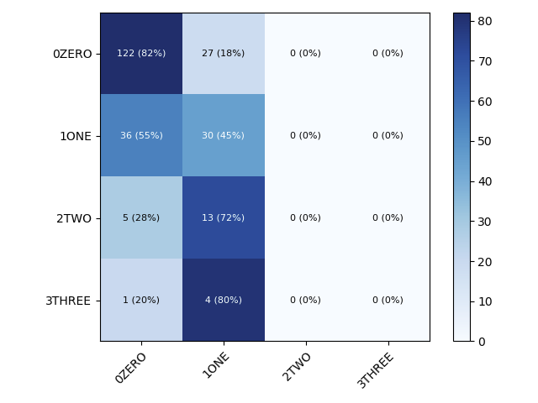
Test Results - 4 classes (Confusion Matrix)
resolution | Batch size | Architecture
 |  | ResNet152 | DenseNet169
480 X 480 | 4 | 59.66 | 63.87
Table 3 model performance - 4 classes (ResNet152, DenseNet169)
Notes:
같은 성능일시 cancer를 더 잘 맞춘 모델로 선택

Slide 10
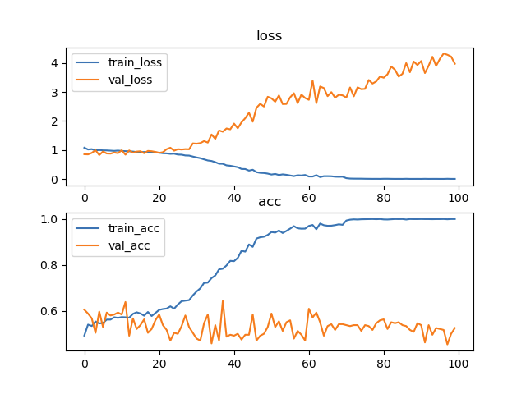
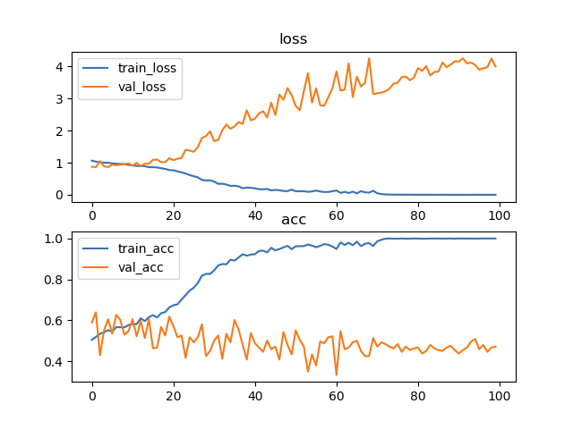
Test Results - 4 classes (Loss & Accuracy)
resolution | Batch size | Architecture
 |  | ResNet152 | DenseNet169
480 X 480 | 4 | 59.66 | 63.87
Table 3 model performance - 4 classes (ResNet152, DenseNet169)
Notes:
같은 성능일시 cancer를 더 잘 맞춘 모델로 선택

Slide 11
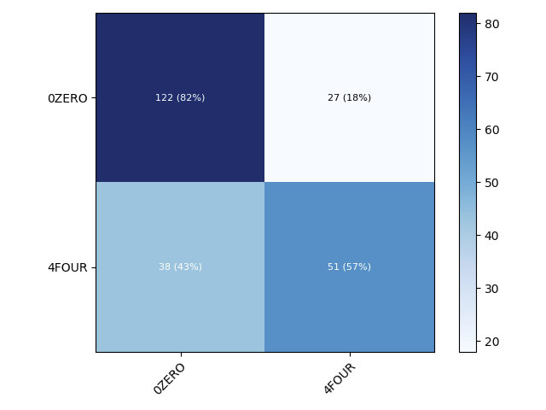

Test Results - 2 classes (Confusion Matrix)
resolution | Batch size | Architecture
 |  | ResNet152 | DenseNet169
480 X 480 | 4 | 72.69 | 70.59
Table 3 model performance - 4 classes (ResNet152, DenseNet169)
Notes:
같은 성능일시 cancer를 더 잘 맞춘 모델로 선택

Slide 12
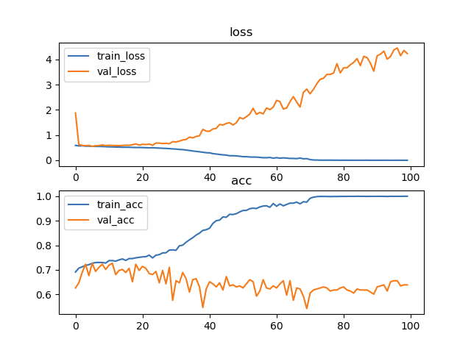
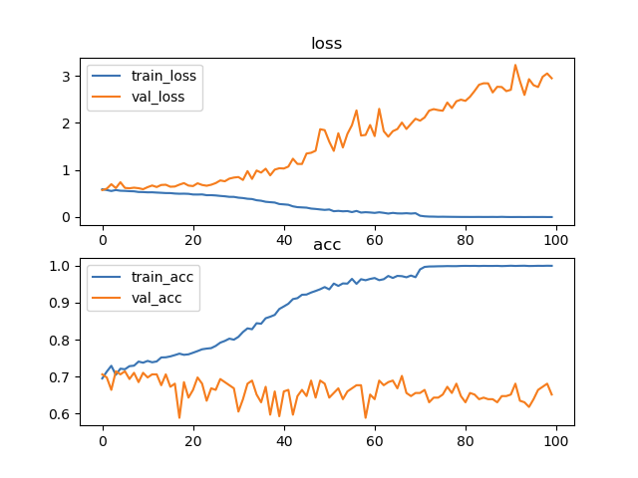
Test Results - 4 classes (Loss & Accuracy)
resolution | Batch size | Architecture
 |  | ResNet152 | DenseNet169
480 X 480 | 4 | 59.66 | 63.87
Table 3 model performance - 4 classes (ResNet152, DenseNet169)
Notes:
같은 성능일시 cancer를 더 잘 맞춘 모델로 선택

