Slide 1
Predicting Fazekas with Fundus Photos using CNN
2020. 05. 14.

Slide 2
Normalization
mean : [0.485, 0.456, 0.406] / std : [0.229, 0.224, 0.225]

Slide 3
Data Augmentations
1. Horizontal Flip
2. Vertical Flip
3. Horizontal Flip And Vertical Flip
원본사진 한장과 3장의 augmented 된 이미지파일
→ 이후 모든Train Set과Validation Set에CLAHE적용

Slide 4
학습 Hyperparameters
Start Learning Rate : 0.000001 (10^-6)
Epoch : 30

Slide 5
Datasets – Original (Training & Test)
 | Whole Dataset |  | Training set |  | Test set
 | Image N | Patient N | Image N | Patient N | Image N | Patient N
Overall | 1574 | 1574 | 1336 | 1336 | 238 | 238
ZERO | 989 | 989 | 840 | 840 | 149 | 149
ONE | 439 | 439 | 373 | 395 | 66 | 66
TWO | 118 | 118 | 100 | 100 | 18 | 18
THREE | 28 | 28 | 23 | 23 | 5 | 5
Table 1 Fundus datasets - original classes (split , 85% : 15%)

Slide 6
Datasets – Original (Training & Test)
 | Whole Dataset |  | Training set |  | Test set
 | Image N | Patient N | Image N | Patient N | Image N | Patient N
Overall | 1574 | 1574 | 1336 | 1336 | 238 | 238
ZERO | 989 | 989 | 250 | 250 | 149 | 149
ONE | 439 | 439 | 250 | 250 | 66 | 66
TWO | 118 | 118 | 100 | 100 | 18 | 18
THREE | 28 | 28 | 23 | 23 | 5 | 5
Table 2 Fundus datasets - original classes (split , 85% : 15%)

Slide 7
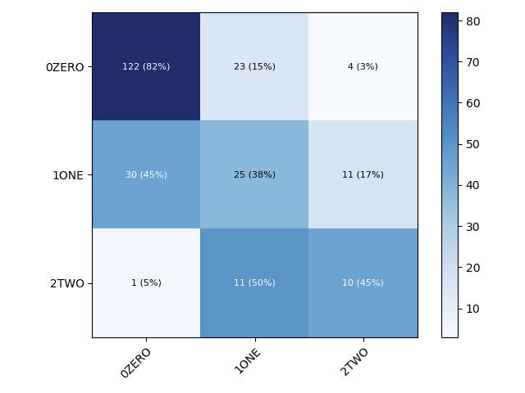

Test Results - 3 classes (Confusion Matrix)
resolution | Batch size | Architecture
 |  | ResNet152 | DenseNet169
480 X 480 | 6 | 65.97 | 63.87
Table 3 model performance - 4 classes (ResNet152, DenseNet169)
Notes:
같은 성능일시 cancer를 더 잘 맞춘 모델로 선택

Slide 8
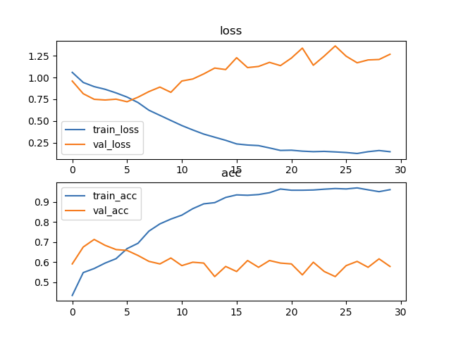
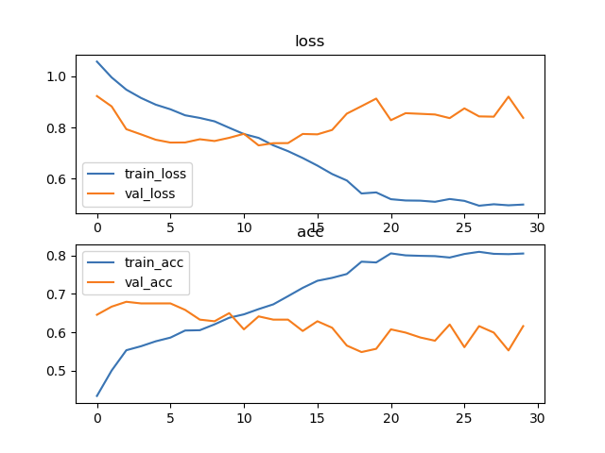
Test Results - 3 classes (Loss & Accuracy)
resolution | Batch size | Architecture
 |  | ResNet152 | DenseNet169
480 X 480 | 6 | 65.97 | 63.87
Table 3 model performance - 4 classes (ResNet152, DenseNet169)
Notes:
같은 성능일시 cancer를 더 잘 맞춘 모델로 선택

