Slide 1
Data Mining Association Rule
Ehsan Mirzaei
Jun 2022

Slide 2
What is Association Rule?
Study of attributes that “go together”
known as market basket analysis
Seeks to uncover rules of the form “If antecedent, then consequent”
All done with two measure “support” and “confidence” for the rule.
E.g.: 1000 customers, 200 bought diapers and of those 50 bought beer leads to rule
if buy diapers then buy beer with support of 50/1000 and confidence of 50/200

Slide 3
Use Case
Medicine :
Proportion of cases in which new drug will exhibit dangerous side effects.
Can use association rules to help diagnose patients.
Retail :
Finding which items in a supermarket are purchased together and which are never purchased together.

Slide 4


Support and Confidence
support s for association rule 𝐴 ⇒ 𝐵 (if A then B)
Support refers to the probability of observing X and Y together
confidence c for association rule 𝐴 ⇒ 𝐵
Confidence refers to the probability of observing Y when the X sold

Slide 5
Example
“If a customer buys bread, he’s 70% likely of buying milk.”
Suppose an X store’s retail transactions database includes the following data
Total number of transactions: 600,000
Transactions containing diapers: 7,500 (1.25 percent)
Transactions containing beer: 60,000 (10 percent)
Transactions containing both beer and diapers: 6,000 (1.0 percent)
80% (=6000/7500) of the people who buy diapers also buy beer (Lift)

Slide 6
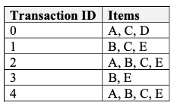
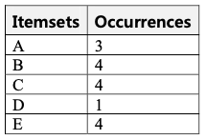
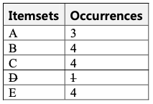
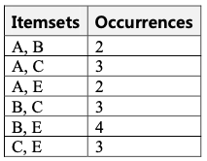
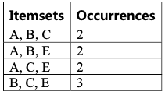

Steps
Step 1: get all frequency items on binary.
Step 2: sets the minimum support (support is 2)
Step 3: process is repeated for a combination of two items as L2,L3,L4

Slide 7
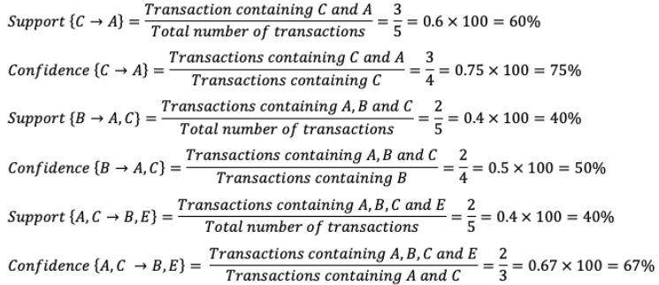
Steps
Step 4: Calculate support and confidence
Step 5: Generating Rules

