Slide 1
Data Mining Cluster Analysis
Ehsan Mirzaei
Jun 2022

Slide 2
Cluster Analysis
Hierarchical Clustering
KMeans

Slide 3
What is cluster analysis?
Cluster analysis is the generic for a wide variety of methodologies that are used to group entities.
Objective: to build groups of similar entities from each other.

Slide 4
Clustering versus classification
Classification
Starts with a set of pre-classified data
The object is to develop a model able to predict how a new record will be classified
Clustering
no pre-classified data
Seek groups (clusters) of individuals who are similar to each other.
Underlying belief is that similar individuals in terms of the variables used will have similar behaviors.

Slide 5
Steps for Cluster Analysis
4 basic stages characterize all studies involving the analysis of clusters.
Definition of Variables
Similarity criterion
Algorithm
Profiling

Slide 6
Definition of Variables
Definition of Variables
Similarity criterion
Algorithm
Profiling
The type of problem determines the variables to choose from
Including discriminant variables is decisive
The quality of any cluster analysis is highly conditioned by the variables used
The choice of variables should play a supporting theoretical context
The quality of the cluster analysis reflects the discrimination ability of the variables we used

Slide 7
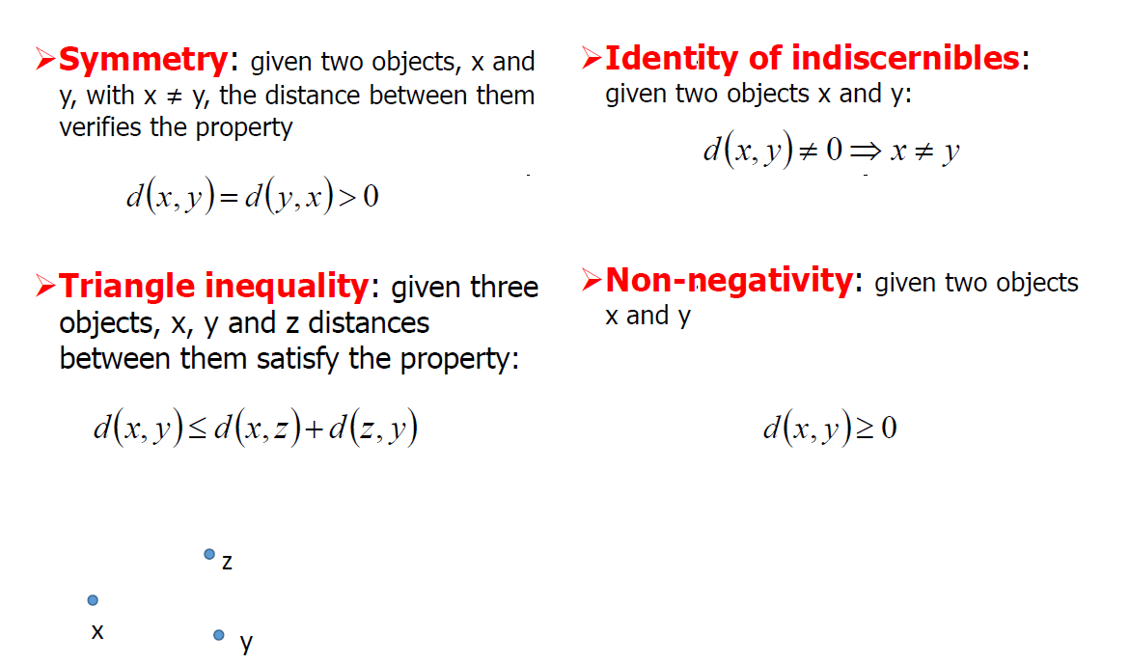
Similarity criterion
Definition of Variables
Similarity criterion
Algorithm
Profiling

Slide 8
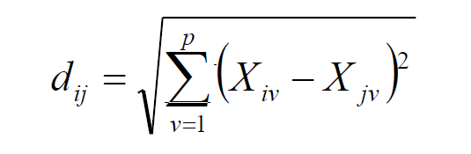
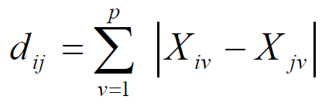
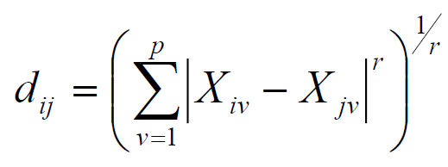
Similarity criterion
Definition of Variables
Similarity criterion
Algorithm
Profiling
Euclidean Distance
Manhattan distance
Minkowski distance

Slide 9
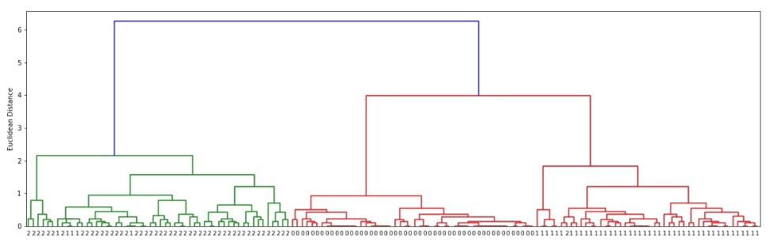
Algorithm
Definition of Variables
Similarity criterion
Algorithm
Profiling
Cluster analysis are divided into two major groups.
Hierarchical Clustering
Based on top-to-bottom hierarchy of the data points to create clusters.
Optimization methods or partition
Based on centroids and data points are assigned into a cluster based on its proximity to the cluster centroid.

Slide 10
Algorithm
Definition of Variables
Similarity criterion
Algorithm
Profiling
Optimization methods or partition
K-Means
Given a database of n objects
Constructs k partitions, where each partition represents a cluster
k < n
Classifies the data into k groups, satisfying the following conditions
each group contains at least one object
each object belongs to only one cluster

Slide 11
Algorithm
Definition of Variables
Similarity criterion
Algorithm
Profiling
Seed definition
Each individual is associated with the closest seed
Calculate the centroids of clusters formed
Return to step 2
End when the centroids no longer change
https://youtu.be/5I3Ei69I40s

Slide 12
Profiling
Definition of Variables
Similarity criterion
Algorithm
Profiling
Helps build a sense of clusters and the distances between them

