Slide 1

ROCKBUSTER STEALTH MARKET ANALYSIS
Presented By Pratham Goswami

Slide 2
Motivations & Objectives
Rockbuster Stealth LLC encounters intense competition from streaming services and intends to leverage its current movie licenses to introduce an online video rental service, ensuring competitiveness. The analysis conducted will assist in identifying the specific movies and regions to prioritize during the launch of the online platform.

Slide 3
Key Questions
Which films had the greatest and lowest impact on revenue growth?
Where are our most consistent and loyal customers are found?
What is average rental duration?
Where are most Rockbuster customers located?

Slide 4
Overview Of Data (All movies released in 2016)
Most Rented Rating
PG-13
Most Rented Genre
Sports
Most Common Rented Rate
$0.99
Total Rentals
16044
Number Of Customers
599
Most Common Rented Duration
3 Days

Slide 5
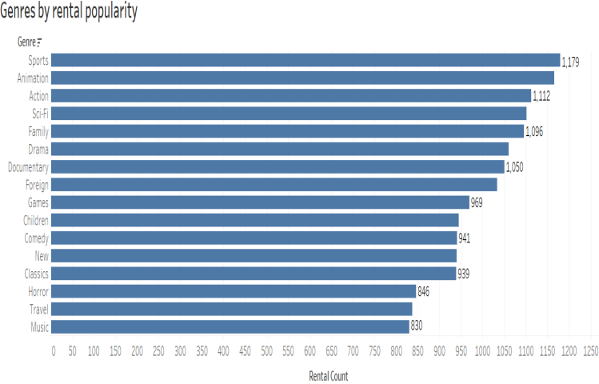
Top 16 Genres By Rentals
Top 5 genres by number of movies rented are Sports, animation, action, Sci-Fi and Family.
Thriller is the only category not on the list as it has only 12 rentals. A contributing factor could be that Rockbuster only has 3 thriller movies in its rental list.

Slide 6
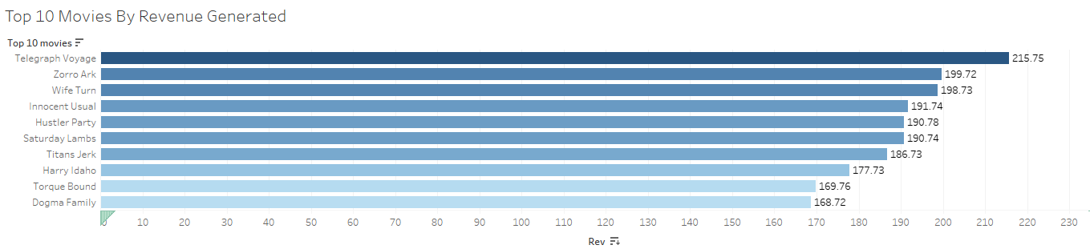
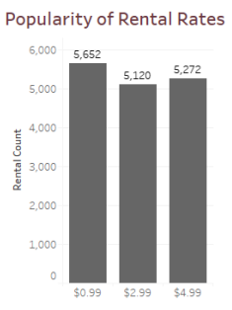
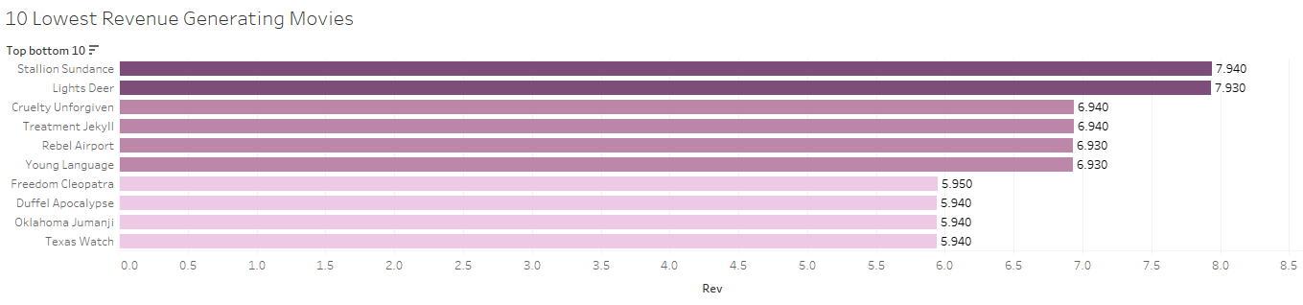
Revenue
Top 10 movies rented at a rate of $4.99
However most movies rented at $0.99
Top 50 movies contributed to 13% of global revenue
Bottom 50 movies contributed to 1% of global revenue

Slide 7
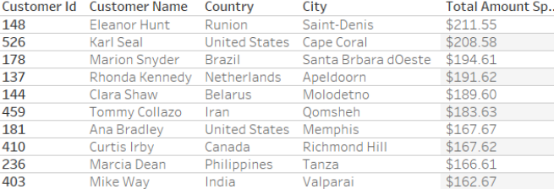
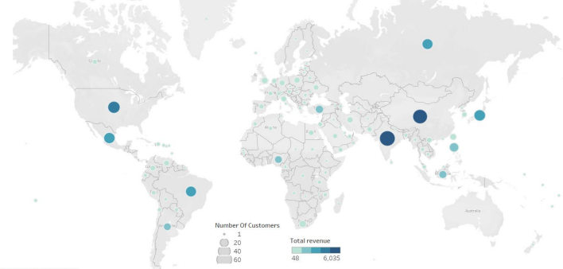
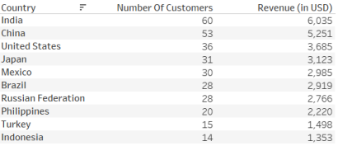
Spatial Analysis
10 Highest Spending Customers
Asia makes up 45% of global sales
Europe makes up 18% of global sales
South America makes up 13% of global sales
North America makes up 12% of global sales
Africa and Oceania make up 11% and 1% respectively
Something to notice is the highest spenders aren't all form the countries with highest revenue.
Number of Customers And Total Revenue
Top 10 Highest Revenue Counties

Slide 8
Recommendations
The movie inventory needs to be streamlined by removing films that do not generate significant revenue I’d suggest given its poor performance at least the bottom fifty should be removed.
Create a rewards program for high value customers to incentivize more rentals and reward our most loyal customers.
When marketing focus on the Asian market heavily and primarily on invest in the top 5 regions.
Look at the lowest performing movies and licensing costs see which moves make a profit and which don’t cut out any nonprofitable rentals.

Slide 9
Thank you for viewing my presentation
Visualization Link

