Slide 1
Hands-On with Sencha Touch and Sencha Architect
Steve Drucker
Founder / President
Fig Leaf Software

Slide 2
About Me
B.S. Computer Science, The University of Maryland College Park
Certified Technical Trainer (CTT+)
Certified Sencha Instructor
Certified Titanium Developer
Authored first book about ColdFusion development
Author of "Teach Yourself Sencha in a Day"
Authored 20+ instructor-led training courses for Adobe, Sencha, Paperthin, JackBe, Google, and Fig Leaf Software
10 years in Web Content Management (www.voanews.com, www.nps.gov)
10 years in apps (desktop web & mobile)
Developed mobile apps for Sony, Quest Diagnostics, Archdiocese of Baltimore, others
One of the winners of the Sencha/Blackberry Lighthouse Competition
(for Sencha's Raiders – an arcade game)
20+ year career in I.T.

Slide 3
About Me
Recent Projects
  "Teach Yourself Sencha Touch and Ext JS 4 in a Day"
  http://training.figleaf.com/tutorials/senchacomplete/
  "Fast Track to Sencha Touch 2.2"
  iPad-based patient chart for Quest Diagnostics
  iPad-based crime reporting tool for D.H.S.
  "Locator" app for Archdiocese of St. Louis
  http://webapps.figleaf.com/archstl
  "Notifier" app for Sony
A few published apps (also available on iTunes & Play)
  Sencha's Raiders (webapps.figleaf.com/sr)
  www.archbalt.org/mobile
  www.entnet.org/mobile

Slide 4
Session Schedule
Demo Sencha Touch Apps
Workstation Setup
Lab 1: Starting a New Project and Loading Data
Lab 2: Defining the Initial View
Lab 3: Defining Data-Bound Views
Lab 4: Defining Controllers and Actions

Slide 5
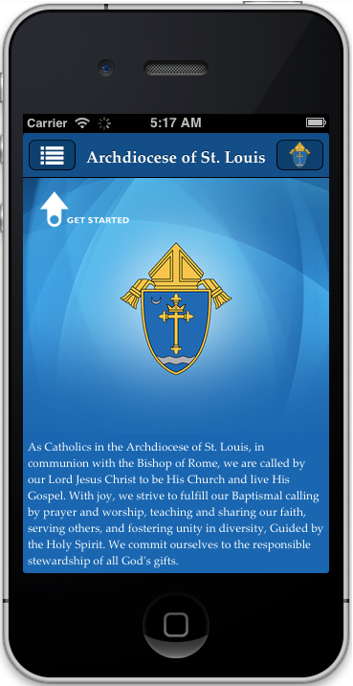


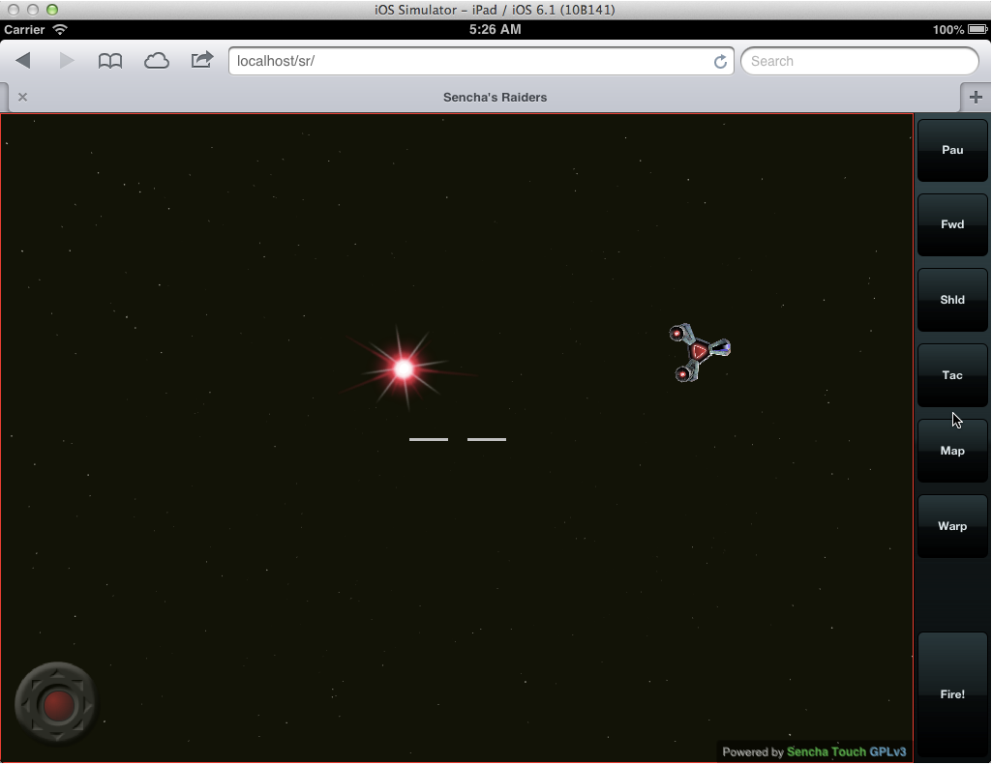
Demo Sencha Touch Apps

Slide 6
Workstation Setup
Download repo from GitHub at:
https://github.com/sdruckerfig/IntroToSenchaArchitect
Follow instructions in PDF file
Required Software:
    Web Server
    Sencha Architect
    Google Chrome
    Yelp API Key

Slide 7
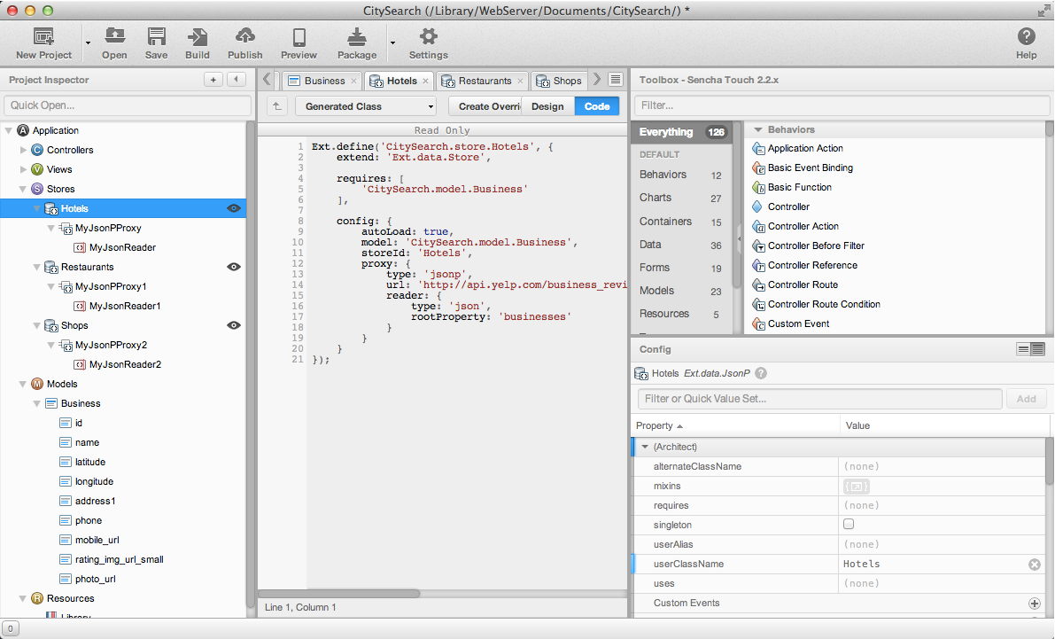

Lab 1: Data Models and Stores

Slide 8
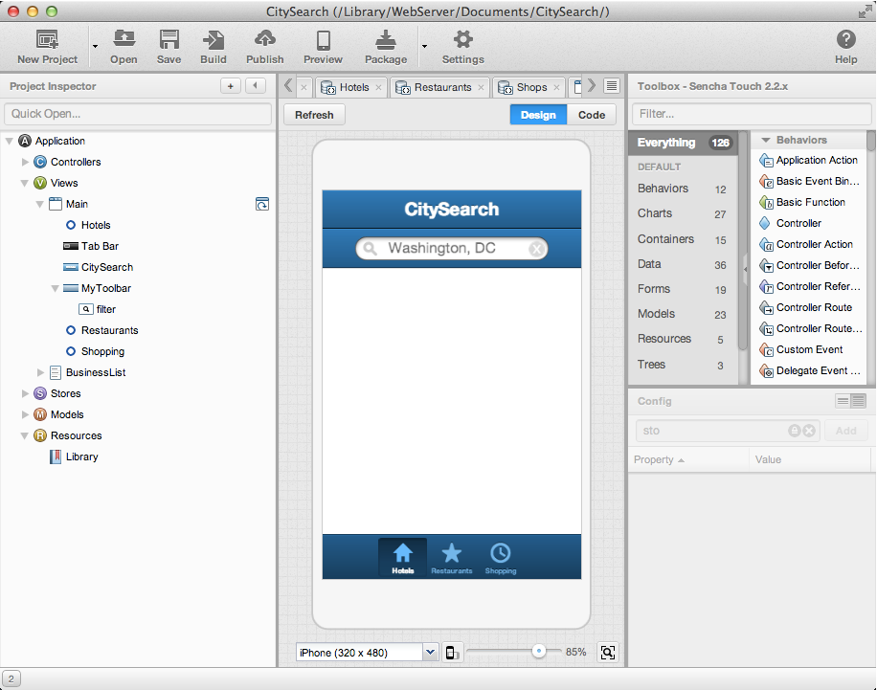
Lab 2: Defining the Initial View

Slide 9
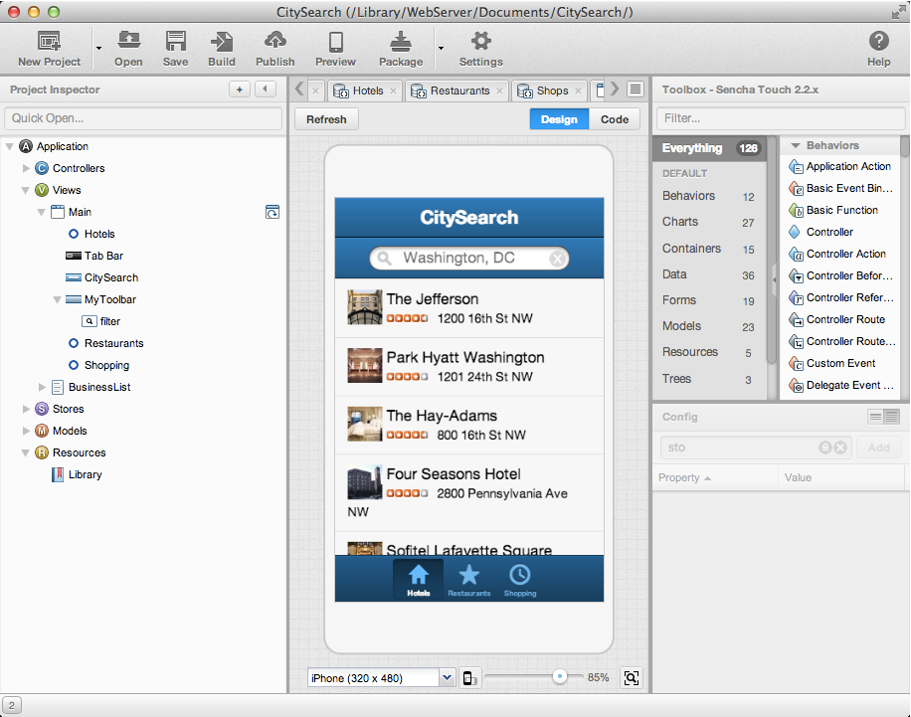
Lab 3: Data-Bound Views

Slide 10
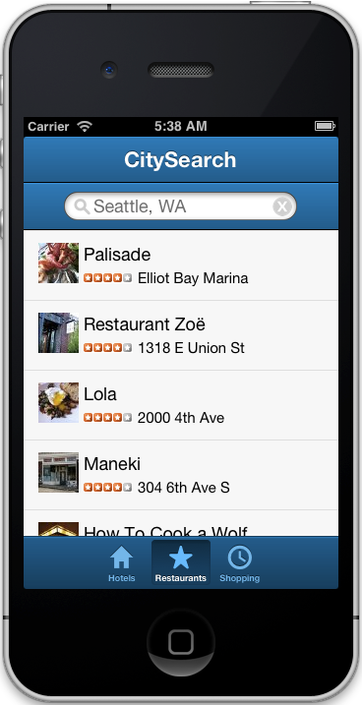
Lab 4: Controller Actions

Slide 11

Q & A

Slide 12
Contact Us
sdrucker@figleaf.com
http://www.linkedin.com/in/uberfig
http://www.facebook.com/steve.drucker
http://druckit.wordpress.com
Twitter: @sdruckerfig
http://www.figleaf.com
http://training.figleaf.com
Free tutorials:
http://training.figleaf.com/tutorials
Ask me about our Consulting, Training, and Software Sales!

