Slide 1
CoolKarachi
An Explainable Machine-Learning Digital Twin for 30 m Urban Heat Mapping and Cooling-Intervention Prioritisation in Karachi
Gotam Dulhani (23I-0545) · Mohat Kumar (23K-0894)
Data Science Course Project · FAST-NUCES Karachi
Google Earth Engine · Landsat 8/9 · Sentinel-2 · SHAP

Slide 2
01 PROBLEM
Karachi is heating faster than it can adapt
• May–June 2015 heatwave: >1,200 deaths, mostly in low-income, low-vegetation districts
• Karachi's built-up area has expanded rapidly, replacing irrigated land and mangrove fringes
• Within a single 2 km block, surface temperature varies by ~5 °C at the median and >8 °C in the hottest tenth
• Cooling budgets are scarce — interventions must be spatially prioritised, not sprayed evenly
  – Current practice relies on coarse 1 km MODIS products or single-date analyses
  – No open, explainable, 30 m decision-support layer exists for the city

Slide 3
02 OBJECTIVE
What this project delivers
• Build a 6-year, 30 m land-surface-temperature record for Karachi (2020–2025) from Landsat 8/9 via Earth Engine
• Explain the drivers of intra-urban heat with four machine-learning models and SHAP attribution
• Use the fitted model as a lightweight digital twin to simulate greening and cool-roof scenarios
• Rank neighbourhoods by expected cooling per intervention, so policy can target the hottest, most responsive cells
  – Explicitly test three prediction targets to separate neighbourhood effects from city-wide climate gradients

Slide 4
03 DATA
Study area and input layers
• Karachi Division, 66.65–67.45 °E, 24.70–25.15 °N, plus a 15 km rural buffer
• Pre-monsoon season (May–June) only — clearest skies, peak heat, minimal cloud contamination
• Landsat 8/9 Collection 2 Level-2 surface temperature, 30 m, median composite per year
Layer | Source | Res.
LST | Landsat 8/9 C2 L2 | 30 m
NDVI / NDBI / NDWI | Sentinel-2 SR | 10 m
Albedo | Sentinel-2 SR | 10 m
Built / tree / water | Dynamic World | 10 m
Elevation | SRTM | 30 m
Population | WorldPop | 100 m

Slide 5
04 SAMPLING
Two datasets, two different questions
• Full sample — 60,000 points/year across all land cover
  – Measures the urban vs rural contrast (surface urban heat island)
• Built-up stratified sample — 60,000 points/year where built fraction ≥ 0.2
  – Isolates intra-urban drivers, which is what intervention design needs
• 360,000 rows total, six years, no missing values after QA
• 28% of pixels were dropped as cloud/QA failures before sampling

Slide 6
05 METHOD
Pipeline
Earth Engine
Feature stack
Targets
Spatial CV
4 models
SHAP + scenarios
Landsat 8/9 + Sentinel-2
median composites
›
9 predictors at 30 m
+ coordinates
›
local / anomaly / raw
LST definitions
›
2 km blocks
no leakage
›
RF, XGBoost,
LightGBM, MLP
›
attribution and
counterfactuals

Slide 7
06 TARGETS
Why three targets instead of one
Target | Definition | Answers
local | LST − 2 km block-year mean | neighbourhood drivers
anomaly | LST − year mean | city-wide pattern
raw | absolute LST (°C) | operational mapping
A single R² hides the design choice. Reporting all three separates what the model can learn about a neighbourhood from what is simply geography and weather.

Slide 8
07 VALIDATION
Spatial blocking instead of random k-fold
• Random splits let the model memorise neighbouring pixels → optimistic R²
• Here the city is cut into ~700 tiles of 0.02° (≈2 km); whole tiles are held out
• Hyperparameters tuned with Optuna using GroupKFold on the training tiles
• Final metrics come only from tiles the model has never seen
• Result: cross-validation RMSE 1.186 vs test RMSE 1.219 °C — a small, honest gap

Slide 9
08 EDA
What the data says
• Mean LST 44.2 °C; inter-annual range 42.9 °C (2022) to 46.2 °C (2024)
• Land cover ordering is physical: water 39.6 < trees 41.0 < crop 43.1 < built 44.2 < bare 44.5 °C
• Urban–rural contrast is NEGATIVE: −1.2 °C — the rural reference is hotter inland desert
• Strongest correlations: NDBI +0.45, elevation +0.39, population −0.33, tree fraction −0.21
• Built fraction correlates only weakly (−0.07) inside the built-up sample — density matters more than presence
• Anomaly: albedo max 1.94 (physically impossible) → clipped to 0.02–0.65

Slide 10
09 RESULTS — LOCAL ANOMALY
Model comparison on held-out spatial blocks
Model | RMSE | MAE | R² | MBE | n
RF | 1.219 | 0.928 | 0.219 | -0.002 | 56613
XGB | 1.221 | 0.931 | 0.216 | +0.002 | 56613
MLP | 1.222 | 0.932 | 0.215 | -0.008 | 56613
LGBM | 1.223 | 0.933 | 0.214 | +0.002 | 56613

Slide 11
09 RESULTS — YEAR ANOMALY
Model comparison on held-out spatial blocks
Model | RMSE | MAE | R² | MBE | n
MLP | 1.754 | 1.379 | 0.500 | -0.107 | 56613
RF | 1.755 | 1.379 | 0.500 | -0.083 | 56613
XGB | 1.757 | 1.380 | 0.498 | -0.107 | 56613
LGBM | 1.759 | 1.383 | 0.497 | -0.106 | 56613

Slide 12
09 RESULTS — RAW LST
Model comparison on held-out spatial blocks
Model | RMSE | MAE | R² | MBE | n
LGBM | 1.661 | 1.299 | 0.626 | -0.109 | 56613
RF | 1.661 | 1.290 | 0.626 | -0.095 | 56613
XGB | 1.663 | 1.299 | 0.625 | -0.111 | 56613
MLP | 1.685 | 1.314 | 0.616 | -0.077 | 56613

Slide 13
10 EXPLAINABILITY
Which features actually drive neighbourhood heat?
Rank | Feature | Mean |SHAP| (°C)
1 | NDBI | 0.326
2 | NDWI | 0.156
3 | TREE_FRAC | 0.142
4 | BUILT_FRAC | 0.126
5 | POP_LOG | 0.088
6 | WATER_FRAC | 0.087
7 | ELEV | 0.087
8 | ALBEDO | 0.061

Slide 14
11 DIGITAL TWIN
Counterfactual cooling scenarios
Scenario | Mean ΔLST | Median ΔLST | % < −0.5 °C | % < −1.0 °C
greening_+10%_NDVI | -0.60 | -0.58 | 60.8 | 10.1
cool_roof_+0.15_albedo | -0.04 | -0.01 | 3.9 | 1.0
combined | -0.60 | -0.59 | 61.6 | 10.9
Local-anomaly target. On the within-year anomaly target the same albedo perturbation cools 0.42 °C instead of 0.04 °C — the instability is the finding.

Slide 15
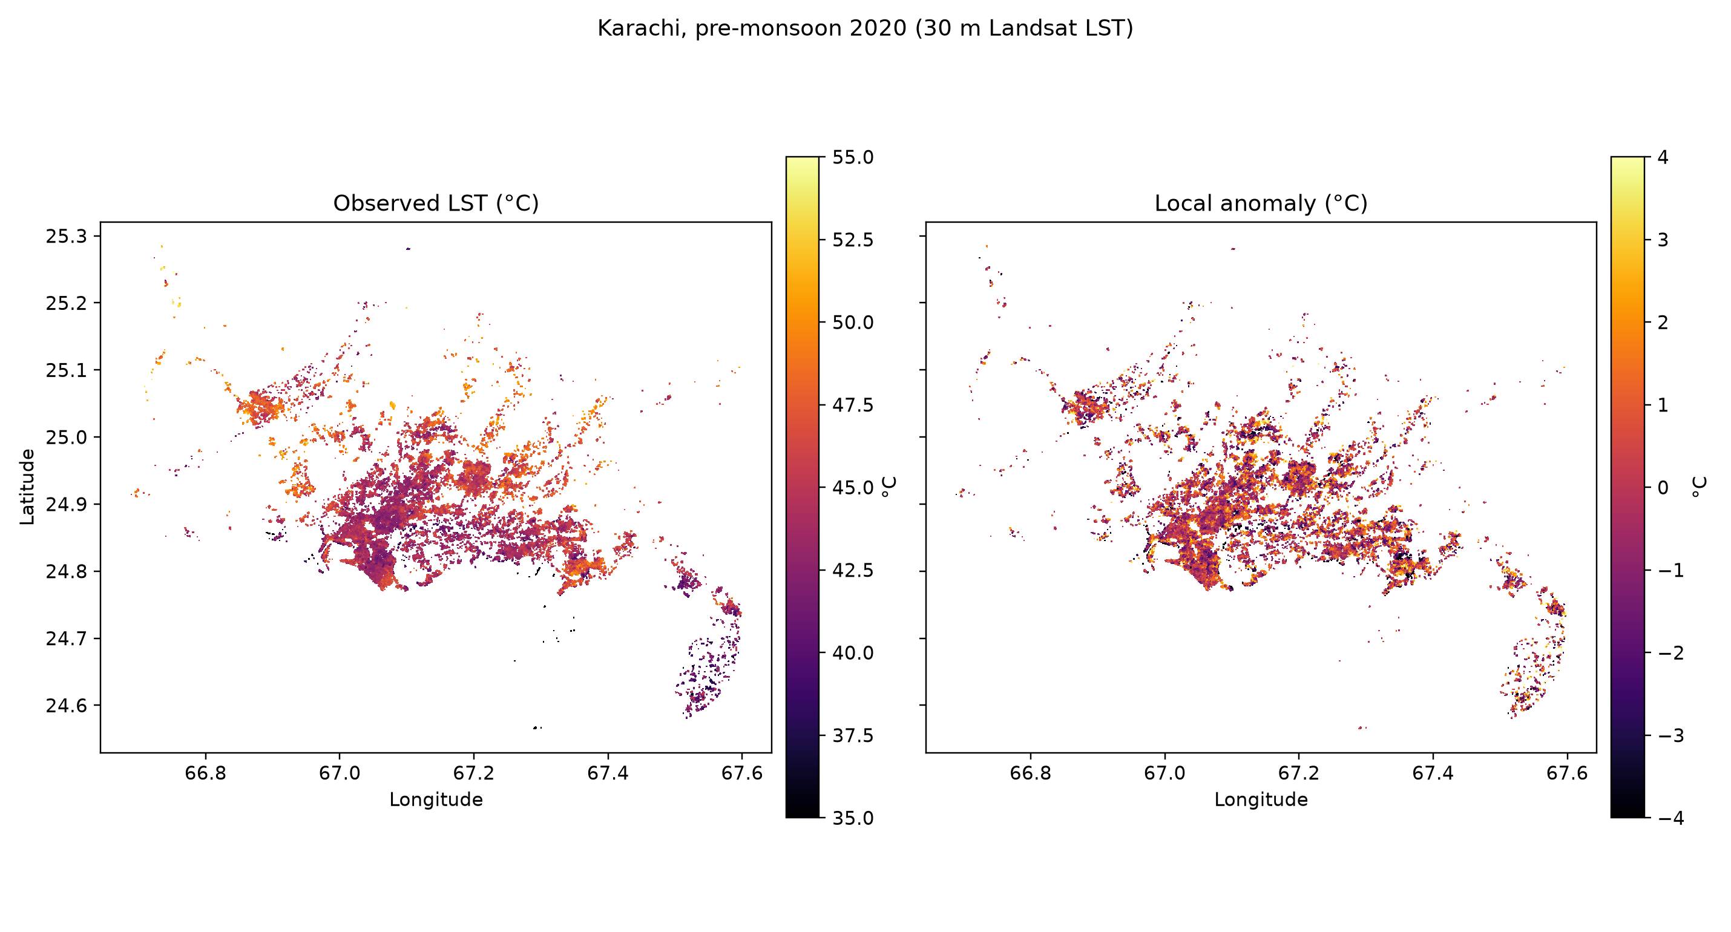
12 OUTPUT
30 m heat map — the digital twin's surface

Slide 16
13 LIMITATIONS
What this study cannot claim
• LST is surface temperature, not air temperature — the two diverge over hard surfaces
• The model is associational; SHAP explains the fit, not a causal mechanism
• Cool-roof simulation inherits confounding: its effect swings from −0.04 to −0.42 °C across target definitions
• WorldPop only provides a 2020 surface, later years reuse it
• Counterfactuals assume pixels change independently, ignoring advection between neighbourhoods
• One city, one season, six years — results do not transfer without re-fitting

Slide 17
14 CONCLUSION
Takeaways
• A 30 m, six-year, open heat record for Karachi is feasible entirely on Earth Engine's free tier
• Four model families converge on the same accuracy — the local signal is simple and robust
• Vegetation and built-up indices dominate the local heat signal; the gradient is physical, not an artefact
• Urban–rural SUHI is negative (−1.2 °C) — the classical index measures geography, not urban heat
• Simulated greening cools ~0.6 °C on average; albedo behaves counter-intuitively and is reported honestly
• Next: causal design (interrupted time series around actual park/cool-roof projects) and live weather coupling

Slide 18
Thank you
Questions and dataset requests welcome
code + data + paper: CoolKarachi project repository

