Slide 1
Big Mountain Resort Ticket Pricing Reccomendation
Gotam Dahiya

Slide 2
Problem Identification
Big Mountain Resort has installed a new chair lift which increases the operating cost by at least $1.54 million
The management wants to know whether to cut down on operating cost or increase ticket pricing
The current price is above average of other resorts in its class. This may have to change.

Slide 3
Key Findings and Recommendations
The ticket price can go up to $95.87 from $81.00, which is an increase of $14.87
The most important features to the random forest model were fastQuads, Runs, SnowMaking_ac and vertical_drop.
Runs, vertical_drop, chairs and snow cover heavily influenced the revenue generated directly. A increase in vertical_drop of 150ft supports a $1.99 increase in ticket price and $3.4 million is generated as revenue.
Include operational costs of resorts to give a better estimate.

Slide 4
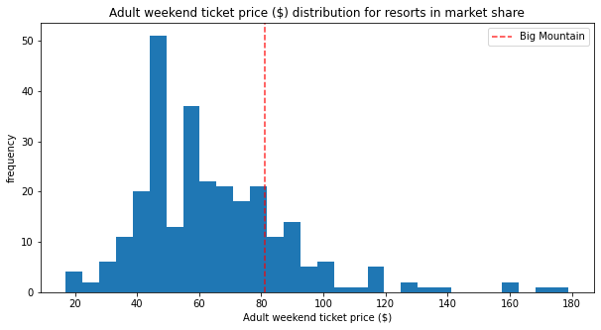
Current Pricing Positon with respect to the Country

Slide 5
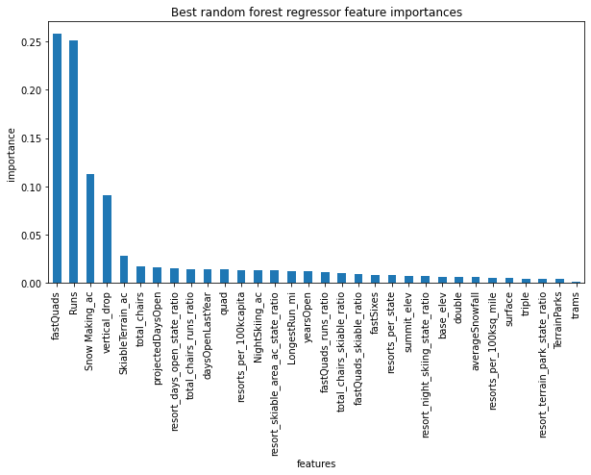
Feature Importance

Slide 6
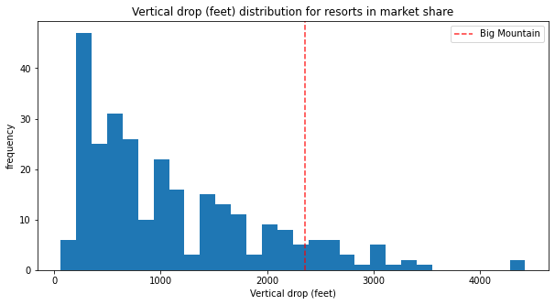
Vertical Drop

Slide 7
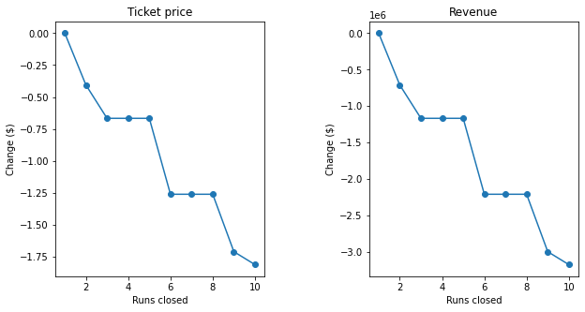
Closing Runs, Ticket and Runs

Slide 8
Conclusion
A new chair lift can be afforded.
Closing one run does not hurt ticket pricing or revenue generated
Best case scenario increase length of vertical drop by 150ft to obtain $3.4 million in revenue
Increasing length of run or adding more snow area does not help in generating revenue.
Operational costs are needed for a better estimate

