Slide 1
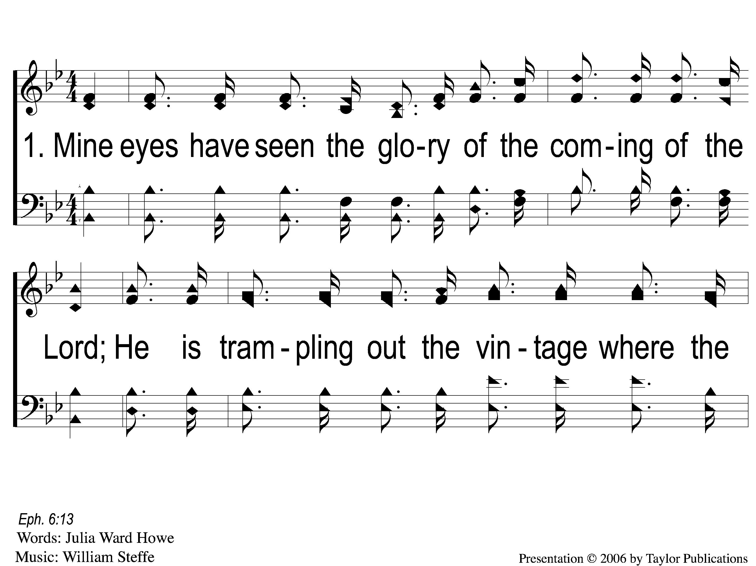
1-1 Battle Hymn of the Republic
Battle Hymn of the Republic
649

Slide 2
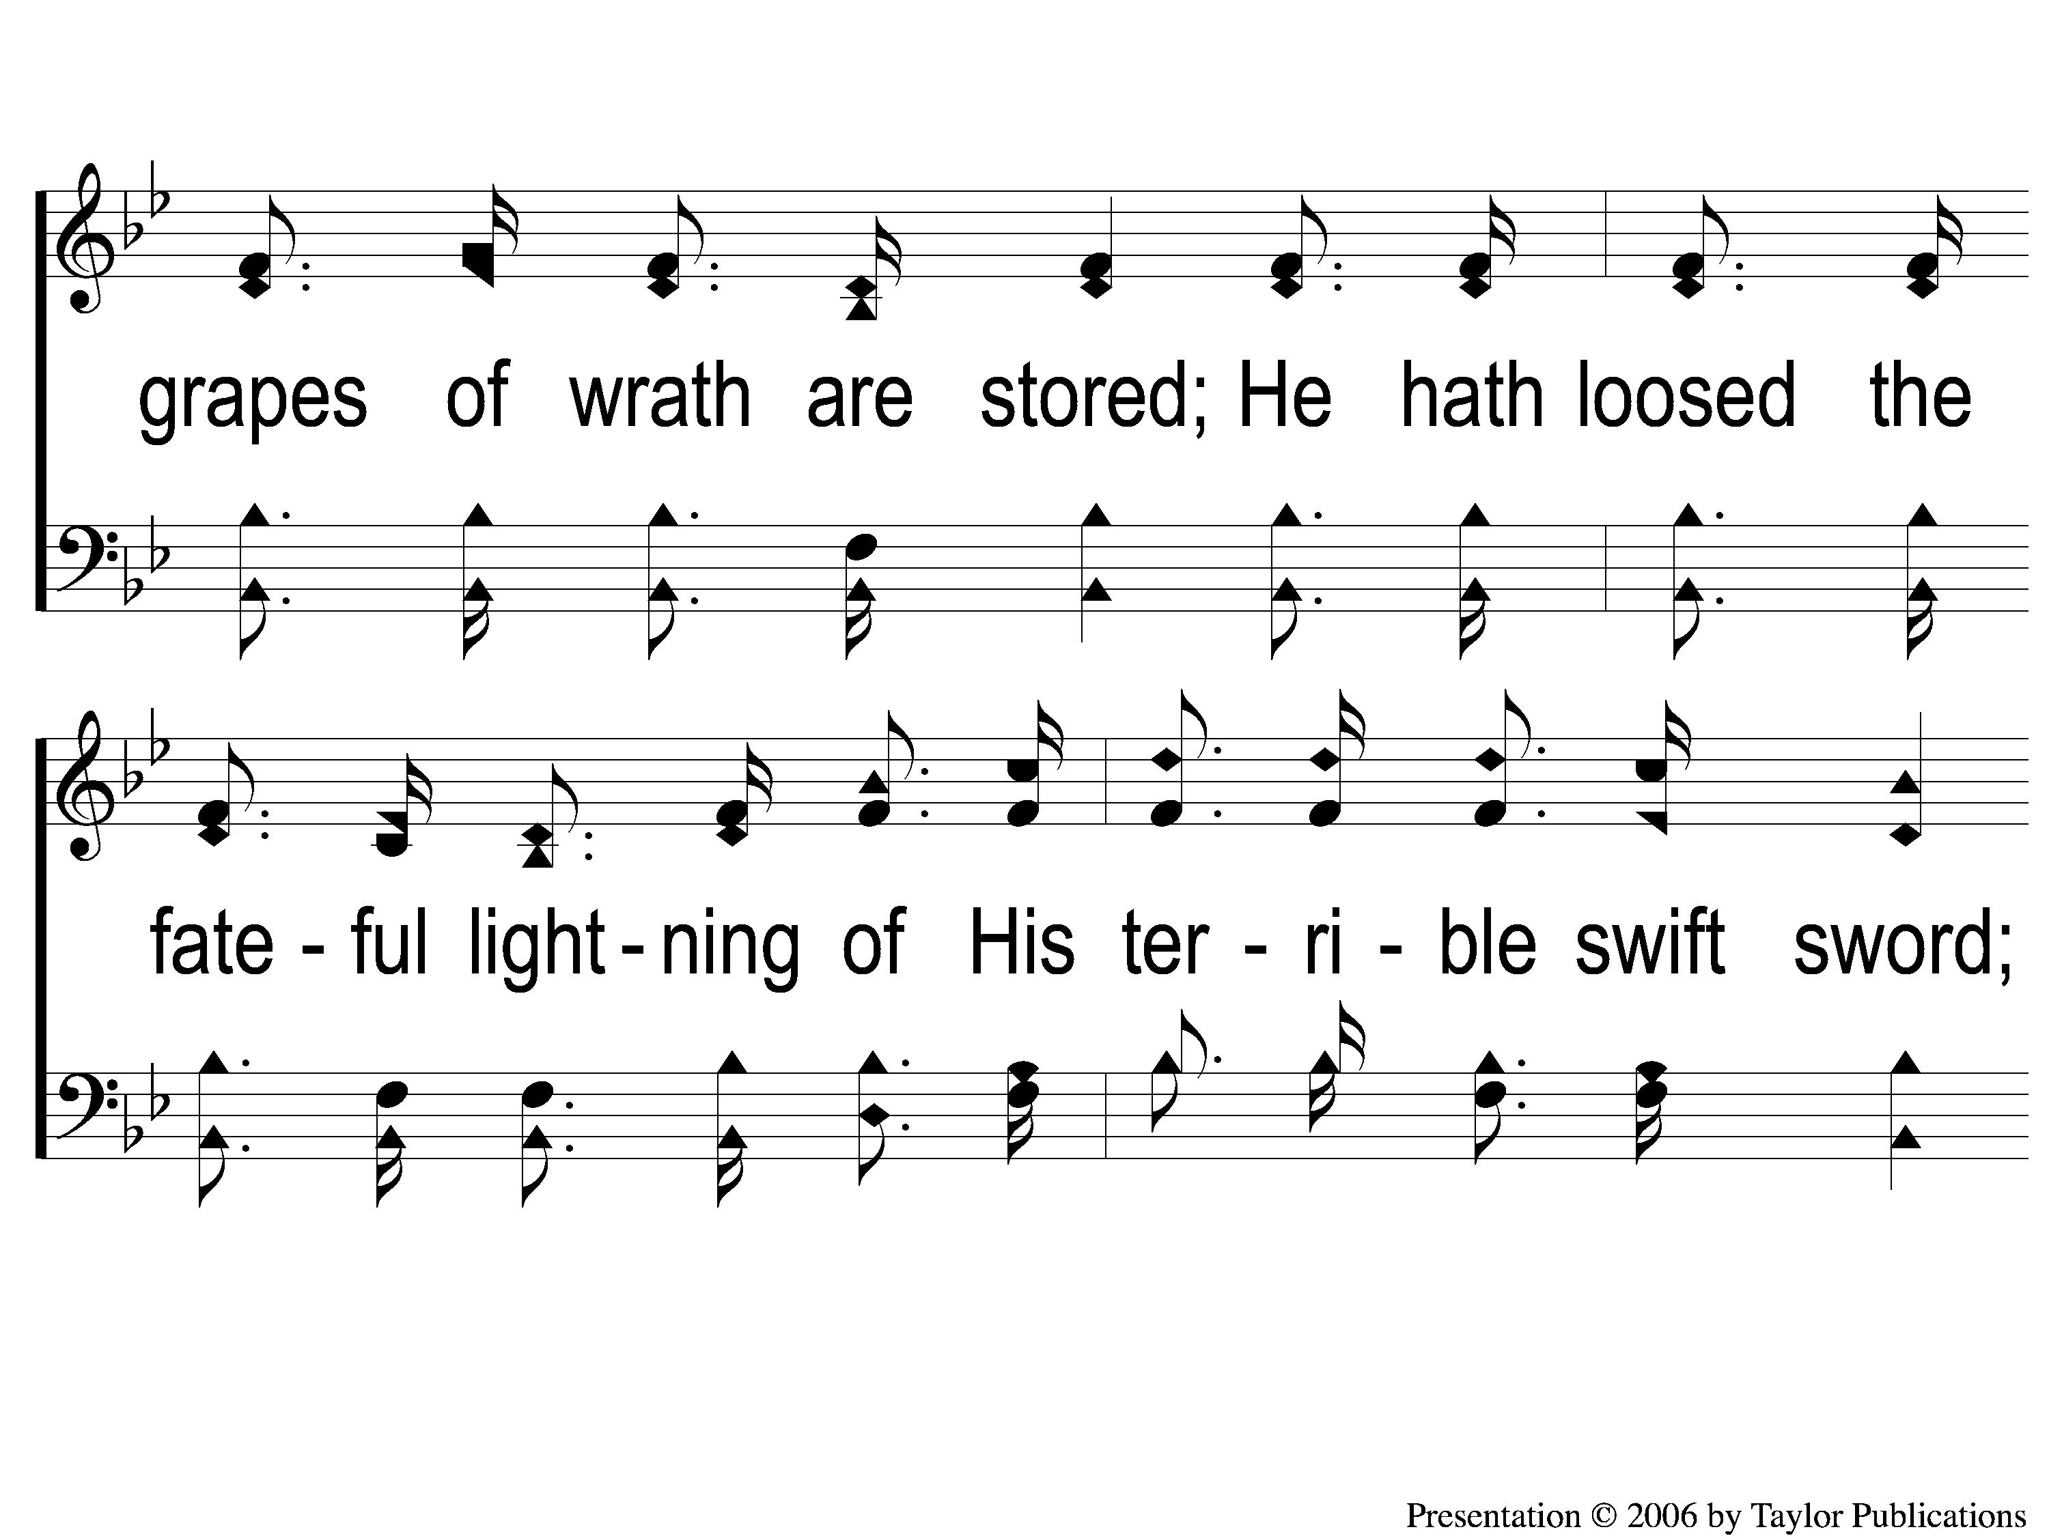
1-2 Battle Hymn of the Republic
Battle Hymn of the Republic
649

Slide 3
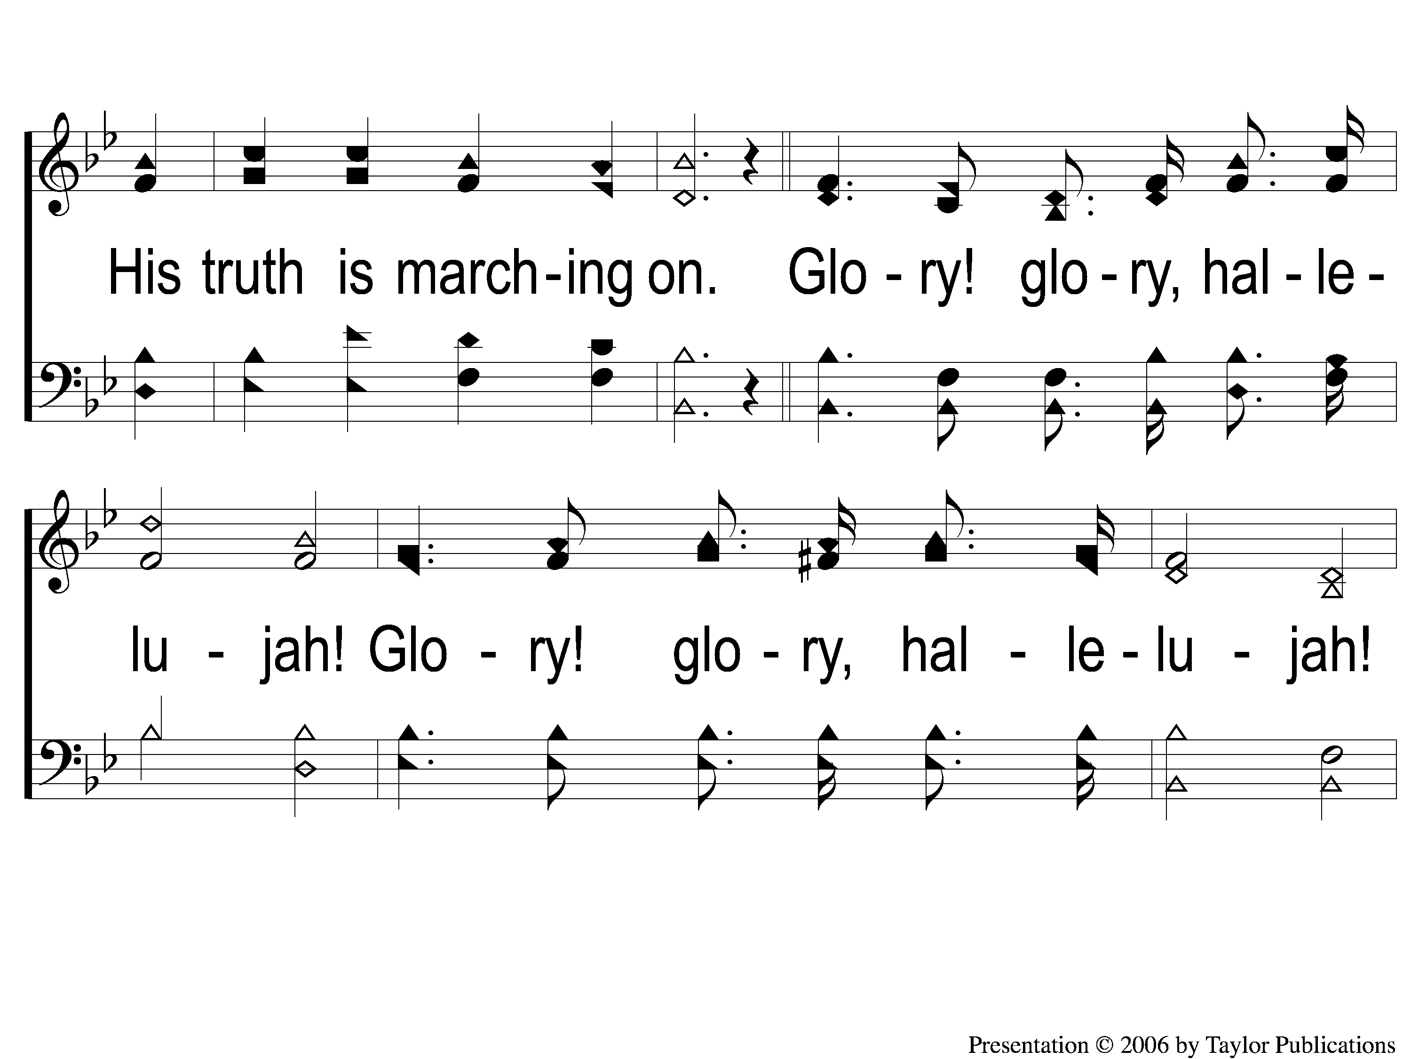
1-3 Battle Hymn of the Republic
Battle Hymn of the Republic
649

Slide 4
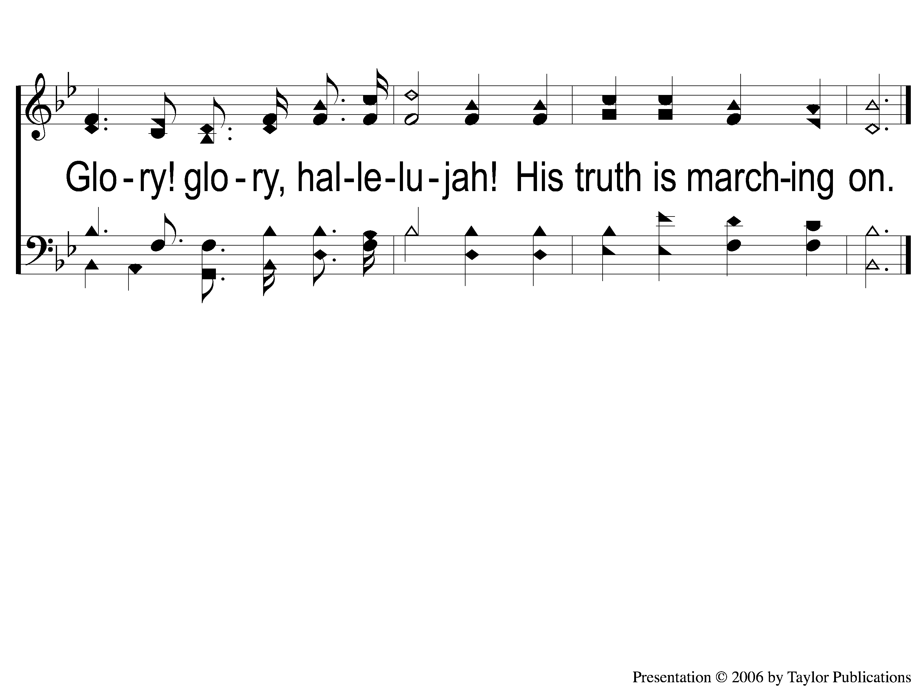
1-4 Battle Hymn of the Republic
Battle Hymn of the Republic
649

Slide 5
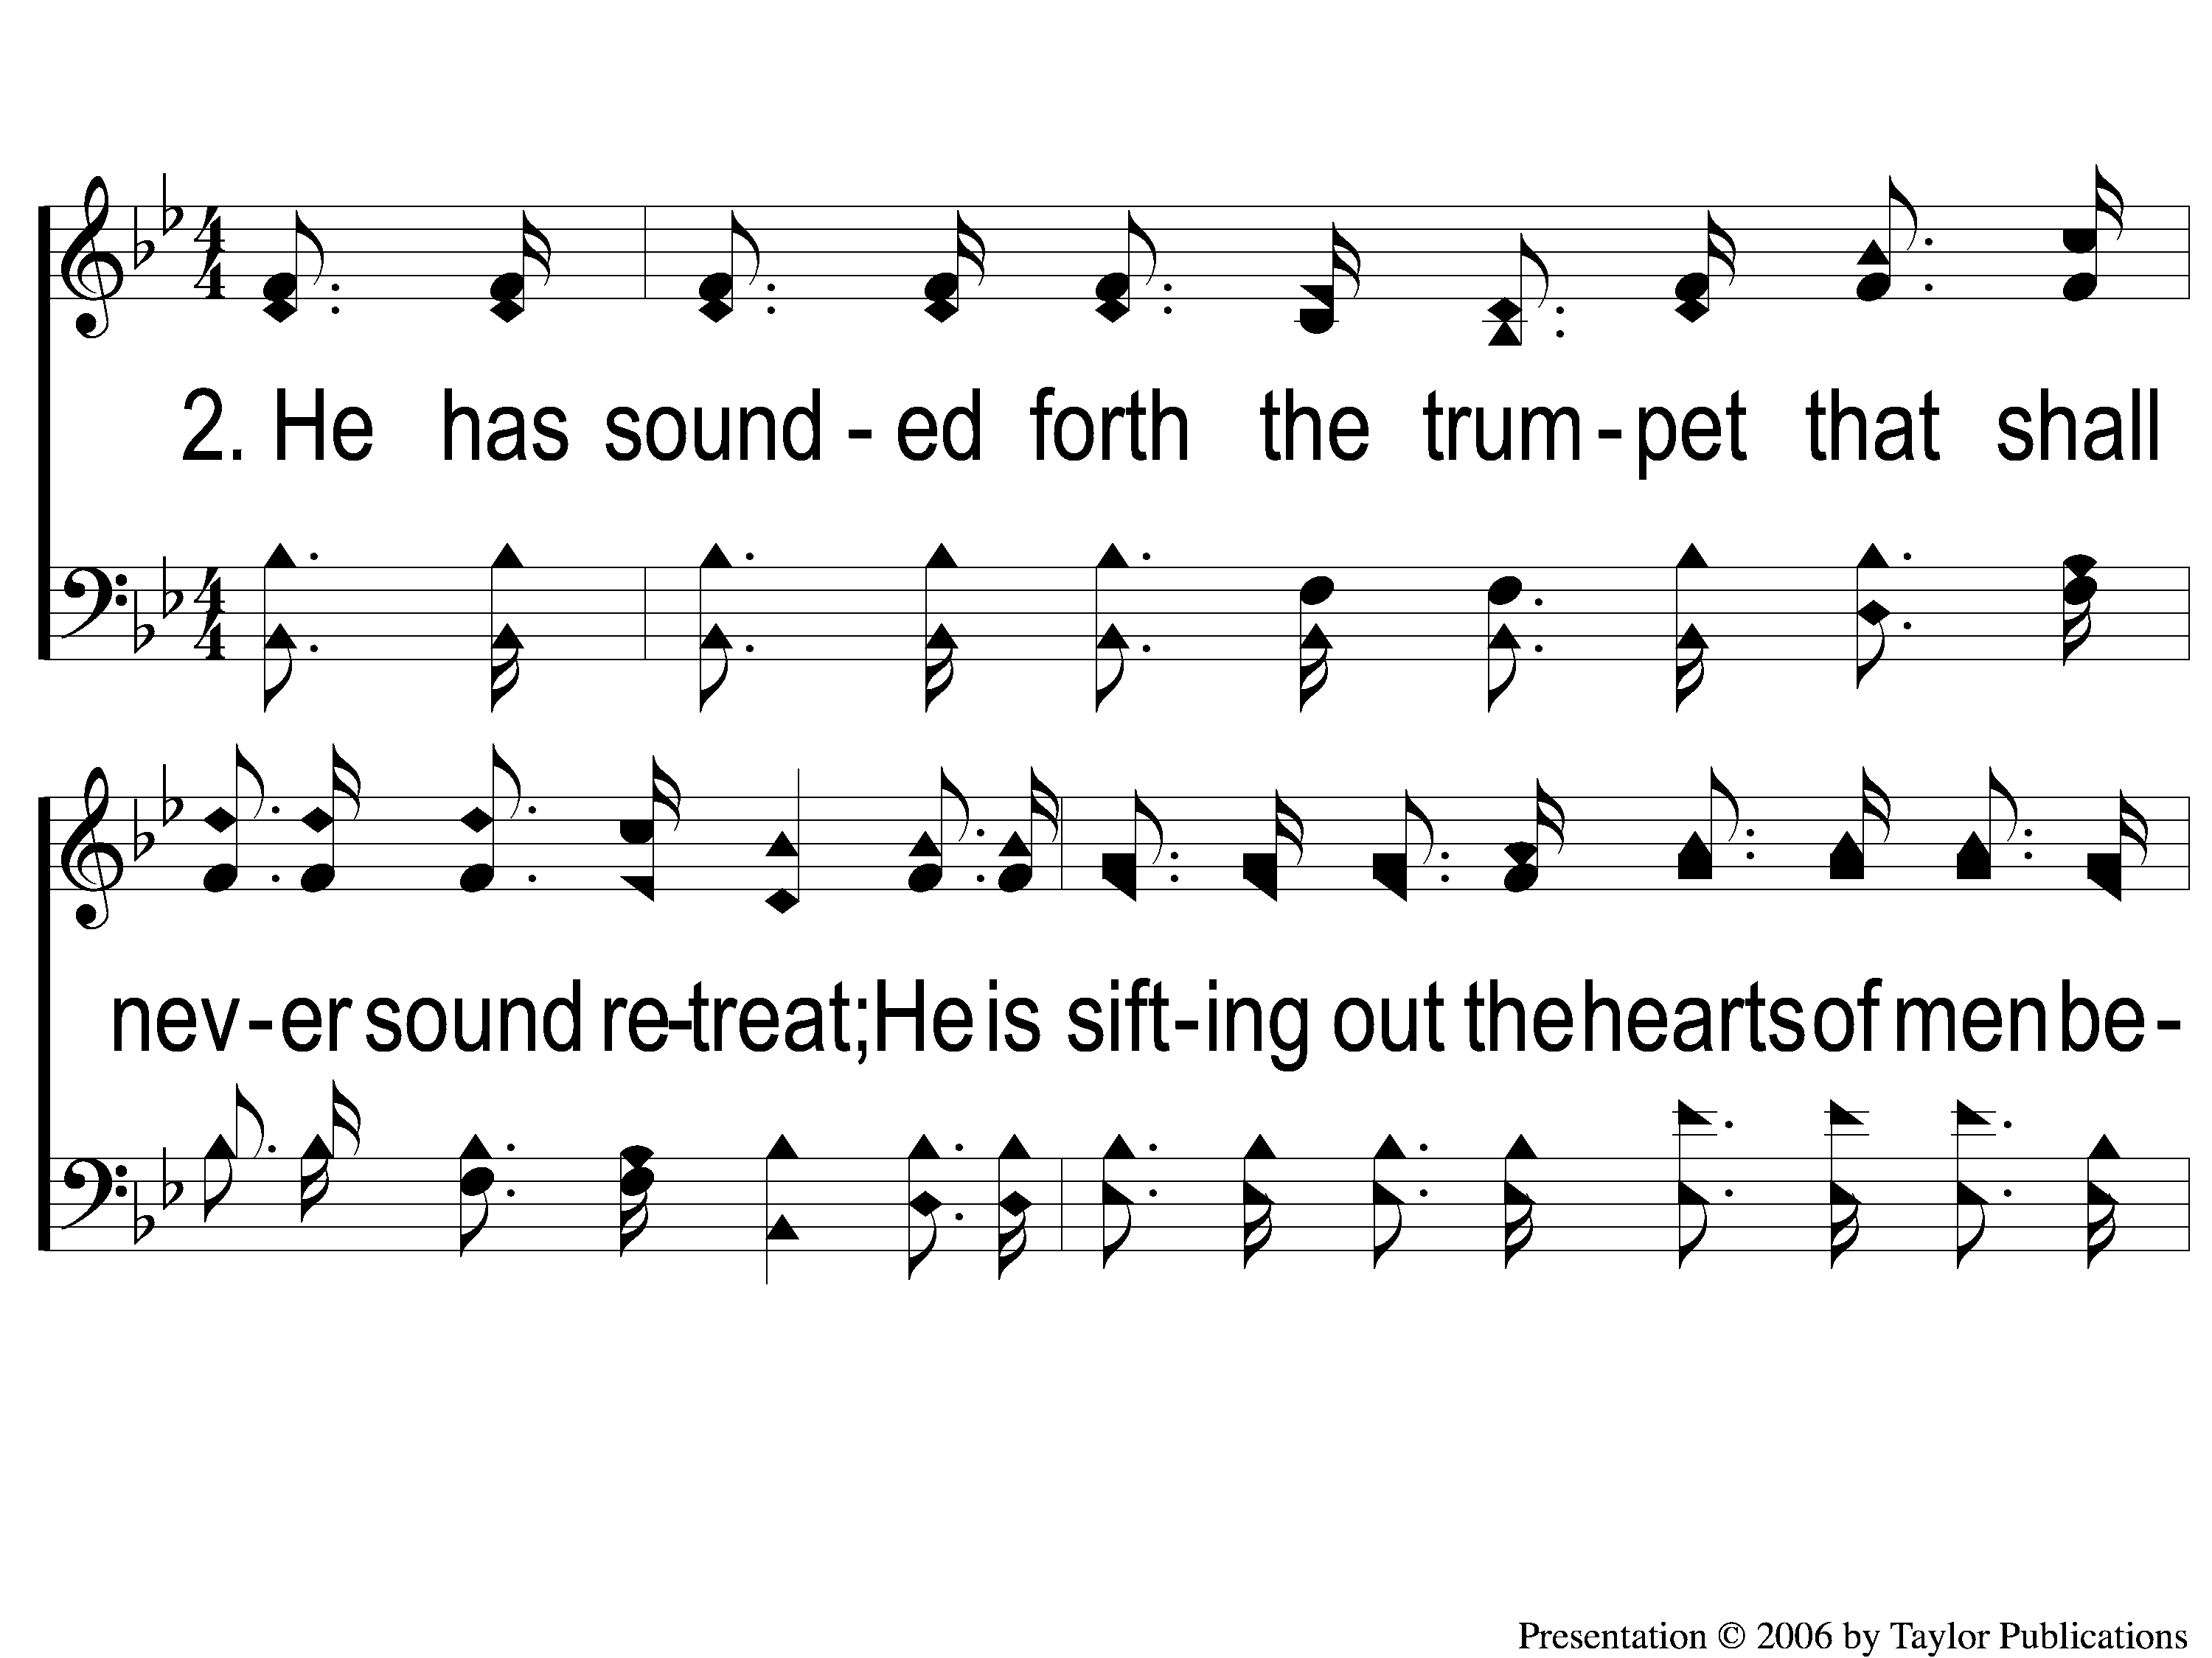
2-1 Battle Hymn of the Republic
Battle Hymn of the Republic
649

Slide 6
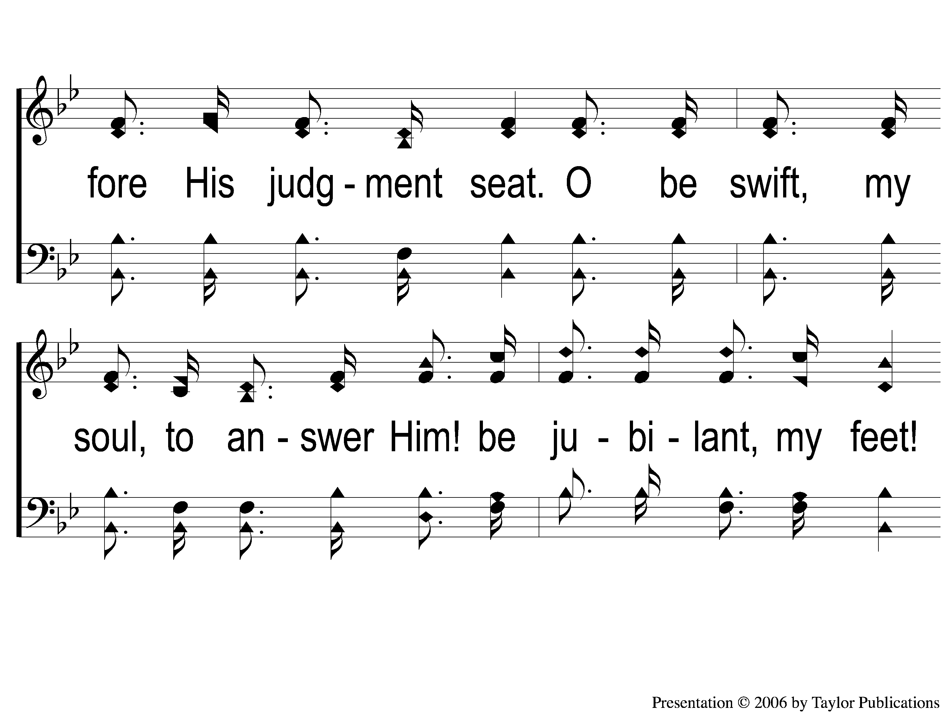
2-2 Battle Hymn of the Republic
Battle Hymn of the Republic
649

Slide 7
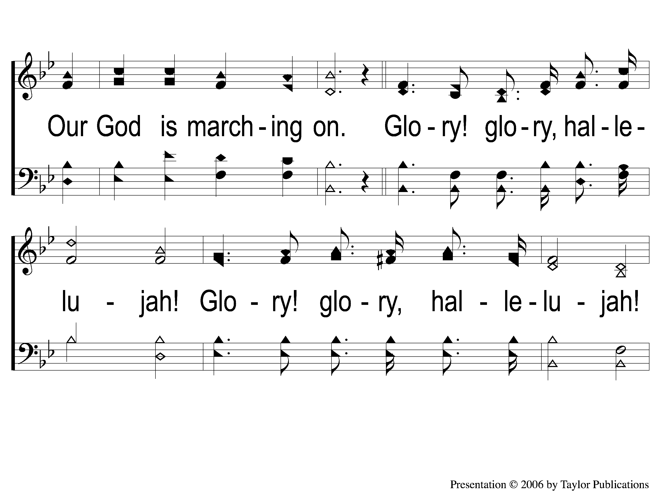
2-3 Battle Hymn of the Republic
Battle Hymn of the Republic
649

Slide 8
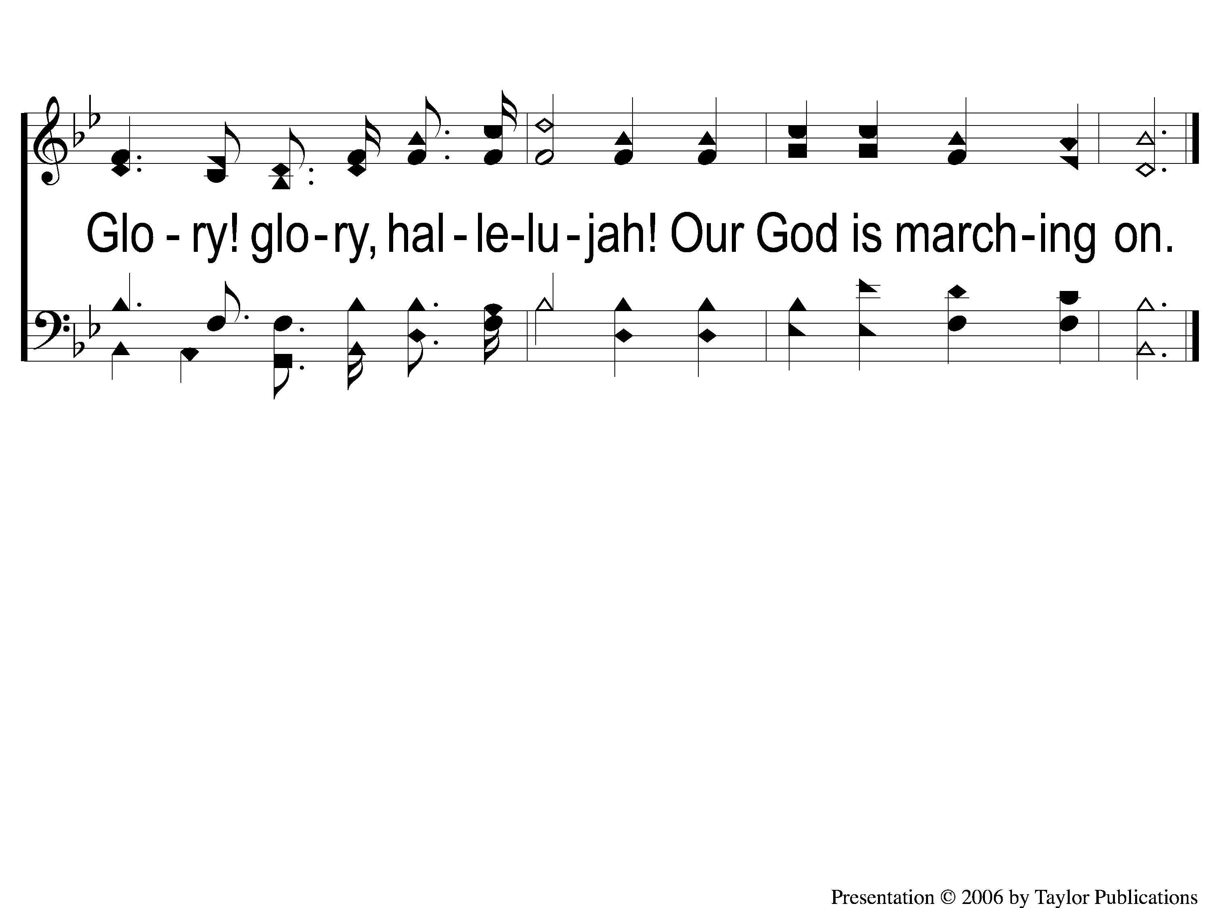
2-4 Battle Hymn of the Republic
Battle Hymn of the Republic
649

Slide 9
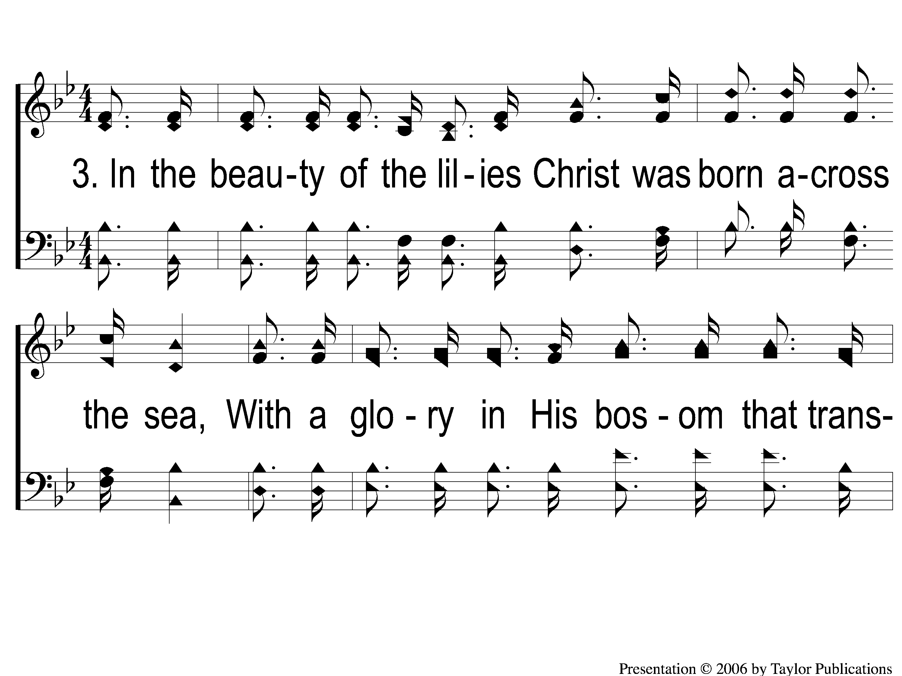
3-1 Battle Hymn of the Republic
Battle Hymn of the Republic
649

Slide 10
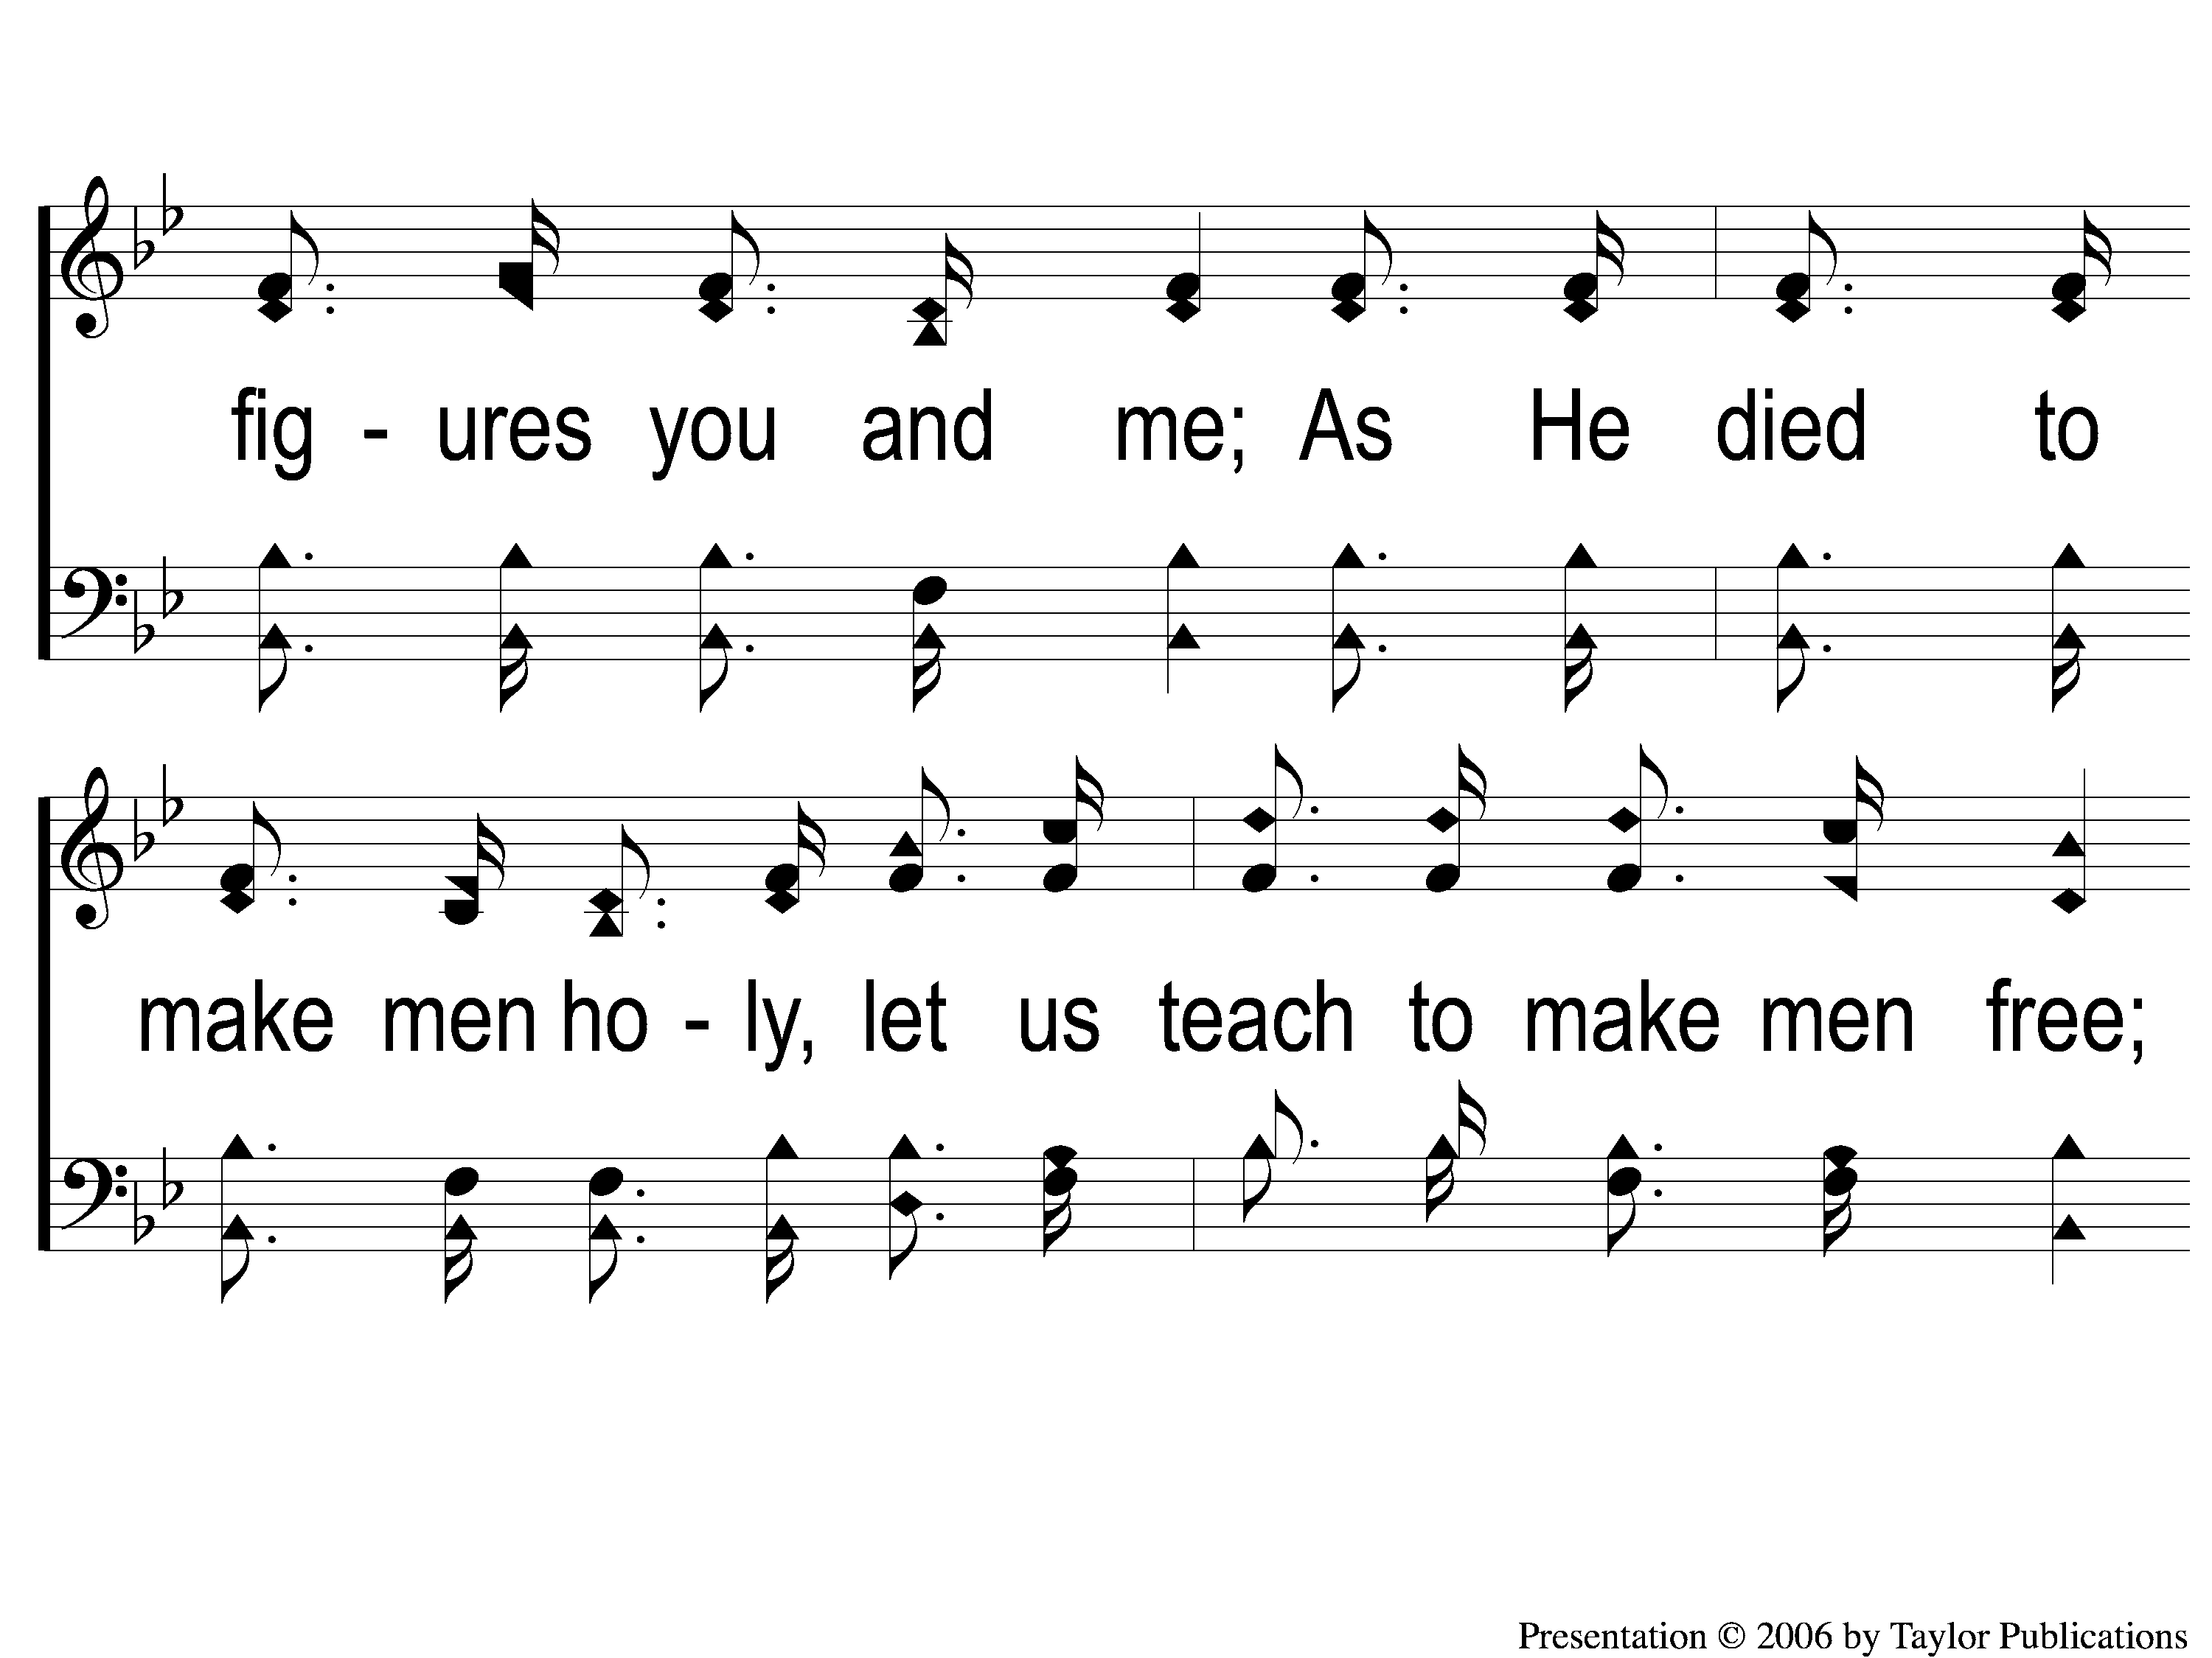
3-2 Battle Hymn of the Republic
Battle Hymn of the Republic
649

Slide 11
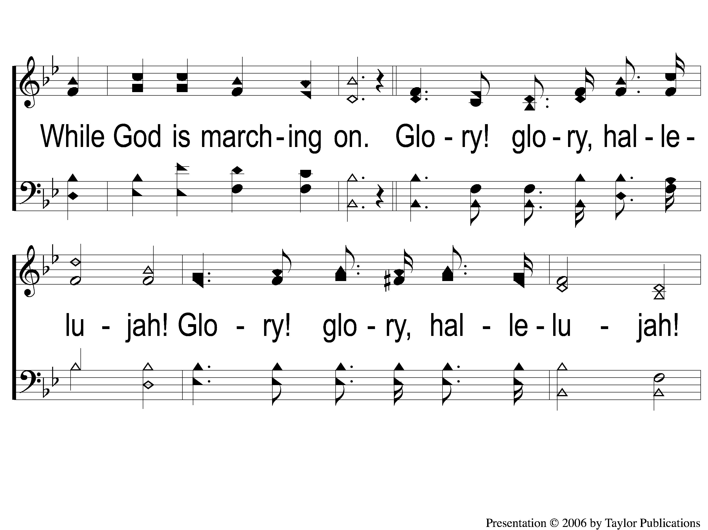
3-3 Battle Hymn of the Republic
Battle Hymn of the Republic
649

Slide 12
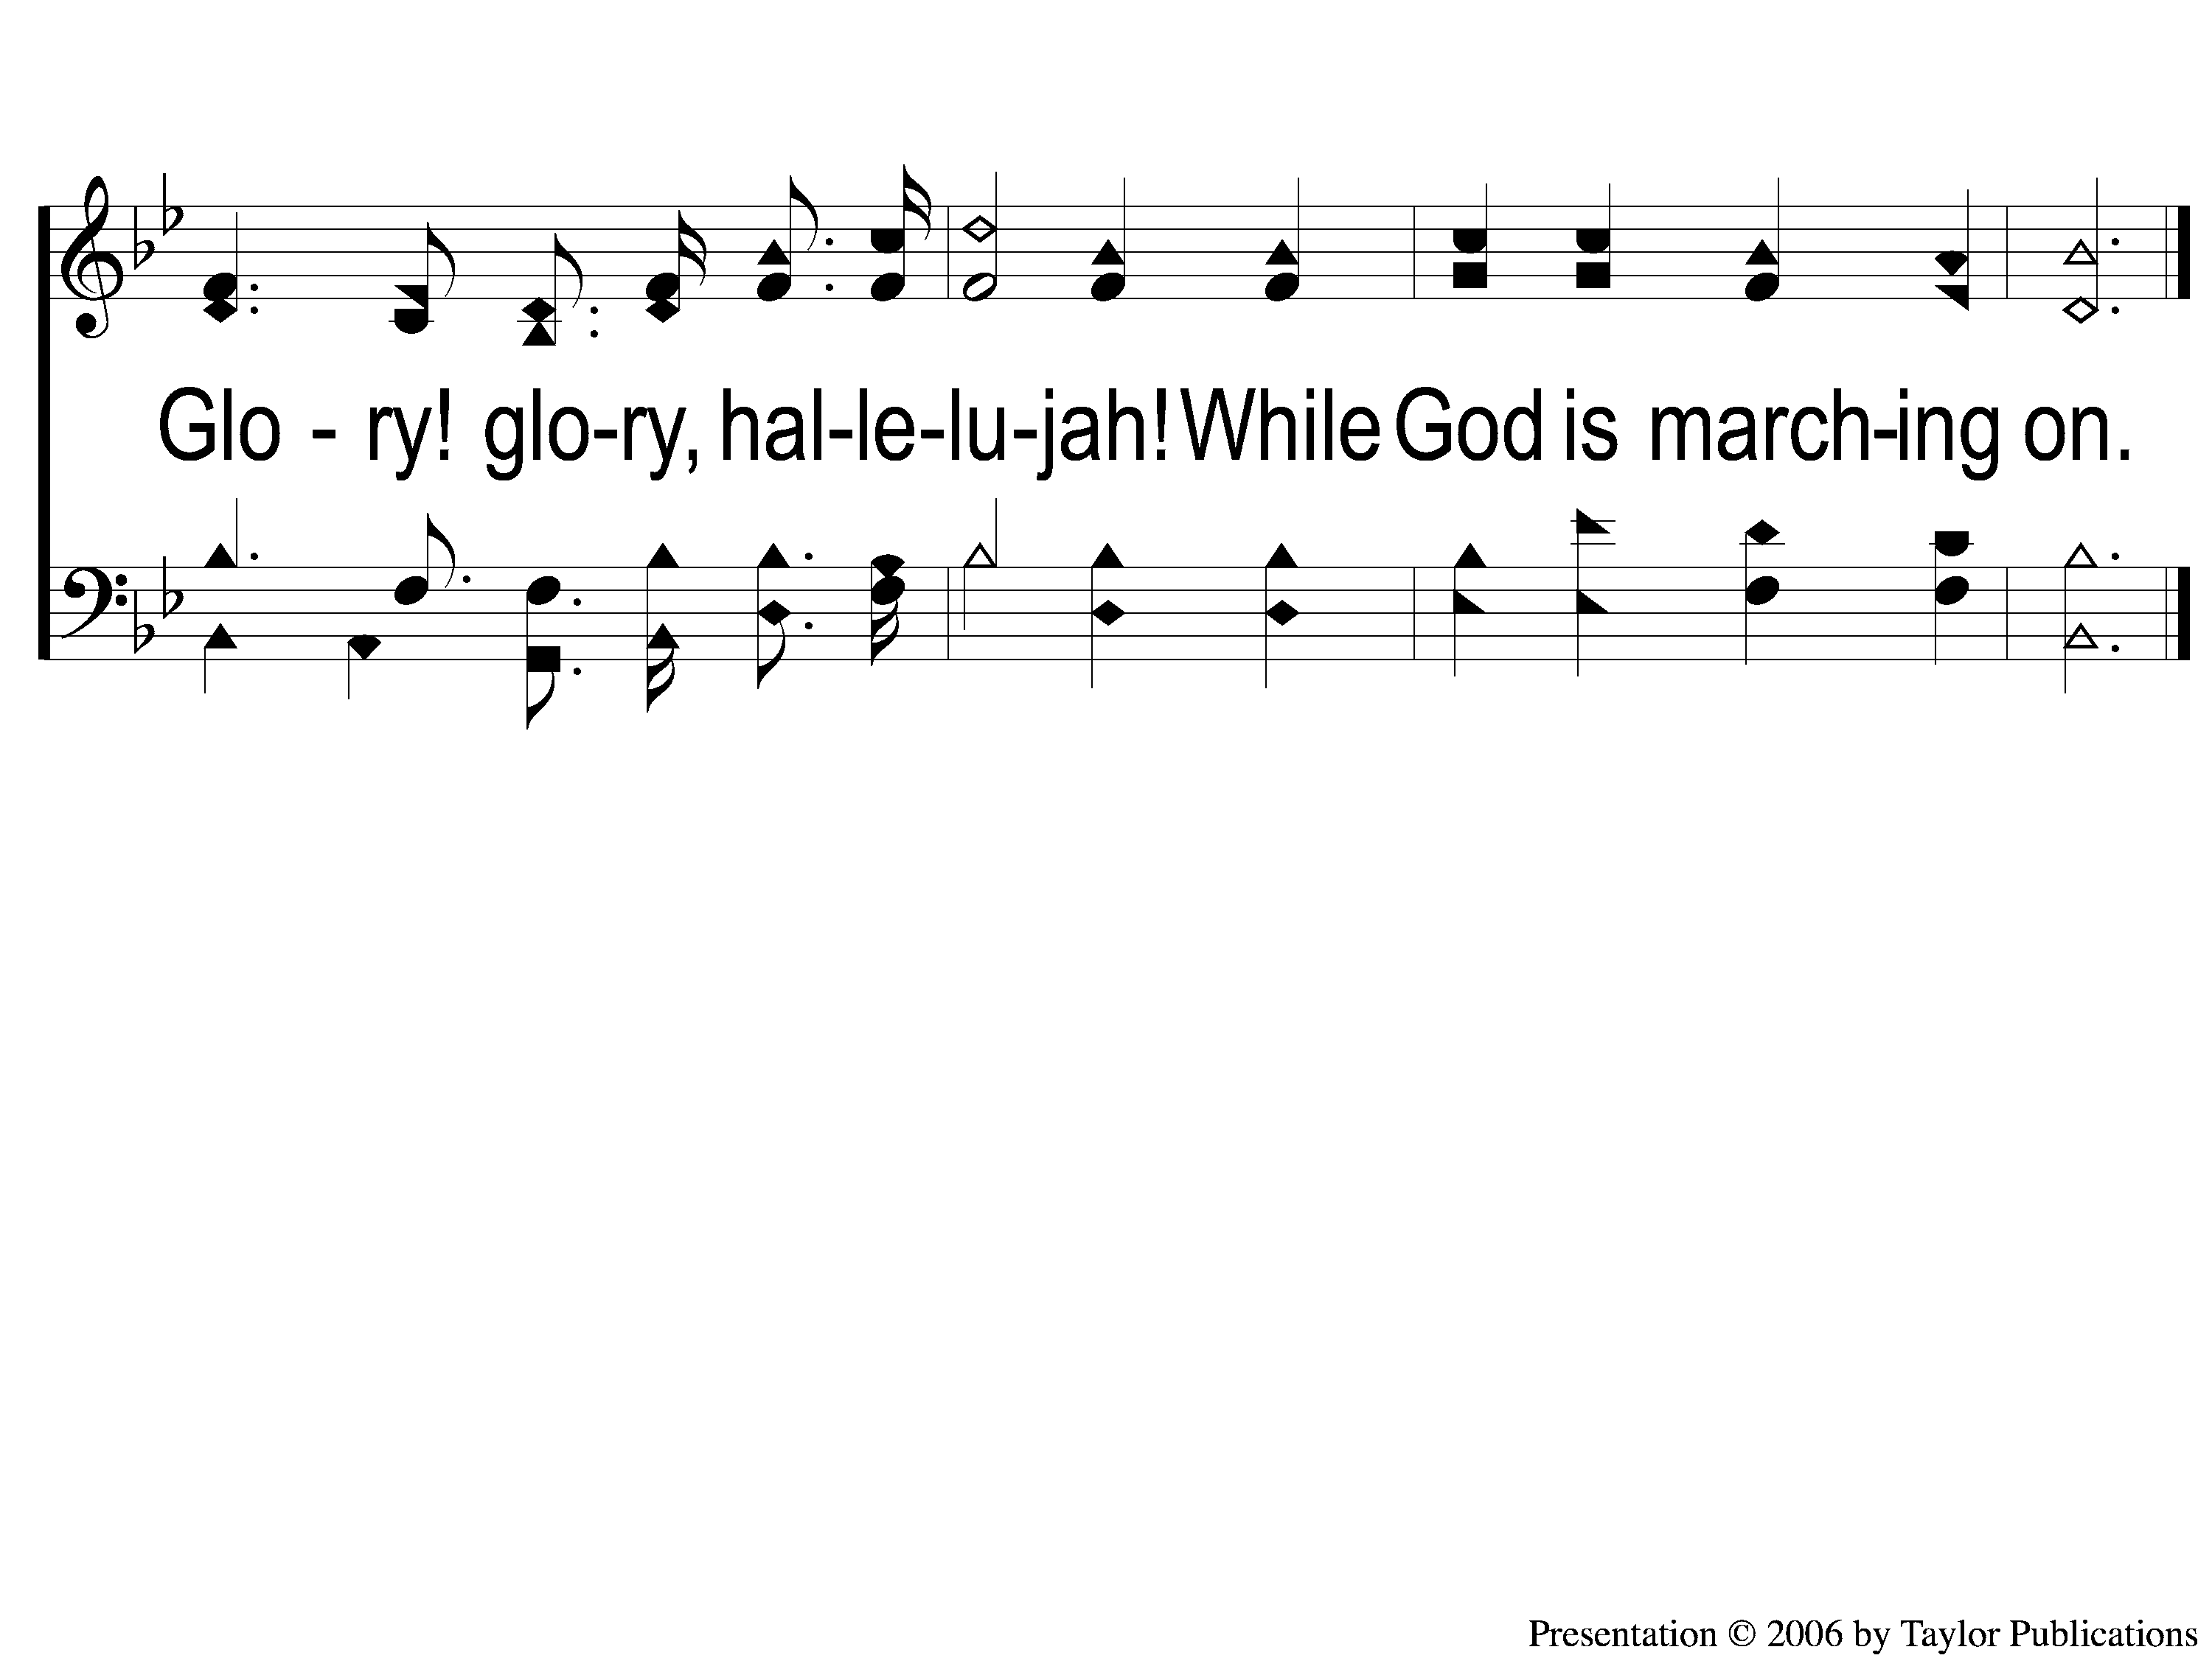
3-4 Battle Hymn of the Republic
Battle Hymn of the Republic
649

