Slide 1
Strategic Coding Practices
Nicholas J. Gotelli
Department of Biology
University of Vermont
14-15 October 2026
THE INTERNATIONAL BIOGEOGRAPHY SOCIETY

Slide 2
Outline
The Problem of Scaling
Set Up in RStudio
Organization of an RStudio Project
Annotation of Script Files and Data Files
Logging
Saving & Restoring R data objects (RDS)
Useful Tools (progress bar, timer, padded labels)
User-defined Functions
Pseudocode & Functional Programming
Notes:
Tables 101

Slide 3

The Problem of Scaling
King Kong (1933)
Notes:
Tables 101

Slide 4
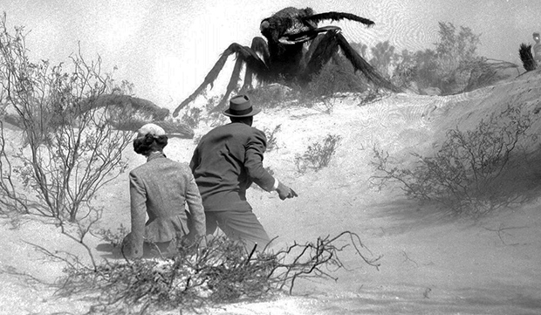
The Problem of Scaling
Them (1954)
Notes:
Tables 101

Slide 5
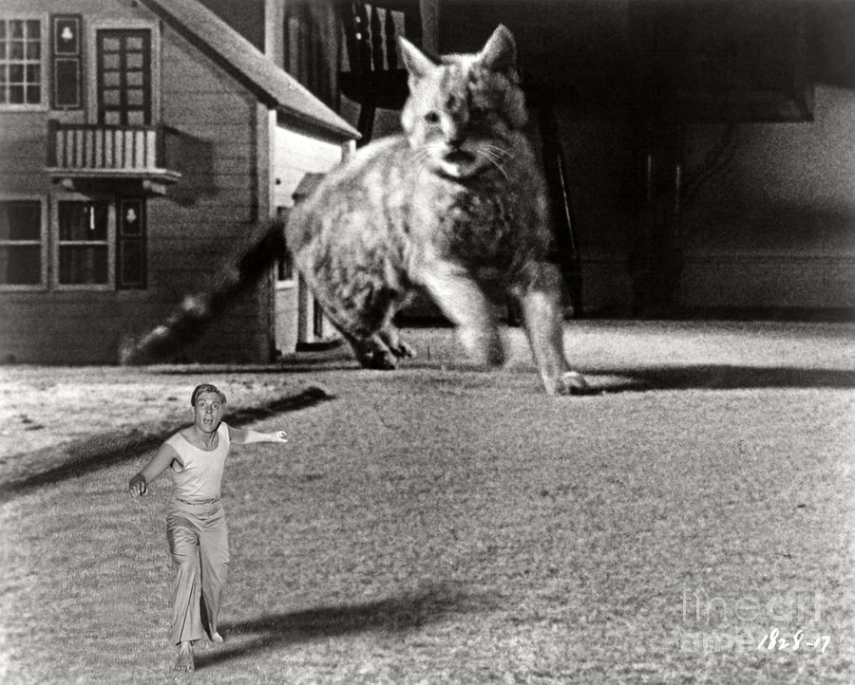
The Problem of Scaling
The Incredible Shrinking Man (1957)
Notes:
Tables 101

Slide 6


Physiological Demand and Supply
“Supply” -> surface area (L²)
“Demand” -> on volume (L³)
L³
L²
Length = x
Length

Slide 7
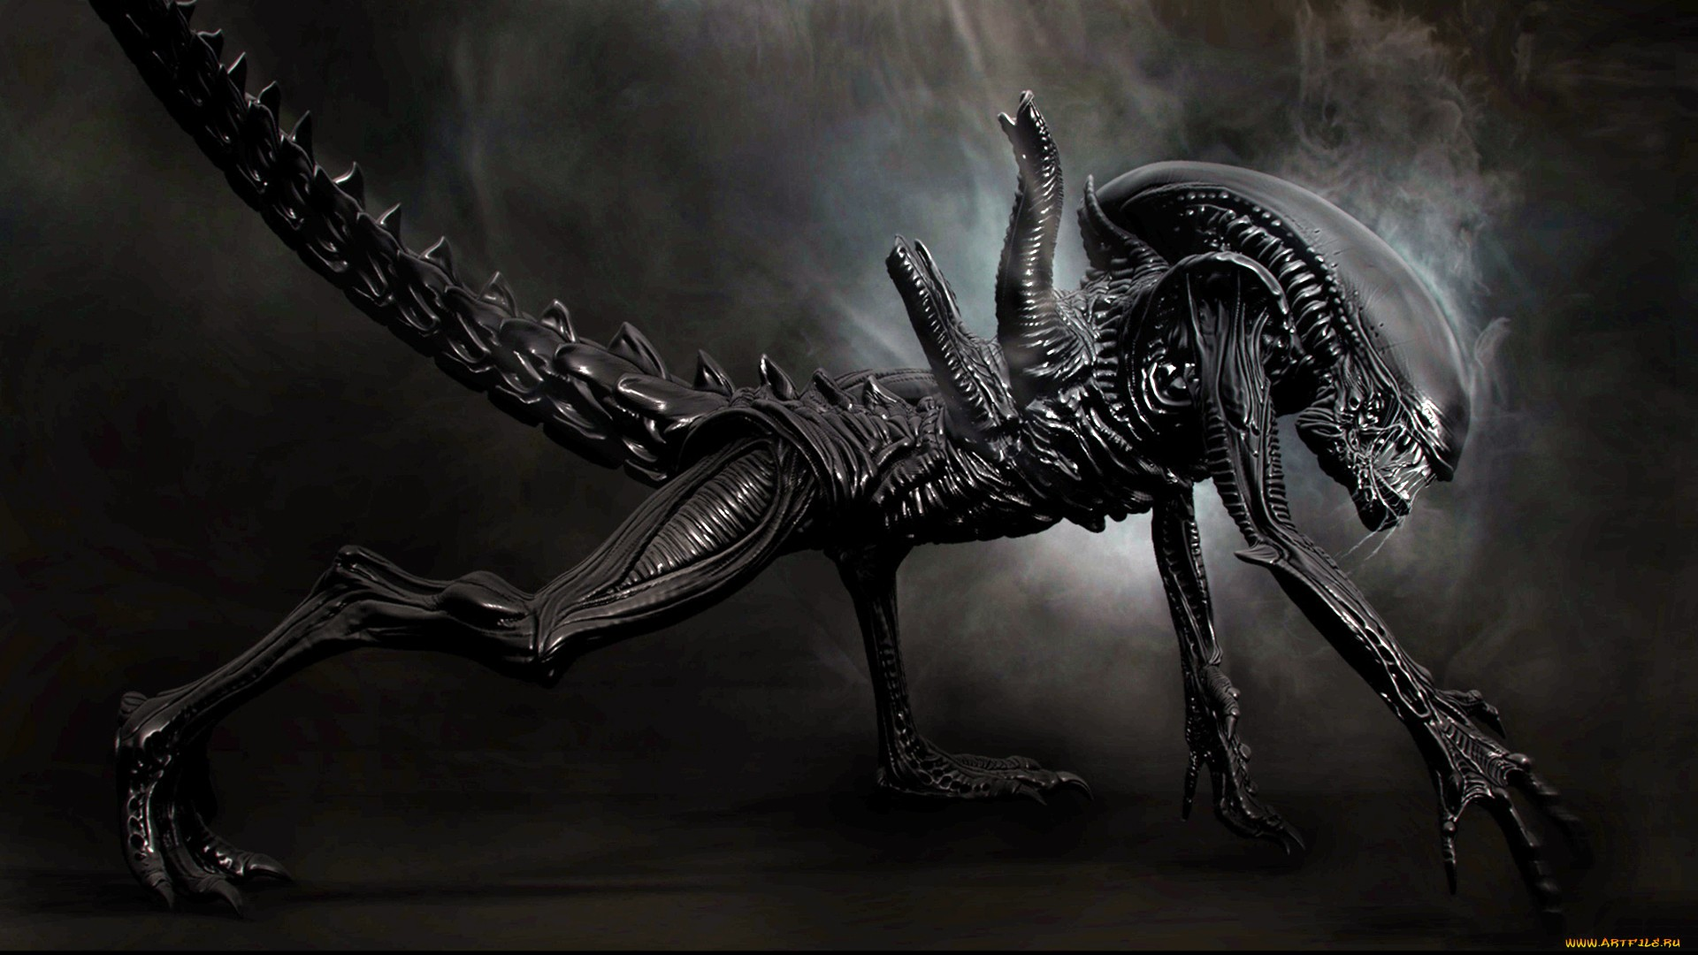
The Problem of Scaling
Alien (1979)
Notes:
Tables 101

Slide 8
Typical R User
Can write and save a script
Can use R syntax and available functions without errors
Can open a simple file, analyze it, generate graphs and results
Notes:
Tables 101

Slide 9
Scaling Problems
You have written a script to open a single data file and analyze results for a single species. You have 50 species and 50 data files.
Over a period of 4 weeks, you find it necessary to add 10 new data files, remove three others, and edit the contents of 12 of the original data files.
You create a model with 3 parameters, a,b, and c. Your script runs correctly using a pre-assigned value for each parameter. Now you need to run it for all combinations of 10 parameter levels (n = a*b*c = 1000 combinations).
A reviewer for your paper requests a statistical analysis of the residuals for each of the regression models in your study.
The journal you are going to submit your paper to wants you supply all of the code needed to reproduce your results.
Notes:
Tables 101

Slide 10
Symptoms of Scaling Problems
Copying and pasting many lines of code within a single script
Inconsistent formatting and obscure object and file names
Little or no annotation of code or data files
Copying, renaming, and editing entire script files
Running model variations by using “find and replace”
Copying numbers by hand from screen output
Saving graphics through GUI interface
Difficulty using the code to do anything other than its original task
Eventually, inability to fully reproduce the original analysis
Notes:
Tables 101

Slide 11
Attributes of a Well-Scaled Large Project
Well-organized project folders with informative file and object names
Extensive annotation of scripts and data files
Most code in user-defined functions (short, simple, limited input & output)
Code can handle multiple input files through batch processing
Use of RDS objects for complex projects and collaborative coding
All output saved as .csv files or final-format image file
Relatively easy to add functionality, re-run analyses, explore new results
Holy grail: source(”Scripts/MainScript.R”)
Notes:
Tables 101

Slide 12

Organization of Code #1 Simple Script
library()
x <- 3
y <- 2
z <- x + y
….

Slide 13

Organization of Code #2 User-Defined Functions
library()
f_1 <- function(shape1,shape2)
…’
x <- 3
y <- 2
z <- f_1(shape1=x,shape2=y)
….

Slide 14

Organization of Code #3 Separate Function Scripts
library()
source_batch(function scripts)
x <- 3
y <- 2
z <- f_1(shape1=x,shape2=y)
result <- f_2(alpha=3, beta=z)
….
f_1 <- function(shape1,shape2)
f_2 <- function(alpha,beta)

Slide 15

Organization of Code #4 Separate Function, Task Scripts
library()
source_batch(function scripts)
x <- 3
y <- 2
z <- f_1(shape1=x,shape2=y)
result <- f_2(alpha=3, beta=z)
….
f_1 <- function(shape1,shape2)
library()
source_batch(function scripts)
xx <- 3
yy <- 2
zz <- f_3(delta=xx,gamma=yy)
result <- f_4(phi, epsilon)
….
f_2 <- function(alpha,beta)
f_3 <- function(delta,gamma)
f_4 <- function(phi,epsilon)

Slide 16

Organization of Code #5 Main, Function, & Task Scripts
MainScript.R
library()
source_batch(function scripts)
source(ScriptA)
source_batch(ScriptB, ScriptC, ScriptD)
ScriptA
Function1
ScriptB
Function2
ScriptC
Function3
ScriptD
Function4

Slide 17

Let’s Code!
Notes:
Tables 101

