Slide 1


Session:
Strategic Coding Practices
Nick Gotelli
----------
Monday June 12, 2023
9AM-12PM

Slide 2


Slide 3
Biodiversity And Rural Response to Climate Change Using Data Analysis

Slide 4
Barracuda Teams
University of Maine
Brian McGill (ecology)
Tim Waring (economics)
Matthew Dube (computer science)
Kati Corlew (psychology)
University of Vermont
Nick Gotelli (ecology)
Meredith Niles (food science)
Laurent Hebert-Dufrense (complex systems)
Notes:
Tables 101

Slide 5
Barracuda Research
Responses of humans and nature to climate change in rural New England
Cultural evolution and behavioral adaptation
Agricultural responses and adaptive planting strategies
Spatially explicit demographic forecasting models of species ranges
Specialized forecasting models for pests, disease, and crop yields
Computational tools for analysis and visualization of space-time data
Workforce development, outreach, education
Notes:
Tables 101

Slide 6
Barracuda Research
Responses of humans and nature to climate change in rural New England
Cultural evolution and behavioral adaptation
Agricultural responses and adaptive planting strategies
Spatially explicit demographic forecasting models of species ranges
Specialized forecasting models for pests, disease, and crop yields
Computational tools for analysis and visualization of space-time data
Workforce development, outreach, education
Notes:
Tables 101

Slide 7
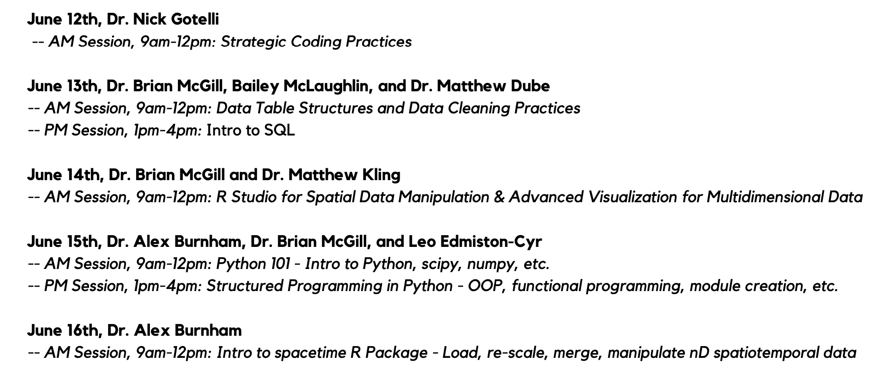

Slide 8
Session Structure
”Code-along” with scripts
Files and Scripts provided for each session
Initially load libraries and files
Execute code one line at a time
Place cursor at the the start of line
<ctrl> or <cmd><return>
Watch what happens
Audio commentary from Barracuda instructors & team members
Chat questions & written commentary from audience
Audio commentary from audience
(1 or 2 short breaks)
Additional time for commentary & questions at end of session (optional)
Sessions are unordered, independent, and stand-alone

Slide 9
Strategic Coding Practices
Nicholas J. Gotelli
Department of Biology
University of Vermont
Federal University of Santa Maria
19 July 2023
Notes:
Tables 101

Slide 10
Biodiversity And Rural Response to Climate Change Using Data Analysis

Slide 11
Strategic Coding Practices
The Problem of Scaling
Set Up in RStudio
Organization of an RStudio Project
Annotation of Script Files and Data Files
Logging
Saving & Restoring R data objects (RDS)
Useful Tools (progress bar, timer, padded labels)
User-defined Functions
Pseudocode & Functional Programming
- q_plot(): 8 archetype visualizations and statistical tests
Notes:
Tables 101

Slide 12
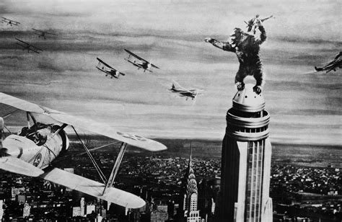
The Problem of Scaling
King Kong (1933)
Notes:
Tables 101

Slide 13
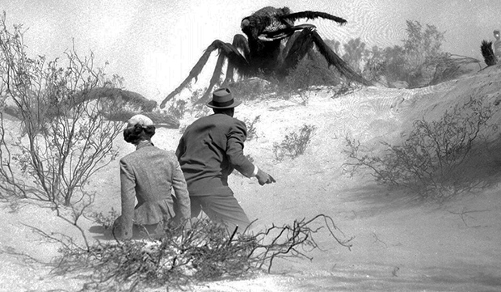
The Problem of Scaling
Them (1954)
Notes:
Tables 101

Slide 14
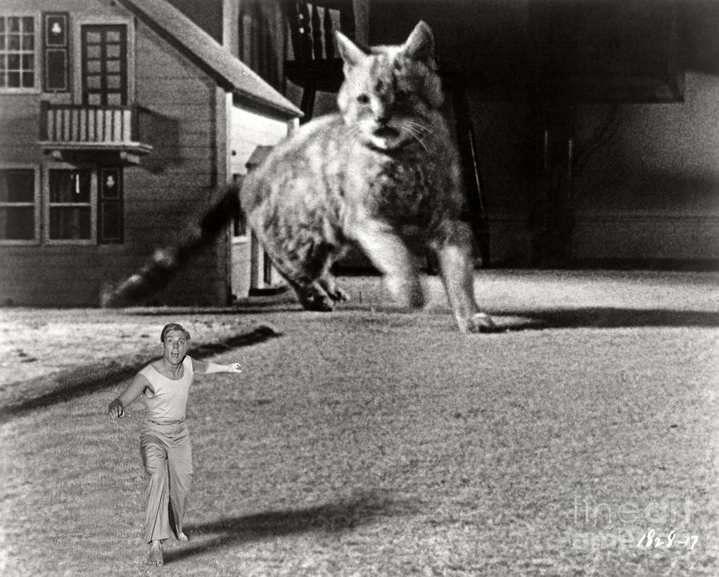
The Problem of Scaling
The Incredible Shrinking Man (1957)
Notes:
Tables 101

Slide 15

The Problem of Scaling
Alien (1979)
Notes:
Tables 101

Slide 16
Typical “R User”
Can write and save a script
Can use R syntax and available functions without errors
Can open a simple file, analyze it, generate graphs and results
Notes:
Tables 101

Slide 17
Typical Scaling Scenarios
You have written a script to open a single data file and analyze results for a single species. You have 50 species and 50 data files.
Over a period of 4 weeks, you find it necessary to add 10 new data files, remove three others, and edit the contents of 12 of the original data files.
You create a model with 3 parameters, a,b, and c. Your script runs correctly using a pre-assigned value for each parameter. Now you need to run it for all combinations of 10 parameter levels (n = a*b*c = 1000 combinations).
A reviewer for your paper requests a statistical analysis of the residuals for each of the regression models in your study.
Notes:
Tables 101

Slide 18
Symptoms of Scaling Problems for R Users
Copying and pasting many lines of code within a single script
Inconsistent formatting and obscure object and file names
Little or no annotation of code or data files
Copying, renaming, and editing entire script files
Running model variations by using “find and replace”
Copying numbers by hand from screen output
Saving graphics through GUI interface
Difficulty using the code to do anything other than its original task
Eventually, inability to fully reproduce the original analysis
Notes:
Tables 101

Slide 19
Features of Code From an “R Programmer”
Well-organized project folders with informative file and object names
Extensive annotation of scripts and data files
Most code in user-defined functions (short, simple, limited input & output)
Code can handle multiple input files through batch processing
Use of RDS objects for complex projects and collaborative coding
All output saved as .csv files or final-format image file
Relatively easy to add functionality, re-run analyses, explore new results
Holy grail: source(”Scripts/MainScript.R”)
Notes:
Tables 101

Slide 20
Strategic Coding Practices
The Problem of Scaling
Set Up in RStudio
Organization of an RStudio Project
Annotation of Script Files and Data Files
Logging
Saving & Restoring R data objects (RDS)
Useful Tools (progress bar, timer, padded labels)
User-defined Functions
Pseudocode & Functional Programming
- q_plot(): 6 archetype visualizations and statistical tests
Notes:
Tables 101

Slide 21

Caveats
My background
Beta-Testing Party!
Coding style is personal and subjective – no single “right” way
Notes:
Tables 101

Slide 22
Let’s Get Started…
Notes:
Tables 101

